Slide 1


INTERIM REPORT
Submitted by Team Members

Slide 2
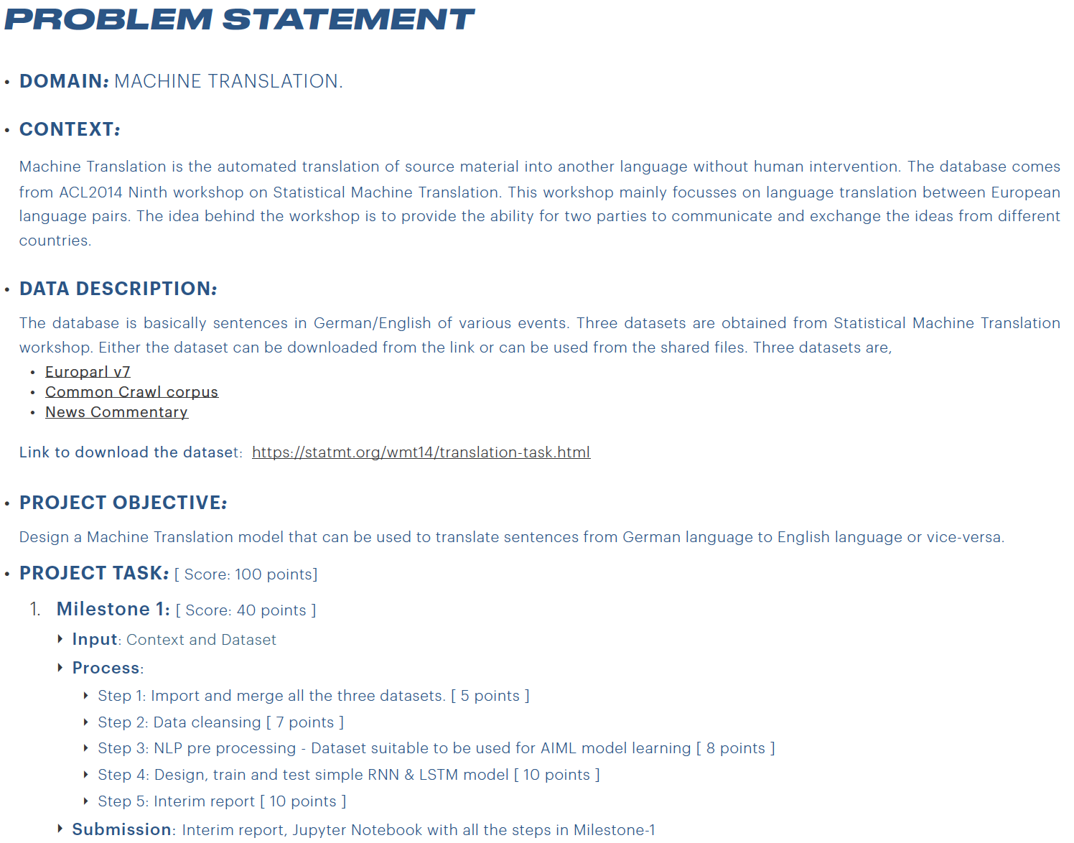

Slide 3
Data combine
Data Cleansing
Data Preprocessing
For NLP
LSTM Model and Evaluation
News-commentary-v9.de-en.de
News-commentary-v9.de-en.en
Europarl-v7.de-en.de
Europarl-v7.de-en.en
Commoncrawl.de-en.de
commoncrawl.de-en.en
Drop Null Values
Remove Leading and Trailing spaces
Convert to lower case
Keep only alphabets by removing special characters and numbers
Remove English and German stopwords
Drop Duplicate Records
Tokenize English German sentences and words,
Create vocab size and length
Add padding to make sentences of equal length
Train test split data into 80:20 ratio
Develop LSTM model
Optimise with learning rate = 0.001
Compile and train model
Get model predictions and compare results

Slide 4
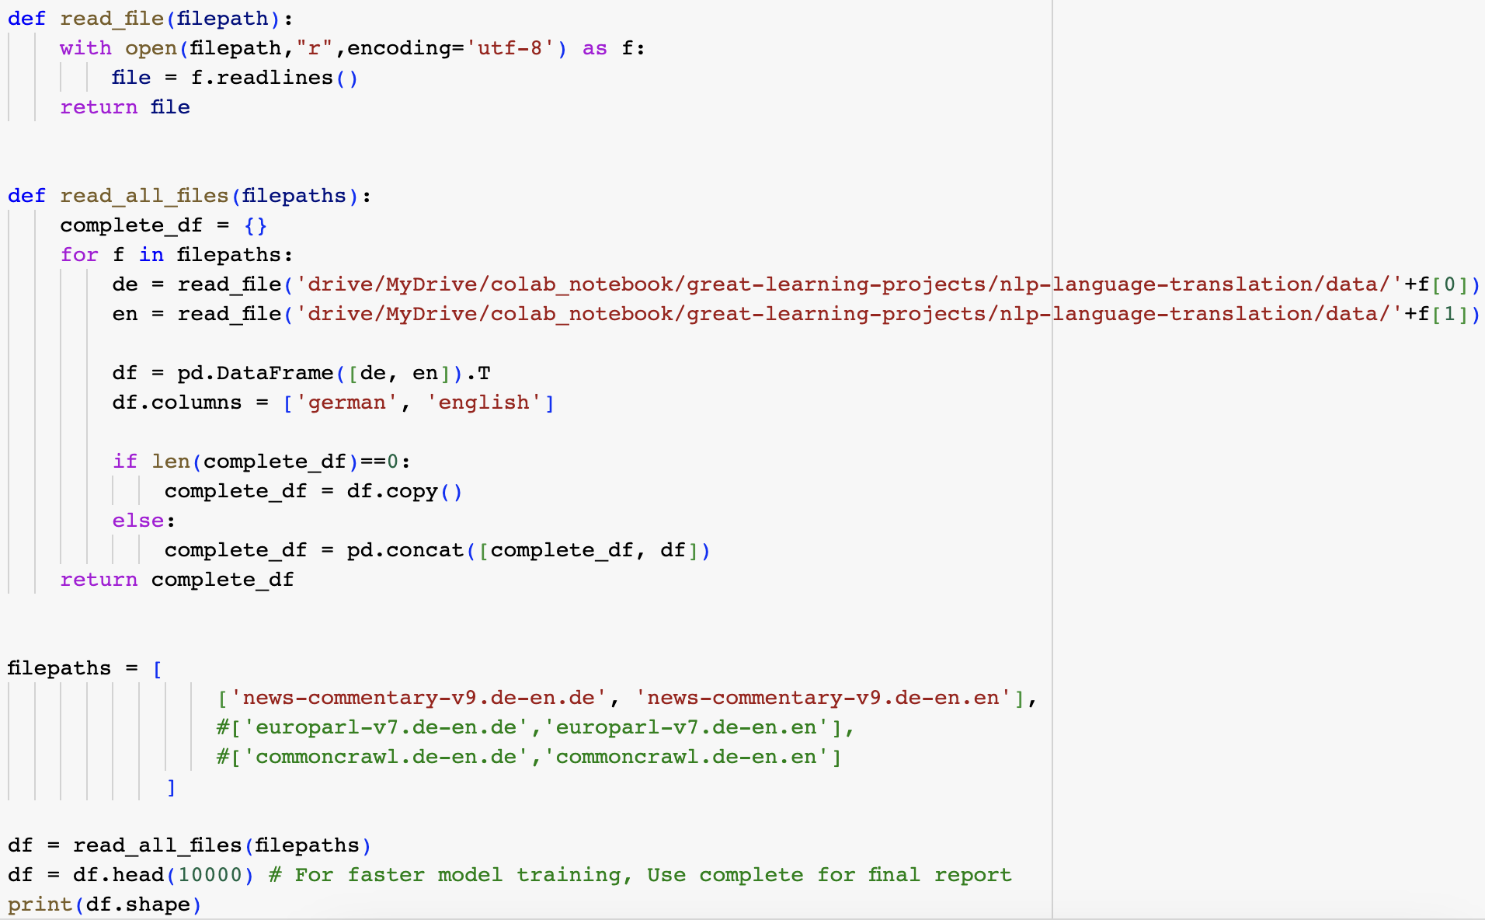
Python code for Joining multiple Datasets
Note: Only 1 dataset is considered for the interim report to complete the assignment within stipulated time. Considering all Datasets required longer training time.

Slide 5
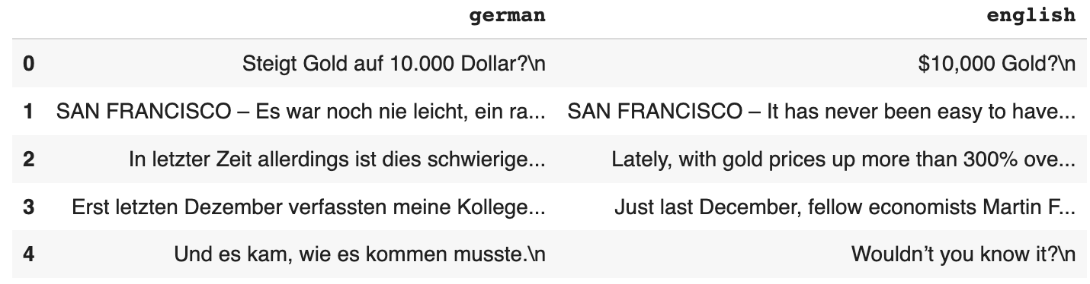
Data Sample after joining multiple Datasets

Slide 6
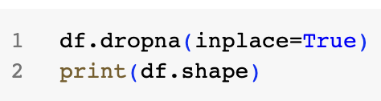
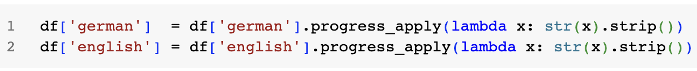
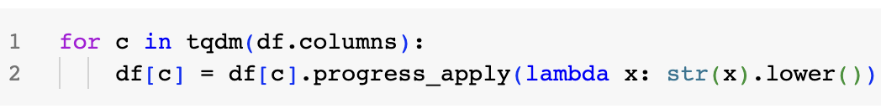
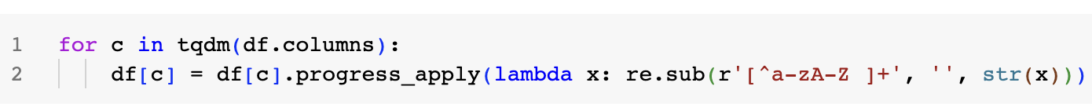
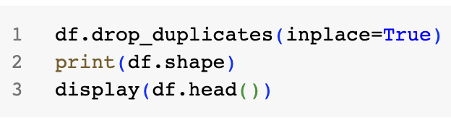
Data Cleaning Steps

Slide 7
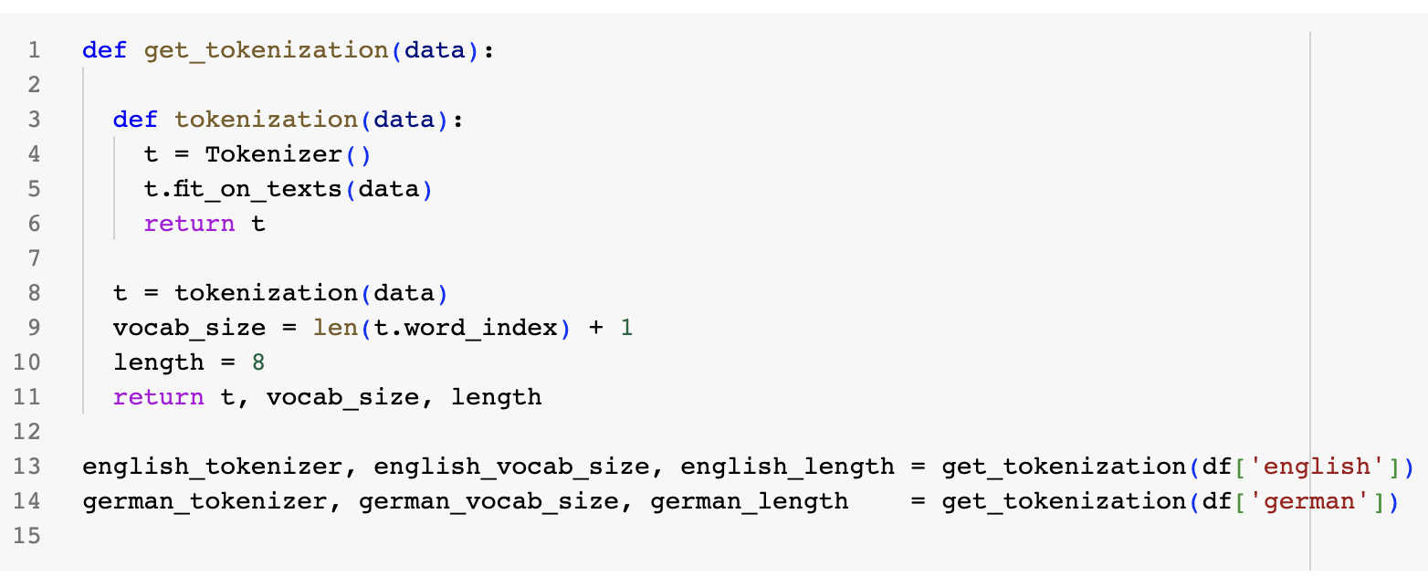
Data Preprocessing for NLP Tokenization

Slide 8
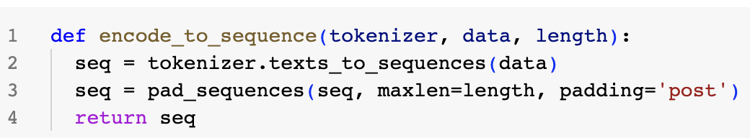
Data Preprocessing for NLP Sequence and Padding

Slide 9
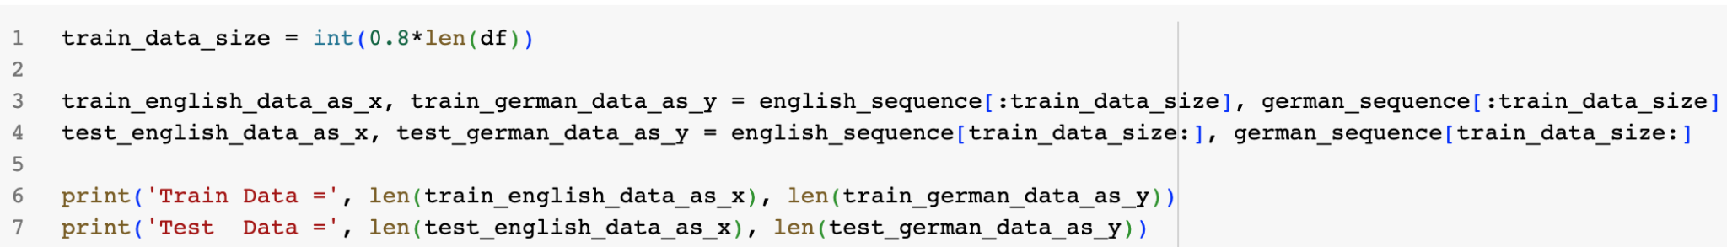
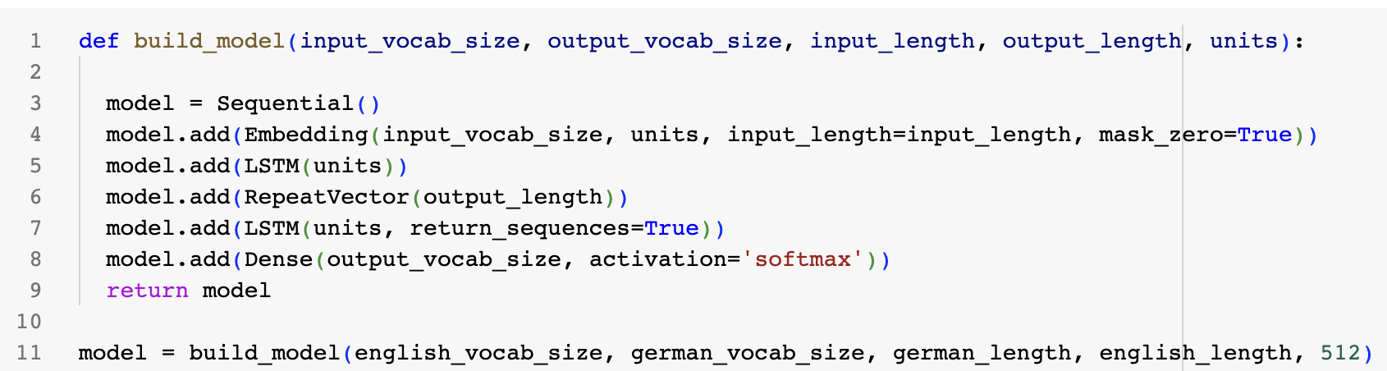
LSTM Model Development

Slide 10
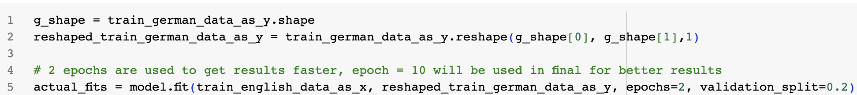
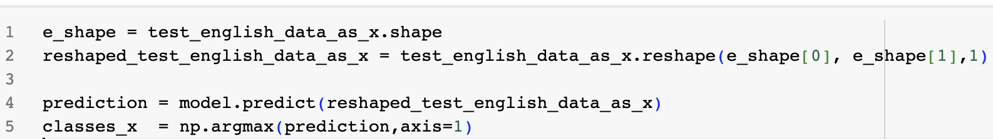
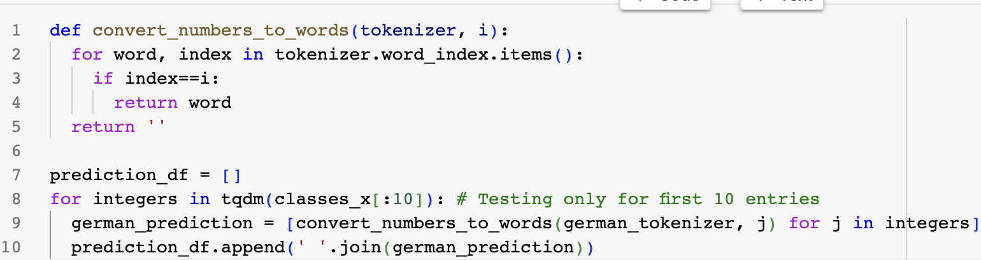
LSTM Model Training & Prediction

Slide 11
Limitation of current approach and future scope
Due to computational and time constraints, only one data set with 10K records is considered
Due to longer training time, only 10K orders are considered for model training with 2 epochs. And first 10 rows are considered to observe model prediction
Due to usage of small dataset, model training is inferior and cannot be used for quality purposes.
However, with larger data volume, model is likely to improve incurring less loss, which is the future scope of this project i.e. final submission.

