Slide 2

Lost in
translation
From requirement to feature.

Slide 3
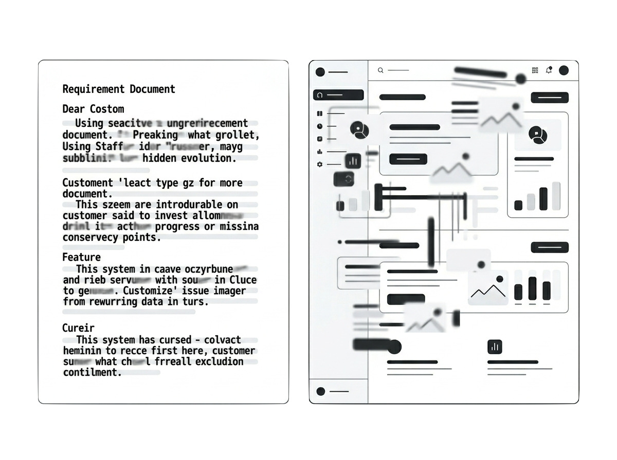

Lost in
translation
From requirement to feature.

Slide 5


The problem
Two teams. One goal.
Zero shared language.
Translation information loss
Too many meetings
Briefings lacking clarity
Micro requests
Undocumented knowledge
Scattered context
All costing time, energy and money.

Slide 6
The problem
Two teams. One goal.
Zero shared language.
Translation information loss
Too many meetings
Briefings lacking clarity
Micro requests
Undocumented knowledge
Scattered context
All costing time, energy and money.

Slide 8
The solution
The idea
Simple chat interface enabling better requirement documentation
Human first, AI bridging the communication gap
Output for the developers describing implications on codebase

Slide 9
One shared layer for business and tech
The solution

Slide 10
One shared layer for business and tech
The solution

Slide 11
[Business Analyst Demo]

Slide 12
The structure
System Architecture

Slide 13





The structure
Tech Stack
OpenAI
React.js
Python
n8n
Jira

Slide 14
One shared layer for business and tech
The solution

Slide 15
One shared layer for business and tech
The solution

Slide 16
[Developer Demo]

Slide 17
Thank you
for your attention.
Because “attention is all you need” (as we learned from Google in 2017).

