Slide 1

MUP TOOL Modernization
cSSD Software (EDG Val Summit) Shreejeet Mishra

Slide 2
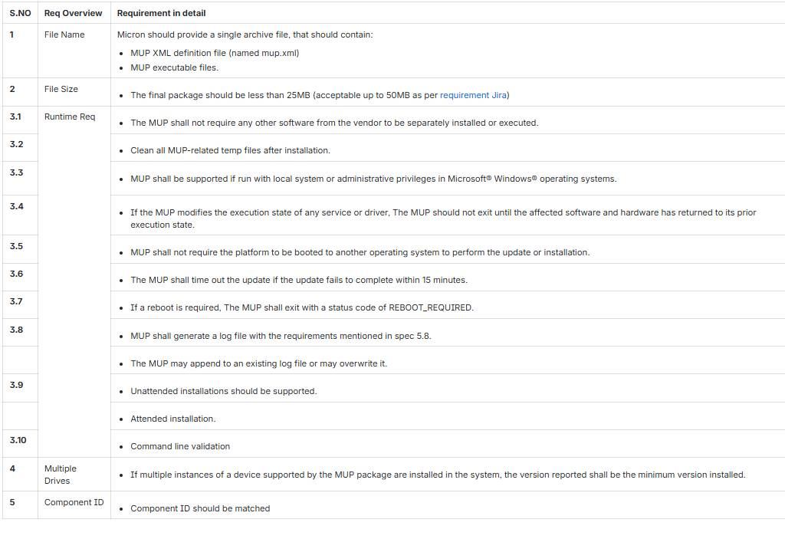

Background
Customers like DELL needs to update the SSD firmware in the field (for every production firmware release/ as needed).
Micron’s Solution: Offers Dell a Manageable Update Package Tool (MUP), which facilitate offline firmware updates.
Key Requirements:
Reference Jira : [SDIRECTOR-15940] Dell request 4600 MUP tool for 46002100 - Micron Jira

Slide 3
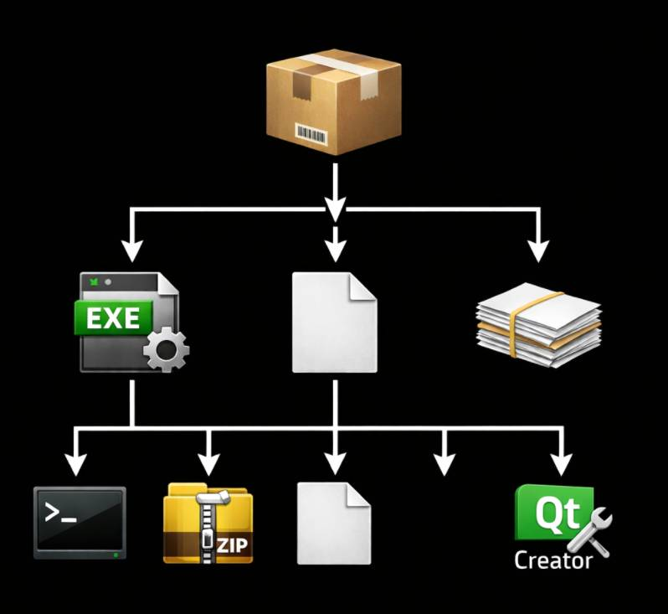
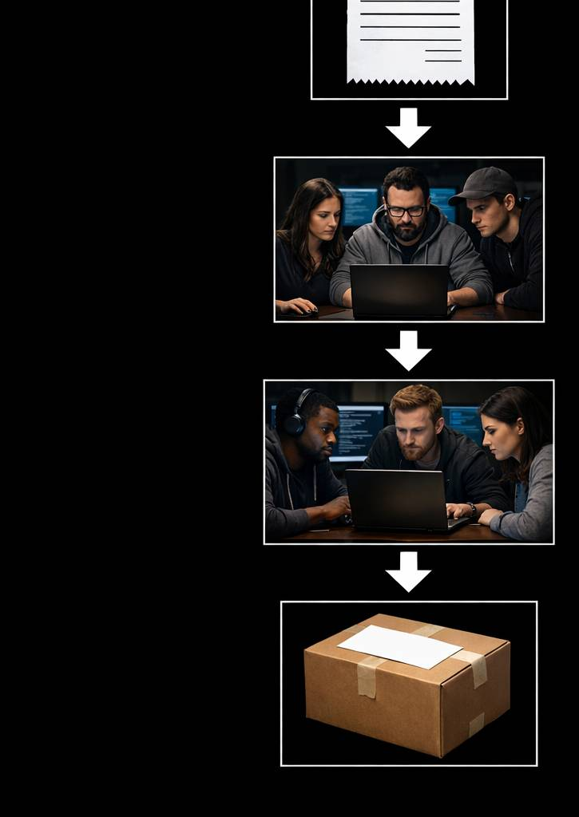

MUP Workflow
How is a new Tool is Delivered?
What’s Inside a MUP Package?
Receive Jira request for new firmware MUP.
New Request
Update the tool with the latest firmware image and build the new MUP.
Micron_4600_46000010.zip
Build Tool
Validate the .exe using Dominion CVT to ensure full functionality.
Micron_4600_46000010.exe
mup.xml
CORIM Files
Validate
Package the final tool into a ZIP file and deliver it.
msecli.exe
new_fw.zip
mse-api.dll
GUI
Deliver

Slide 4
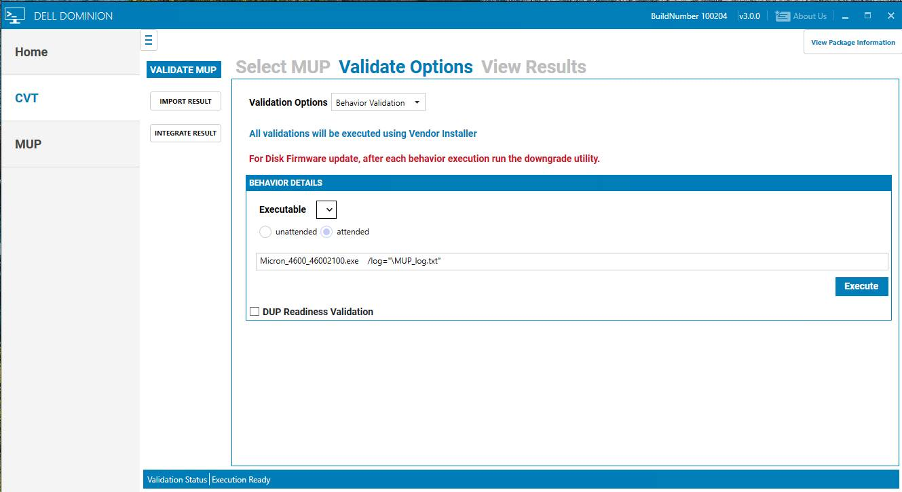
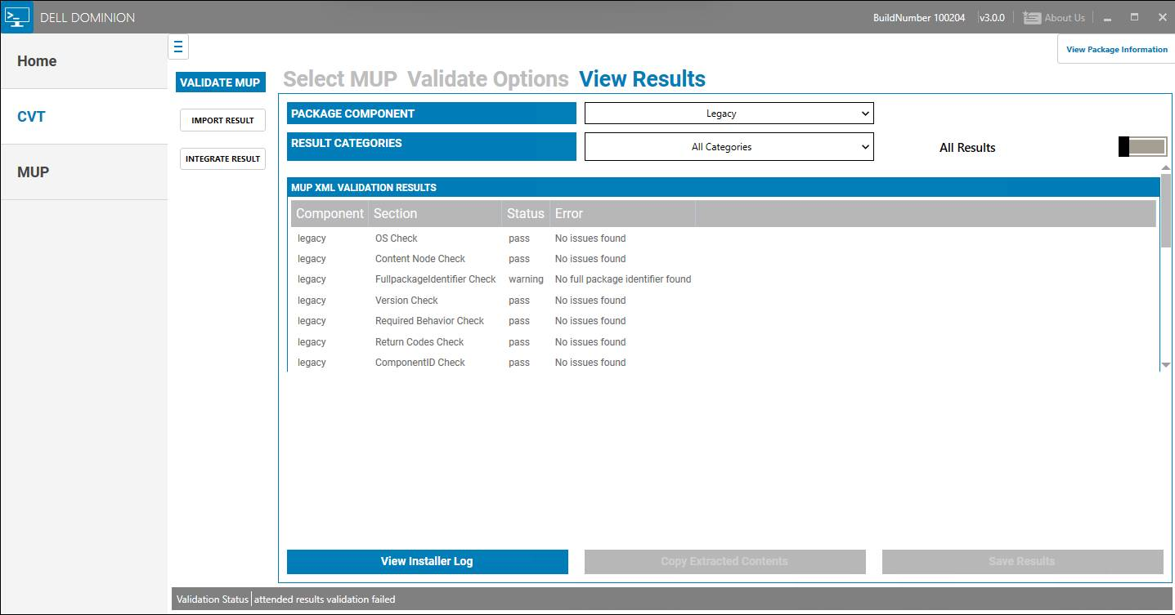

Validating MUP Package via DELL DOMINION
The MUP tool delivered is validated in the DELL Environment.
Operational Modes:
Unattended Mode: No user intervention required.
Attended Mode: GUI mode, for user monitoring.
Final Status:
Pass
Warning
Fail

Slide 5
Challenges
With the Existing MUP Tool
₹4.25L
Per Year Per Licensed Developer
30MB+
QT Rendering Engine and
QT Widgets Libraries
Up to 80MB RAM
High Memory Footprint
Expensive
Large Executable
NO AUTOMATION
Manual Build Process

Slide 6
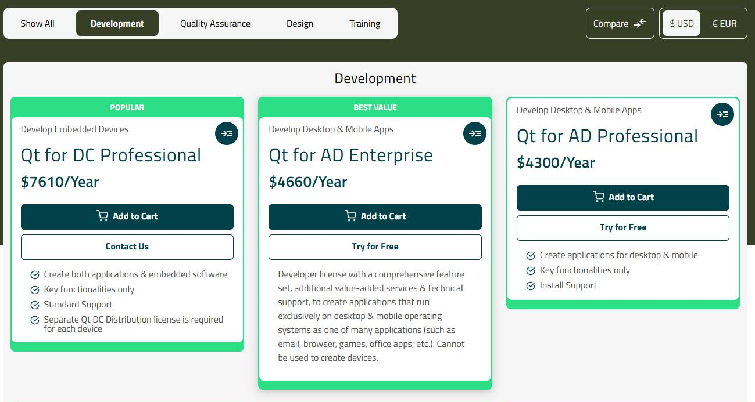
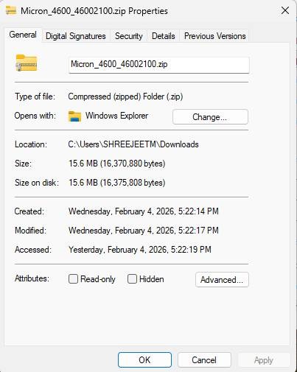
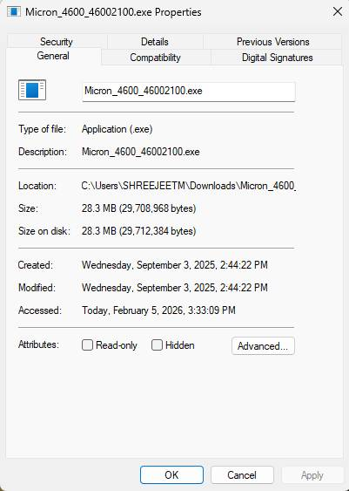
1. Expensive License
Challenges with existing MUP Tool (contd..)
2. Large Executable
$4660 Per Year Per Licensed Developer |
~₹4.25L Per Year Per Licensed Developer
Reference : https://www.qt.io/pricing

Slide 7
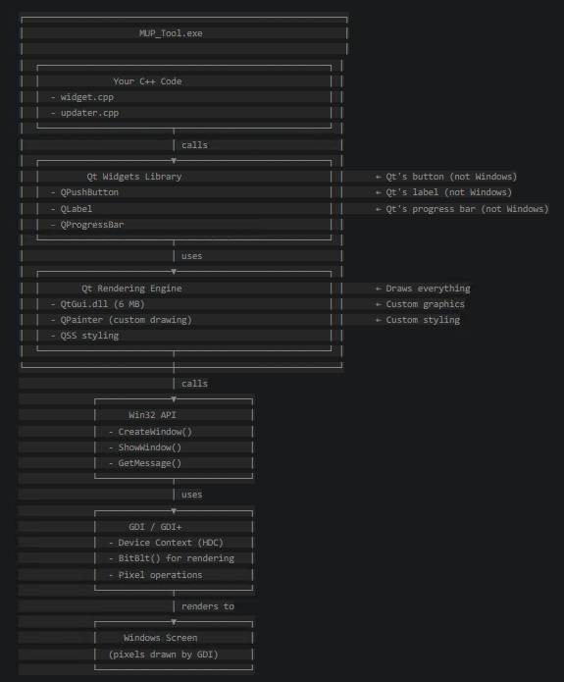
3. Heavy UI (QT based)
MUP Tool displays simple UI elements (text, buttons, progress bar)
Qt's complex rendering engine is an overkill (Memory intensive)
Win32 API and GDI+ are sufficient.
40+ MB Qt runtime libraries
(QtCore, QtGui, QtWidgets) can be eliminated

Slide 8
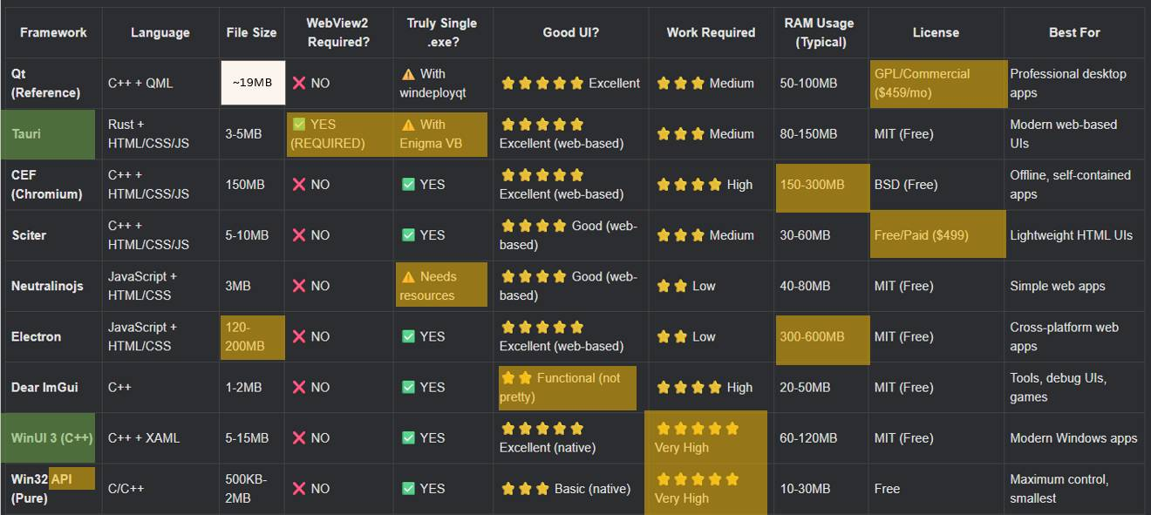
Comparative Analysis of GUI Frameworks
In terms of Cost, Technology, Size & Memory usage
Option-1: Modern UI
Option-2: Windows Native
Tech Stack Evaluation | Existing | Proposal1(Tauri) | Proposal2 (Win32 API)
Backend | msecli.exe, mse-api.dll | Same (C/C++) | Same (C/C++)
Frontend | QT Framework (C/C++ and .ui files) | Tauri Framework + Rust (Html+CSS+JS) | Win32 API + GDI (C/C++ native Windows)
License Cost | 4.25 Lakhs | Zero | Zero
Notes:
Memory and storage are a growing portion of the global semiconductor industry and today represent approximately 30% of the semiconductor market. Secular growth drivers like 5G and AI will expand usage of memory and storage across the data center and the intelligent edge, and in areas like automotive and a diversity of user devices. ​
​
As one of the world’s largest semiconductor manufacturers and the only U.S.-based manufacturer of memory, we believe that continued investment in manufacturing and R&D puts us in the best position to continue to deliver industry-leading memory and storage technologies to our customers and meet the growing demand. ​
​ ​
State-of-the-art memory manufacturing at competitive costs requires large-scale fabs that have the potential to create tens of thousands of new jobs and significant economic growth. Government support is essential to enable cost-effective memory manufacturing. U.S. memory manufacturing costs run 35-45% higher than in lower-cost markets with established semiconductor ecosystems, making passage of CHIPS funding and a refundable investment tax credit critical to potential expansion of U.S manufacturing as part of Micron’s targeted investment. ​
​

Slide 9
Tauri Framework
Win32 API + GDI
Tech Stack:
Uses Rust for Frontend-Backend Bridge.
Uses Systems WebView2 for Graphics.
Tech Stack:
Native Windows API (C/C++).
GDI/GDI+ for Graphics and Drawing
Direct OS-level control, no abstraction layers
Advantages of WebView2 :
Pre-installed in Windows 10 or higher.
Most of Windows Applications are WebView based
Uses the Chromium-based Microsoft Edge engine.
(always in the runtime, no need to restart)
Best readability (Uses HTML+CSS+JS)
Tradeoff?
× Adds a dependency for the customer to have pre-installed Webview2.
× For Legacy Windows (Win7 or older) and other OS (Linux, Mac), need to bundle a chromium .exe
(extra 100MB).
× Would take a lot effort to migrate to Rust.
Advantages Win32 API:
Zero dependencies
Smallest binary size - Direct Windows integration
Maximum performance - Direct system calls
Full Windows control - Access to all OS features
Pre-installed on Windows - No runtime required
Even QT Framework uses Win32 API internally - QT is just an abstraction layer on top of Win32
Tradeoff?
× Limited modern UI - Hard to create fancy animations
× Outdated UI paradigms - No modern web-style layouts
× Windows-only - Not cross-platform
Conclusion: Win32 is the Best Fit, Zero Licensing Cost
Notes:
Memory and storage are a growing portion of the global semiconductor industry and today represent approximately 30% of the semiconductor market. Secular growth drivers like 5G and AI will expand usage of memory and storage across the data center and the intelligent edge, and in areas like automotive and a diversity of user devices. ​
​
As one of the world’s largest semiconductor manufacturers and the only U.S.-based manufacturer of memory, we believe that continued investment in manufacturing and R&D puts us in the best position to continue to deliver industry-leading memory and storage technologies to our customers and meet the growing demand. ​
​ ​
State-of-the-art memory manufacturing at competitive costs requires large-scale fabs that have the potential to create tens of thousands of new jobs and significant economic growth. Government support is essential to enable cost-effective memory manufacturing. U.S. memory manufacturing costs run 35-45% higher than in lower-cost markets with established semiconductor ecosystems, making passage of CHIPS funding and a refundable investment tax credit critical to potential expansion of U.S manufacturing as part of Micron’s targeted investment. ​
​

Slide 10
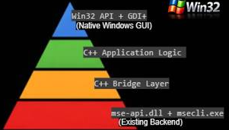
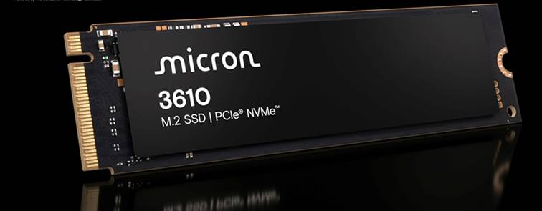
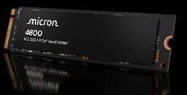
Proposed MUP Architecture/Technology Stack
User Interface Layer
Frontend Pages
End-User-License Agreement
Update Progress
Error/Failure
GDI/GDI+ Rendering
Before Update Instructions
Action Buttons
Update Completion
Application Layer
App initialization
Firmware Update
Status updates
Drive Discovery
Window management
Silent mode execution
Threads
Preconditions
Framework Services & Utilities
Logger
Error Handler
Command Parser
Resource Manager
Protocol Layer
Existing Backend Modules
Platform Abstraction Layer
msecli.exe
mse-api.dll
Driver Layer

Slide 11
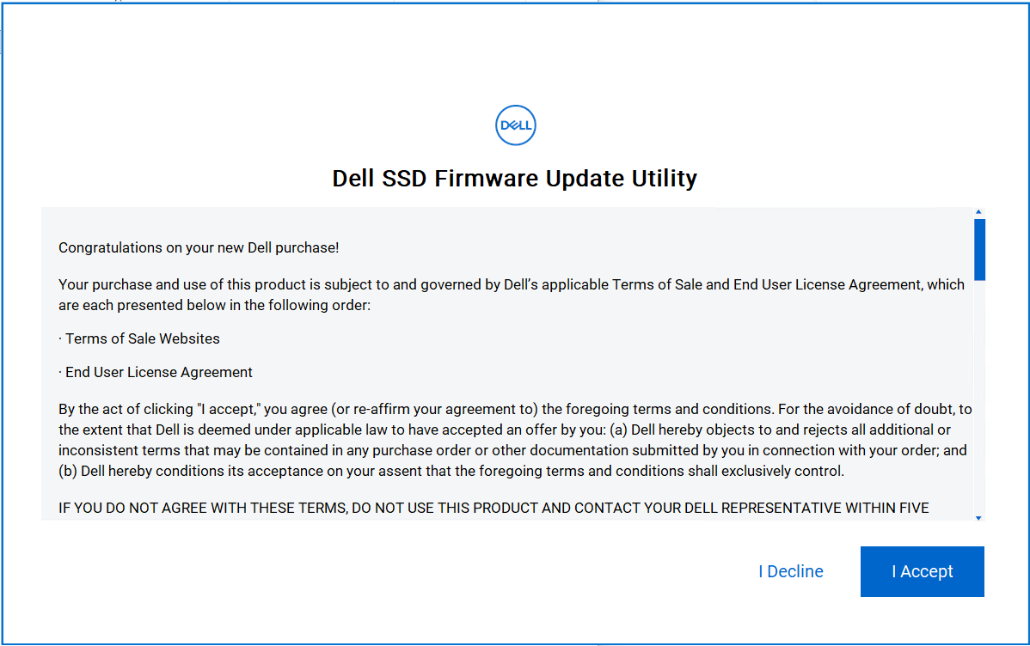
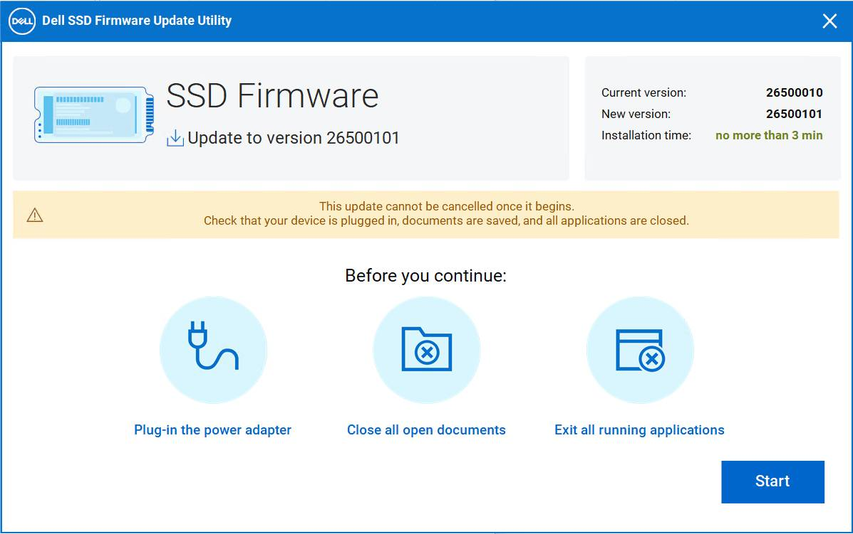
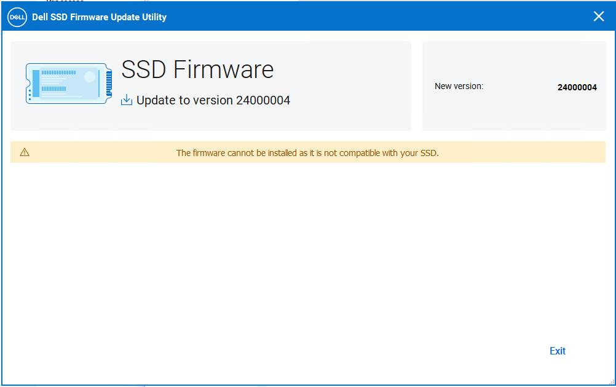
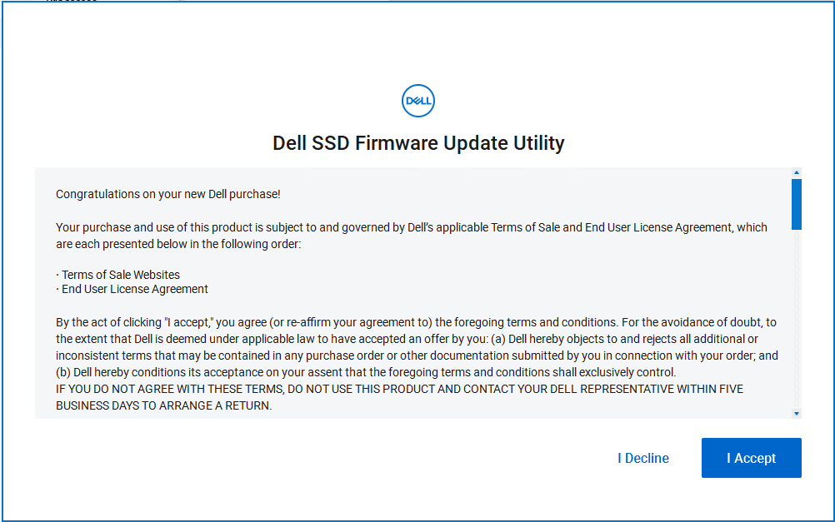
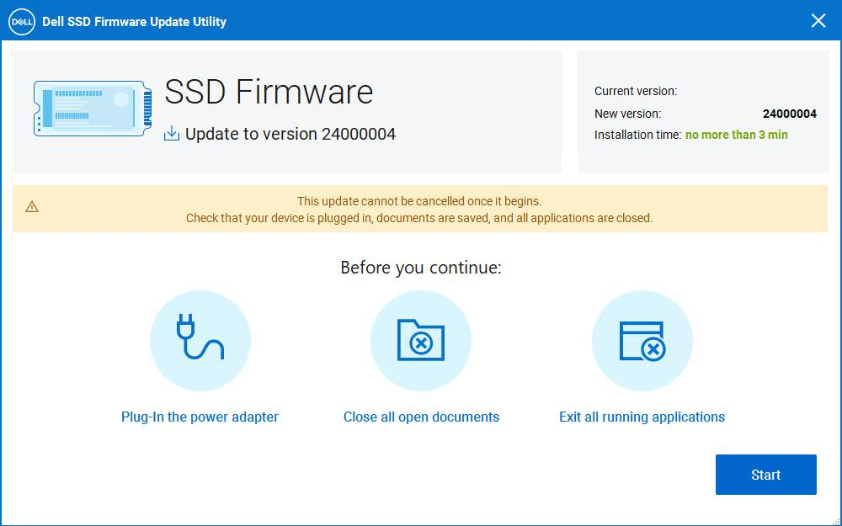
Ensured Same GUI
Win32 GDI+ (New Implementation)
QT Framework based (Old Implementation)
Notes:
Key message: The point of this slide is to show that AI is now integrated into all aspects of our lives. Bringing value and new insights.
Talking points
We now live in the age of artificial intelligence, a force so pervasive it's interwoven into the very fabric of our existence.
AI's influence has been felt for decades, but the advent of generative AI has catapulted it into the global limelight.
Before transformer models like ChatGPT, AI was specialized, designed for specific tasks.
We honed models to master specific use cases.
At Micron, our extensive experience with AI spans diverse applications, from promoting environmental sustainability in air and water to identifying intricate challenges in wafer substrates.
Micron statistics:
We have 590K sensors.
Run 23M wafer images through an AI model weekly.
Generate 30 terabytes of new data each day.
Reduce time to market by 50%.
Reduce product scrap by 22%.
Resolve quality issues 50% faster.
Micron’s industry recognition:
Recognized by the World Economic Forum Lighthouse certification for Smart Manufacturing in Singapore and Taiwan.
World Economic Forum sustainability lighthouse in 2022.
Winner of the Asia Pacific Digital Impact Award and Risk & Resilience Award for our Procurement AI Solutions.
Healthcare and Automotive Advancements:
In healthcare, AI enhances diagnostic precision in mammography and accelerates new drug discoveries.
In the automotive industry, AI is expected to drive the transition to fully autonomous vehicles.
Supervised learning vs. generative AI:
Showcase the specialized nature of traditional AI systems—immensely powerful within their scope yet limited in breadth.
AI has evolved significantly in recent years.
Supervised learning learns from labeled training data to make predictions or classify new data points, suitable for precise predictions or classifications.
VS
And now we have Large Language Models that are generative AI
Generative AI models train on large datasets to generate new content rather than making predictions.
Generative AI represents a significant advancement, serving as a powerful tool for creativity and innovation.
It taps into the vast pool of global knowledge, enabling the generation of fresh ideas.
This AI excels at the creative process, allowing us to concentrate on evaluation, enhancement, and strategic planning.
We're entering a period of unprecedented productivity, where AI and human ingenuity work together to accelerate progress.
Future of AI:
Both streams will evolve side by side, each bringing forth new insights and opportunities.
For AI to achieve its full potential, it demands a revolution in memory and storage technology.
Transition:
Just like our brains need memory to function, AI needs memory and storage to store and process information.
The more data AI can access quickly, the faster it can learn and perform complex tasks.
This brings us to the heart of today's talk.

Slide 12
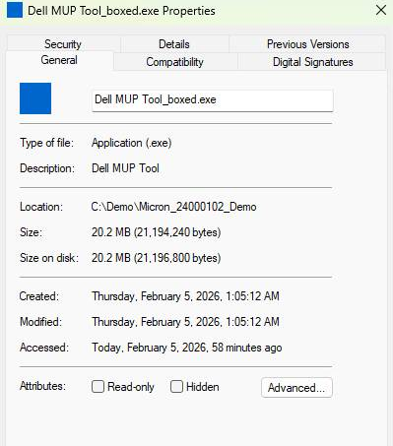
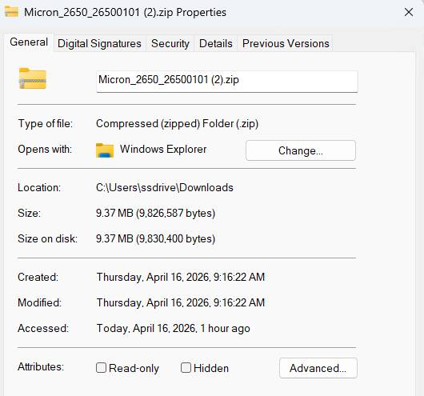
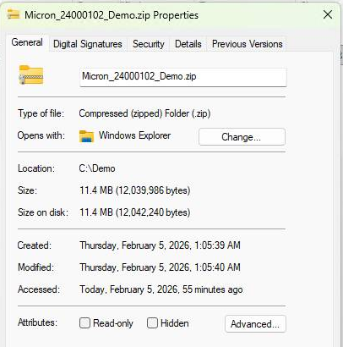
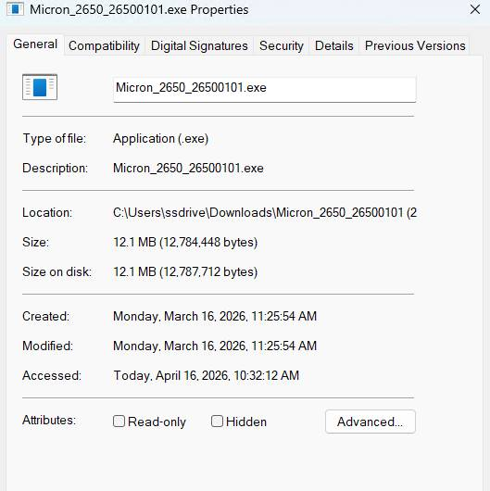


~57% Tool size reduced
Effectiveness of the Solution (Statistical Data)
QT Framework
Tauri Framework
Win32 API
~40% Package size reduced
QT Framework based
Win32 API based
~58% RAM Usage reduced

Slide 13
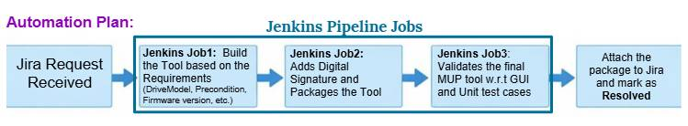
Future Enhancements
Scope for enhancing Security
Automate the MUP Tool Unit Testing and GUI Validation using Jenkins.
Jira Integration

Slide 14
Thank You Any Questions ?

