Slide 1
Geometric Analogies
Deirdre Scully and Caitlin Snyder

Slide 2
Introspective Observations
Identification and isolation of different shapes in the image, even if they are overlapping
Creation of generic logical rules such as "the shape inside of the bigger shape is removed”
The different operations manipulating the images include: rotation, flipping, adding, and subtracting shapes (moving shapes are considered adding then subtracting)
Edge detection must explore every pixel neighboring a non-zero one in order to find the entire boundary of the shape, but will fail when shapes are overlapping

Slide 3
System Description
Idea: Solve the problems without having to isolate the different shapes
Algorithm first attempts to find the correct answer if the only change is a simple rotation or flip of the entire image
Operates under the theory that whatever changes happen between images A and B, they will be congruent to the changes between C and the correct answer
The difference maps between images are created by subtracting B from A and all possible answers from C
Added pixels are valued as +1 and removed pixels are valued as -1
Pixels changed within each quadrant is compared between the A-B and C-options difference maps
Whichever C-option image has the closest number of quadrant differences on average to the A-B quadrants, is chosen as the correct answer

Slide 4
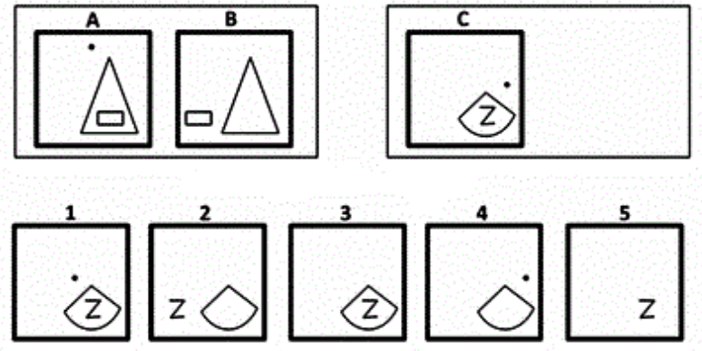
Example Problem 1

Slide 5
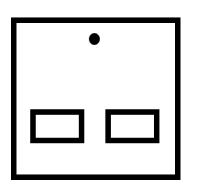
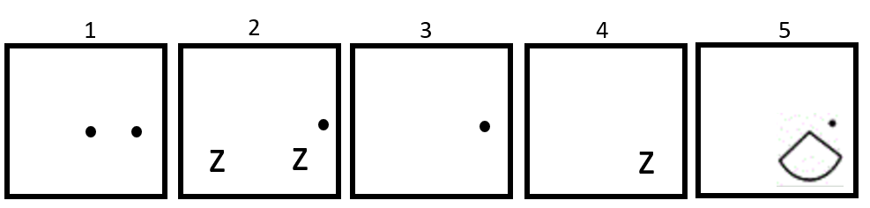
Example Problem 1
Problem 1
(A - B)
(C - options)

Slide 6
Results
Part 1:
Solves 8 problems correctly for 53% accuracy: 1, 2, 5, 6, 8, 9, 11 and 12
Solves two additional problems in top two answers for 67% accuracy: 7 and 15
Solves three additional problems in top three answers for 13/15 problems (87% accuracy): 3, 10 and 14
Part 2:
Solves 3 of the 5 additional problems correctly for 60% accuracy rate: 16, 17, and 19
Solves one additional problem in top two answers for 80% accuracy: 13
Only problems that our system does not come close to the correct answers are 4, 13 and 20

Slide 7
Conclusion
Main idea: What is easy for us to do is not easy to program the computer to do
We are are versatile while computers are not - we have to consider every possible case when creating a system

