Slide 1
Teacher Dashboard Baseline
Caitlin Snyder

Slide 2
Motivation
C2STEM – computational modeling environment
Goal: Help teachers effectively interact with their students while they work on modeling tasks in the environment
Chicago student data, log files have been processed

Slide 3
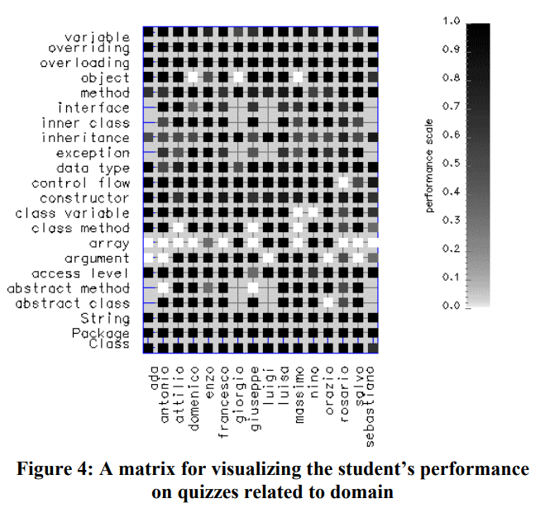
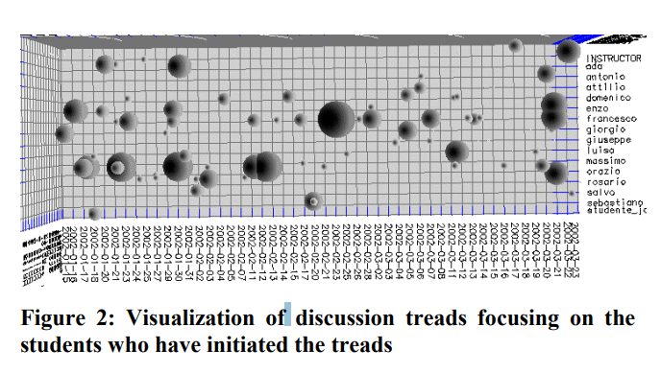
Related Work – Visualizing Student Tracking Data (Mazza and Dimitrova 2004)

Slide 4
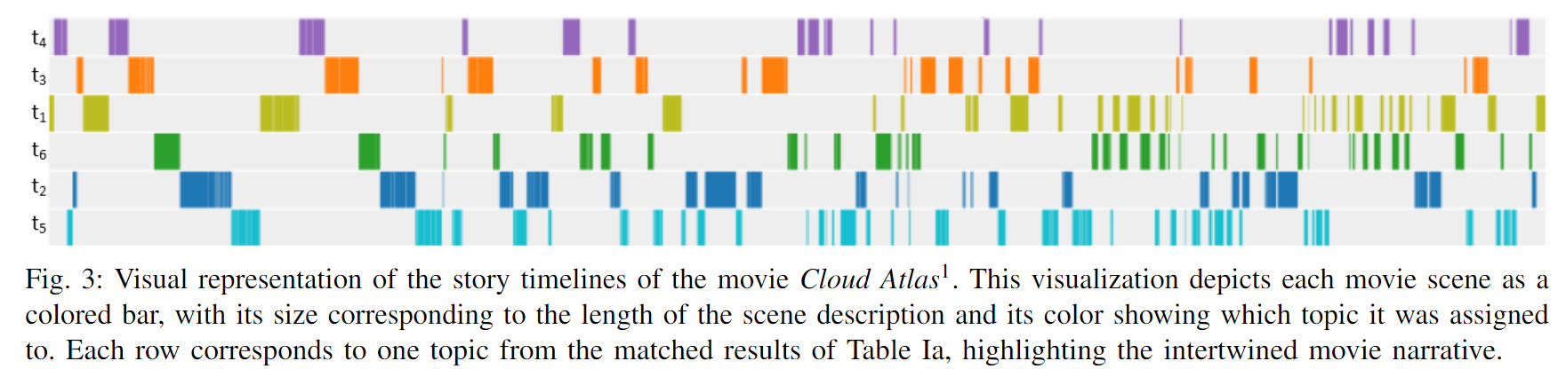
Related Work - LTMA

Slide 5
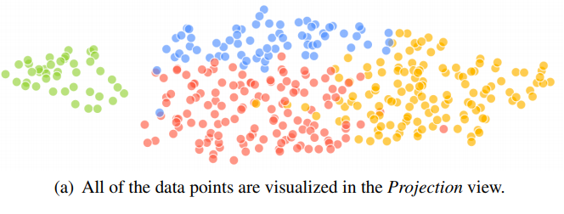
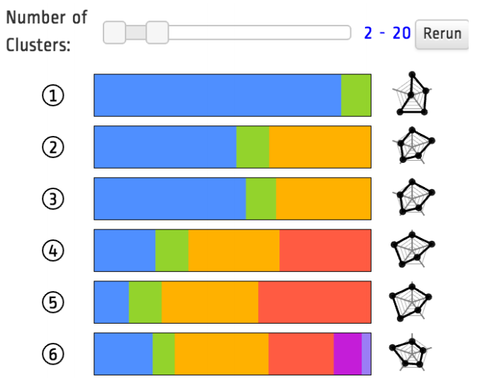
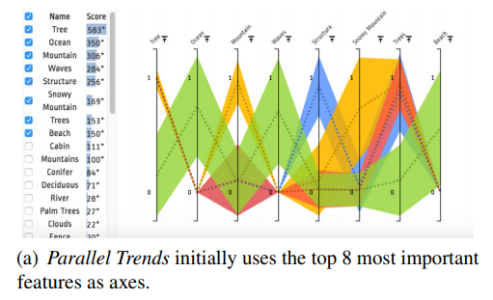
Related Work – ClusterVision (Kwon et al. 2018)

Slide 6
Baseline
Objective: Help a teacher understand student
Data Features: Total actions, total plays, total changes, totals models, total steps, total creates, proportions of each of these with respect to number of total actions
Clustering and 2d projection
Visualization of 2d projection of clusters, coordinated by color
Parallel coordinate graph of all the features, colored by cluster

