Slide 1

FIREBASE
KIDOCODE WEB DEPARTMENT
15 FEBRUARY 2023

Slide 2



FIREBASE TOPICS
What is Firebase?
What are the features of Firebase?
What project will we do?

Slide 3

WHAT IS FIREBASE?
A set of hosting services for applications on various platforms developed by Google

Slide 4
FEATURES OF FIREBASE
Authentication
Realtime Database
Hosting
Test Lab
Notifications

Slide 5
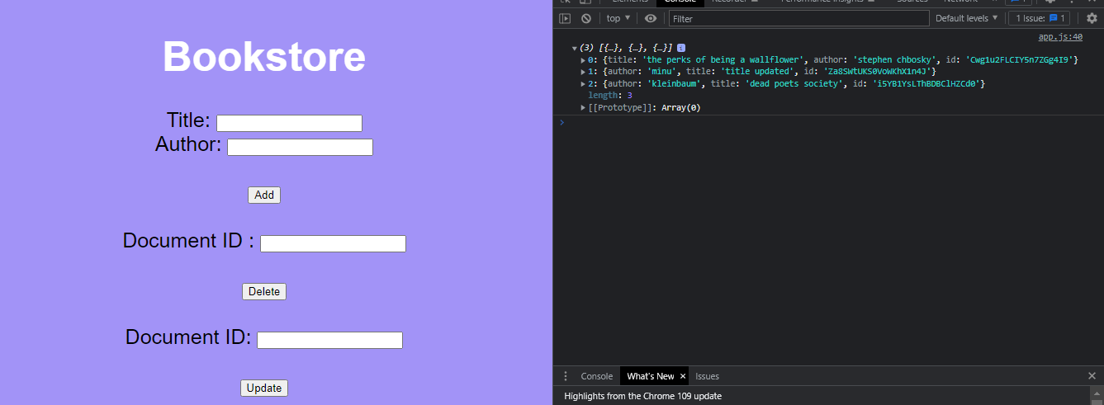
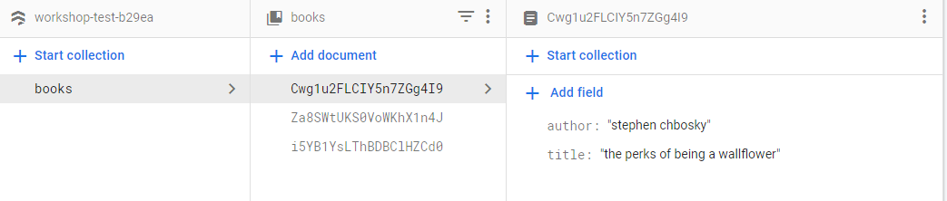
FIREBASE TEST PROJECT

Slide 6

THE END
thank you for attending though, i’m going to be like this exact spongebob meme when you start asking questions.

