Slide 1




Workshop on Numerical Modeling in MHD and Plasma Physics: methods, tools, and
outcomes.
High performance collisional PIC plasma simulation with GPU-based clusters
A.V.Snytnikov,
Supercomputer Simulation Lab, ICMMG
A.A.Romanenko
Faculty of Information Technologies, NSU
G.G.Lazareva,
Peoples' Friendship University of Russia (RUDN University), Moscow,
Russian Federation

Slide 2
Why?
Quality of Particle-In-Cell simulation crucially depends on the number of particles so it is important to be able to process as many particles as possible
The present Particle-In-Cell performance
0.5 TFLOPS
with GPU Tesla V100 “Volta”,
6.4 million model particles processed in 0.006 sec.,
or
1 Giga-particle per second

Slide 3

Main equations
М
A
N
A
S
Boundary conditions: periodic

Slide 4

Particle-In-Cell basics
М
A
N
A
S
In Particle-In-Cell method plasma is simulated by means of the model particles. Motion equations of model particles are the characteristic equations of Vlasov equation.
Motion equations for model particles ar solved with leapfrog scheme
Maxwell equations are solved with FDTD method
Computational complexity: 500 floating point operations per particle
Quality of the solution crucially depends on the number of particles

Slide 5
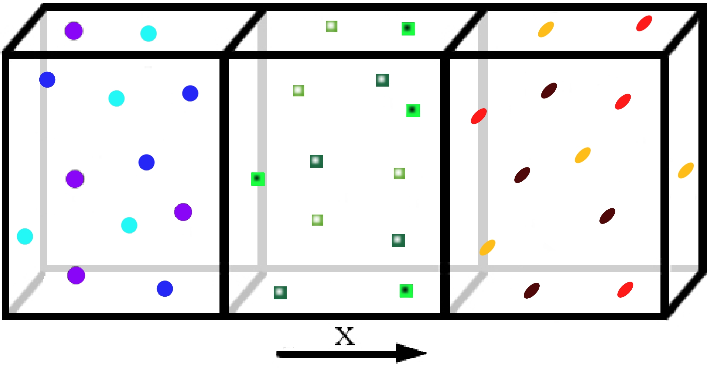
Physical validation of the code:
Two-stream instability simulation,
thanks to Dr. Ekaterina Genrikh
М
A
N
A
S
Beam density
Beam temperature
Hydrodynamical mode
Transition mode
Kynetic mode
Computation parameters
Domain length
Spatial mesh
Timestep
Particles per cell
Y

Slide 6

Domain Decomposition
Particles belonging
to different processors (or cores,
or GPUs) are shown
with different colours
Collective MPI operations
(MPI_Allreduce are shown with
large hollow arrows)
Peer-to-peer MPI operations
(send/recv)
are shown with small black arrows
Lagrange
decomposition
Mixed
Lagrange-Euler
decomposition

Slide 7
GPU implemenation
М
A
N
A
S
The particles are stored in small array attached to cells
Particle push is performed with shared memory
The transit of particles from one cell to another is performed with no synchronization

Slide 8

The two-level multi-flow computation
М
A
N
A
S
Simulation domain is decomposed ( using MPI) into subdomains, attached to
different GPUs
For each GPU the particles of each cell are processed with different CUDA threads

Slide 9
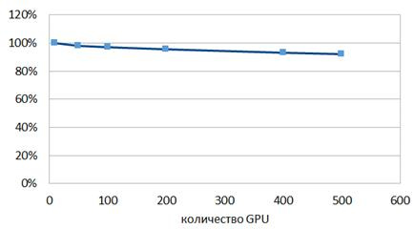
Weak efficiency
Lomonosov supercomputer, MSU
М
A
N
A
S
Number of GPUs
Mesh: 100х4х4 nodes, 6.4 million particles, MPI_Allreduce

Slide 10
Particle push
М
A
N
A
S
Particle push is the most expensive part of the code (up to 90 % of the total time)
Fortunately, particle push is accelerated the best with GPU
Speedup against a 4-core Intel Xeon
Particle push
Field evaluation

Slide 11
Recent optimizations
М
A
N
A
S
Transit of model particles from cell to cell with no synchronization using buffers
Get rid of buffers using particle labels
Get rid of atomic operations when computing current within a cell

Slide 12
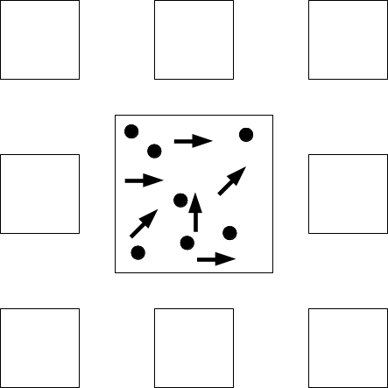
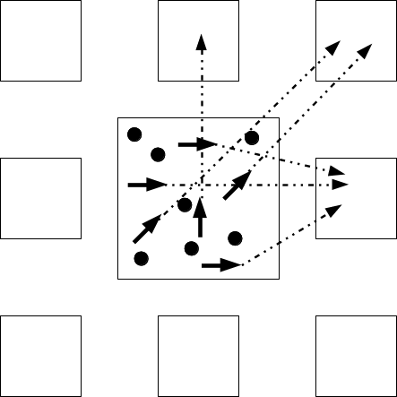
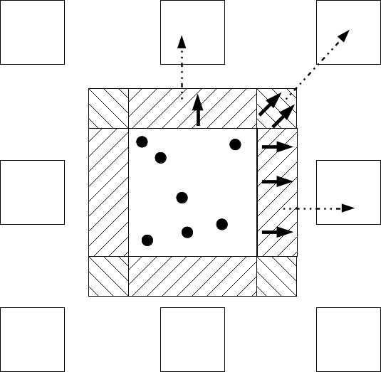
Transit of model particles from cell to cell with no synchronization using buffers
М
A
N
A
S

Slide 13
Get rid of buffers using particle labels
М
A
N
A
S
Instead of moving into buffer the particle is given a label (“which direction it goes”)
Then neighbour cells read their particles from the particle list of the present cells with no read-and write conflict
After that the flow-away particles are removed from the list by a separate kernel
In such a way, send buffers (quite big) are not necessary

Slide 14
Get rid of atomic operations when computing current within a cell
М
A
N
A
S
The particles are stored in small array attached to cells
Current a computed in each cell asynchronously by CUDA threads, one thread for one particle
Each thread reads the present value of the current in a mesh node, adds the current of the particle and writes the result into the mesh node (reading and writing to different places by different threads at once)
In this case the read-and write conflict occurs and atomic operations are necessary
If we do the opposite and attach a CUDA thread to the mesh nodes instead of particles,
Then the thread reads the current value from each particle and writes to its own memory (reading from different places but writing to one place only for each thread)
Arrows of different colours do not cross in one node.
No read and write conflict

