Slide 1
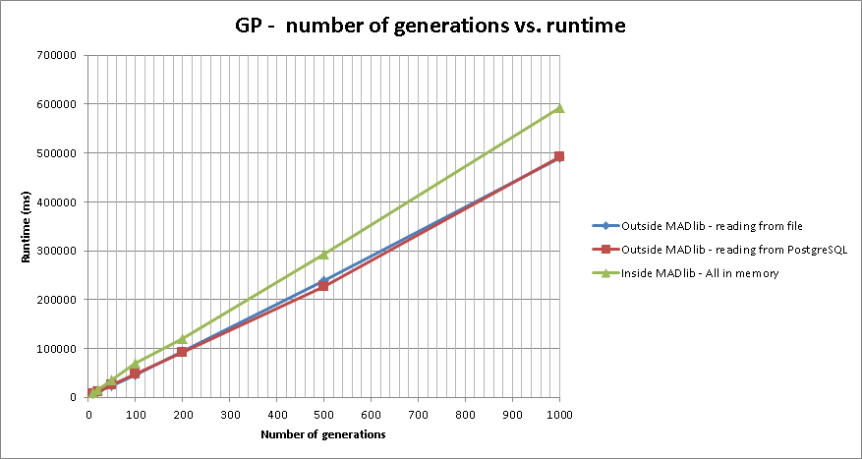
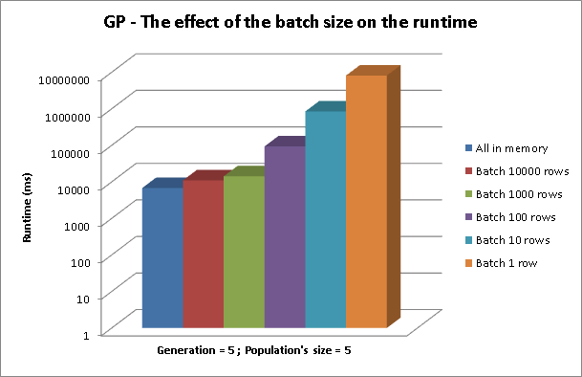
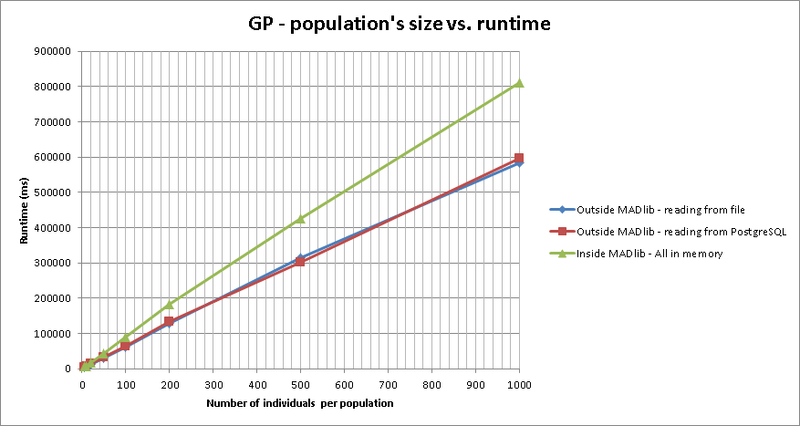
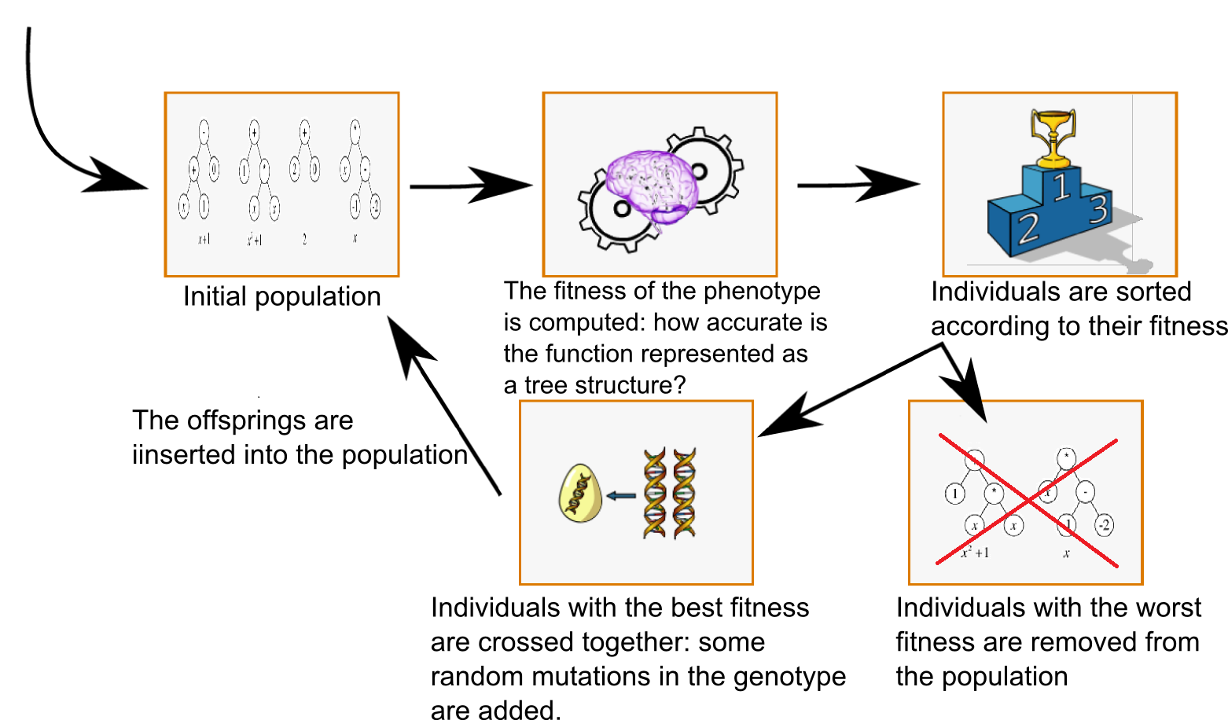


Machine Learning Algorithms for In-Database Analytics
Franck Dernoncourt & Sumaiya Nazeen
MIT
6.830
Spring
2013
Abstract
Results
Our project focused on extending the functionality of MADlib. MADlib is an open source machine learning and statistics library which works with Postgres or Greenplum to provide in-database analytics.
Although some machine learning algorithms have been implemented in MADlib, there is room for additional contributions. We implemented two different machine learning algorithms, symbolic regression with genetic programming and adaptive boosting for MADlib, and are in the process of contributing our code to the MADlib community codebase.
We also assess the performance of our implementations and compare their performance with the same algorithms outside MADlib.
Objectives
Copy and paste your text content here, adjusting the font size to fit.
Methods
Symbolic Regression using Genetic Programming:
Conclusions
Copy and paste your text content here, adjusting the font size to fit.
References
Journal Article, Name of Journal
Journal Article, Name of Journal
Journal Article, Name of Journal
Journal Article, Name of Journal
6.830 : Database System – Poster Session – May 15, 2013

