Slide 1

Deep Compression
胡超杰

Slide 2
background
Deep neural networks have achieved state-of-the-art performance on computer vision problems, such as classification, detection, etc.
Though these neural networks are very powerful, the large number of weights consumes considerable storage and memory bandwidth.
having deep neural networks running on mobile has many great features such as better privacy, less network bandwidth and real time processing

Slide 3
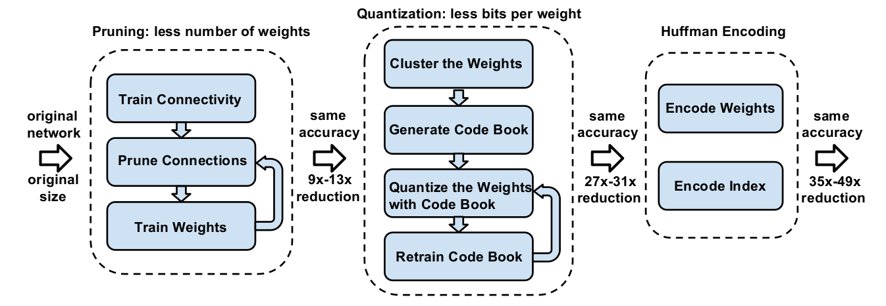
how to depress
1.prune the network by learning only the important connections
2.weight sharing and quantize
3.apply Huffman coding

Slide 4
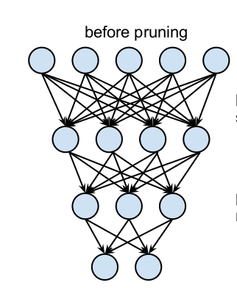
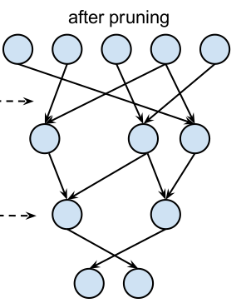
prune the network
Threshold

Slide 5

prune the network
store the sparse structure that results from pruning using compressed sparse row (CSR) or compressed sparse column (CSC) format

Slide 6
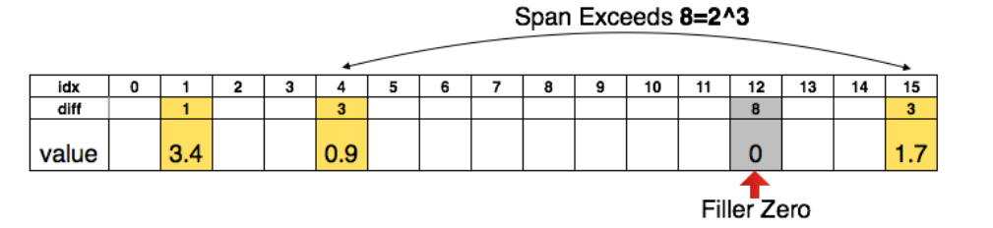
prune the network
To compress further

Slide 7
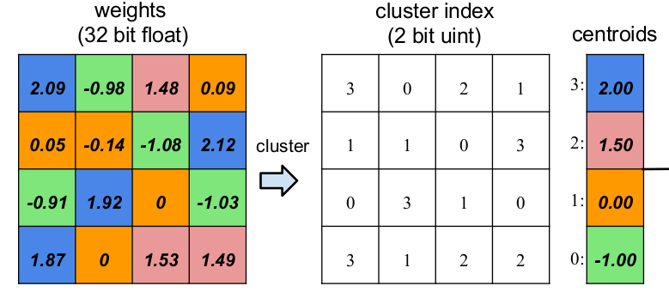
weight sharing and quantize
K-means算法进行分组聚类
4*4*32
4*4*2 + 4*32
k-means算法聚类中心初始化
Forgy (random)、Density-based、Linear initialization

Slide 8
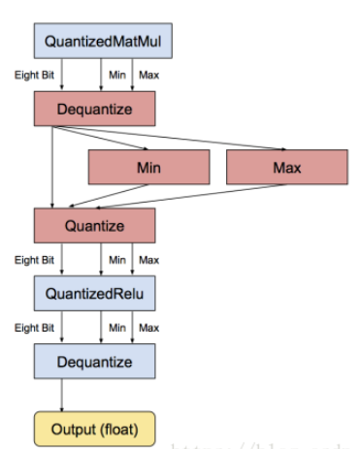
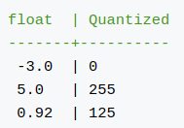
weight sharing and quantize
quantize

Slide 9
apply huffman coding
Experiments show that Huffman coding these non-uniformly distributed values saves 20% − 30% of network storage.

Slide 10
classification
low-rank
pruning
quantization
knowledge distillation
compact network design
…..

Slide 11
Future trends
non-fine-tuning or unsupervised compression
self-adaptive compression
network acceleration for other tasks
hardware-software co-design
binarized nerual networks
…..

Slide 12
Thank you!

