Slide 1
Screenshots

Slide 2
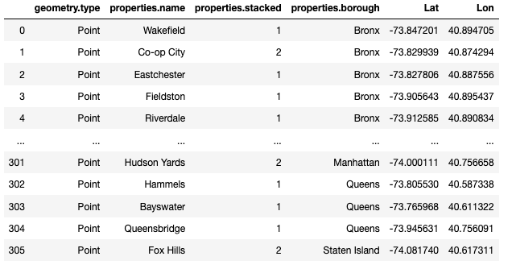
Modified Dataframe of New York

Slide 3
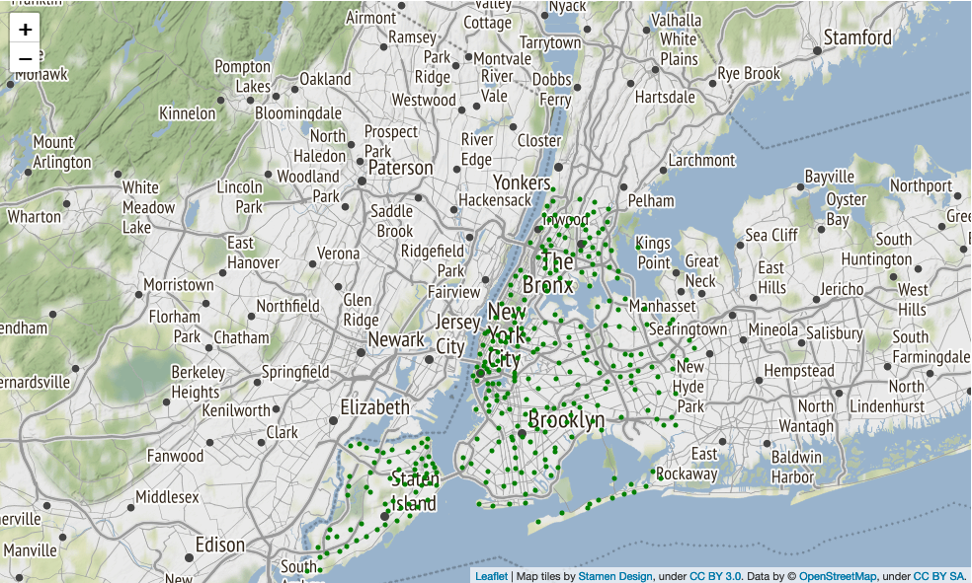
Map of New York + Markers

