Slide 1
King County - House Sales
Sales analysis
for
William Rodriguez
by Stephan O. Adler

Slide 2
Requirements
2 People
2 Houses
City → central, fast
Country → non-renovated, best timing

Slide 3
Considerations and Assumptions
City: for work, 2-3 rooms, 1 bathroom
Country: for leisure, 2-4 rooms, 1 bathroom
  not renovated after 1982 (within last 40 years)
Most relevant factors:
  Price, Grade, Condition, Rooms
  Distance
  Surroundings

Slide 4
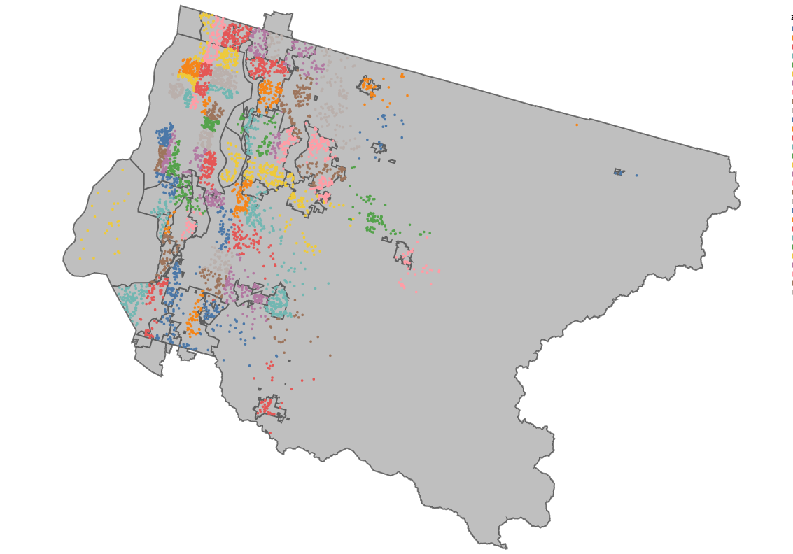
Sales Overview
Seattle

Slide 5
City
Considerations:
  Seattle → largest city in county
  Central districts in seattle:
    Downtown Seattle: ZIP codes 98101, 98104
    Capitol Hill: ZIP codes 98102, 98112
    South Lake Union: ZIP code 98109
    First Hill: ZIP code 98104
    Belltown: ZIP code 98121

Slide 6
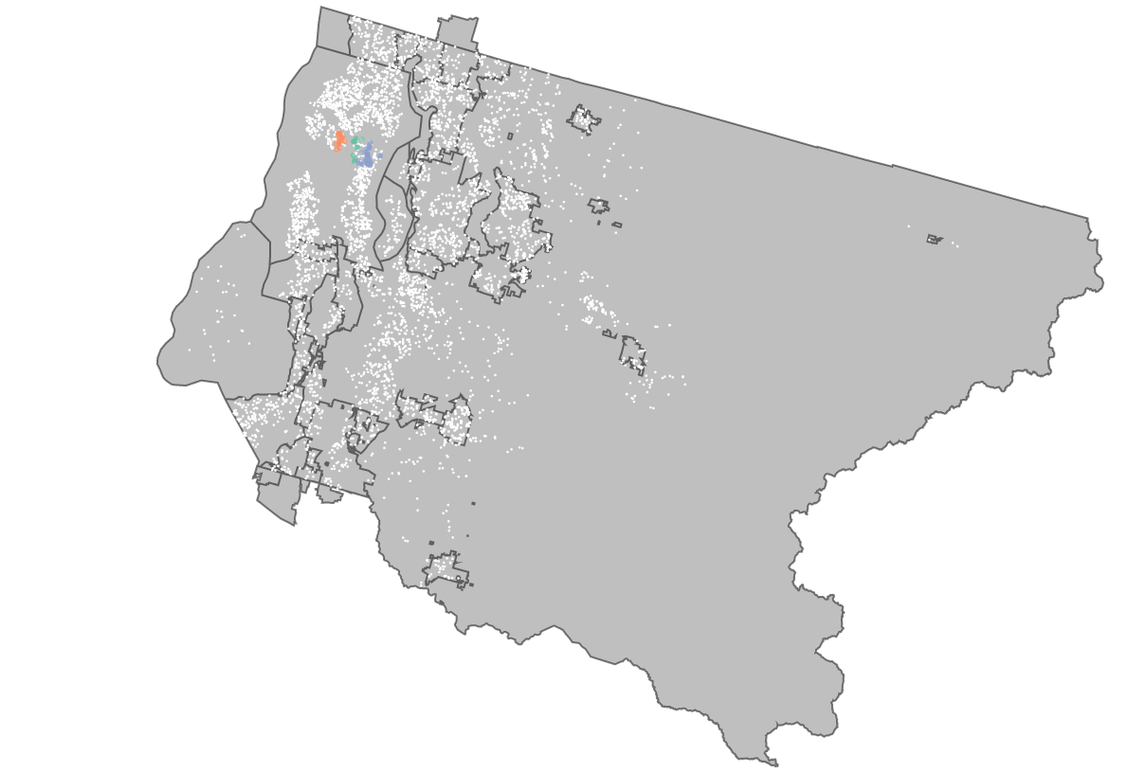
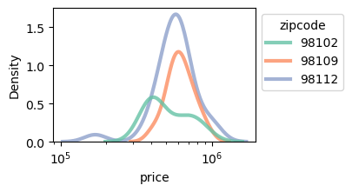
Attractive Central Districts with Sales
Capitol Hill
South Lake
Union
South Lake
Union
Capitol Hill

Slide 7
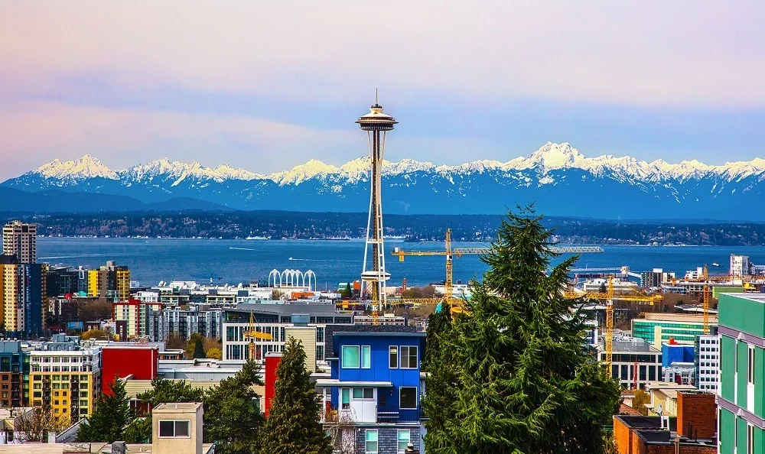
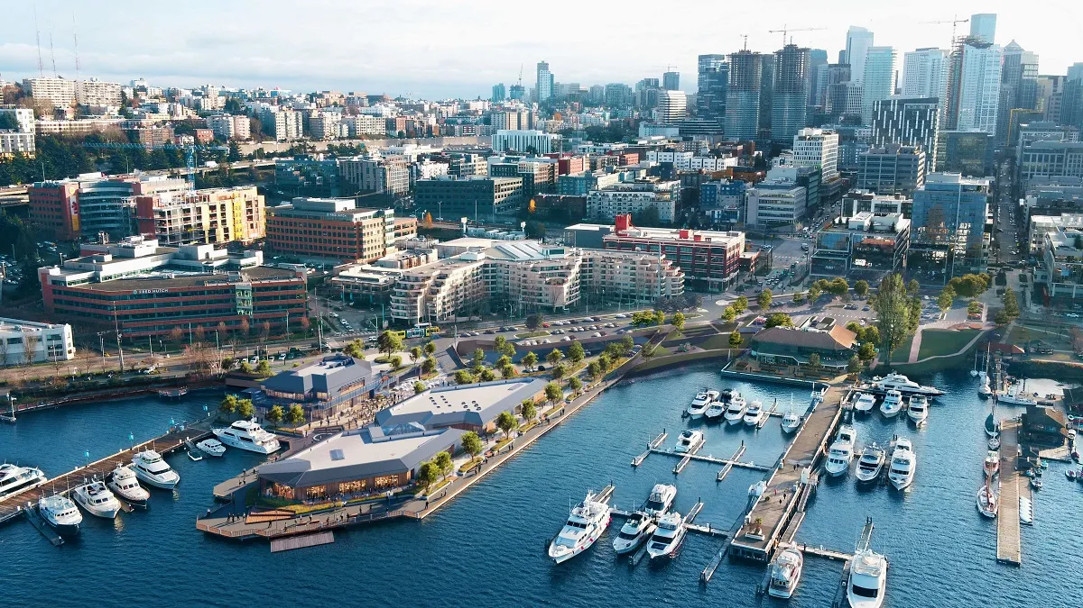
Impressions, City
South Lake Union
Capitol Hill

Slide 8
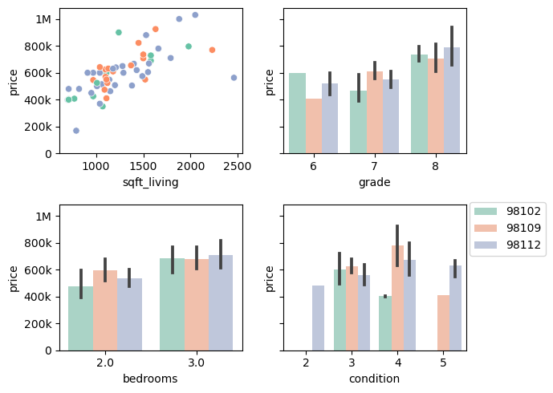
Comparison of Central Districts
Capitol Hill
South Lake
Union

Slide 9
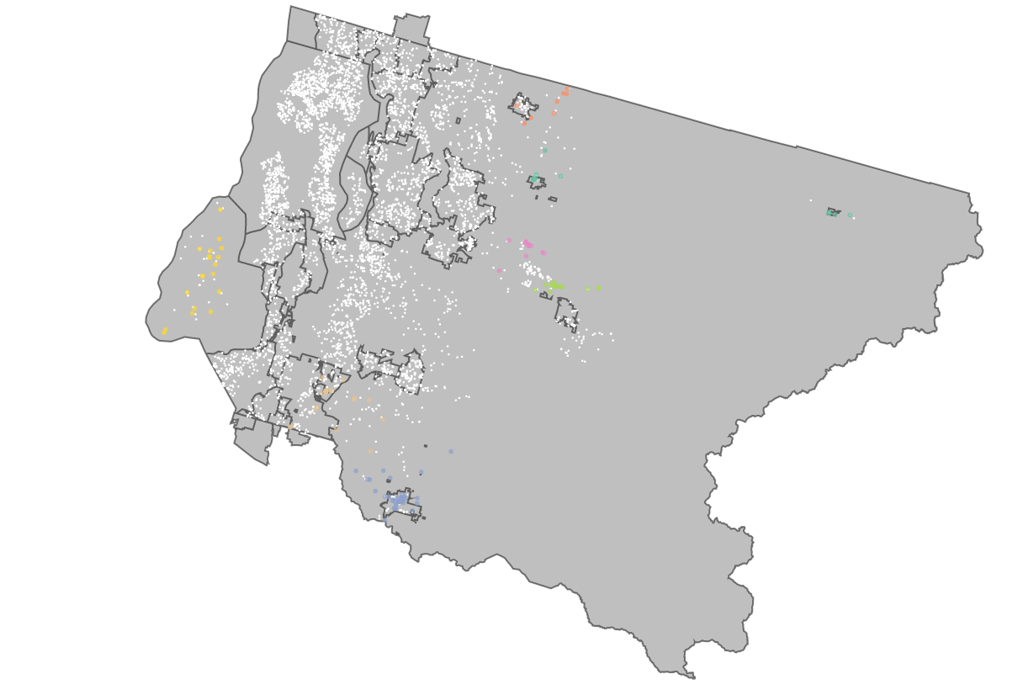
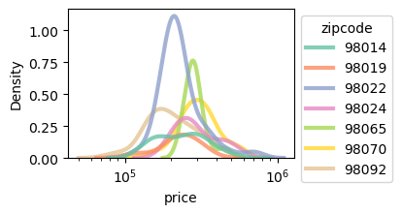
Attractive Country Districts with Sales
Duvall
Vashon
Island
Duvall
Enumclaw
Vashon
Island
Enumclaw

Slide 10
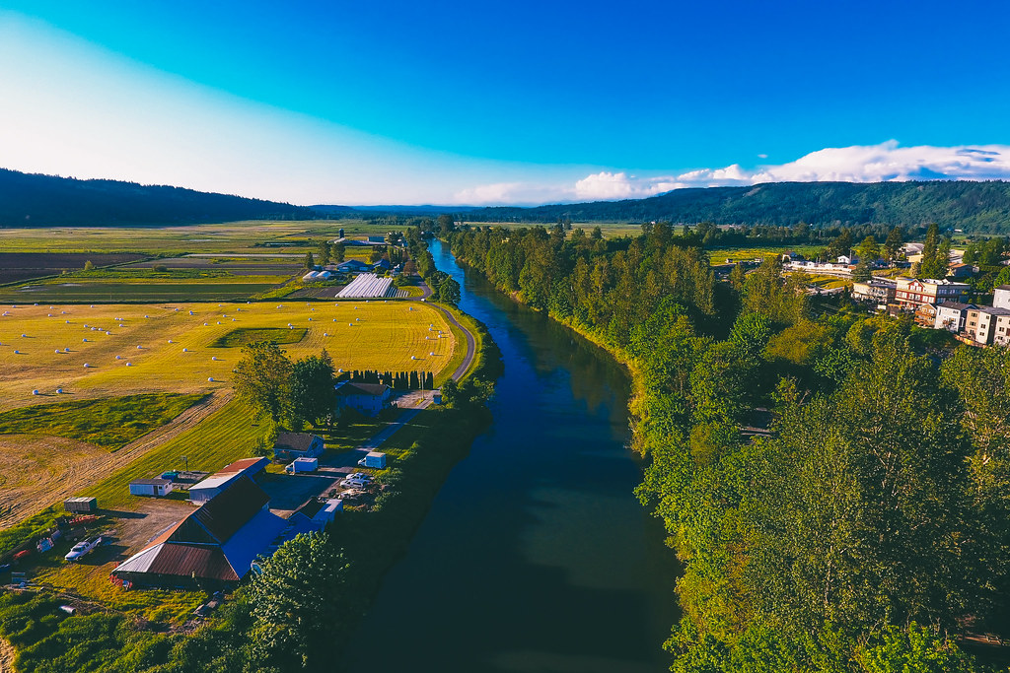
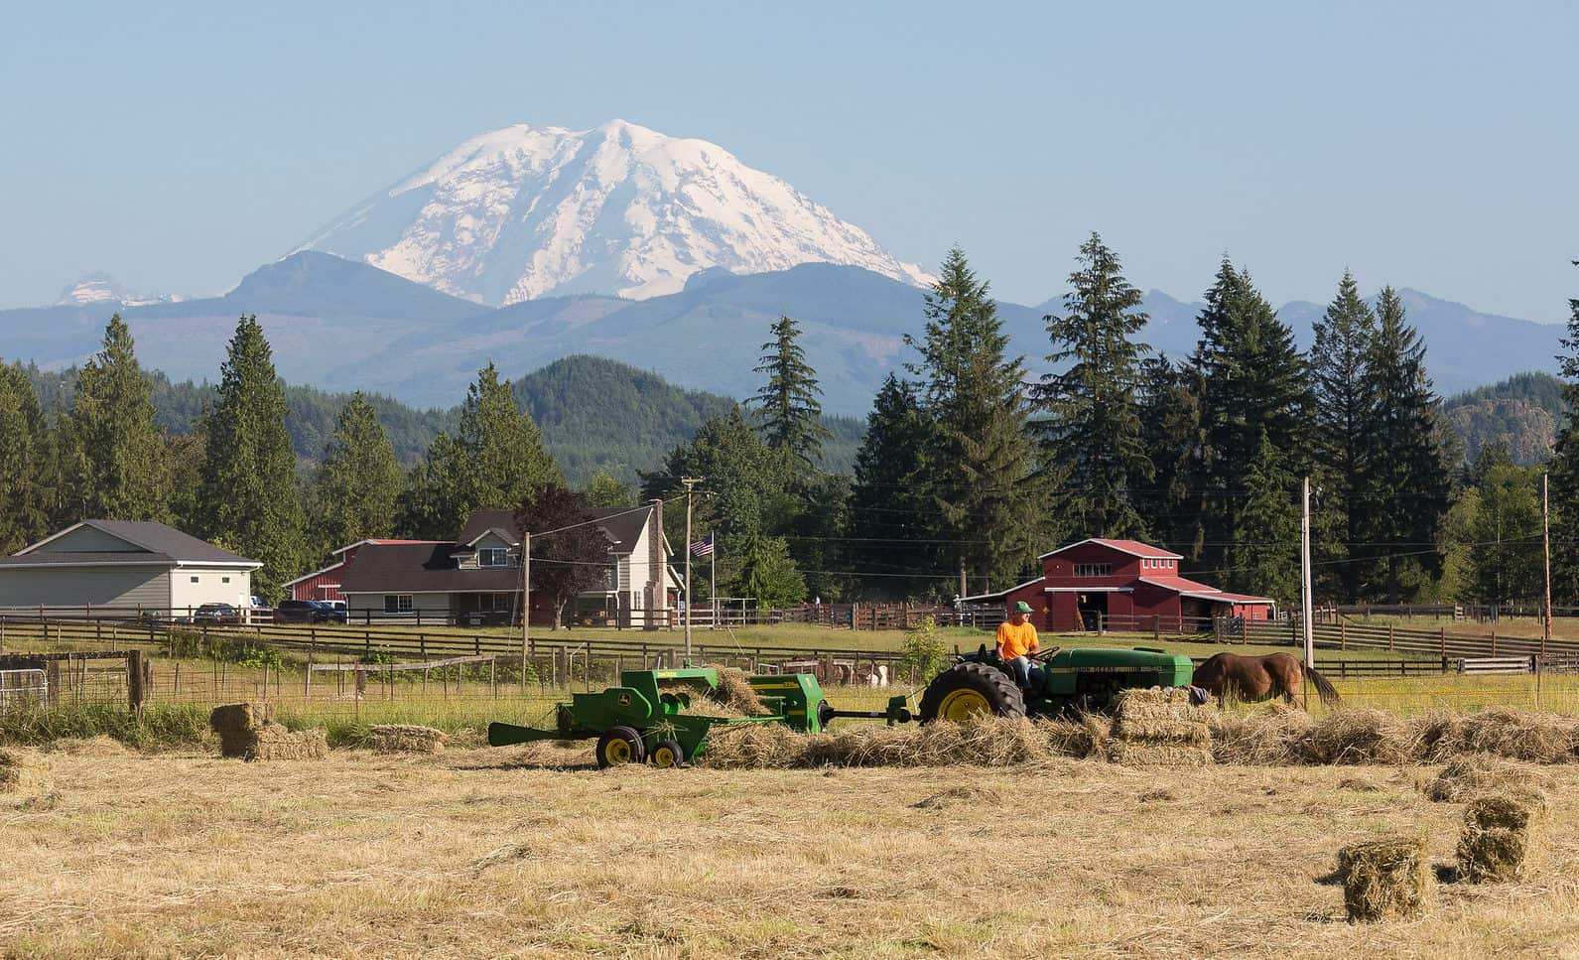
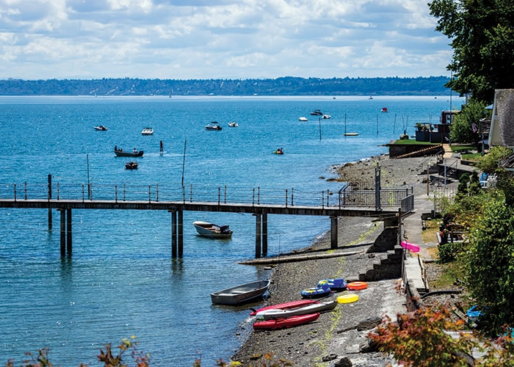
Impressions, Country
Enumclaw
Vashon Island
Duvall

Slide 11
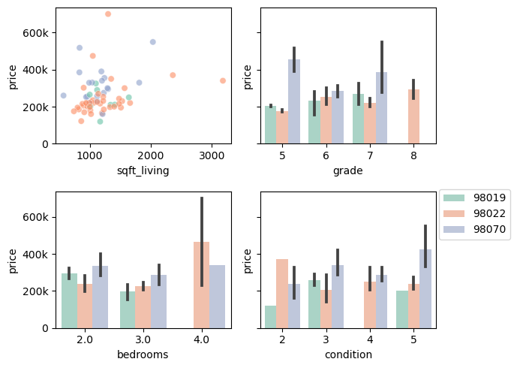
Comparison of Country Districts
Duvall
Enumclaw
Vashon Island

Slide 12
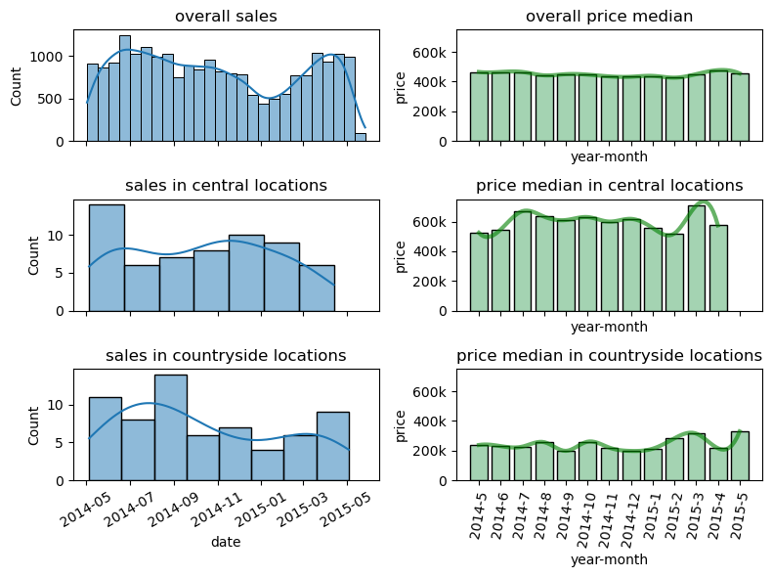
Timing

Slide 13
Recommendations
City Property in Seattle Capitol Hill or South Lake Union
  grade is costly, condition not necessarily
  usual grade 7 prices are between 456k and 627k $
  usual grade 8 prices are between 635k and 788k $
Country House in Duvall, Enumclaw or Vashon Island
  Duvall: Closer to City Property, good price/value ratio
  Vashon Island: Still close to City, Nice Island, more expensive
  Enumclaw: Best price/value ratio, farthest from City

