Slide 1
转正答辩
报告人：吴西飞

Slide 2
目录
主要工作
技术总结：JavaScript 语法
技术总结：Custom Component
工作计划

Slide 3
主要工作
通过MDN，学习Firefox OS编译、刷机。
了解XPCOM组件，实现C++的Demo。
CORE-307：在ftu_ping中加入findmydevice参数。
CORE-636：OTA分析与开发。
CORE-835：Telemetry相关分析。
CORE-844：Calendar与UX操作风格对比。
？：feather-phone上Calendar功能实现。

Slide 4
技术总结：JavaScript 语法
Use of function expression
Inheritance and the prototype chain
JavaScript Modules Management
Some Traps

Slide 5
function expression
var foo = function () {
...
};
function declaration
function foo () {
...
};
Use grouping operator convert from Declaration to Expression to reduce Global pollution.
(function foo () {
...
};)

Slide 6
function expression
Create encapsulated scope to hide auxiliary helper data from external context
var foo = {};
(function initialize() {
var x = 10;
foo.bar = function () {
alert(x);
};
})();
foo.bar(); // 10;
alert(x); // "x" is not defined

Slide 7
function expression
IIFE(Immediately-Invoked Function Expression)
(function(exports) {
...
})(window);

Slide 8
Inheritance and the prototype chain
JavaScript中的对象通过new Function实现
function Person(name) {
this.name = name;
}
Person.prototype.getName = function() {
return this.name;
}
Var person = new Person();
person.__proto__ == Person.prototype

Slide 9
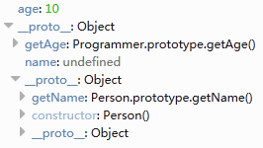
Inheritance and the prototype chain
function Programmer(name, age) {
this.age = age;
}
Programmer.prototype = new Person();
Programmer.prototype.getAge = function() {
return this.age;
}
var p = new Programmer("me", 10);

Slide 10
JavaScript Module Pattern
Purpose: Code Management, Code Reuse.
AMD vs. CommonJS
Requirejs: http://requirejs.cn/
alameda.js: https://github.com/requirejs/alameda
AMD loader, like requirejs, but with promises and for modern browsers

Slide 11
Some Traps
The number of childNodes
<ul id="myList">
<li>Item 1</li>
<li>Item 2</li>
<li>Item 3</li>
</ul>
Promise, =>, ``
apply, call and bind.

Slide 12
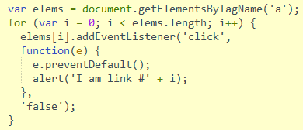
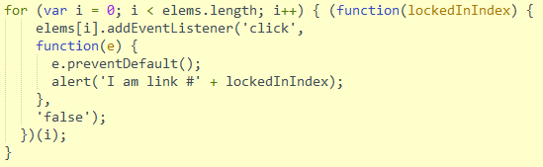
Some Traps

Slide 13
技术总结：Custom Component
Gaia Components is a kind of Custom Component.
Register Element
Shadow DOM
Template
Web Component(Custom Component)

Slide 14
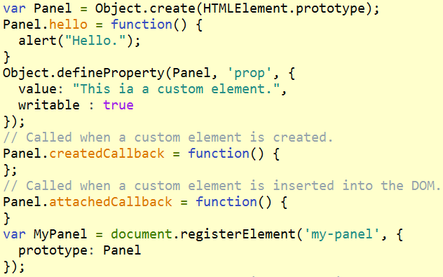
Register Element
Define your own html tag, add attributes and functions.
Notes:
var Panel = Object.create(HTMLElement.prototype);
Panel.hello = function() {
alert("Hello.");
}
Object.defineProperty(Panel, 'prop', {
value: "This ia a custom element.",
writable : true
});
Panel.createdCallback = function() { };
var MyPanel = document.registerElement('my-panel', {
prototype: Panel
});

Slide 15
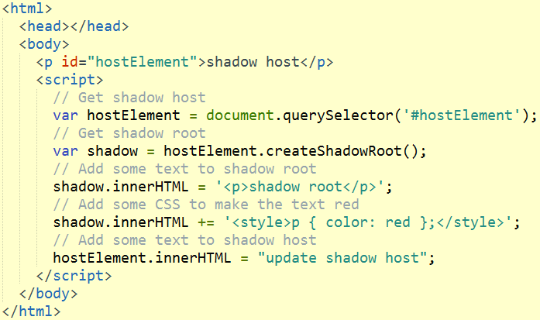
Shadow DOM
DOM tree encapsulation.
Separate Content from Presentation( by the means of shadow root and shadow host)

Slide 16
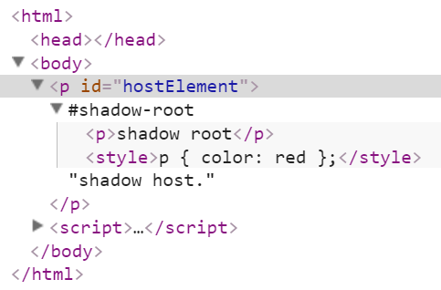
Shadow DOM
How to access content of shadow host from shadow root?
Use html tag content and its property select.

Slide 17
Shadow DOM
Shadow host
<div id="hostElement">
<h2>Introduction</h2>
<h1>My custom panel</h1>
<p>This is the content of the panel.</p>
</div>
Shadow root
<content select=“h1”><content>
shadow.innerHTML = '<p>shadow root<content select=“h1”></content></p>';

Slide 18
Template
HTML <template> element represents a template in your markup
<template> tag is suitable to store content of shadow root.
Its content is effectively inert until activated.
Any content within a template won't have side effects.
Templates can be placed anywhere.

Slide 19
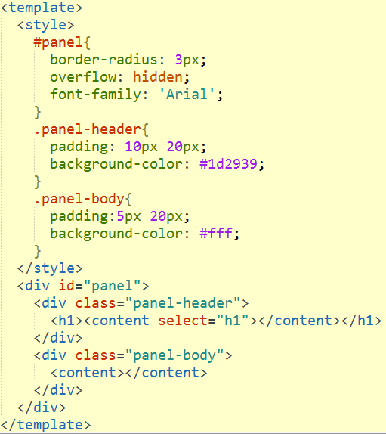
Custom Component - template

Slide 20
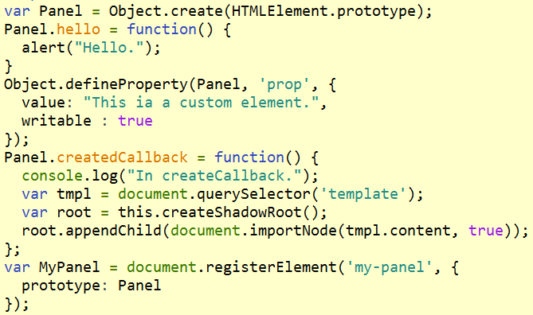
Custom Component - registerElement

Slide 21
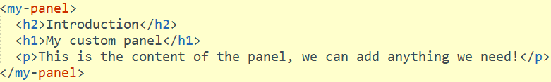
Custom Component

Slide 22
工作计划
完成Calendar的功能。
Gaia现有功能，如UI库、事件处理等；设计模式；CSS界面设计。
Notes:
JavaScript在入门与熟练之间。CSS熟悉语法，缺少实践。
H5熟练：熟悉Gaia现有技术，如UI库、事件处理、现有接口等；深入理解JavaScript语法及ES6新增语法，灵活使用JavaScript设计模式；了解常用JavaScript库的使用，如requirejs、jquery，angularjs；了解常用CSS库的使用，如bootstrap、appframework，能快速设计具有一定风格的CSS布局。完成较复杂的Gaia App开发。
H5精通：了解全部Gaia App的实现及调用关系，灵活使用Gaia现有功能快速完成app开发。深入理解现有JavaScript和CSS开源库。

Slide 23
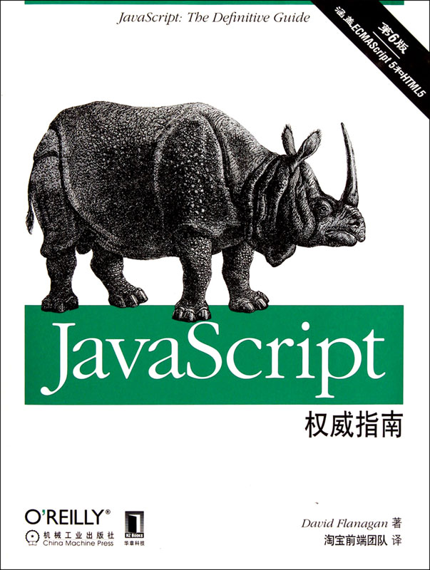
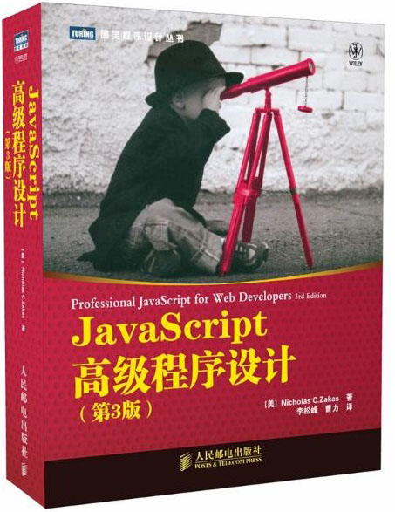

Slide 24
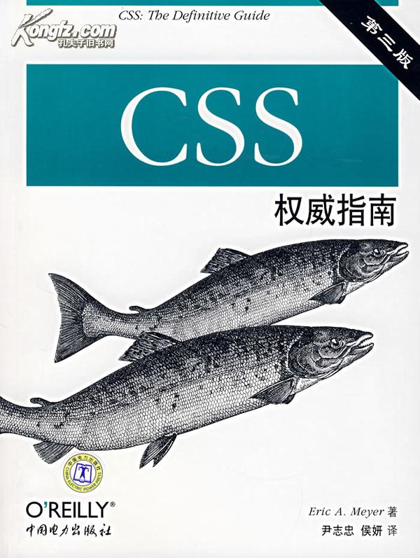


Slide 25
谢谢！

