Slide 1
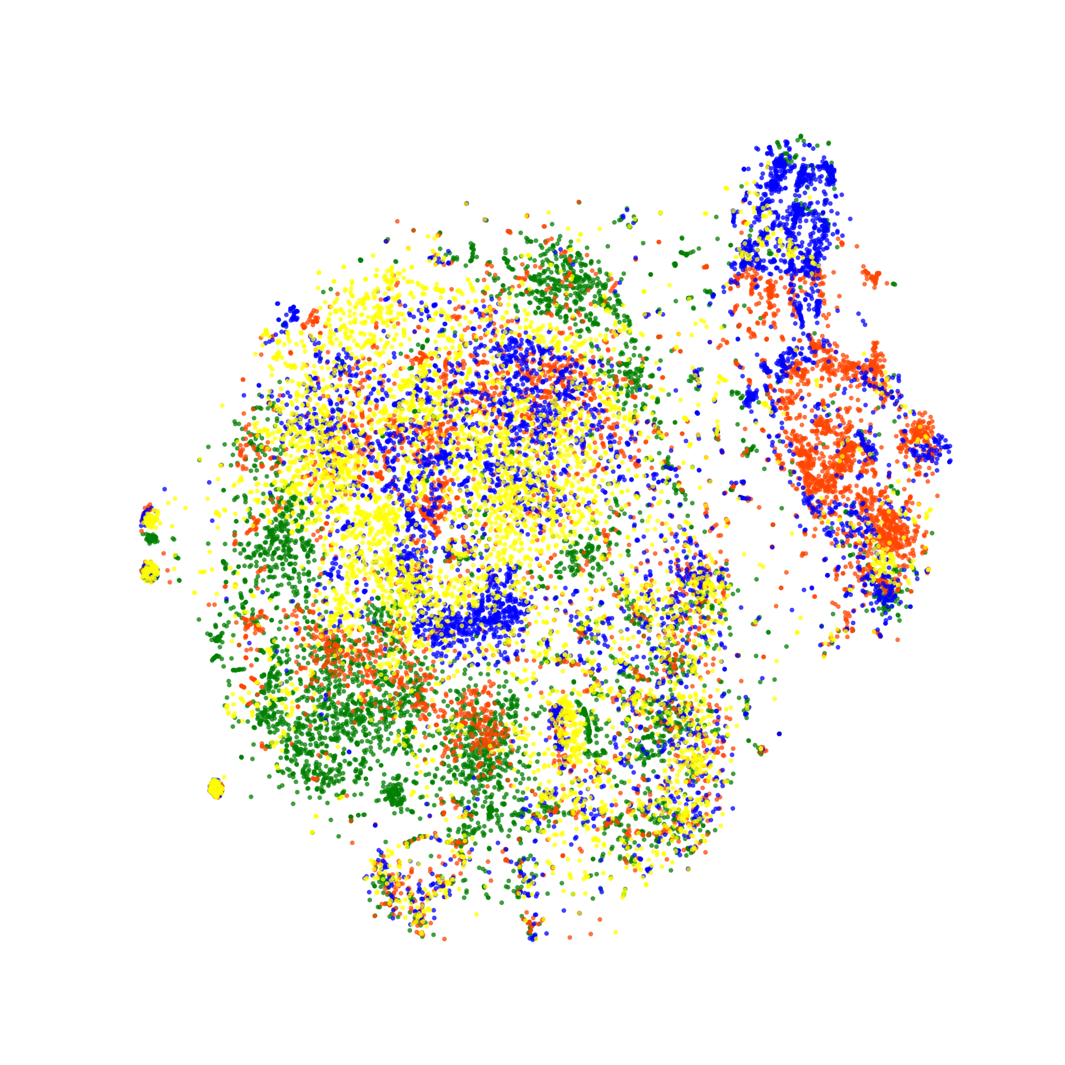
Zoo
Our
Existing1
Existing2

Slide 2
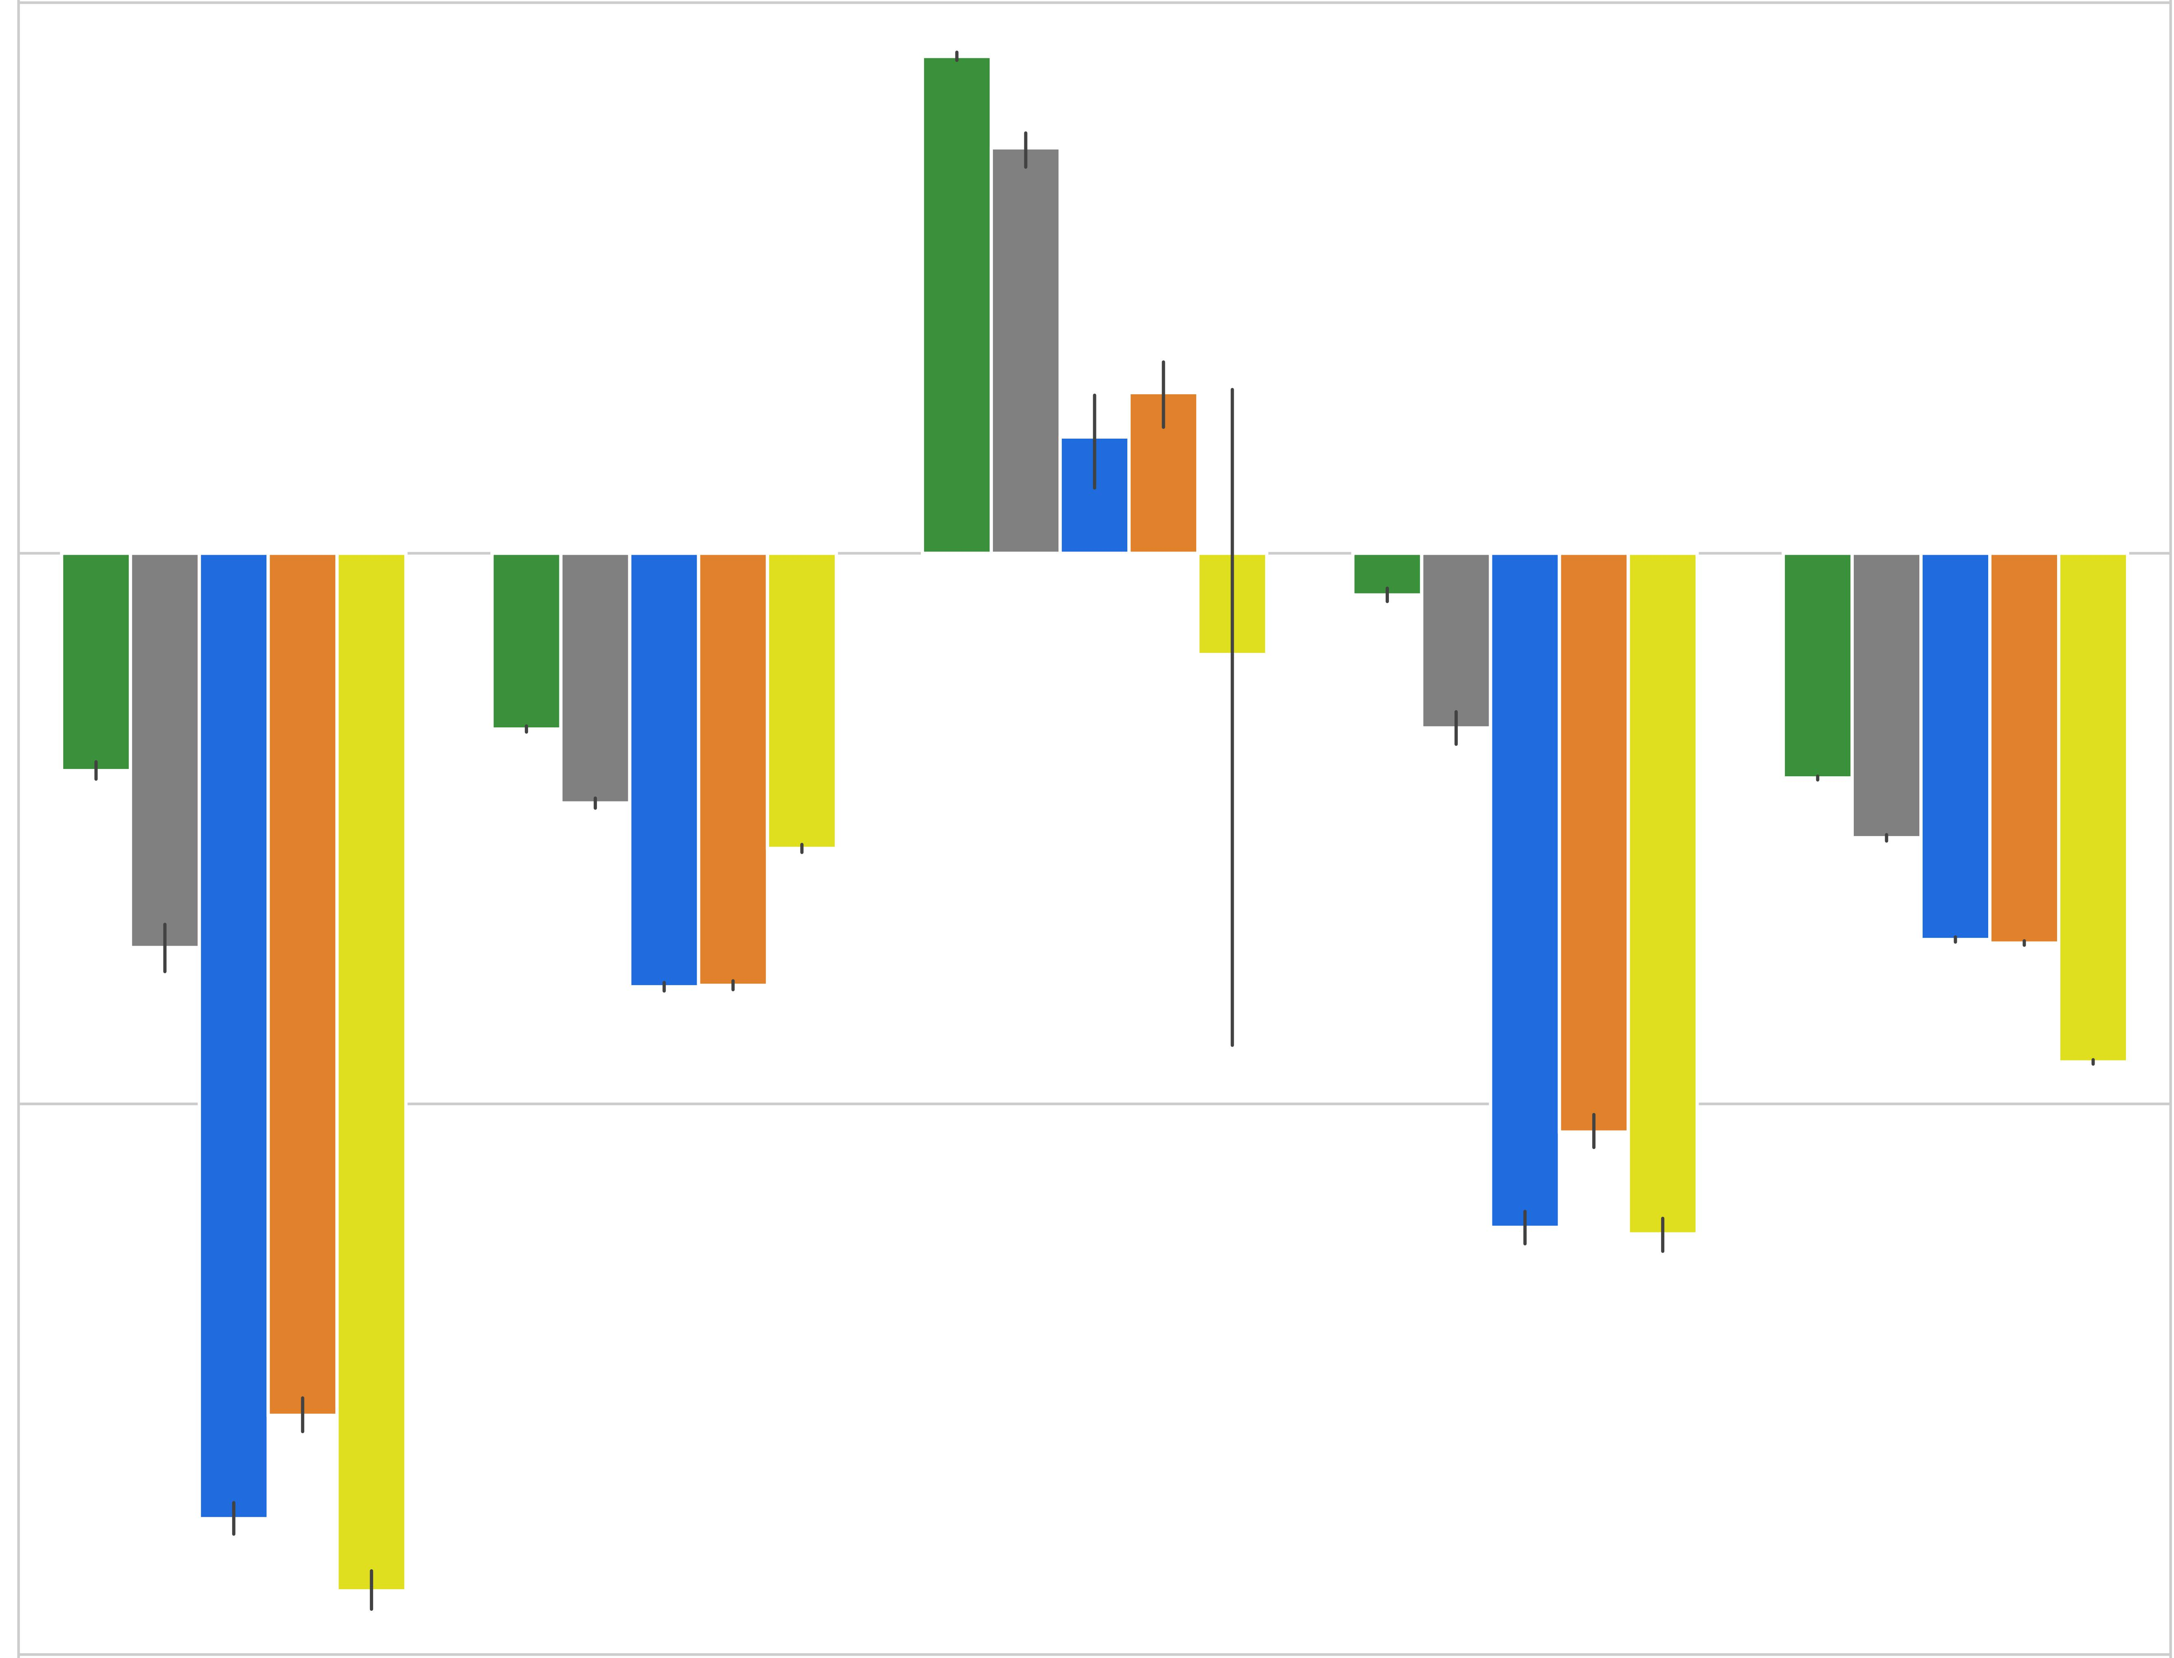
ZooT
Existing1
Our
ZooV
Existing2
200
0
Mean Log Probability
-200
-400
Kick and Defend
You Shall
Not Pass
Sumo
Humans
Sumo
Ants
Run To
Goal Ants

