Slide 1

A Pure Java Implementation of Soar
Dave Ray
daveray@gmail.com

Slide 2
Agenda
What and why?
What's (not) there?
What's new?
Performance
Nuggets and Coal
Demo
Conclusion

Slide 3
What is JSoar?
100% Java implementation of Soar
Open Source, BSD licensed
Runs on Java SE versions 1.6 and higher
Started in Fall of 2008 based on Soar 9.0.1
http://jsoar.googlecode.com

Slide 4
Why JSoar?
It's a fun and educational personal project
"It's like someone who doesn't know how to drive building a car."
- Anonymous

Slide 5
Why JSoar?
Native dependencies are a frequent topic on Soar mailing lists
  System.DllNotFoundException: Unable to load DLL 'CSharp_sml_ClientInterface': The specified module could not be found.
  Native code library failed to load.
  java.lang.UnsatisifiedLinkError:
  libJava_sml_ClientInterface.jnilib
  etc
Notes:
Everyone eventually works through this, but it's a hindrance to getting started and makes people think that Soar is buggy and difficult to work with.

Slide 6
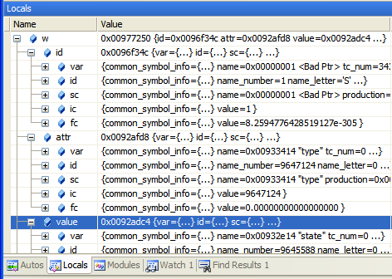
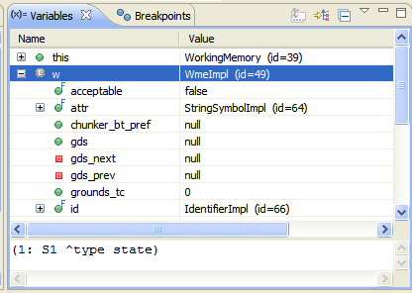
Why JSoar?
Debugging the Soar kernel in C is painful
Unions, pointer tricks, poor tool support
Tests are easier to write and run
Simpler crash diagnosis
Notes:
Symbol unions as shown here are difficult, but you can train yourself to deal with them. RHS actions and other structures that flip low-order pointer bits never get easier to work with.

Slide 7
Why JSoar?
Java is a kitchen sink. Easy access to extensive, often built-in, libraries
Seamless (no SWIG) integration with a growing list of alternative languages
  JRuby, Jython, JavaScript, Scala, Groovy, Clojure, …
  And you thought Tcl was dead ☺
.NET interoperability with IKVM.NET

Slide 8
What's there?
Base Soar kernel (9.0.1)
  Extensive, automated, functional tests to ensure compatibility and prevent regressions
Chunking
Reinforcement learning
Java API
  Encapsulates kernel while still providing access to Soar internals if needed
Notes:
Functional tests are much more extensive and lower-level than what csoar currently has, which provides a level of confidence for kernel hackers that you don't get with CSoar. That said, there's still a lot of room for improvement.
The Java API is (hopefully) as easy to use as SML while still allowing access to low-level kernel details if necessary. SML doesn't have any backdoors.

Slide 9
What's not there?
SML
  No remote debugging
Rete network save/load
Episodic Memory
Semantic Memory
Several small, recent fixes and changes
Notes:
Jon says he'll port small fixes and changes over after Soar workshop craziness.

Slide 10
What's new?
JSoar debugger
Improved concurrency
  One thread per agent
  wait RHS function: no busy waiting for input
    Give your CPU fan a break
"Real" RHS functions
  Multiple args, as symbols
  Return structures as well as primitives

Slide 11
What's new?
Additional RHS functions
  java – Call Java code
  debug – Open the debugger
  wait – Pause the agent's thread until new input arrives
  get-url – Read from a URL
  to/from-xml – Convert XML (e.g., from a URL) to working memory
  All java.lang.Math functions

Slide 12
What (else) is new?
source command works on URLs
  source http://darevay.com/jsoar/waterjugs.soar
SoarBeans – Auto-convert working memory to Java objects
QMemory – Dead-simple, thread-safe input generation
RSoar – Ruby API (w/ example Twitter interface)
  Yet another wrapper for Soar

Slide 13
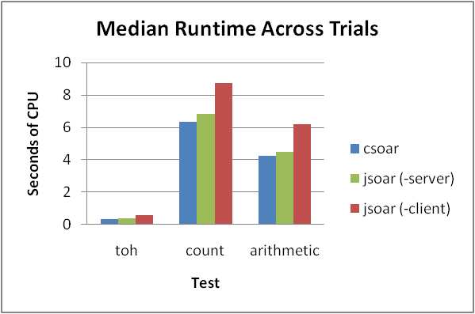
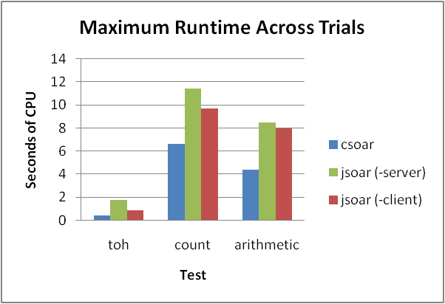
Performance
JSoar fairs pretty well in CPU performance
-server option of JVM provides significant speedup
Significant startup cost seen in "max" graph
See http://code.google.com/p/jsoar/wiki/PerformanceTestNotes20090621

Slide 14
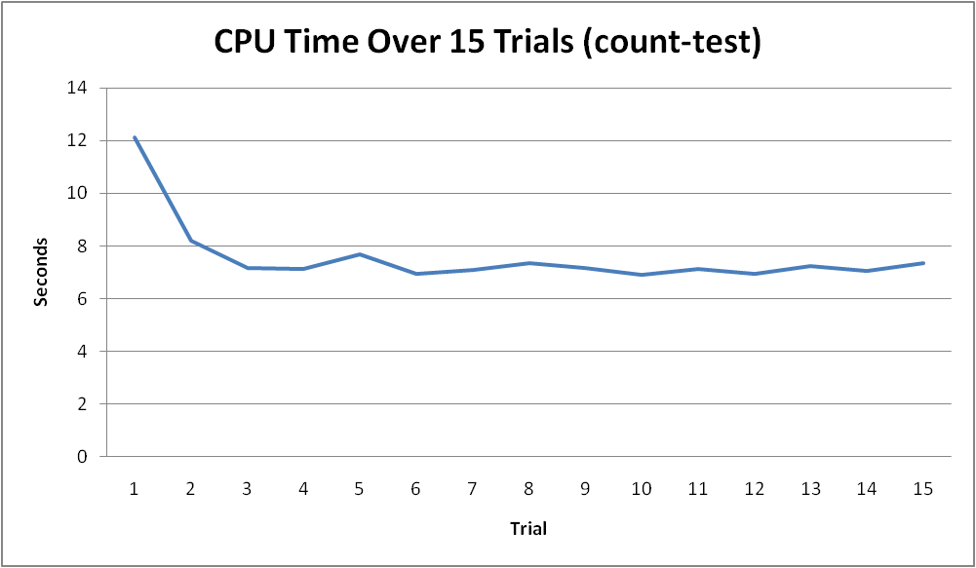
Performance
JVM optimizes at run-time
JSoar gets faster the longer it runs

Slide 15
Future Plans
Port Episodic and Semantic Memories
Finish SML Port (volunteers?)
Investigate memory usage issues
Build a cool demo with a cluster of agents handling requests behind a JRuby on Rails web app (or something)

Slide 16
Nuggets
It works!
Performs better than expected
Jon Voigt: "Develop and debug in JSoar, backport to CSoar"
In use on at least one SoarTech project
Symbol reference counts are gone

Slide 17
Coal
Large memory footprint
Lack of SML support means rewriting interface code
Symbol reference counts are gone, but counts remain on other structures

Slide 18
JSoar Debugger Demo

Slide 19
Conclusion
Please give it a try!
Home: http://jsoar.googlecode.com
Applet: http://darevay.com/jsoar
Blog: http://blog.darevay.com/category/soar/
Thanks
  to SoarTech for supporting this talk
  to Bob Marinier for early, painful debugging and performance testing
  to Jon Voigt for ongoing bug fixes

Slide 20
OVERFLOW

Slide 21
What's new
Quick Memory
Simple, thread-safe input generation
Programmatic, or command-line
> qset block(red).x-location 1
> qset block(red).y-location 0
> qset block(red).color red
> qset block(blue).x-location 2
> qset block(blue).y-location 0
> qset block(blue).color blue
...
> qset block(red).x-location 2
> qset block(red).y-location 1
^io.input-link
^block
^x-location 2
^y-location 1
^color red
^block
^x-location 2
^y-location 0
^color blue
See org.jsoar.kernel.io.quick
Notes:
qset, qget, qrm, and qclear are all just aliases for the qmemory command.

Slide 22
What's new?
Convert any working memory to Java beans
^output-link
^move-along-route
^route-name |alpha|
^desired-speed 100.0
^altitude 35.0
class MoveAlongRoute {
public String routeName;
public double altitude;
private double speed;
public double getDesiredSpeed(){
return speed;
}
public void setDesiredSpeed(double s){
speed = s;
}
}
See org.jsoar.kernel.io.beans
Notes:
Special support is given for handling output commands, but the conversion code is not limited to input/output memory.

