Slide 1

Department of Computer Science and Technology
Indian Institute of Technology, Guwahati
Presentation
on
Access Intensity & Row Buffer Locality-based Data Migration in Hybrid Memory System
Presented by:
Soumya Asati
Mtech CSE (224101046)
Supervisor’s Name:
Prof. Hemangee K. Kapoor

Slide 2
Page
Table of
Contents
I
Introduction & Background
3
II
State-of-art Technique
5
III
Proposed Methodology
8
IV
Evaluations & Results
14
V
Conclusion
20

Slide 3
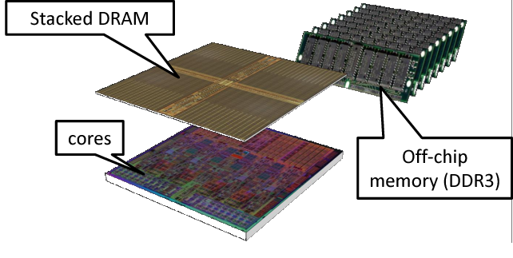
INTRODUCTION
Hybrid Memory System Architecture
Integrates diverse memory types or tiers.
Balances speed, capacity, and latency trade-offs.
Combines faster, smaller memory with slower, larger ones.
This architecture can be utilized in two ways:-
Parallel Architecture
Hierarchical Architecture
Fig 1. Example of HMS

Slide 4
Data Migration:
It refers to the process of swapping data between different tiers of memory in system
It optimize the performance by placing frequently accessed data in faster memory while less frequently to the slower one.
CHALLENGE
Swapping doubles overhead by copying data from both Near and Far memory. Also, latency cost of looking up the remapping address.

Slide 5
State-of-art Technique
RHPM : Relative Hotness Page Migration
RHPM [1] leverages congruence group remapping flexibility.
It identifies hot pages through competition rather than threshold comparison.
The migration is performed only when a new page wins the competition.
Parallel data/metadata fetch with small remapping buffer reduces metadata query latency via locality.
[1] Z. Peng, D. Feng, J. Chen, J. Hu, and C. Huang, “Rhpm: Using relative hotness to guide page migration for hybrid memory systems,” IEEE Transactions on Computer Aided Design of Integrated Circuits and Systems, 2022.

Slide 6
The following are the main implementation rules of the RHPM design
1. Hotness Rule
CGroup page access increments hotness counter for that page, decrements others by 1 within the same group.
2. Migration Rule
Hottest page (Accessed page cntr > NM resident cntr) in CGroup is chosen for migration.
3. Reset Rule
When a new hottest page in a CGroup migrates to NM, reset other pages' hotness counters in the same CGroup

Slide 7
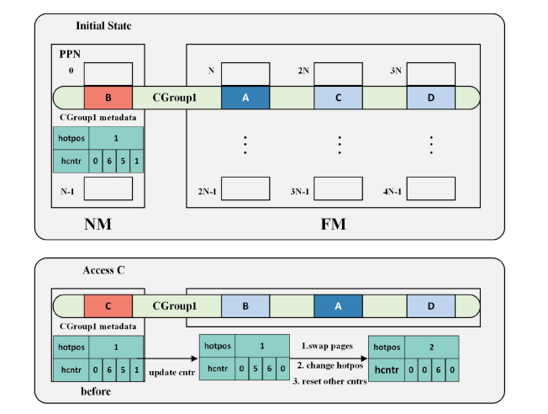
Fig. 2 Example of RHPM design

Slide 8
Proposed methodology
1
2
Which page to Migrate?
When to Migrate?
Row Buffer Locality
Access
Intensity

Slide 9
What is Row Buffer Locality?
Each bank in memory has an internal buffer known as the row buffer.
The fraction of row buffer hits out of all memory accesses to a row is termed row buffer locality.
Row buffer hit latency is consistent across memory types, whereas row buffer miss latency is significantly higher in denser memories.
Migrating low-locality pages to fast memory boosts performance by reducing row buffer misses.

Slide 10

Access Intensity:-
Number of access counts per unit of time is termed as Access Intensity.
Access intensity reflects current memory access behavior, whereas access counts may not.
Helps identify frequently accessed pages within a specific time window.
Crucial for efficient memory management techniques.
Calculate as:-

Slide 11
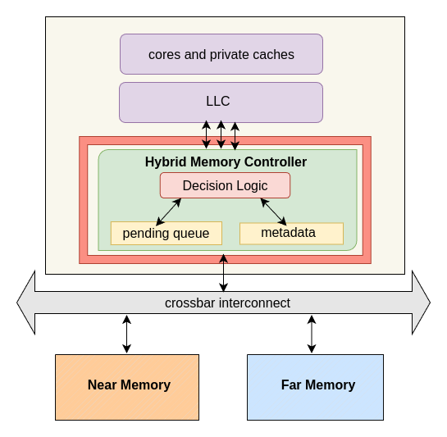
System Overview
Decision Logic :-
This module ensures data accuracy and migrates information based on set rules.
Pending Queue :-
Stores the page reference along with its access intensity of pages which are the candidates for migration
Counters :-
counter[] – Array of access counts of pages
rowMiss[] – Array of row miss counts of pages
AI[] – Array of access intensity of pages
Fig. 3 System Architecture

Slide 12
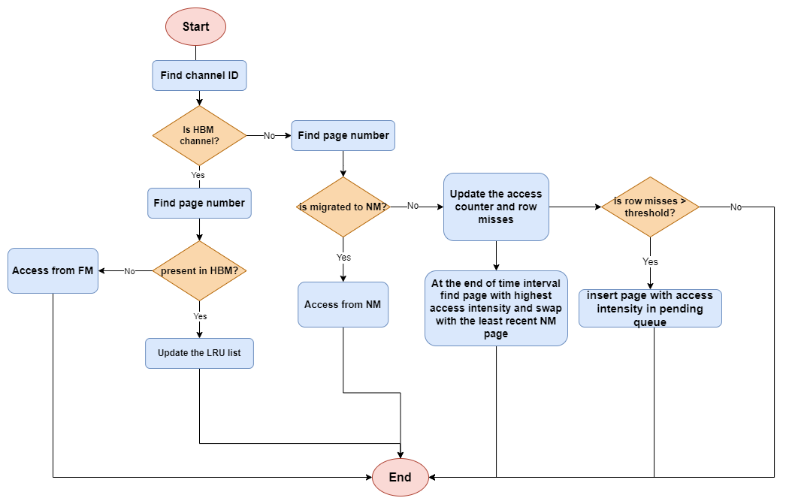
Flow Diagram of Design

Slide 13
EXAMPLE
PENDING QUEUE
P8
P10
P14
P17
P21
AT INTERVAL BOUNDARY HIGHEST AI PAGE SELECTED FOR MIGRATION
rowMiss > missThes
Select Least Recent page from NM for swapping
P7
P8
P9
P10
P11
P1
P2
P3
P12
P13
P14
P15
P16
P17
P18
P19
P20
P21
P4
P5
P6
swapping
FAR MEMORY
NEAR MEMORY

Slide 14
Evaluations & Results
Experimental Setup
Used Gem5 simulator, and utilized SPEC2017 suite for simulation
Selected 6 applications with varied MPKI workloads, which are parest, leela, xalancbmk, cactus, sjeng, lbm
Benchmarks executed with 1 Billion instructions with 250 million warmups
Proportional and random distribution of requests to Near and Far Memory
Memory ratio is 1:7, total 8GB memory used, out of 1GB for NM and other 7GB for FM
Page Size is 256 Bytes, number of times required to read/write a page is 4

Slide 15
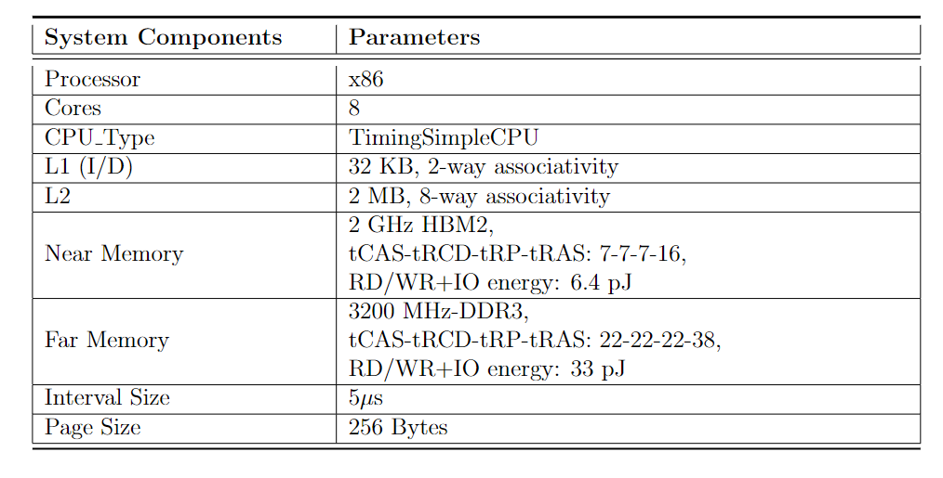
Table 1 System Parameters

Slide 16
We compare our work with baseline configuration and the state-of-the-art technique RHPM,
Baseline: Only Far Memory with total capacity equal to our design.
RHPM: Utilizes congruence group flexibility for migration within groups. Hotness counters track page access, triggering migration if FM page exceeds NM page. Reset rule resets other page counters.
AI-RBL: Proposed migration policy based on row buffer locality and access intensity. Low-row buffer locality pages sent to pending queue. Highest access intensity page selected for migration during interval from pending queue

Slide 17
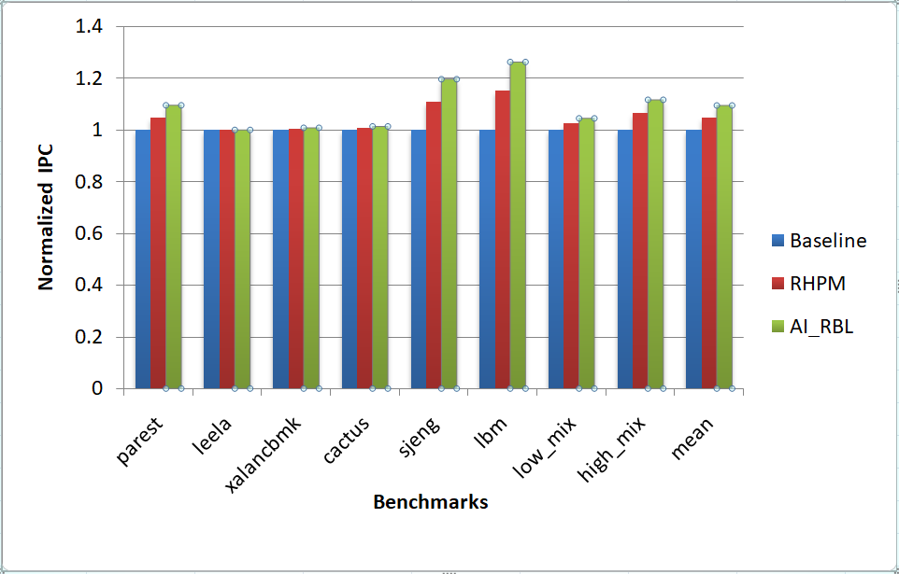
Overall Performance
Graph shown the Normalized IPC for different design approaches across different workloads.
.
Overall, our AI_RBL design outperforms RHPM by 5%, achieving a 10.75% improvement over baseline compared to RHPM's 6.15%
Fig. 4 Normalized Speedup (higher is better)

Slide 18
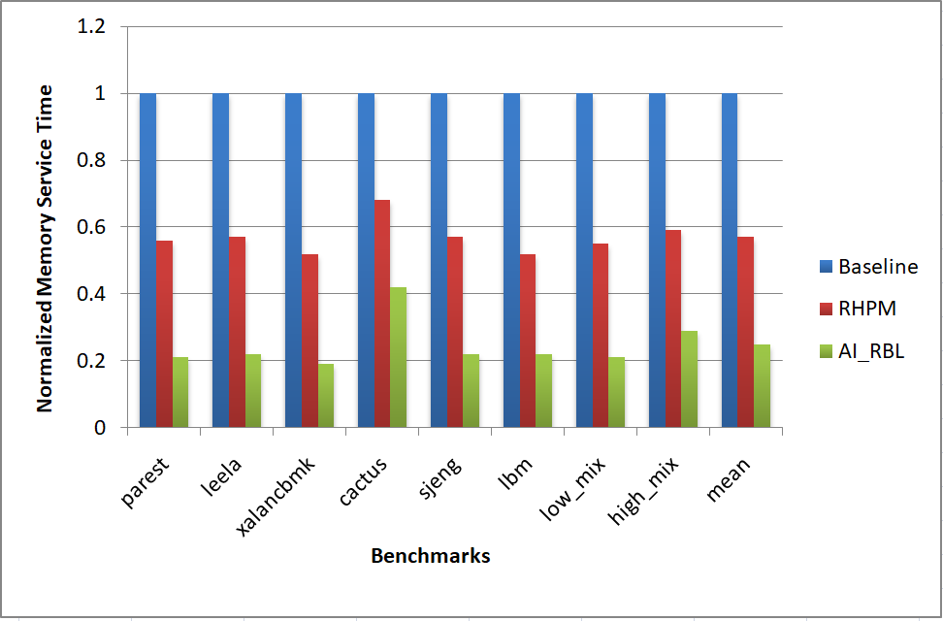
Memory Service Time
AI_RBL improves memory service time, by 74.6% over baseline compared to RHPM's 42.5% improvement.
Fig. 5 Normalized Memory Service Time (Lower is better)

Slide 19
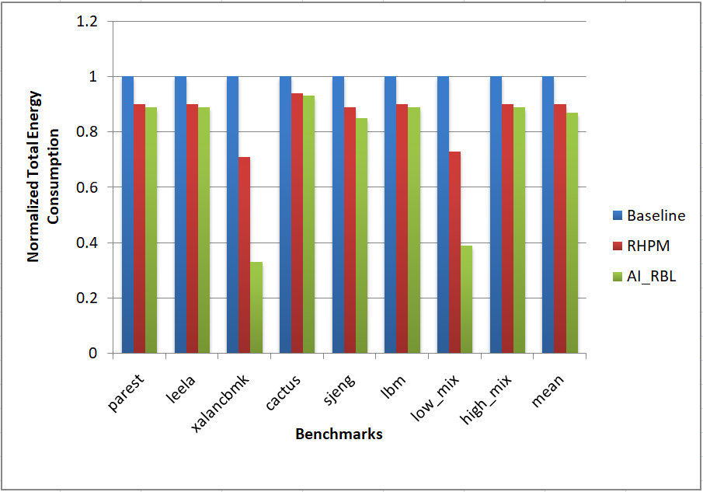
Total Energy Consumption
AI_RBL improves energy by 19.8% over baseline, whereas RHPM improves by 12.06% over baseline.
Fig. 4.3 Normalized Total Energy Consumption (Lower is better)

Slide 20
please write this in short bullet points so that it can be put in slide
please write this in short bullet points so that it can be put in slide
please write this in short bullet points so that it can be put in slide
please write this in short bullet points so that it can be put in slide
please write this in short bullet points so that it can be put in slide
please write this in short bullet points so that it can be put in slide
please write this in short bullet points so that it can be put in slide
please write this in short bullet points so that it can be put in slide
please write this in short bullet points so that it can be put in slide
please write this in short bullet points so that it can be put in slide
please write this in short bullet points so that it can be put in slide
please write this in short bullet points so that it can be put in slide
Conclusion
Modern Computing system adapts hybrid memory systems which combines faster and slower memory aggregating 3D-stacked DRAM and off-chip DRAM
This technology exhibits differences in latency, bandwidth and capacity. Hence, page migration is used to overcome with these trade-offs
Our algorithm, AI_RBL combines row buffer locality and access intensity to find the better candidate of FM to swap with NM page.
Overall its improve performance by 10.75%, memory service time by 74.6% and energy by 19.8%.

Slide 21
Thank you
for listening!

Slide 22
references
M. K. Qureshi and G. H. Loh, “Fundamental latency trade-off in architecting dram caches: Outperforming impractical sram-tags with a simple and practical design,” in 2012 45th Annual IEEE/ACM International Symposium on Microarchitecture, pp. 235–246, IEEE, 2012
J. B. Kotra, H. Zhang, A. R. Alameldeen, C. Wilkerson, and M. T. Kandemir, “Chameleon: A dynamically reconfigurable heterogeneous memory system,” in 2018 29 51st Annual IEEE/ACM International Symposium on Microarchitecture (MICRO), pp. 533–545, IEEE, 2018.
E. Vasilakis, V. Papaefstathiou, P. Trancoso, and I. Sourdis, “Hybrid2: Combining caching and migration in hybrid memory systems,” in 2020 IEEE International Symposium on High-Performance Computer Architecture (HPCA), pp. 649–662, IEEE, 2020
J. Sim, A. R. Alameldeen, Z. Chishti, C. Wilkerson, and H. Kim, “Transparent hardware management of stacked dram as part of memory,” in 2014 47th Annual IEEE/ACM International Symposium on Microarchitecture, pp. 13–24, IEEE, 2014.

Slide 23
E. Vasilakis, V. Papaefstathiou, P. Trancoso, and I. Sourdis, “Llc-guided data migration in hybrid memory systems,” in 2019 IEEE International Parallel and Distributed Processing Symposium (IPDPS), pp. 932–942, IEEE, 2019.
Z. Peng, D. Feng, J. Chen, J. Hu, and C. Huang, “Rhpm: Using relative hotness to guide page migration for hybrid memory systems,” IEEE Transactions on ComputerAided Design of Integrated Circuits and Systems, 2022.
T. D. Doudali, S. Blagodurov, A. Vishnu, S. Gurumurthi, and A. Gavrilovska, “Kleio: A hybrid memory page scheduler with machine intelligence,” in Proceedings of the 28th International Symposium on High-Performance Parallel and Distributed Computing, pp. 37–48, 2019
C. C. Chou, A. Jaleel, and M. K. Qureshi, “Cameo: A two-level memory organization with capacity of main memory and flexibility of hardware-managed cache,” in 2014 47th Annual IEEE/ACM International Symposium on Microarchitecture, pp. 1–12, IEEE, 2014.

