Slide 1


Presentation
on
Semantic Terrain Segmentation
Presented By-
Basu Hela (224101013)
Harsh Verma (224101021)
Himanshu Chhabra (224101023)
Soumya Asati (224101046)
Vaishali Chaudhari (224101055)
Guided By-
Prof. Debanga Raj Neog

Slide 2


CONTENTS:
Problem Statement
Description of Dataset
Related Works
Methodology
Results & Evaluation
Novelty
Deployment
Conclusion

Slide 3
1. Problem Statement
In our problem statement, we considered three robots equipped with different movement configurations; legs, belts, and wheels.
Goal is to develop a Deep Neural Network that performs semantic image segmentation and differentiates between the 4 categories based on robot mobility i.e. legged traversability, belted traversability, wheeled traversability and including non-traversable terrain.
Each robot has its advantages and disadvantages (constraints) in regards to mobility. The primary focus is on what type of robot would suit the task/terrain when several robots with varying mobility are available.

Slide 4
2. Description of Dataset
The name of the dataset, Vale, is inspired by the capture location. Campus Do Vale, The Federal University of Rio Grande Du Sul (UFRGS), Brazil.
This dataset was captured for the purpose of segmenting and classifying the terrain based on the movability constraints of three different mobile robots.
Dataset consists of 600 full HD RGB images of terrains and each image has associated segmentation mask i.e. 600 segmentation mask.
The dimensions of the input image is 480x270x3
Number of classes in the segment mask is 4 which denotes the category based on the Robots mobility.
Yellow – Belted Robots
Green – Wheeled Robots
Orange – Legged Robots
Red – Non Traversable

Slide 5
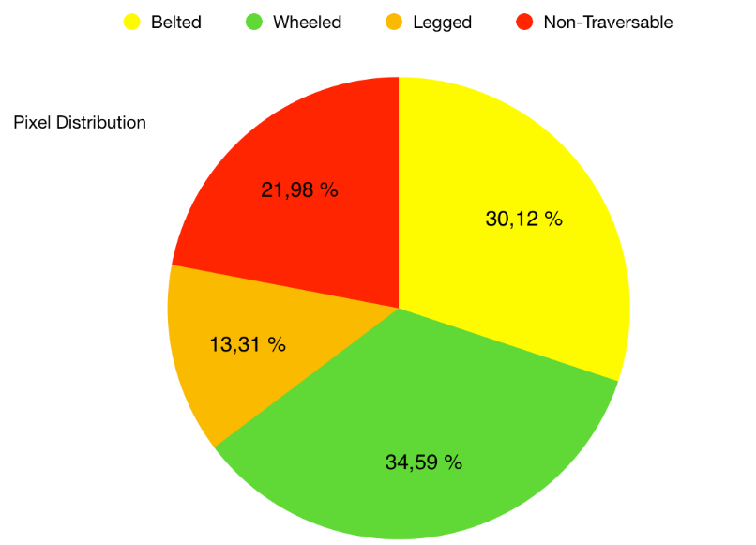
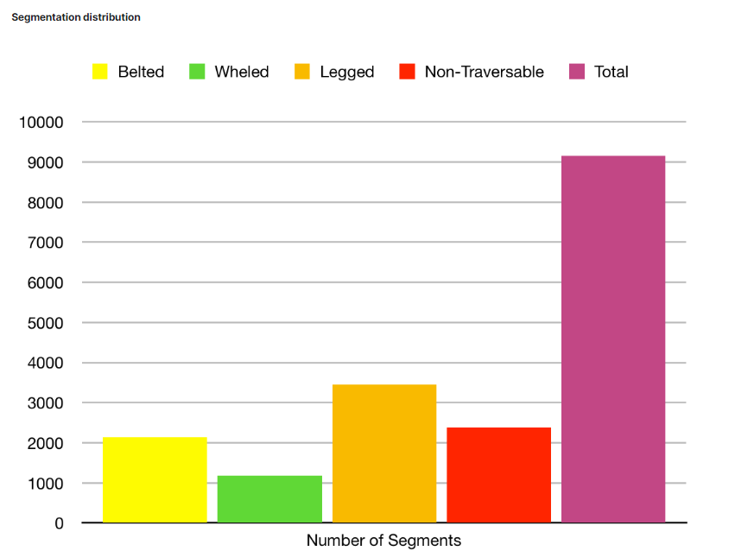
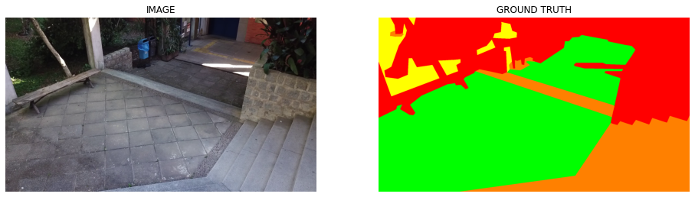
Fig 1. Pixel Distribution
Fig 2. Segment Distribution
Fig 3. Image and its corresponding segmentation

Slide 6
Data Pre-processing:
1. Bad Image Removal:-
One image could not read by cv2, then it is discarded. And each image is partitioned into 16 smaller parts of equal size in both width and height dimensions.
2. One-hot Encoding:-
It used to represent categories of class, i.e. Each pixel will create vector of size 4, value is either 0 or 1, ith entry is 1 if it belongs to the ith class.
3. Augmentation:-
It involves creating new training data by applying various transformations to the existing training data. Augmentation technique includes:
a) Horizontal Flip (p=0.5) b) Vertical Flip (p=0.5) c) Rotation (p=0.5)
d) Elastic Transform (p=0.5) e) Brightness-Contrast (p=0.5)
f) Gamma (p=0.3) g) Coarse dropout (p=0.3) h) Color Jitter (p=0.5)
4. Train-Test Splitting:-
Size of train data is 479 (80%)
Size of validation data is 60 (10%)
Size of test data is 60 (10%)
5. Data Loading:-
Here we have loaded the train and validation data using data loader where batch size is 16 and the shuffling is set to true.

Slide 7
3. Related work
We have taken references from the research paper “U-Net: Convolutional Networks for Biomedical Image Segmentation”
-> In this paper author proposes a deep convolutional neural network architecture called U-Net for biomedical image segmentation tasks for grayscale images.
-> Whereas, in our work we have taken the full HD RGB images of terrains and modify the architecture based on our requirements.
In our work, we also followed the below approaches for Batch Norm and Attention.
Batch Normalization: Accelerating Deep Network Training by Reducing Internal Covariate Shift
https://medium.com/mlearning-ai/self-attention-in-convolutional-neural-networks-172d947afc00
Attention mechanisms help to address limitation by allowing the network to learn to focus on the most informative parts of the image while ignoring irrelevant or noisy regions.

Slide 8
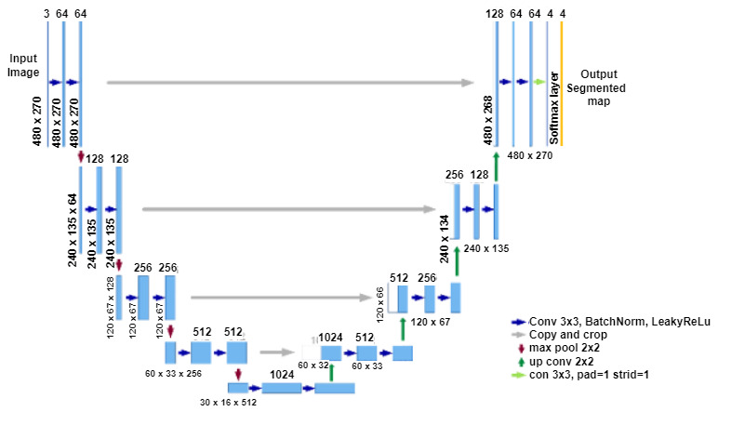
4. Methodology: UNET
We chose the UNET architecture due to its effectiveness in handling complex visual tasks and its ability to learn features automatically.
Fig 4. U-Net Base Model

Slide 9
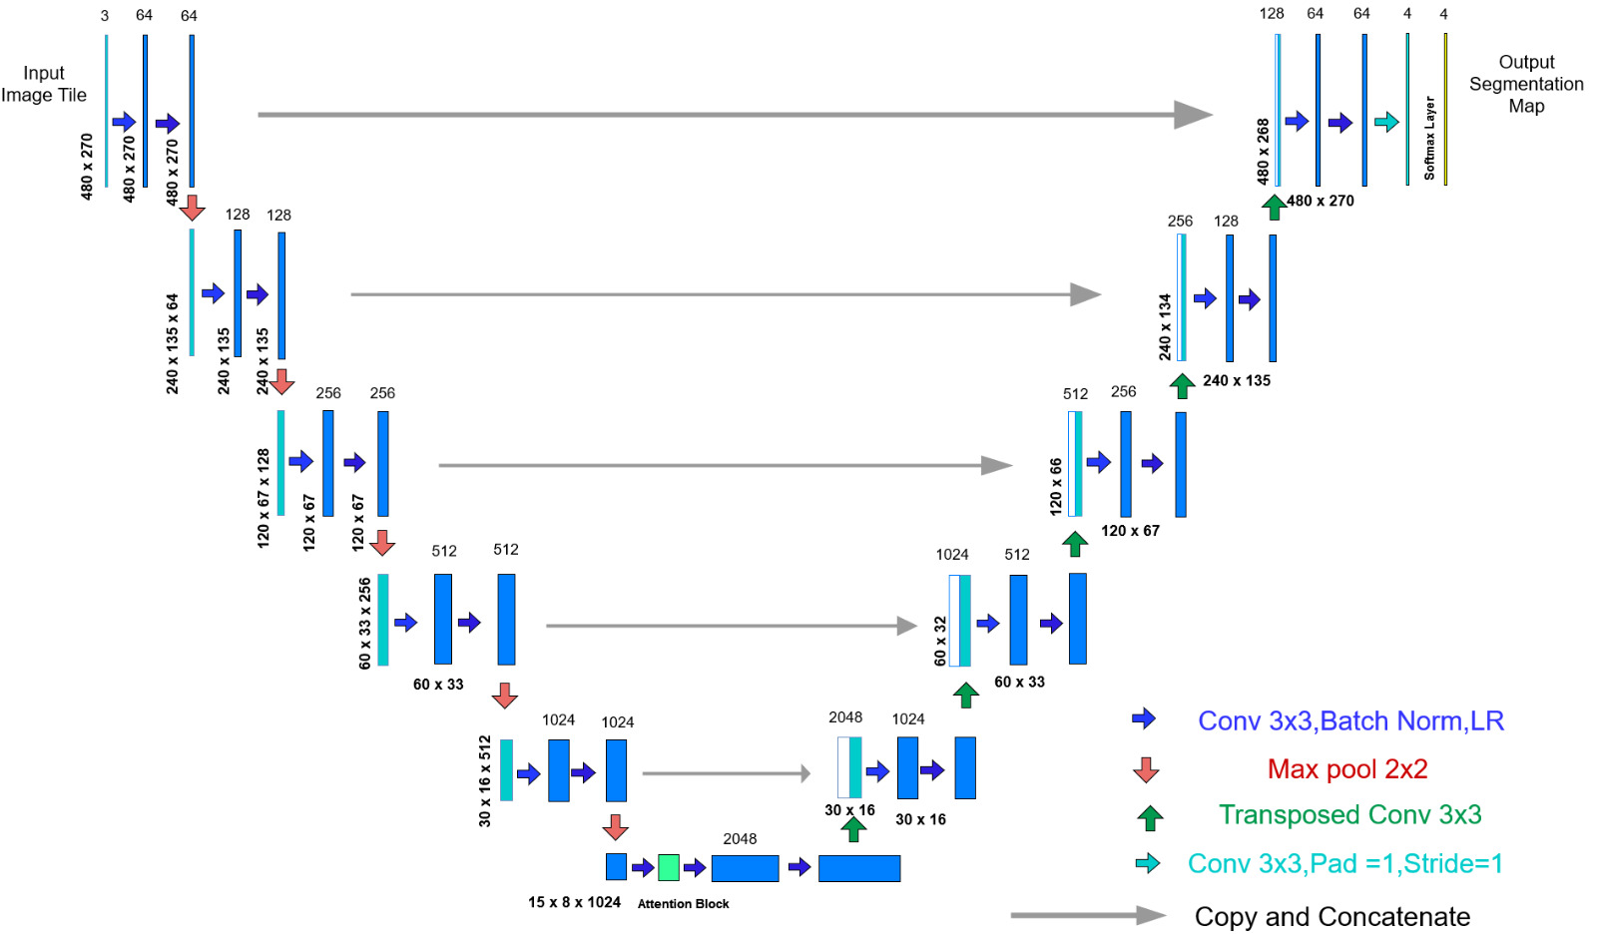
Fig 5. U-Net Model 1

Slide 10
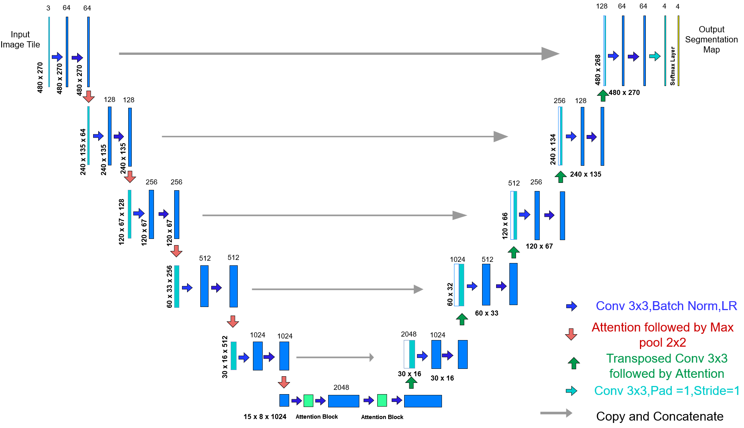
Fig 6. U-Net Model 2

Slide 11
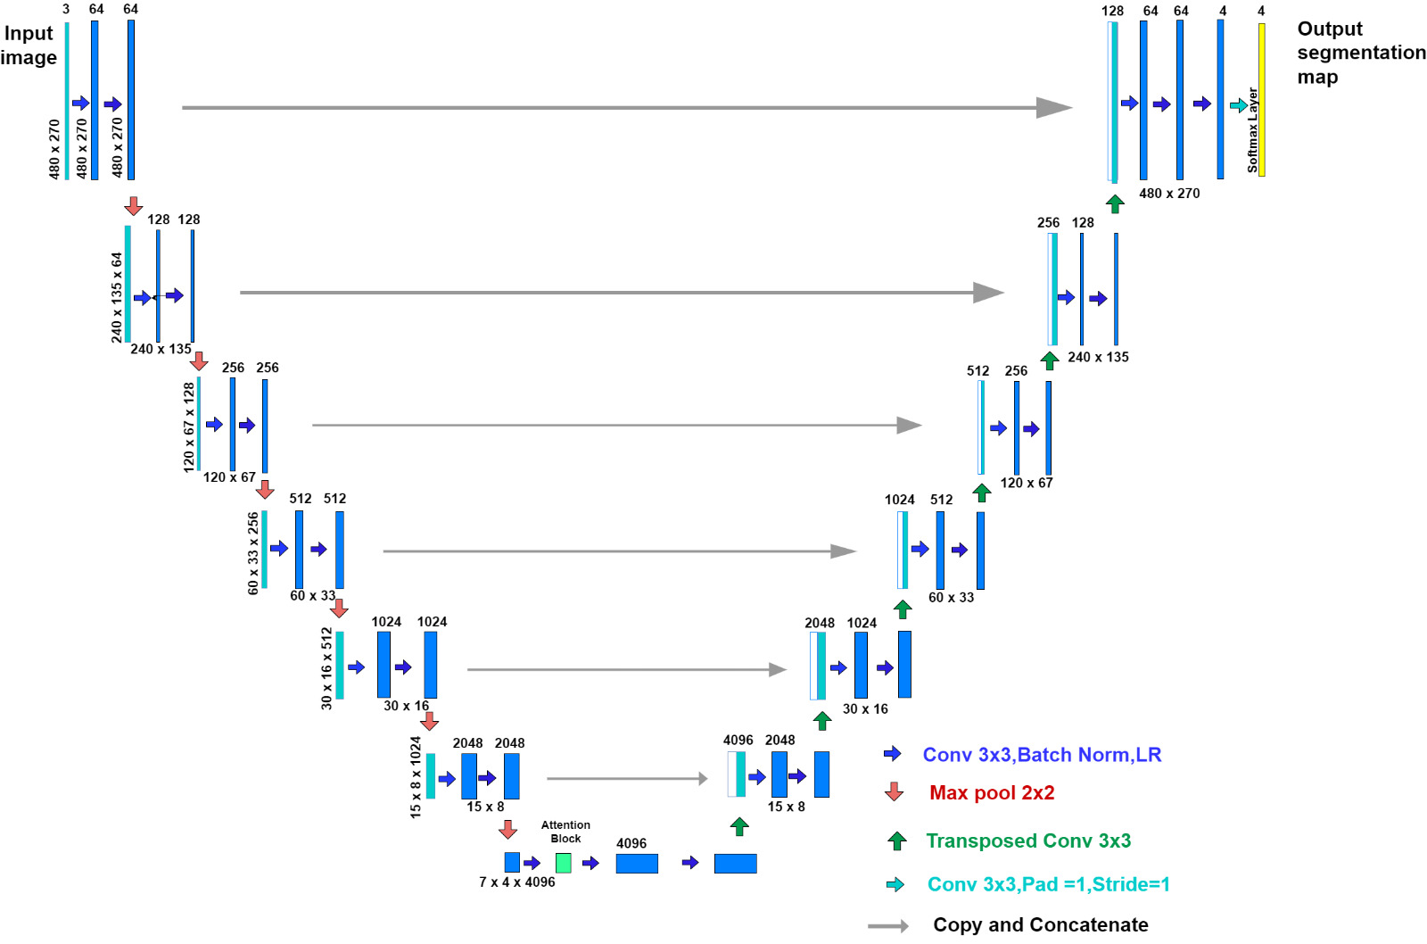
Fig 7. U-Net Model 3

Slide 12
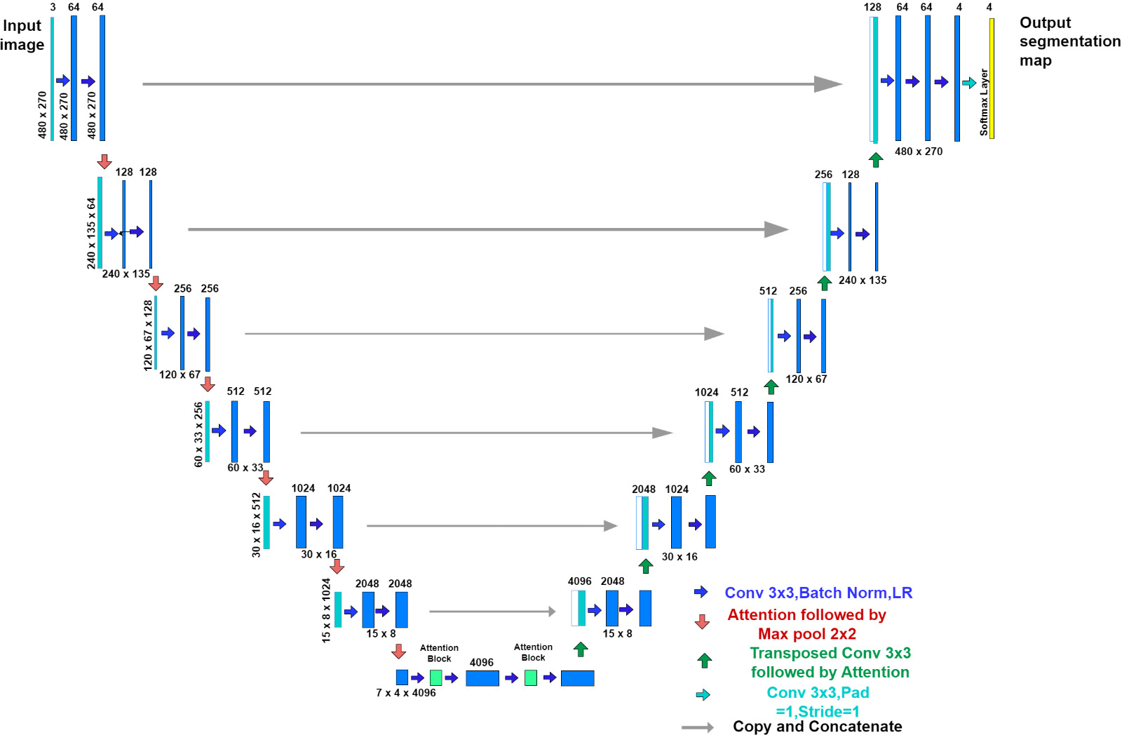
Fig 8. U-Net Model 4

Slide 13
Structure of U-Net Architecture
The U-Net architecture consists of an encoder and a decoder, with skip connections that enable the decoder to access feature maps from the encoder at multiple scales.
The contracting path follows the double convolutional layer, after each conv layer there is a batch norm layer and the activation function Leaky ReLu is used. The max pooling is performed to halve the size and this process is performed 4 times.
In the expansive path, the image is going to be upsized to its original size using transposed convolution after that image is concatenated with the corresponding image from the contracting path using skip connections
At last, after getting the 4 out channels and then applying soft max function along the channel dimension.
We have used the optimiser Adam and weight initialization done using Xavier Normal weight initialization for conv & convTranspose and constant initialization for Batch Norm.
Loss Function is Cross Entropy Loss
Learning rate =0.005
Also, Gradient clipping is used where L2 normalization of the gradient should be less than equal to 1.6 (<= 1.6)

Slide 14
5. Results & evaluation:
Evaluation Metric: This is for the validation phase
1. Accuracy: It is given by the number of correctly classified examples divided by the total number of classified examples.
Accuracy = No. of correctly classified pixels/ Total no. of pixels
EPOCHS | Mean Training Loss | Validation Accuracy
25 | 8.127 | 81.17
50 | 3.047 | 86.67
75 | 1.890 | 88.68
100 | 1.570 | 89.19
Table 1. Results of Validation from base Model

Slide 15
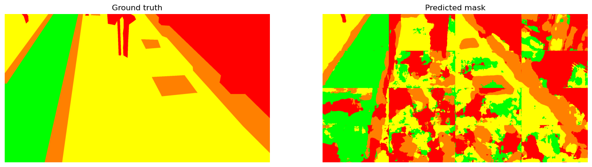
Fig 9. Example output of an image in test set

Slide 16
2. Dice Score : It can be calculated as below
Dice Score = 2 * Intersection(Truth and Predicted) / (Ground Truth + Predicted)
MODEL | Mean Dice Score (MDS) | Accuracy
1 | 0.60 | 72.17
2 | 0.598 | 73.54
3 | 0.57 | 71.88
4 | 0.636 | 74
Table 2. Comparison results of different models
Note, we are using step learning rate scheduler with learning rate of 0.01, step size is10 and gamma is 0.1
Attention is used to reshape the features from previous hidden layer which helps to improve the dice score.

Slide 17
6. NOVELTY
To further improve the performance of our semantic terrain segmentation model, we introduced our own U-NET like architecture, dividing images into equal parts to fit the input size, also applying
- Multi-class segmentation
- Batch Normalization
- One-hot-encoding of segmentation mask
- Leaky ReLu
- Gradient Clipping.
- Xavier Weight Initialization
- Self Attention
The UNET approach is effective for several reasons:
Because of Architecture, Skip Connection, Data Augmentation
Overall, the UNET approach has been shown to be effective for semantic terrain segmentation.

Slide 18
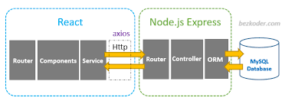
7. Deployment
We will be using a client-server architecture using React on frontend and Node.js based Express.js framework in backend for exposing apis related to uploading of images, segmentation and classification.
Node server written in backend spawns a child process for executing ML model written in python and getting the output via executable shell script.

Slide 19
CONCLUSION
To address the problem of semantic terrain segmentation for robots with different movement configurations, we proposed a Deep Neural Network based on the UNET approach.
Our methodology involves the use of a convolutional neural network that performs pixel-wise segmentation of terrain images into four categories based on robot mobility.
Our work contributes to the field of robotic mobility and terrain analysis, and has the potential to impact a wide range of applications.
Future research can focus on further improving the accuracy and robustness of our proposed Deep Neural Network and exploring its applicability to other types of terrain and robot configurations.

Slide 20


