Slide 1
Slide 1
Welcome to PPT Navigator!

Slide 2
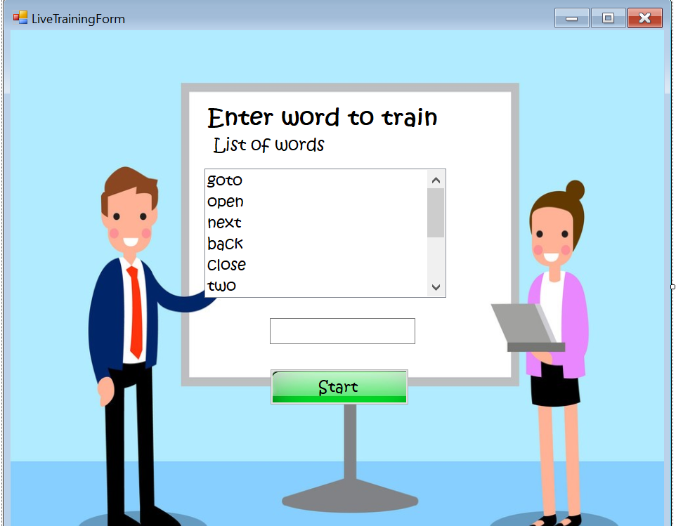
Slide 2
This application helps user to navigate ppt without using hand!!!

Slide 3
Slide 3
Let’s test.

Slide 4
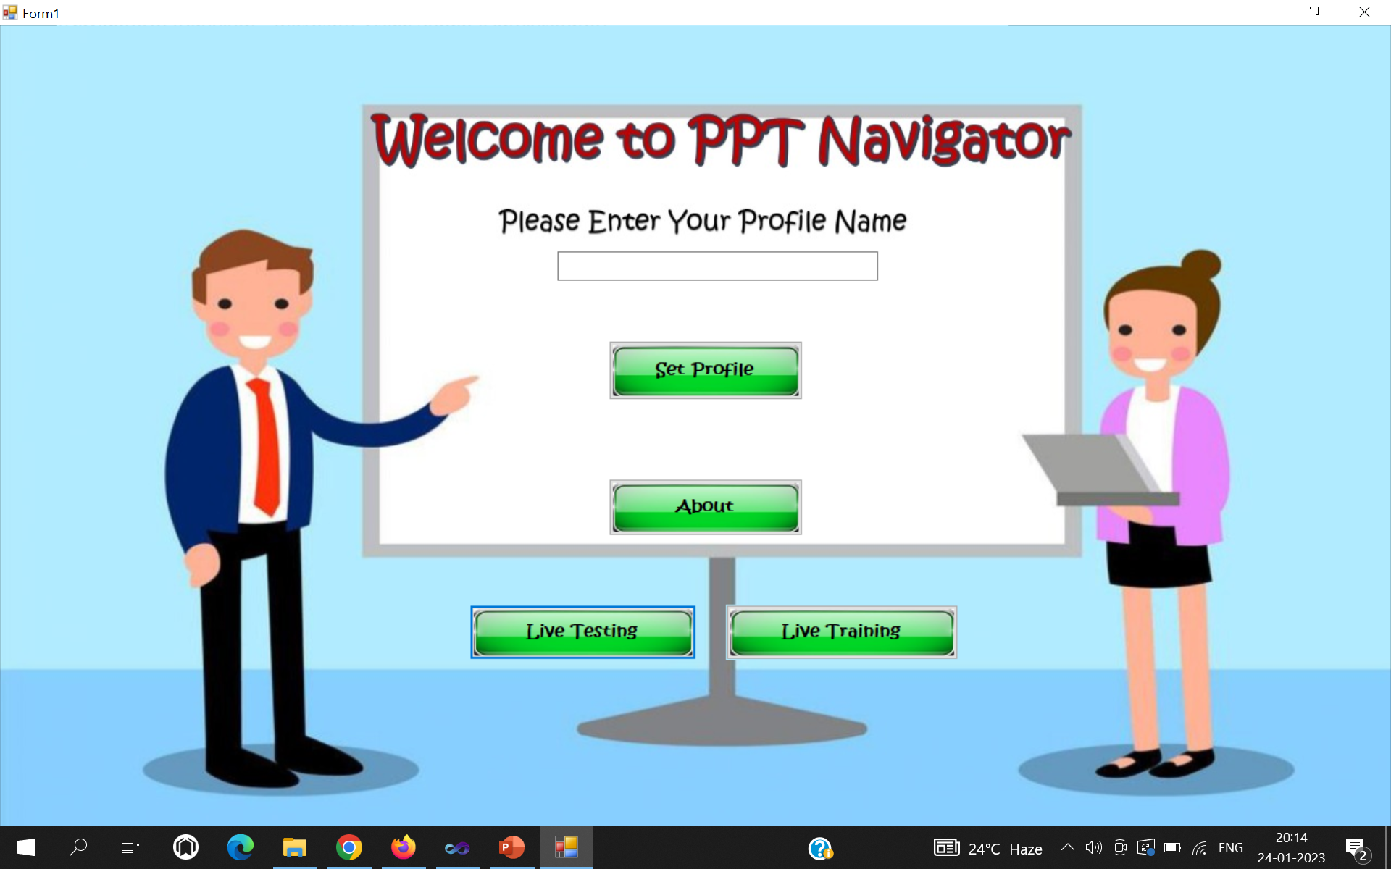
Slide 4
User can move to any slide using speech command!

Slide 5
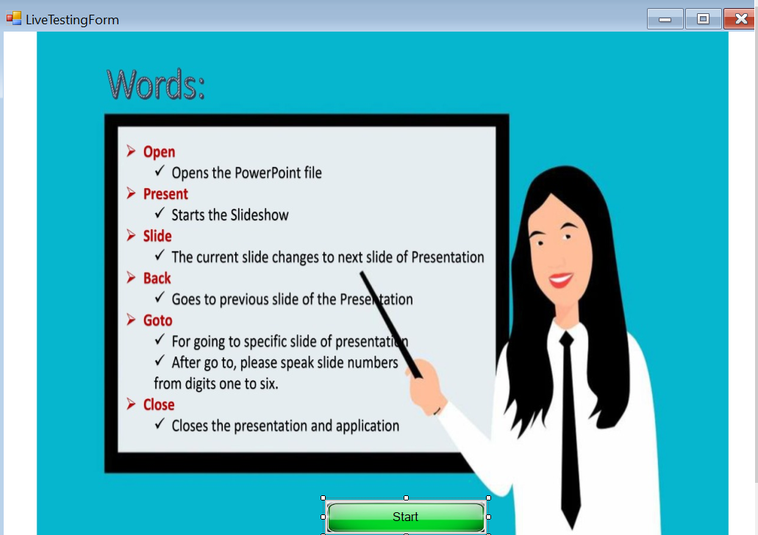
Slide 5
Let’s have a look.

Slide 6
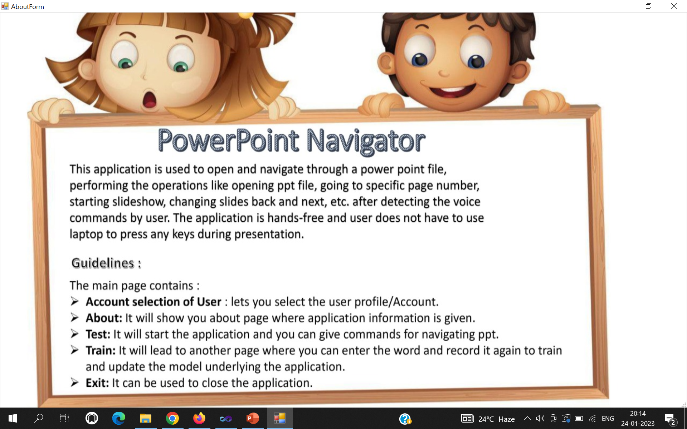
Slide 6

Slide 7
Slide 7

Slide 8
Slide 8

Slide 9
Slide 9

Slide 10
Slide 10

Slide 11
Slide 11

Slide 12
Slide 12

Slide 13
Slide 13

Slide 14
Slide 14

Slide 15
Slide 15

