Slide 1
Java – for beginners
EmbedIT - Brno
31.5.2022
Jan Kovář

Slide 2
Content
About Java
Java syntax
Java programming
Types, controls, exceptions, …
OOP
Spring

Slide 3
What is (not) “Java”
compiled
interpreted
object oriented
typed
the island
simple
popular
motorbike
hard to learn
similar to JavaScript
memory consumer
cross platform
easy to learn
multithreading

Slide 4
Java from 1996 (from SUN now ORACLE)
Object oriented language
Interpreted language
Every *java file is compiled to *class file and interpreted in JRE (java runtime environment – JVM (java virtual machine)
Currently there are two main streams – paid and open version
(OpenJDK)
> GraalVM
On JVM runs also:
Scala, Groovy, Kotlin, Closure, …

Slide 5
JRE / JDK
JDK – Java development kit > contains libraries (already compiled “core” java files and sources for actual development of the app)
You can actually write code in notepad and compile the code yourself – but most convenient way is to use some workplace
Compiler - javac
JRE – runtime environment > contains
Java virtual machine (JVM) - java
(other supporting libraries needed to run the compiled code)

Slide 6
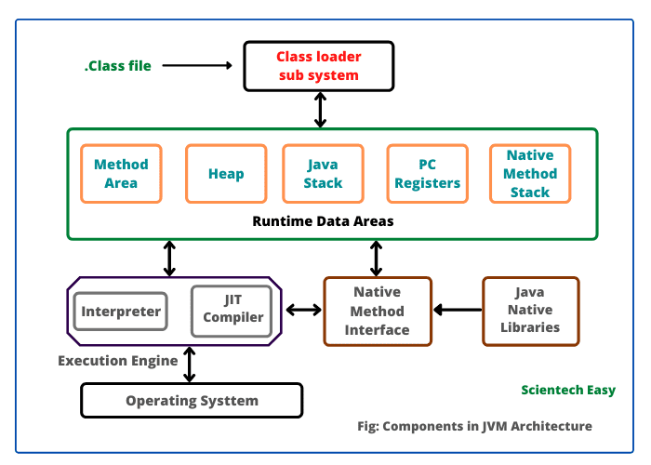
How does Java program run

Slide 7
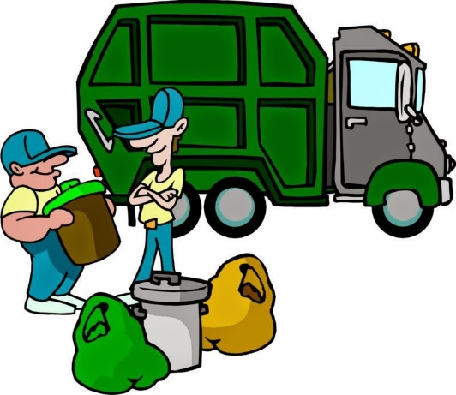
Garbage collection
build-in Java memory management
ensures cleanup of Heap memory
runs in JVM independently of the user code – cant be called manually
< cant be scheduled, cant be stopped
Can throw OutOfMemoryError – no more heap to use

Slide 8
Java syntax
Java is case sensitive
Class and methods
Names should start with letter. Java uses camelCaseName for inner (not methods) names
Identifiers
Begins with letter, can’t with number
Keyword cannot be used as identifier: (for, int, super, void…)
Line of code ends with ; or with “newline” symbol and continues (for example multiline strings)
(blank lines are ignored)

Slide 9
Java syntax
Object
Representation of real-life thing (or function) with its behavior
Car, cat, person, bank, .., calculator, counter,.., client / server
Class
Recipe how the “instance” of the object will be looking like
Defines object state and behavior
Methods
Access points to object behavior – you write logic into this part of class.
Instance variables
Represents inner state of an object instance.
Notes:
test

Slide 10
Class
Contains
Local variables
Inside methods – for temporal count / behavior process, not available outside the object
Instance variables
Inside class – are available in the object and can be accessed
(Class variables)
Methods
for access variables
for behavior

Slide 11
Method
Performs an operation in the program
Usually sits in object
Modifier + return type + method name + parameters
Then body
Methods cant have methods as return type or parameter
Method is called on created instance or as class method
Method can call another method in its body
Java passes parameters by value – makes copy of the parameter and inside the method is “local copy”
Can point to same object (by reference) or primitive type are in “cache”
Notes:
test

Slide 12
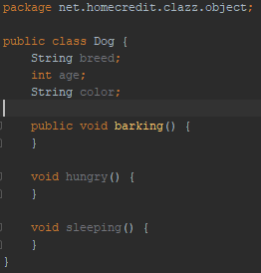
Object
Class Dog
Have breed, age and color properties
Can bark
Is also vital through hungry and sleeping methods
(note this Dog can’t bite – do you now how to teach him ? ☺)

Slide 13
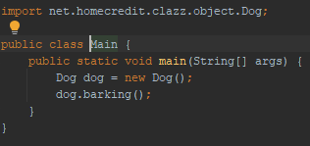
How to run Java program – create Object
Every Java code needs “main” entry point
Old days – on servers, like WLS need some runtime and context – most likely servlet context. WLS started and grabs this and makes your Objects new instances
Nowadays (and also pure java run) – there is a Main class that has “main” method that starts your “run”

Slide 14
Basic data types
Primitive types
byte, short, int, long, double .. char (in Unicode)
- For most cases int and long is suitable.. byte / short are used to save memory
Reference data types
Any “new Object” has its “reference” in the memory.
Dog dog = new Dog() > red variable dog is a reference data type of Dog pointing to the memory where Dog instance is.
Default value for reference variable is null
Reference variable can point to any object of the declared type, e.g.: dog variable can reference Terrier same as Bulldog
Notes:
test

Slide 15
Modifiers and operators
Access control
private > no modifier > protected > public
Non access control
Static – belongs to Class
Final – can’t be modified (e.g.: method overriding)
Abstract – is not known exactly > must be implemented
Synchronized and volatile – for threads and concurrent use
Arithmetic operators (+,-,*,/,..)
Relational (==, ><, !=) .. Can you spot difference: == vs equal() ?
Logical (&&, ||, ! )
Assignment operator = .. Can be +=, -=,…
Notes:
test

Slide 16
Flow controls
Loop
While loop (and “do ... while” loop). Can you spot the difference ?
For loop
Exit from loop
Break > breaks current loop (or switch) and continues after the last loop statement
Continue > breaks execution of the loop and test next condition immediately
Decisions (conditionals)
If, then, else
Switch
Ternary operator a > b ? c : d
Notes:
test

Slide 17
Immutable types
Object, that can’t be changed during its lifetime
primitive types, characters, Strings > because primitive types exists in “cache” and can’t be “recreated”
(https://www.javatpoint.com/immutable-string)
all wrapper classes (Integer, Boolean, Short, … )
Immutable class
Must have final declaration (can’t be recreated)
No access methods (getters, no public properties)
A constructor (or initialization method) must set all internal properties
PROS: as key to maps, saving memory, good for multi threads,…
Notes:
test

Slide 18
Arrays, Maps, .. Collections
Arrays
Typed as []
Or object as Array
Collections – interface – mostly used for its useful methods (Iterator interface, add, remove, count, … )
List – bunch of elements with no order but same “type”
ArrayList, Stack,…
Queue – ordered list
Set – can’t contain duplicates, one null value only
Map – has key and value
HashMap
Notes:
test

Slide 19
Exceptions
Two types (and error)
Checked – if the program throws an checked exception user (developer) must react to this exception and solve it
IO exceptions,,.. or custom > extends from Exception class
Unchecked
Bubbles through the app from point of occurrence to the “entry” point of the app (thread) > extends from RuntimeException
(ERRORS > can be declared, internal on JVM level
runtime errors > dividing by zero, ..
compile time errors > bad (type) statement assignment, missing part of code syntax, …
Custom (extends from Exception > mostly RuntimeException to signal some fault in the running app)
Notes:
test

Slide 20
Try, catch, finally > throw exceptions
try {
run the code in the “check” spy
} catch (…) { // can be omitted > but why ?
when the … exception occurs, it goes here
} finally {
run always after the try block – even when no catch occurred
(only one exception > when the thread is “destroyed” > e.g.: signal stop or something this finally is not executed; or JVM crashes (out of memory); or deadlock in try block
}
throw > throw new NPE, RE, ERROR
throws > void read() throws IOException
Notes:
test

Slide 21
All the other stuff
IO > provided by various util classes
Regular expressions
Date and time
example: System.currentTimeMillis()….
Enum type
Set of constants used as fixed on first sight recognizable variables (types)
JDBC
REST / WS (networking)

Slide 22
OOP
Object oriented programming
Encapsulation, inheritance, interface, abstraction, polymorphism.
Can a dog be an animal and mammal together?
Can a dog fly?
… let’s see.

Slide 23
Encapsulation
Every object has right to hide its data
variables are declared as private
public access methods are provided to view and modify the variables
The fields can be then “read only”.. a class have control of the stored values
Notes:
Test az po slide 27

Slide 24
Inheritance
IS-A helper world.. Dog is-an animal, rose is-a flower, car is-a vehicle.
Every object is-a someone child – at least from basic class Object
Object can “extend” or “implement” its parent.
has-a relationship determines dependency / encapsulation of reference variable inside the object
Notes:
test

Slide 25
Interface
keyword “interface” in the class declaration
can’t have: constructor, instance fields
can: extend multiple interfaces, static final fields (constants)
object can “implement” any number of interfaces
(sometimes used just as a “marker” > Serializable for example)

Slide 26
Abstraction
keyword “abstract” in the class definition
can’t: be final, cannot be instantiated, may contain methods with body or just declarations of methods.
why we use?
if we don’t know the exact implementation when we design the program / API / …
Object “can not” extend multiple abstract (nor regular) classes. (we can not make flying dog) or can we ?

Slide 27
Polymorphism
Object can take on many forms according of what type it is. It uses inheritance to achieve this.
We can make dog signing instead of barking
We can make snake fly
There are many ways how to do this
Compile time polymorphism > overloading of methods
Runtime polymorphism > overriding
Notes:
Test az po slide 27

Slide 28

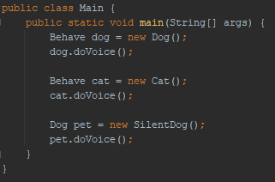

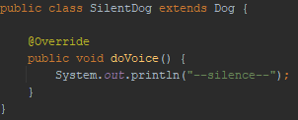
Polymorphism

Slide 29
Coupling
The term when one object is dependent on (in) the other
Loose coupling
Whenever the one class needs to be changed, the other does not care:
Classes are dependent via interface
No property of one class is instantiated in the other with “new” construct
Or no class dependency – the two are separated. Accessed only via access methods
Tight coupling
When one class is changed, the other needs to be changed (modified) as well.
Direct inheritance via “extend” class method
Objects created in the other ones

Slide 30
Spring (IOC)
IOC – container to manage objects created for purpose
objects created / managed there are known as “beans”
the “recipe” of that creation called as context
There can be a lot of types of beans:
Services – contains logic of the app
Repositories (persists objects via JDBC to … )
Various network templates: REST, WS
Various listeners: KAFKA, Rabbit, JMS, …
and other stuff like: IO, batch, security,

Slide 31
WHY Spring?
IOC pattern helps to abstract the need of concrete implementation through the interface.
When dependencies (remember loose coupling) are needed
Is widely used across the community
Well documented
Lots of help tools: starter projects, libraries,
Its free
….

Slide 32
Spring boot
Set of libraries to bootstrap and run Spring container and app on the any platform / system
(mostly nowadays in Docker (on K8))
https://start.spring.io/

Slide 33
sources
https://www.scientecheasy.com/2021/03/what-is-jvm.html/
https://www.javatpoint.com/
https://www.geeksforgeeks.org/
Baeldung.com
https://www.baeldung.com/java-pass-by-value-or-pass-by-reference
https://www.baeldung.com/java-equals-hashcode-contracts
https://www.baeldung.com/java-stack-heap
(stackoverflow.com)
(Java doc ☺)

