Slide 1


DS Part I I I Inferential Statistics
(Hypothesis Testing, Anova, Chi Squared )
Sasken Training, Adyar , 9840014739 Chennai – 600 020
Notes:
m_
http://www.marsja.se/pandas-python-descriptive-statistics/
It is a common practice to import NumPy and assign it the np alias. Same for
pandas with pd, and matplotlib's high-level interface named pyplot with plt. The
%matplotlib inline magic command tells matplotlib to render figures as static
images in the Notebook.
https://www.slideshare.net/wesm/data-structures-for-statistical-computing-in-python?next_slideshow=2
https://www.kaggle.com/pmarcelino/house-prices-advanced-regression-techniques/comprehensive-data-exploration-with-python
https://github.com/fonnesbeck/statistical-analysis-python-tutorial/blob/master/2.%20Data%20Wrangling%20with%20Pandas.ipynb
awesome
https://github.com/kjam
https://www.kaggle.com/chridam/house-prices-advanced-regression-techniques/python-data-exploration
http://pandas.pydata.org/pandas-docs/stable/pandas.pdf

Slide 2
Hypothesis Testing - Quiz
Hypothesis tests are based on samples, and therefore are prone to sampling error. Identity how you would categorize each of
the following
outcomes of a drug study test:
1. Truth: The drug is ineffective. The test on your sample leads you to conclude that it is effective.
Type I Error
Correct conclusion
Type II Error
2. Truth: The drug reduces allergies. The test on your sample leads you to conclude that it is effective.
Type I Error
Correct conclusion
Type II Error
3 Truth: the drug is ineffective. The test on your sample leads you to conclude that it is ineffective.
Type I Error
Correct conclusion
Type II Error
Truth: the drug does reduce allergies. The test on your sample leads you to conclude that it does not reduce allergies.
- Type I Error
Correct conclusion
Type II Error
Notes:
m_
1. Type I Error
2. Correct conclusion
3. Correct conclusion
4 . Type II Error

Slide 3
Hypothesis Testing - Quiz
Aviation experts fear that pilots are being asked to fly longer than is recommended by national guidelines. Current FAA regulations for domestic flights generally limit
Pilots to eight hours of flight time during a 24-hour period. FAA administrators conduct an analysis using a large sample of flight records for domestic flights in the past
year.
What are the null and alternative hypotheses for this test?
If the FAA administrators want to be 95% confident in the result of their hypothesis test, what value of α should they set?
a. α = 0.001
b. α = 0.01
c. α = 0.025
d. α = 0.05
Which of the following is true of the t-distribution?
a. Increasingly resembles the normal distributions degrees of freedom increase
b. Assumes the population is normally distributed
c. It has a greater spread than the normal distribution
d. All of the above
Identify the critical z-value(s) for this problem.
a. z = 2.31
b. z = -1.96
c. z = 1.64
d. z = ± 1.96
H₀ : μ ≤ 8 hours , and H_{a} : μ > 8 hours
H₀ : μ ≤ 8 hours , and H_{a} : μ < 8 hours
H₀ : μ = 8 hours , and H_{a} : μ ≠ 8 hours
H₀ : μ ≠ 8 hours , and H_{a} : μ = 8 hours
Notes:
m_
1. Type I Error
2. Correct conclusion
3. Correct conclusion
4 . Type II Error

Slide 4
Hypothesis Testing - Quiz
A necessary condition for a one-sample t-test is that the sample must consist of "independent" observations. What does this mean?
The data must have been collected by an objective, non-biased investigator.
There must be no predictable relationship between one subject's score and any other subject's score.
The subjects in the study must be individuals that don't know each other.
The sample cannot have come from the population that is under investigation.
Researchers are interested in whether or not the average person consumes 2,000 calories per day. Their random
sample of 25 people consumed an average of 1,891 calories, with a standard deviation of 251 calories.
2a. What is the t-statistic? (Round to 2 decimal places.)
2b. What is the absolute critical t value, assuming α=0.05?
2.064
2.060
1.708
1.960
2c. What should the researchers conclude?
People consume 2,000 calories per day on average.
People consume more than 2,000 calories per day on average.
People do not consume an average of 2,000 calories per day.
Notes:
m_
There must be no predictable relationship between one subject's score and any other subject's score.
2a. -2.17
2b. 2.064
2 c People do not consume an average of 2,000 calories per day.

Slide 5
Hypothesis Testing - Quiz
Scientists fear that polar bears are slowly starving due to their shrinking habitat. A healthy male polar bear weighs about 900 pounds. A new
expedition was able to estimate the weight of 7 male polar bears. They found an average weight of 861 lbs with a standard deviation of 59 pounds.
1. What is the alternative hypothesis for this test ?
H_{a} : μ < 900
H_{a} : μ >900
H_{a} : μ = 900
H_{a} : μ ≠ 900
2. What is the value of Standard error ?
Do you Reject the null hypothesis ?
Yes
No
Cannot be concluded
What should the researchers conclude ?
a. The average weight of polar bears has dropped significantly.
b. There is no evidence that polar bears weigh less than 900 lbs on average.
c. We must conclude the polar bears are slowly starving because the sample mean was less than the hypothesized mean.
Notes:
m_
A
22.3
No .. Donot reject null hyp

Slide 6
Write the Null, and alternate Hypotheses and identify type I and type II errors in the following scenarios:
a) An innocent person is sent to jail
b) A manager sees some evidence that stealing is occurring but lacks enough confidence to conclude the theft, and he decides not to fire the employee

Slide 7
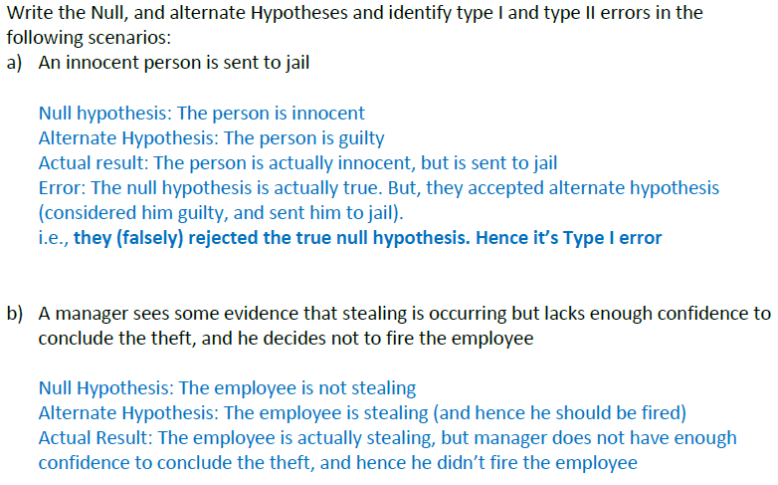
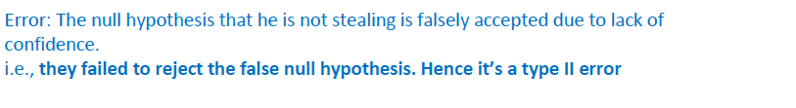

Slide 8
Suppose a car manufacturer claims a model gets 25 mpg. A consumer group asks 40 owners of this model to calculate their mpg and the mean value was 22 with a standard deviation of 1.5. Is the manufacturer's claim supported?

Slide 9
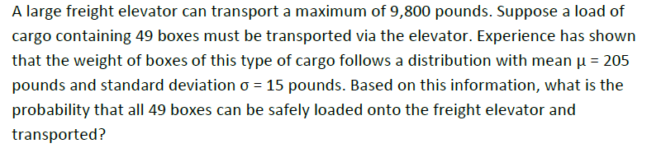

Slide 10
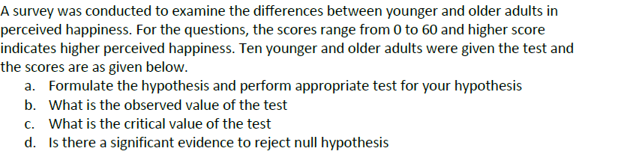
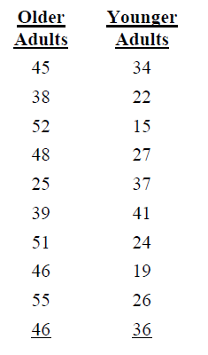

Slide 11
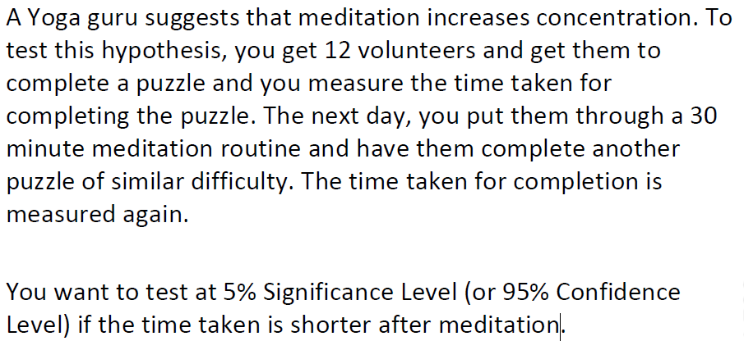

Slide 12
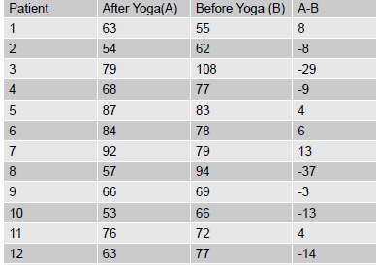
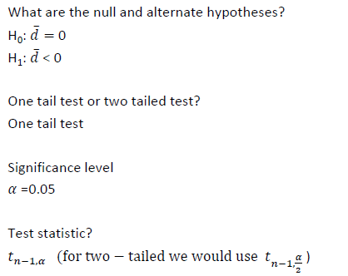


Slide 13
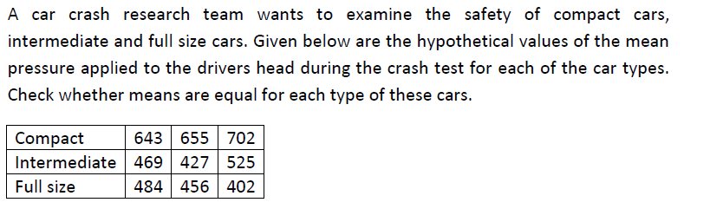
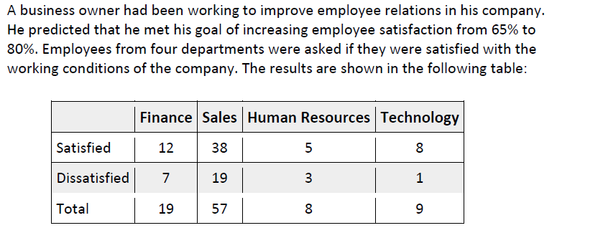

Slide 14
Chi Sq Test

Slide 15
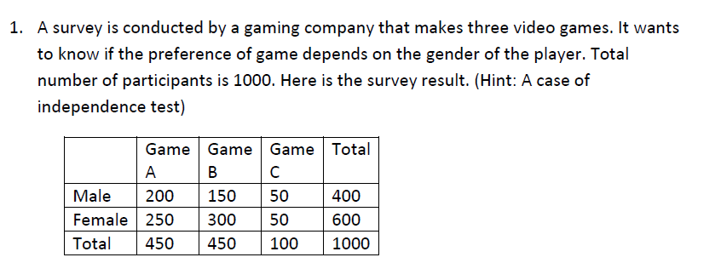

Slide 16
