Slide 1
AWS Virtual Learning Series (ETL)
March 2022

Slide 2
Agenda

Slide 3
Introduction to ETL at AWS
Presented by Samkelo Maneli, ETL Cloud Engineer

Slide 4
Data Movement/Migration
Generally data movement comes from a Raw Data environment into a Cleansed Data Environment.
Let us look into these respective Data Environments

Slide 5
Data Environments in the cloud
We are looking to retain and make use of all the data we have, unstructured or structured.
As we can imagine this data gets messy and will need to be cleansed.
Data Lake
In a Data Warehousing environment, the data that we are bringing in already has some structure in it and is normalized.
Data Warehouse
AWS

Slide 6
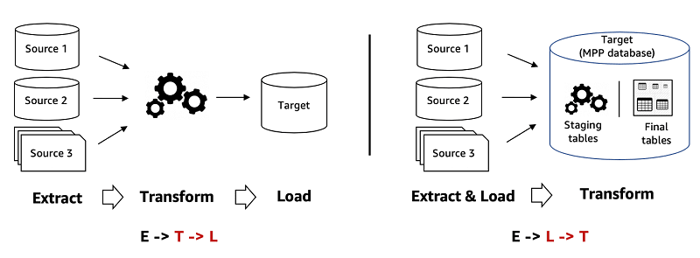
ETL vs ELT
To conduct the migration/s needed above we have 2 approaches: ETL and ELT

Slide 7
What is ETL?
Extract: Read what we need from the Source Store/s
Transform: Cleanse/Wrangle the source data into the shape and/or format that we would like it be
Load: Write out the transformed data into a Target Store. Generally from multiple sources (such as a raw Data Lake environment, JDBC stores, etc) into a Data Warehousing environment where business insights are generated

Slide 8
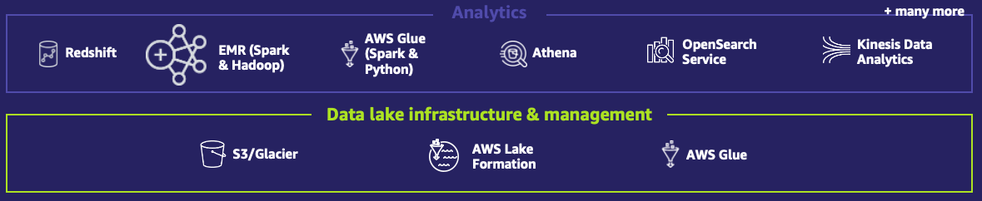
ETL Offerings at AWS
AWS Glue
Data Pipeline
AWS Lake Formation
Amazon Athena
Managed Workflows for Apache Airflow
AWS Glue DataBrew

Slide 9




AWS Glue
Crawler: infers data source metadata such as schema, partitions, etc. and then based on this metadata creates a Data Catalog table
ETL engine: we have options either based on Vanilla Python (called the Python Shell) or Open Source Apache Spark for ETL transformations
1. Download data into Amazon S3
2. Schedule jobs to clean and transform data
Amazon S3
AWS Glue

Slide 10
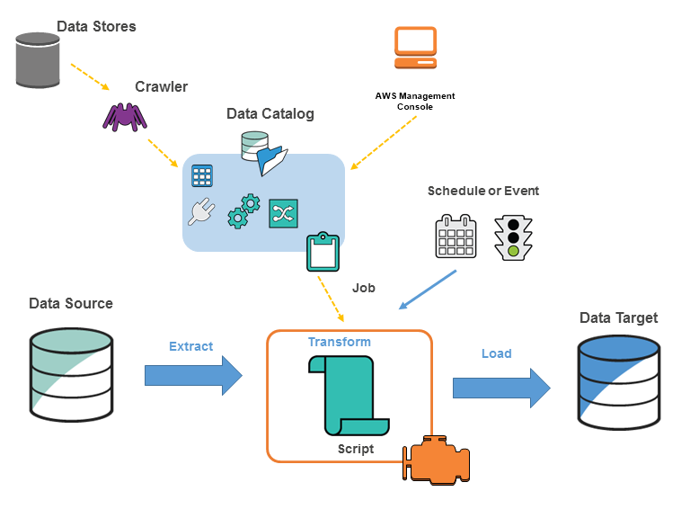
Glue Cont.
Data Catalog: A metadata store that holds metadata tables and databases. These tables can either be created and/or updated by the crawler or we could create and/or update them manually
Workflows are a Glue proprietary feature that allows for orchestration of Glue components such as the ETL job, crawlers, etc

Slide 11

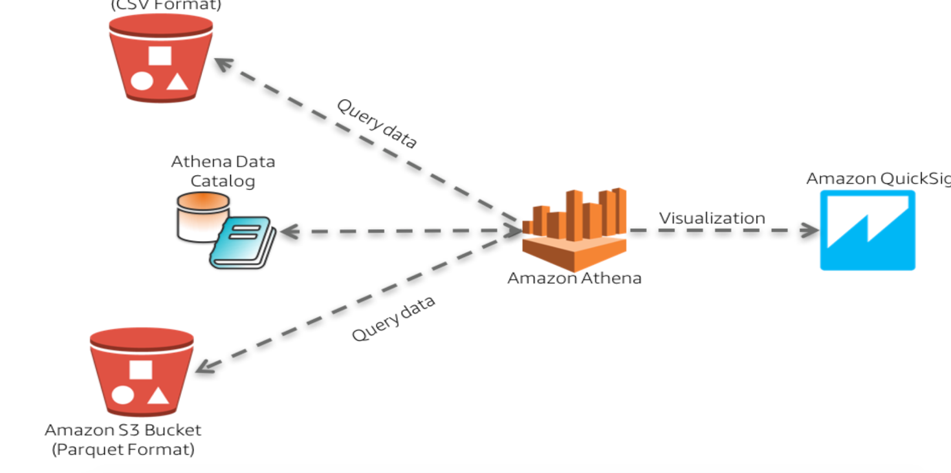
Amazon Athena
A SQL query tool based on open source Presto for DML queries and Hive for DDL queries
Federated queries have also provided us the ability to use AWS-provided connectors or make use of our own Custom Presto Connectors using Lambda

Slide 12
AWS Data Pipeline
Serves purely for ETL purposes just like Glue but unlike Glue lacks the Developer experience and provides more of a basic ETL functionality .i.e more drag and drop interface with little code involved
The benefit from Glue is that we have more flexibility to the operations we have such as the CLI activity whereas with Glue we are limited to either Python or Scala for our ETL migration.
Data Pipeline also has Change Data Capture capabilities which is more JDBC friendly than Glue Job Bookmarks

Slide 13
Managed Workflows for Apache Airflow
This offering is a managed version of the Open Source Software Apache Airflow.
We have not adapted this in any way. MWAA was meant to assist Data Engineers/Data Scientist with the ability to conduct their workload orchestration without the need to setup an airflow Environment
We define the Workflow tasks as a Directed Acyclic Graph

Slide 14
AWS Lake Formation
- The administrative layer for our Data Lake ecosystem
Lake Formation’s most popular feature allows us to be able to manage our Data Catalog metadata as well as the data for the underlying s3 location.
Another up and coming Lake Formation feature is the newly-GA Governed Tables, which allow our S3 data lake location to have ACID properties so that each data lake user can have their own consistent view of the source data

Slide 15
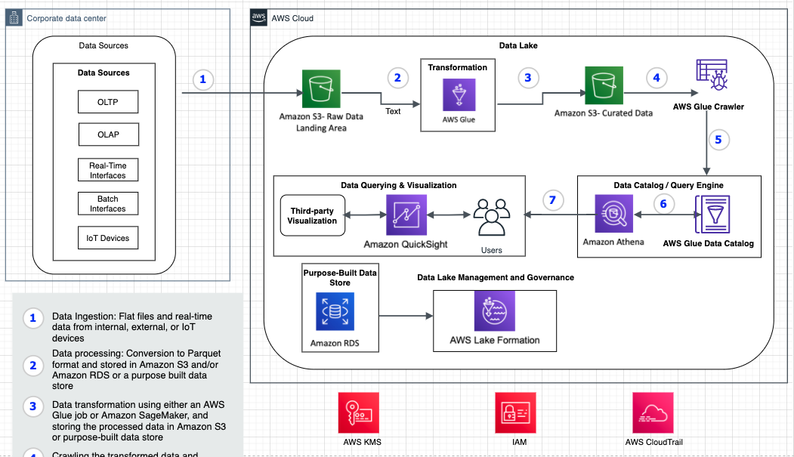
Data Lake Scenario

Slide 16
Q & A

Slide 17
Thank You!

Slide 18
ETL Demo Using Glue Databrew
Presented by Adedolapo Oluwabukunola Akin-Adetoro, ETL Cloud Engineer

Slide 19
Table of Contents
Aim of the ETL Demo Session
What is AWS Glue Data Brew
Core concepts of AWS Glue Data Brew
ETL Demo

Slide 20
Aim of the ETL Demo Session
The aim of this ETL Demo Session is give you hands on exposure to AWS Glue DataBrew.
We will cover the following topics
What is AWS Glue DataBrew?
Core concepts and terms in AWS Glue DataBrew
ETL Demo using AWS Glue DataBrew

Slide 21
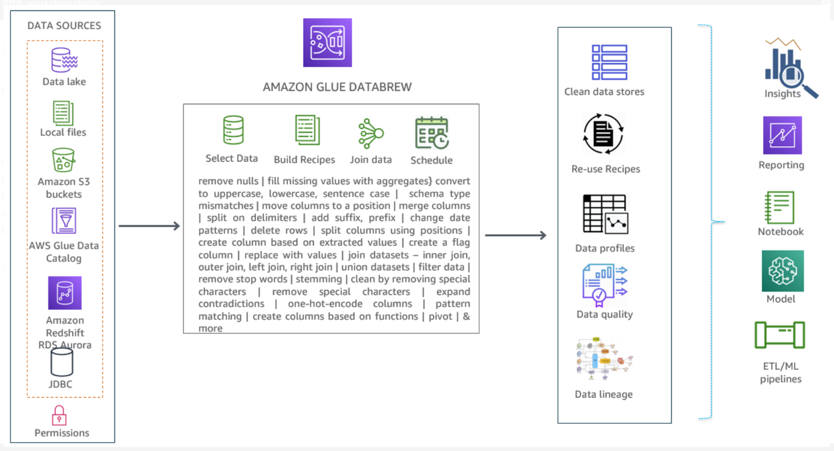
What is AWS Glue Data Brew
AWS Glue DataBrew is a visual data preparation tool that makes it easy for data analysts and data scientists to prepare data with an interactive, point-and-click visual interface without writing code.

Slide 22

Poll
What is the difference between ETL and ELT?

Slide 23
Core concepts of Glue Data Brew
Dataset
For DataBrew, a dataset is a read-only connection to your data. DataBrew collects a set of descriptive metadata to refer to the data. No actual data can be altered or stored by DataBrew .
Project
The interactive data preparation workspace in DataBrew is called a project. Using a data project, you manage a collection of related items: data, transformations, and scheduled processes.
Recipe
In DataBrew, a recipe is a set of instructions or steps for data that you want DataBrew to act on. A recipe can contain many steps, and each step can contain many actions. You can download and reuse recipes in other projects.

Slide 24
Core concepts
Job
DataBrew takes on the job of transforming your data by running the instructions that you set up when you made a recipe. The process of running these instructions is called a job
Data lineage
DataBrew tracks your data in a visual interface to determine its origin, called a data lineage. This view shows you how the data flows through different entities from where it originally came, what happened to it over time, and where it was stored.

Slide 25
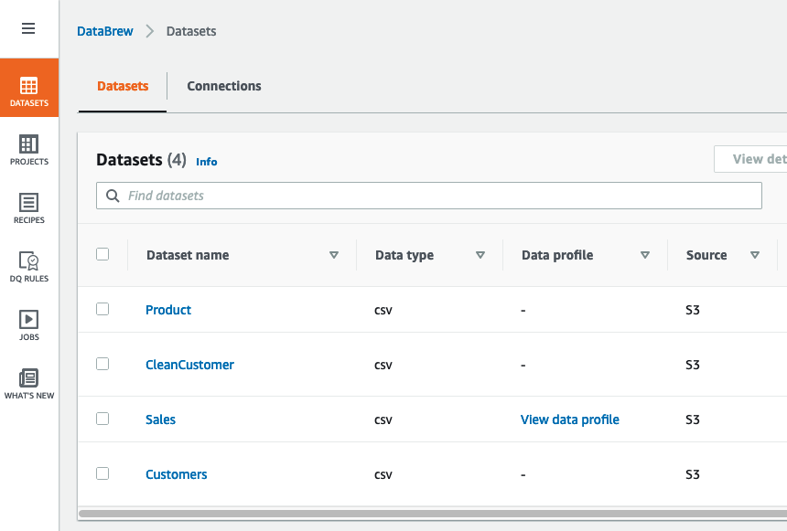
Core concepts

Slide 26
ETL Demo- Business case
Company ABC is a online pet product retailer that has recently launched a new product line for pet. Sales for the new product line is struggling in some regions
Their market research shows that the poor sales is due to limited product awareness in the affected region. To address the sales problem, they need to start a targeted mail campaign in the affected region to increase awareness.
The team needs a fast turn around and they don’t have much time to write code and manage infrastructure.
Actions: The team needs to analyse and transform customer, product, and sales data to compare and contrast sales of two product lines and identify zip codes where specific product types need to be marketed.

Slide 27

Poll
What is a Bridge Table?

Slide 28
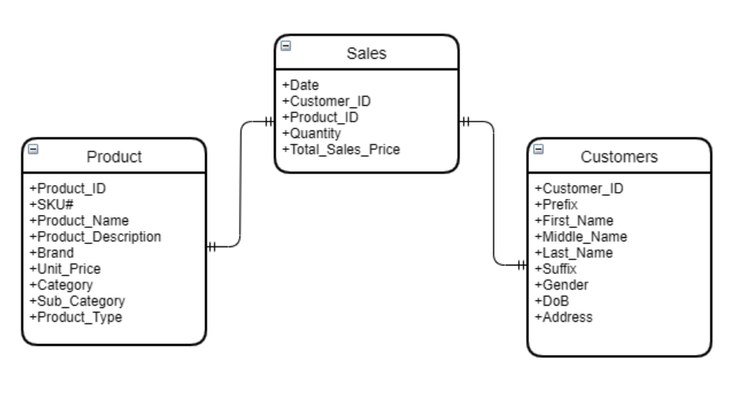
ETL Demo- Data Model

Slide 29
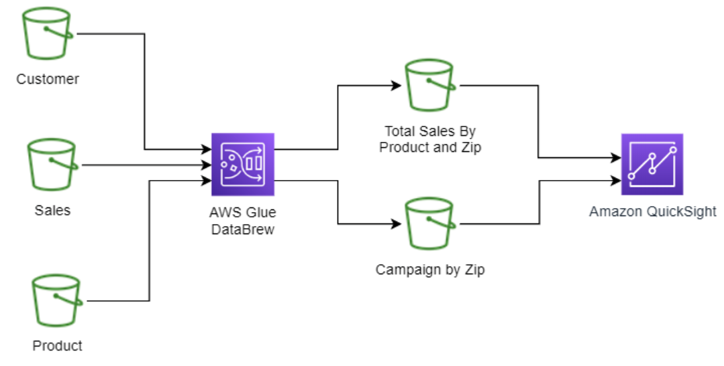
ETL Demo- Logical Data Flow

Slide 30
ETL Demo- Data transformation steps
Clean the customer data and parse the zip code from the address column
Join sales data with customer data and product data to compare sales by zip and product type
Finally generate lists of zip codes with marketable product IDs.

Slide 31
Poll
Does AWS Glue Databrew store the actual dataset?

