Slide 1
Backpack Prediction Challenge
Presented By: Sobia Alamgir

Slide 2
Synthetic Dataset
3.7 million records in training_extra data
3 lac records in training data
2 lac records in testing data

Slide 3
Features:
A Data Frame contains following variables.
* id: A unique identifier for each backpack.
* Brand: The manufacturer or company that produces the backpack.
* Material: The type of fabric or material used (e.g., polyester, leather).
* Size: The overall dimensions or volume of the backpack.
* Compartments: The number of storage sections or pockets in the backpack.
* Laptop_Compartment: Whether the backpack has a separate space for a laptop (Yes/No).
* Waterproof: Indicates if the backpack is water-resistant or waterproof (Yes/No).
* Style: The design category (e.g., casual, travel, hiking, business).
* Color: The primary color of the backpack.
* Weight Capacity (kg): The maximum weight the backpack can carry safely.
* Price: The selling price of the backpack.

Slide 4
Models Applied:
This is a regression task.
Linear Regression [RMSE: 39.01095927]
Bayesian Ridge [RMSE: 39.00919829]
Bayesian Ridge with Hyperparameter Tuning [RMSE: 39.00920377]
Random Forest [RMSE: 39.19962857]
Random Forest with Hyperparameter Tuning [RMSE: 40.05915199]
Light GBM [RMSE: 39.18356741]
Light GBM with Hyperparameter Tuning [RMSE: 38.99717213]
XG Boost [RMSE: 40.55518914]
Gradient Boosting [RMSE: 45.89556401]
Gradient Boosting with Hyperparameter Tuning [RMSE: 40.44895865]

Slide 5
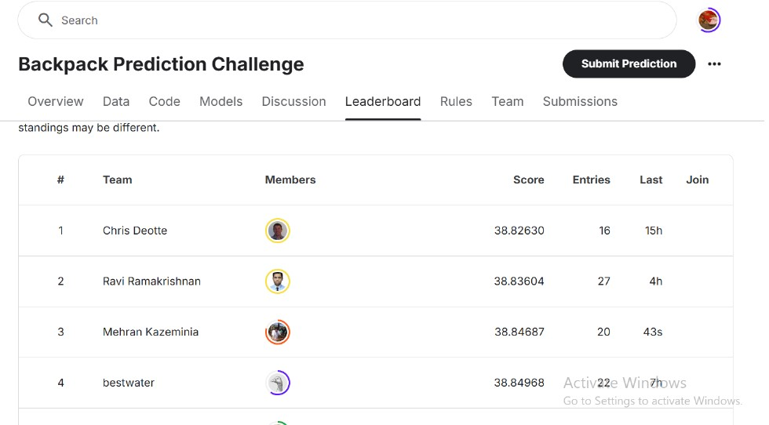
Kaggle Competition

Slide 6
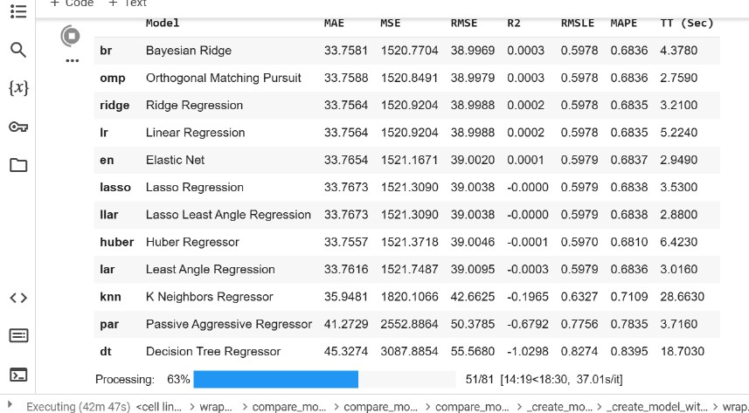
Bayesian Ridge is on TOP (PyCaret)

Slide 7
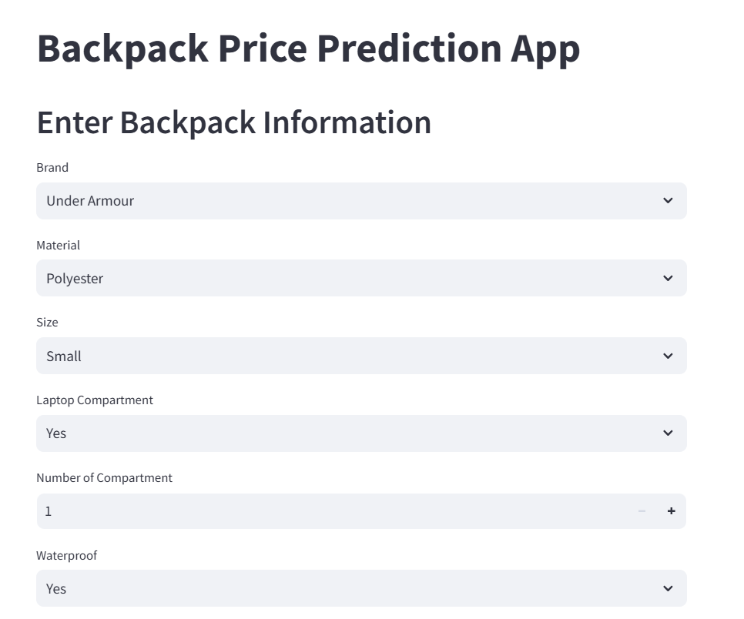
Streamlit App

Slide 8
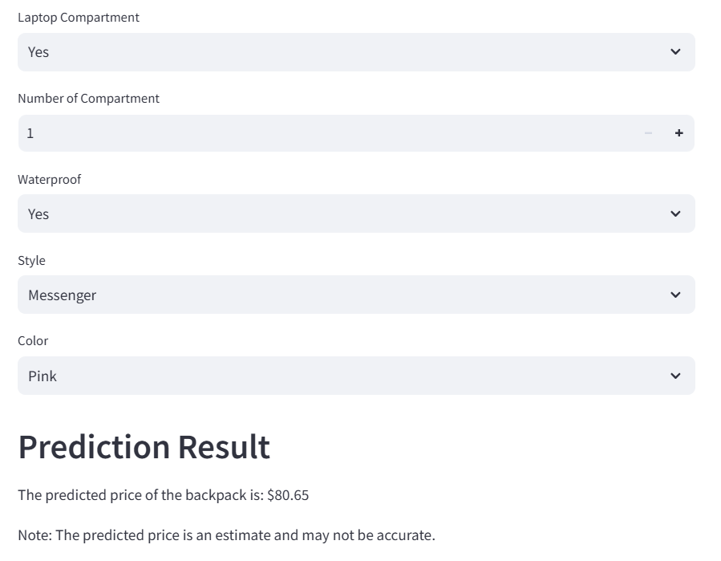
Streamlit App

Slide 9
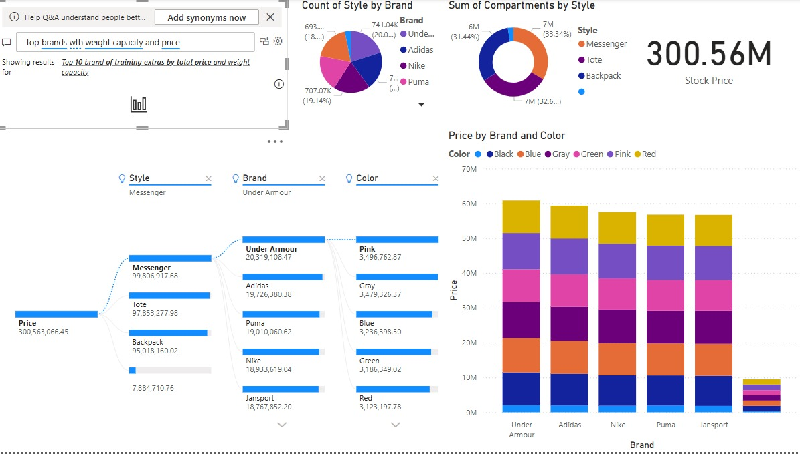
Dashboard using Power BI

Slide 10
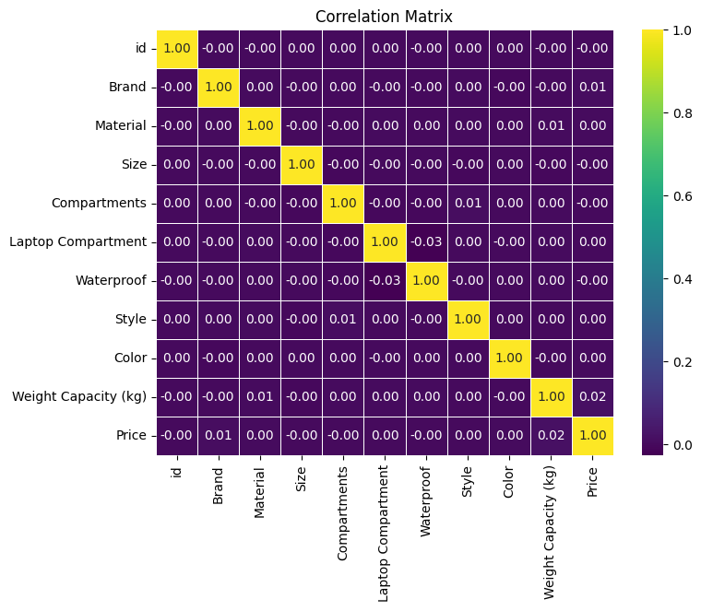
Data Visualization
Heat Map

Slide 11
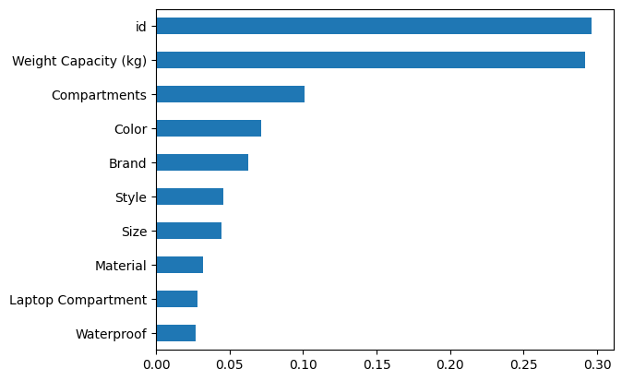
Data Visualization
Feature Importance

Slide 12
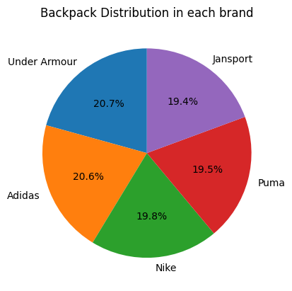
Data Visualization
Pie Chart
brand wise

Slide 13
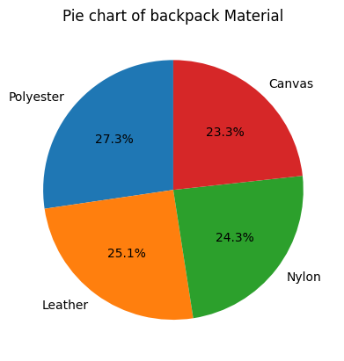
Data Visualization
Pie Chart
Material wise

Slide 14
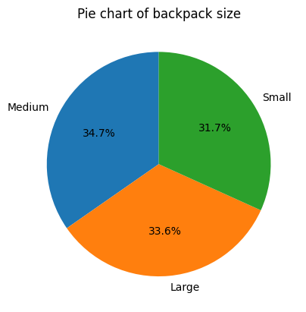
Data Visualization
Pie Chart
Size wise

Slide 15
Thankyou

