Slide 1
How much do you know about the world?

Slide 2
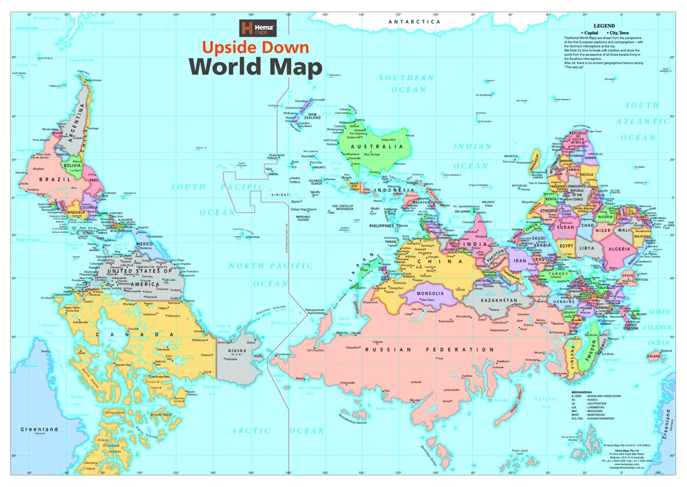

Slide 3
Time for the QUIZ
https://datatopics.worldbank.org/world-development-indicators/stories/the-classification-of-countries-by-income.html

Slide 4
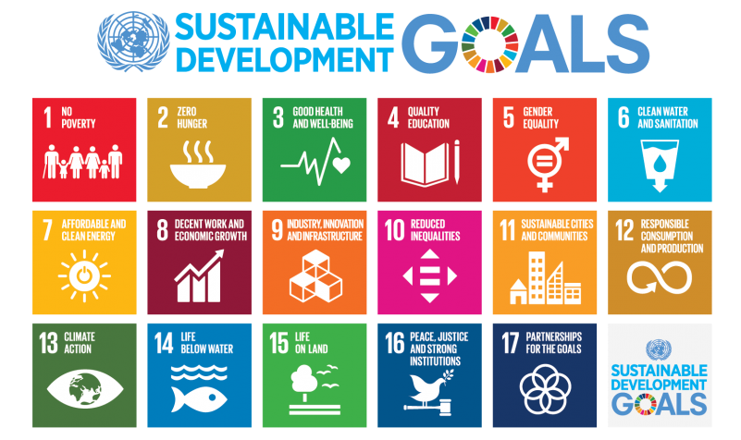

Slide 5

Important stuff most people get wrong

Slide 6

Popular myths
The world is divided into rich and poor; most countries are either wealthy or poor, with few in between.
The world is getting worse
The number of people on Earth will continue to grow

Slide 7
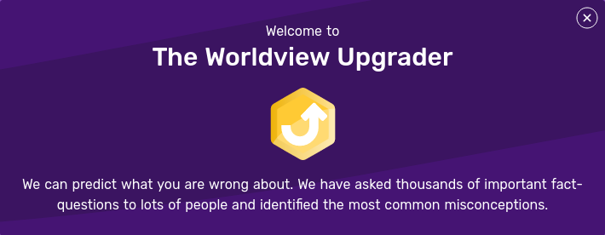
Worldview upgrader

Slide 8
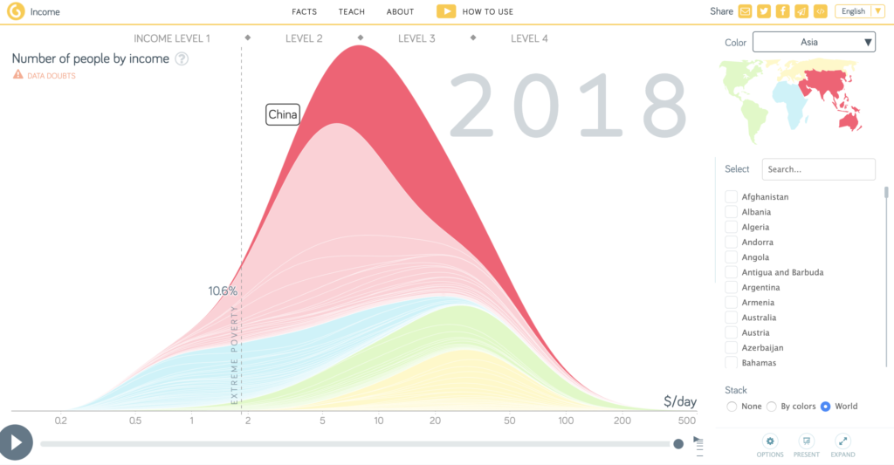
Population by income
,z

Slide 9
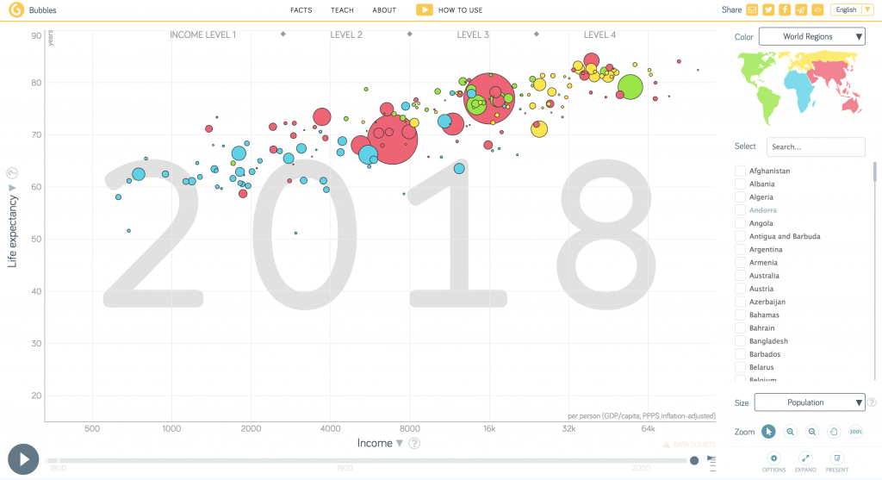
More bubbles

Slide 10
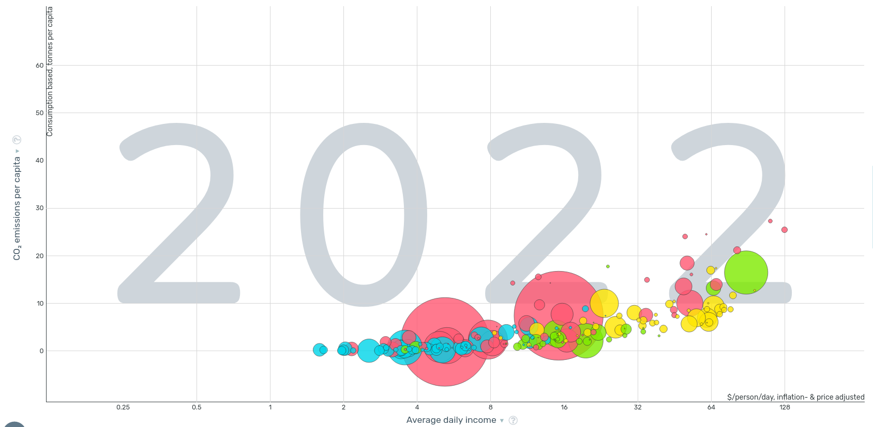
Bubbles

Slide 11
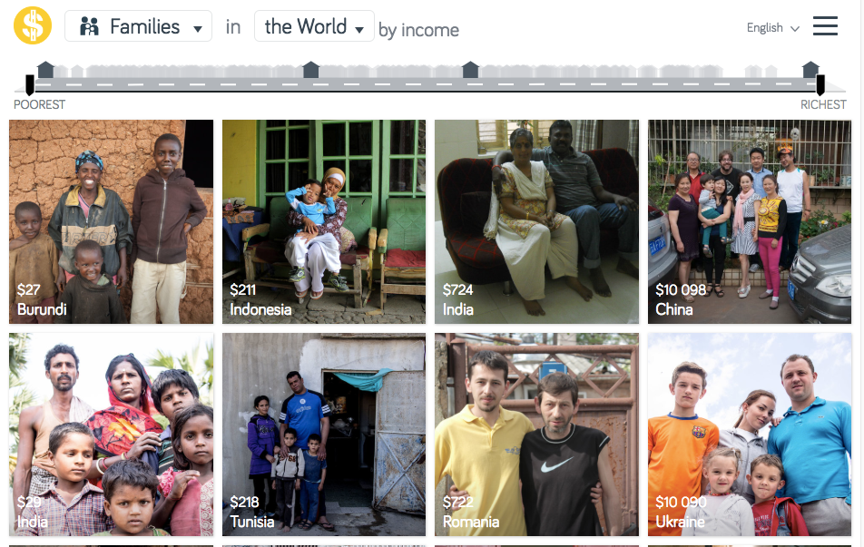
https://www.gapminder.org/dollar-street

Slide 12
Presentation access
https://tinyurl.com/polites-world

Slide 13
