Slide 1
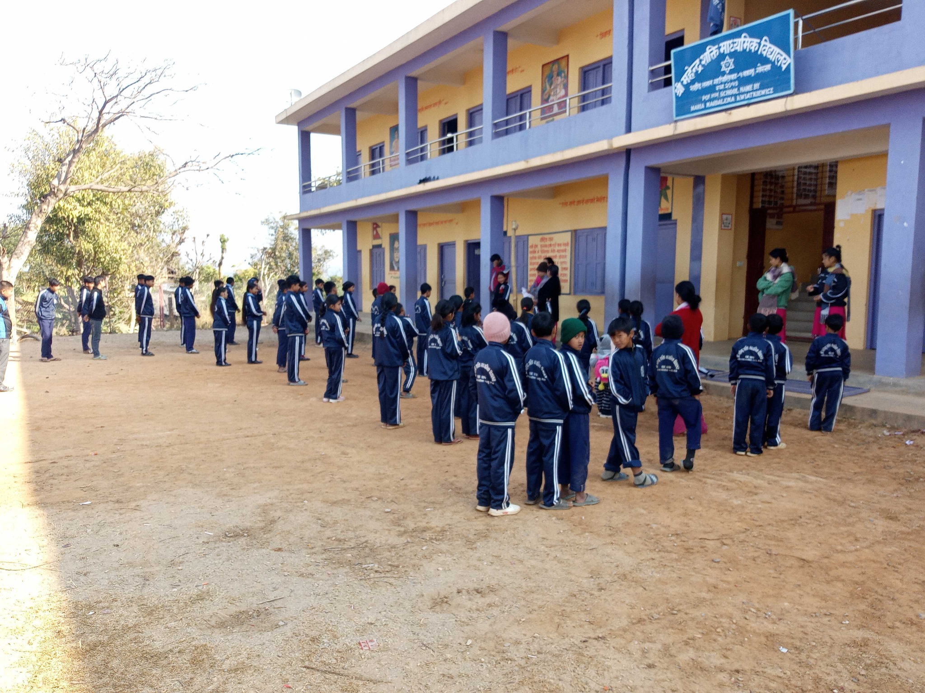
5 months in rural school in Nepal

Slide 2
What is voluntourism
Was Szymon a voluntourist?
What differs European Solidatity Corps from voluntourism

Slide 3

Definition of volunteering

Slide 4
What is Voluntourism (Volunteer Tourism)
Voluntourism, a combination of volunteering and tourism, is used to describe tourist trips taken with the intention to volunteer for an organisation in a foreign (usually less developed) country.

Slide 5
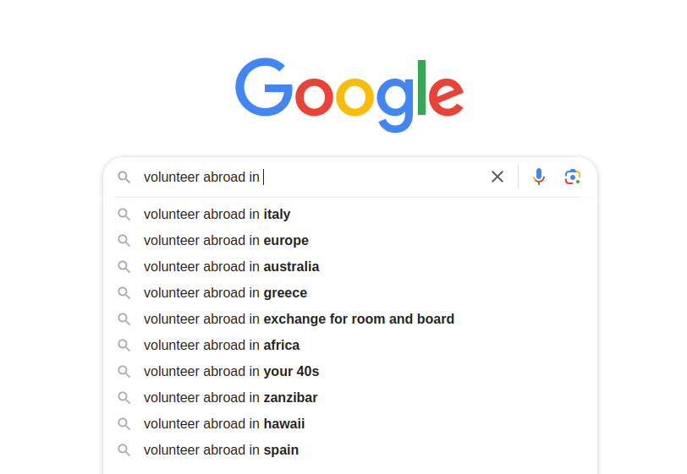
Voluntourism
Volunteering abroad

Slide 6
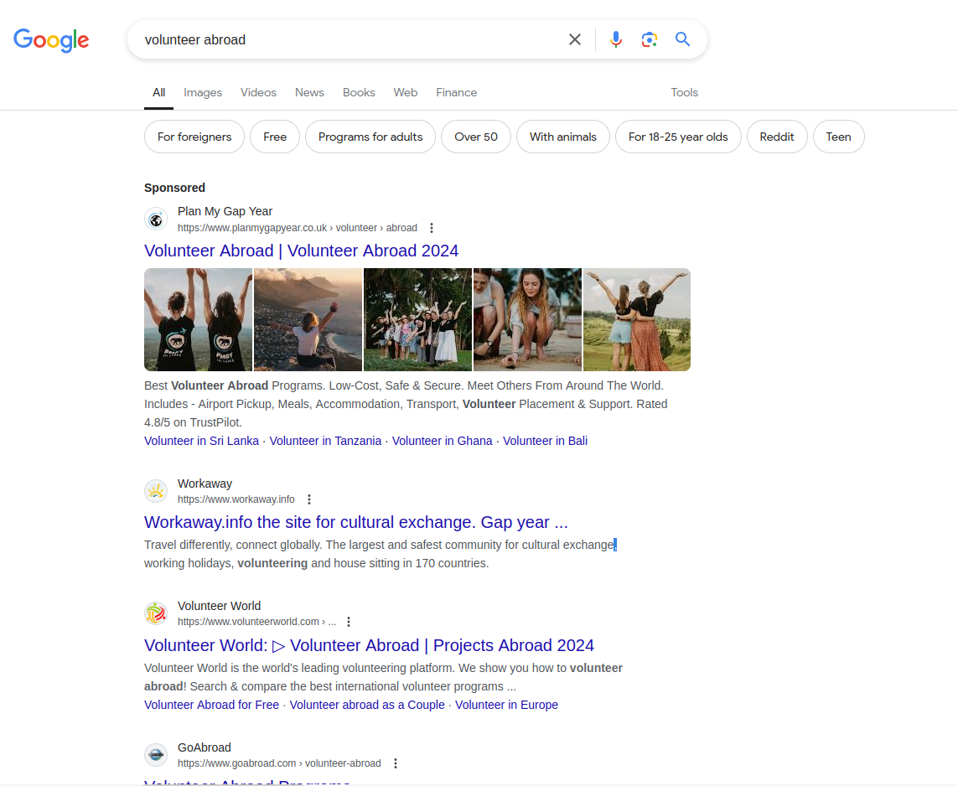

Slide 7
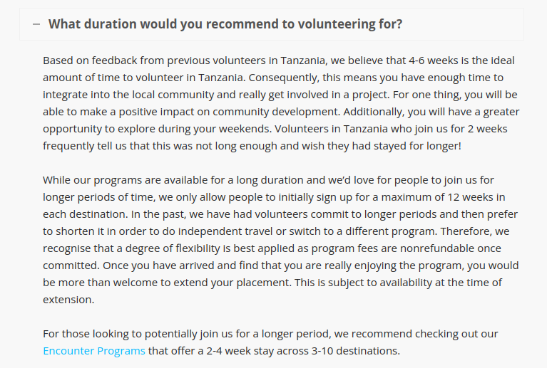

Slide 8
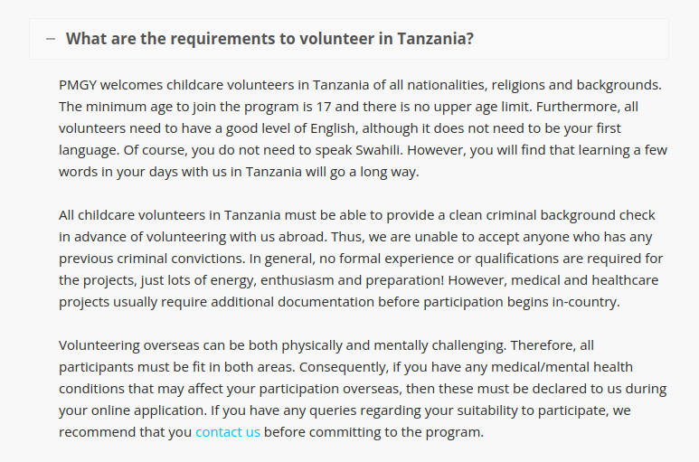

Slide 9

Horror stories from voluntourism

Slide 10

The case of Renee Bach, an American teenager who founded a center for malnourished children in Uganda, demonstrates how dangerous such actions can be. Between 2010 and 2015, Bach admitted 940 children to the facility, 105 of whom died. Not only did Bach abuse her status as a white American, but most importantly, she prevented her patients from accessing professional care, which was available elsewhere and could have saved their lives. Based on this, among other factors, in 2020 legal proceedings were initiated against Bach by the mothers of two of the victims of her actions.

Slide 11
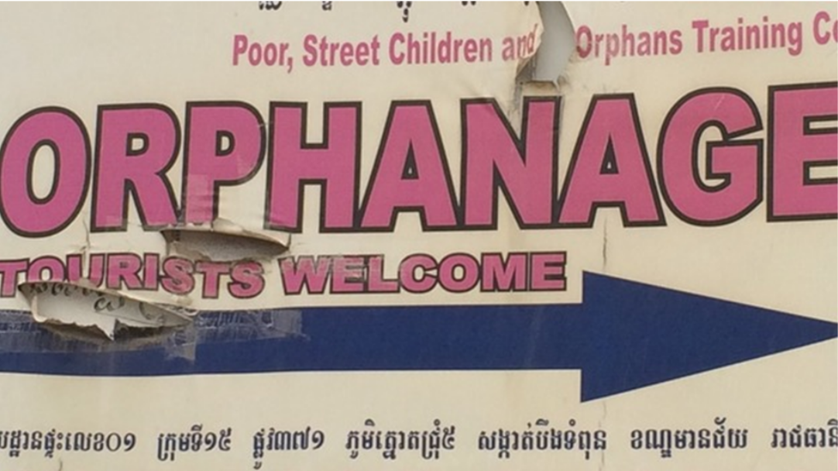
As much of the world began moving away from institutionalized child care, in some countries of the Global South, the number of orphanages and the children placed in them increased. From 2005 to 2010, the number of orphanages in Cambodia alone grew by 75%, despite a decrease in the number of orphans. Not coincidentally, during the same period, tourism surged, with a growth rate of 250% between 2005 and 2013.
Not only in Cambodia was there a correlation between the rise of foreign volunteer interest in working with children, tourism, and the increase in orphanages. Worse yet, these orphanages are often deliberately located in popular tourist areas. In Cambodia, they are mainly situated around the famous Angkor temple complex, the country's biggest tourist attraction.

Slide 12

One of the attractions in South Africa is lion sanctuaries. Since the 1990s, over 200 of these have been established, many of which have welcomed or still welcome volunteers to care for young animals. While these sanctuaries claim that they care for lion cubs abandoned by their mothers and later release them into the wild, the truth is much more brutal. Many of them sell the lions, raised by volunteers, to foreign hunters for "canned hunting." This is a type of enclosed hunting, offering a quick, guaranteed shot at a pre-selected trophy animal. The animal chosen for the hunt is released into an area enclosed by a fence, meaning it doesn't even need to be tracked by the hunter.

Slide 13
Our task during our stay at the orphanage was to build a library. It turned out that we, a group of students from an excellent private school, were so bad at the basics of construction that every night the workers had to dismantle the walls we had built and lay the bricks again so that we wouldn’t notice the difference the next day or realize our failure. Unfortunately, this is a common practice, not just in construction but also, for example, repainting murals done by volunteers, preparing for the next group’s arrival. We were much more of a burden than a help during this project. I was really frustrated; we all felt we were being treated very condescendingly.
Meghan (18 years old) in . „The Voluntourist”.

Slide 14
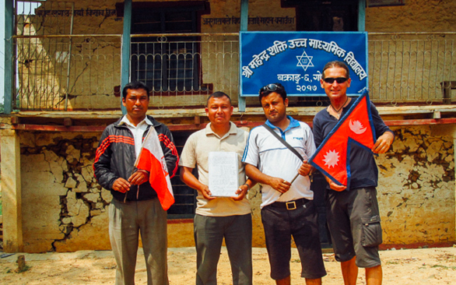
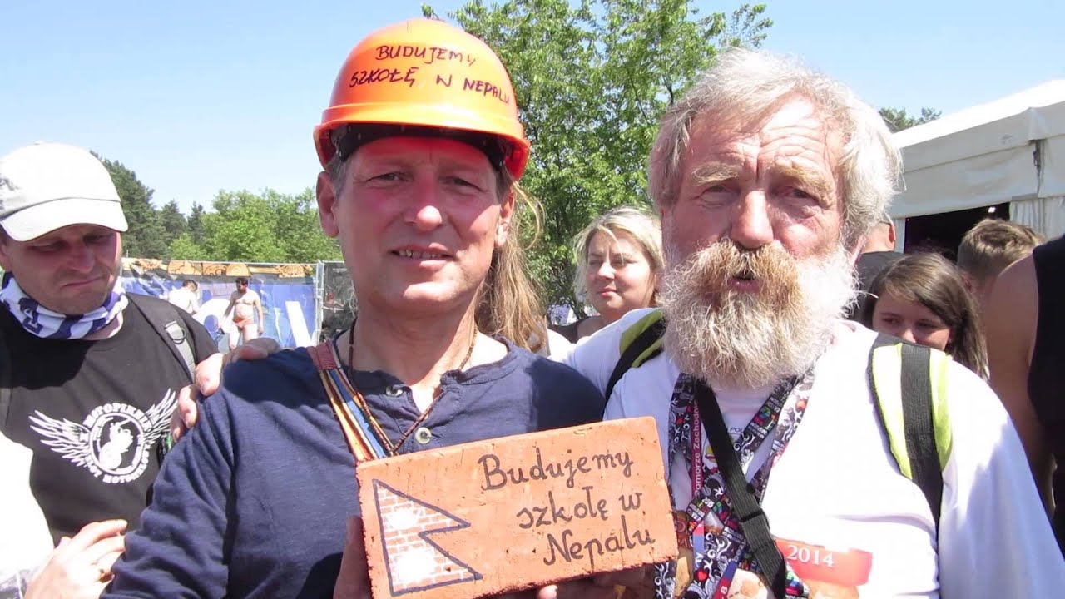
2016

Slide 15

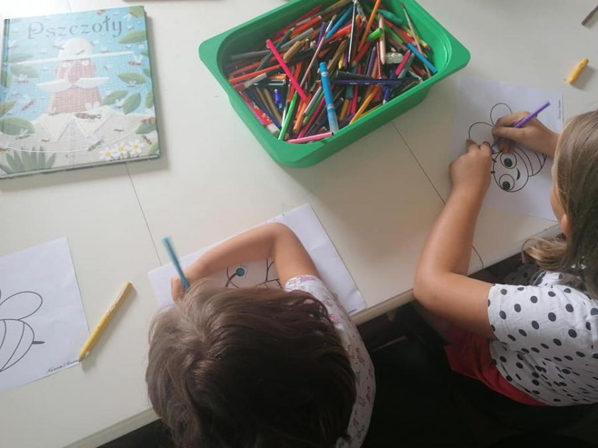


Slide 16
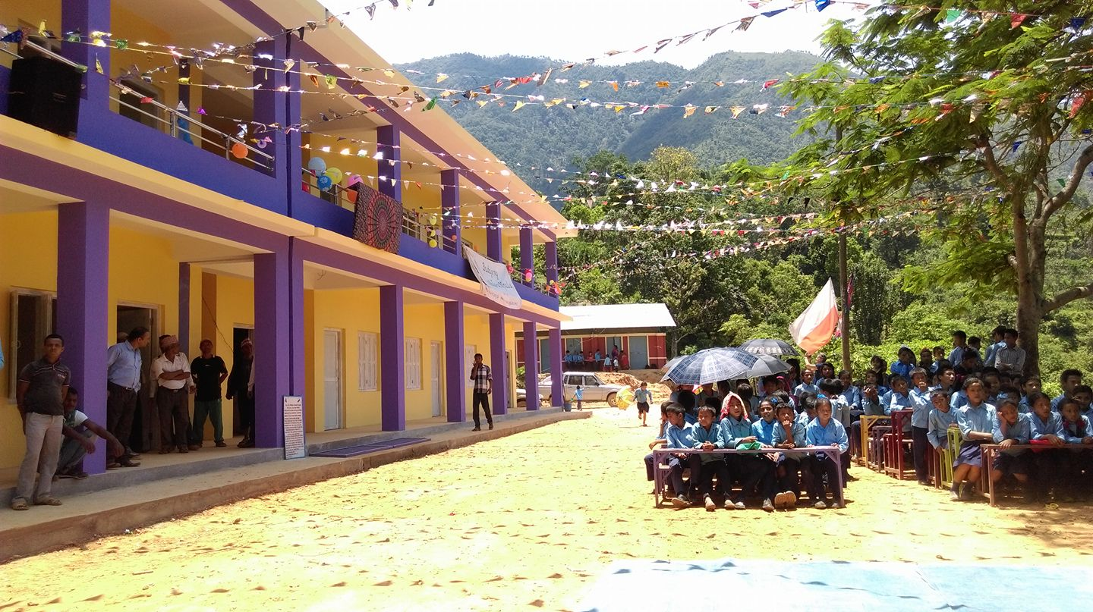

Slide 17
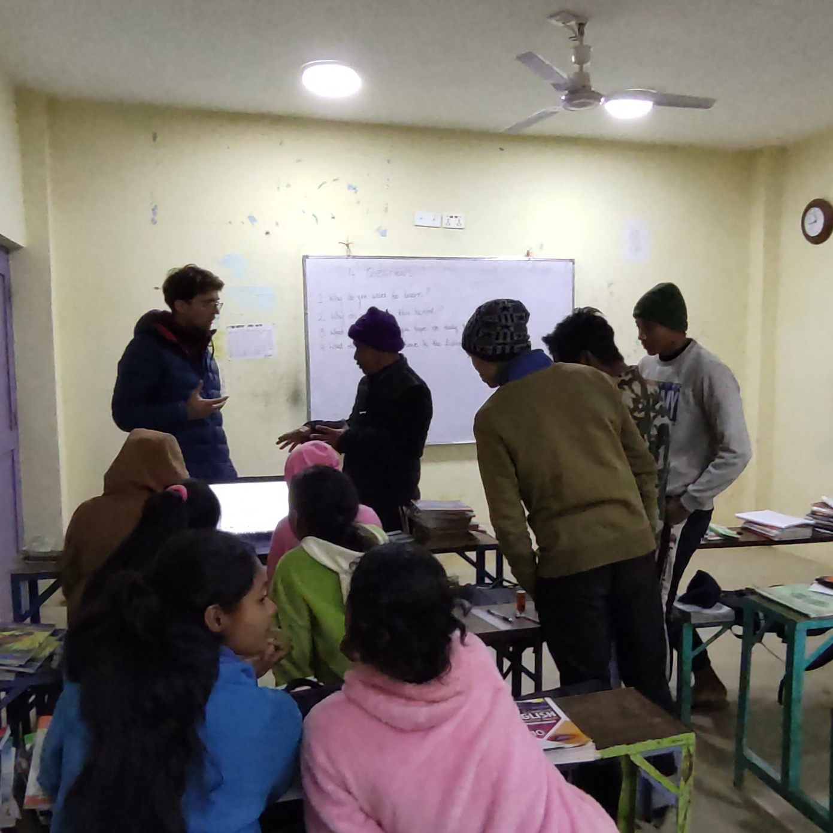
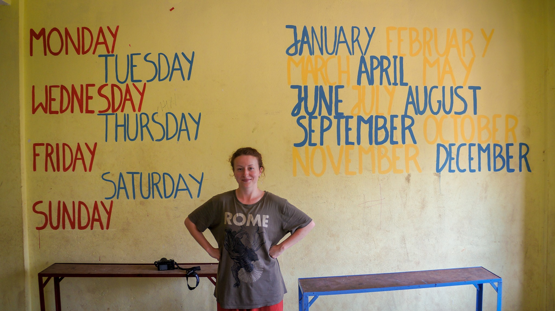
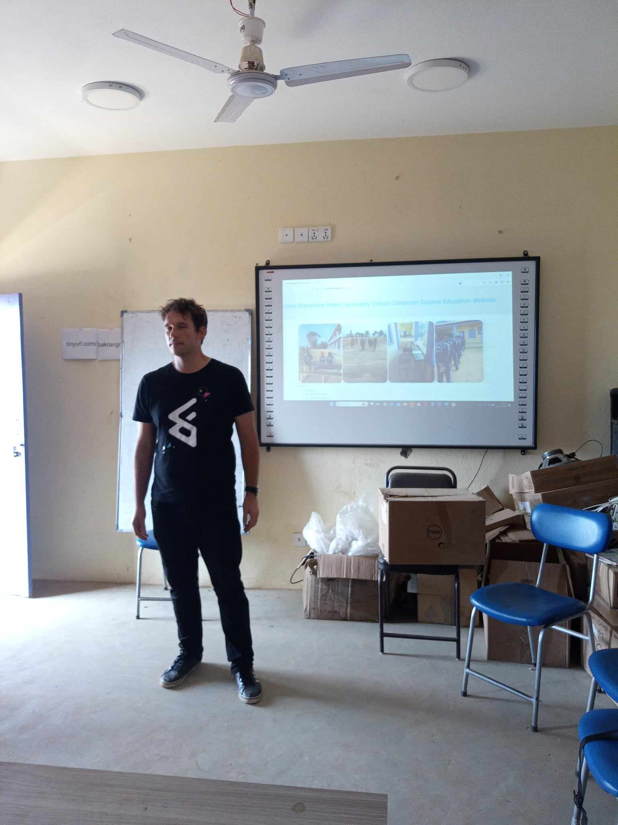

Slide 18
Why did I go?
I’m trained and experience teacher. I was doing similar workshops in Poland, combining school knowledge with business experience.
I know the sending organization and I trust them. One of board members of the association graduated humanitarian aid.
Hosting school is a regular public school. The headmaster was the initiator of the projects. Some of schools in Nepal teach in English.

Slide 19
The narrative
An extremely important, yet often overlooked issue in youth trips is the narrative surrounding them. Voluntourism, both in promotional brochures and organized trips, readily reinforces the belief that the presence of volunteers in Global South countries is essential for their development. This is one of the reasons why this type of vacation has been widely criticized for years by leading organizations focused on humanitarian aid and development cooperation. The language used in the offers describes in lofty terms how young people can "help the poor people at the ends of the earth."
Such divisions are not only false but also condescending toward the host communities, assuming their helplessness and inability to act. A common occurrence is that young volunteers leave with the conviction that, had it not been for their presence, the work would not have been done at all! Moreover, they may begin to think that the citizens of the country they visited are completely helpless, or even lazy. All of this can lead to a sense of superiority, agency, and making very superficial judgments. One teenage volunteer summed it up: Maybe there's something wrong with developing countries? After all, we’re working non-stop without a break.

Slide 20
Why European Solidarity Corps is not voluntourism?
Partnership
All participating countries are both sending and hosting volunteers.
Strong, reliable network
All organizations are verified by national agencies.

Slide 21
Mission of the European Solidarity Corps
The European Solidarity Corps brings together young people to build a more inclusive society, supporting vulnerable people and responding to societal challenges. It offers an inspiring and empowering experience for young people who want to help, learn and develop.

Slide 22


Slide 23
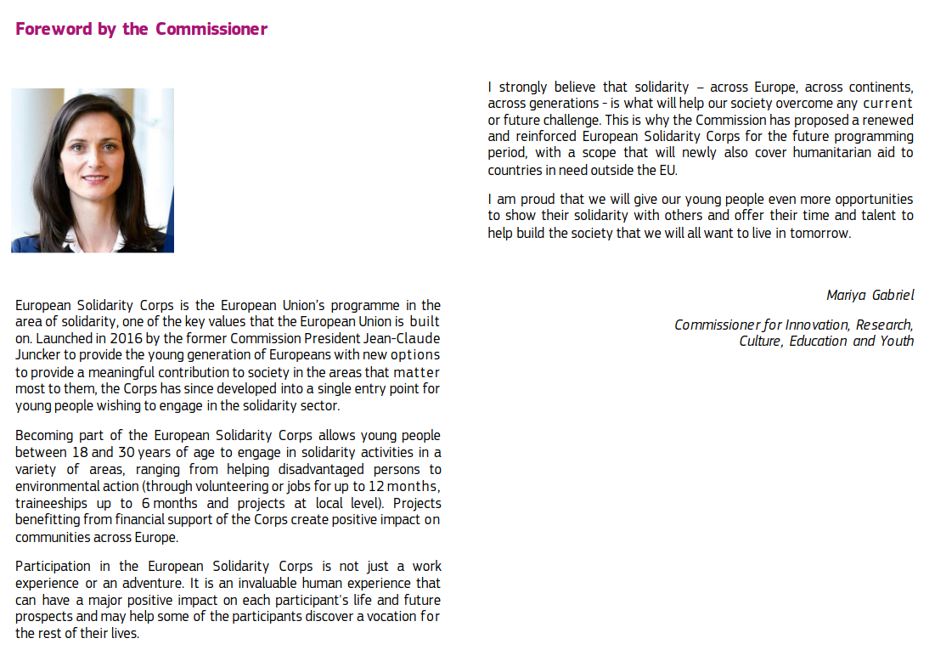

Slide 24
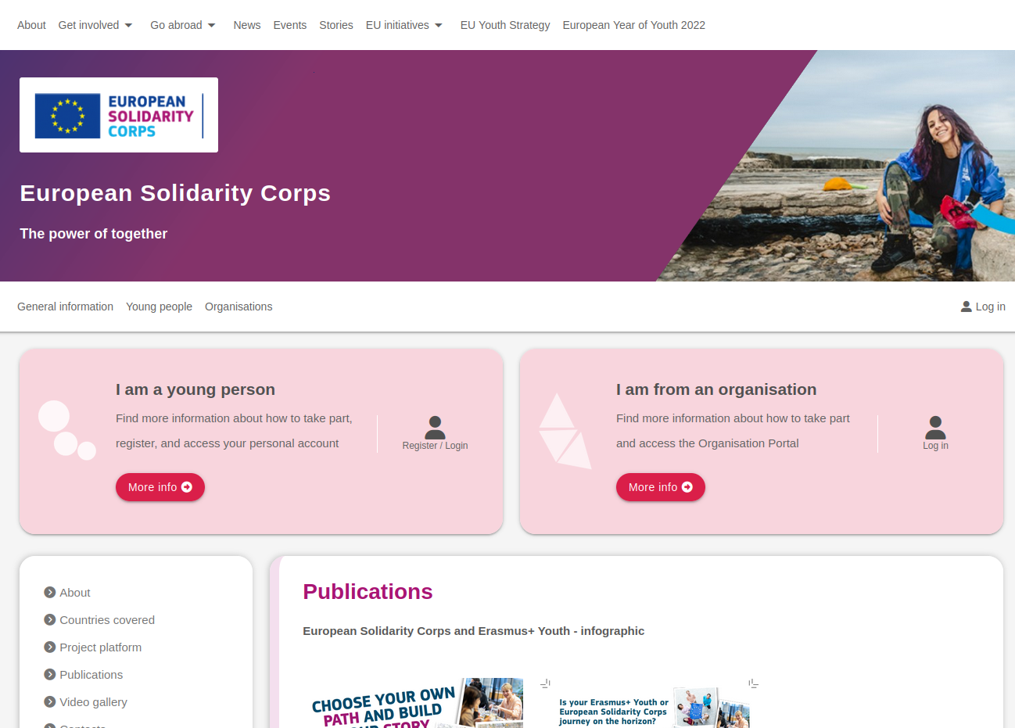
https://youth.europa.eu/solidarity/publications_en

