Slide 1
How much do you know about the world?

Slide 2
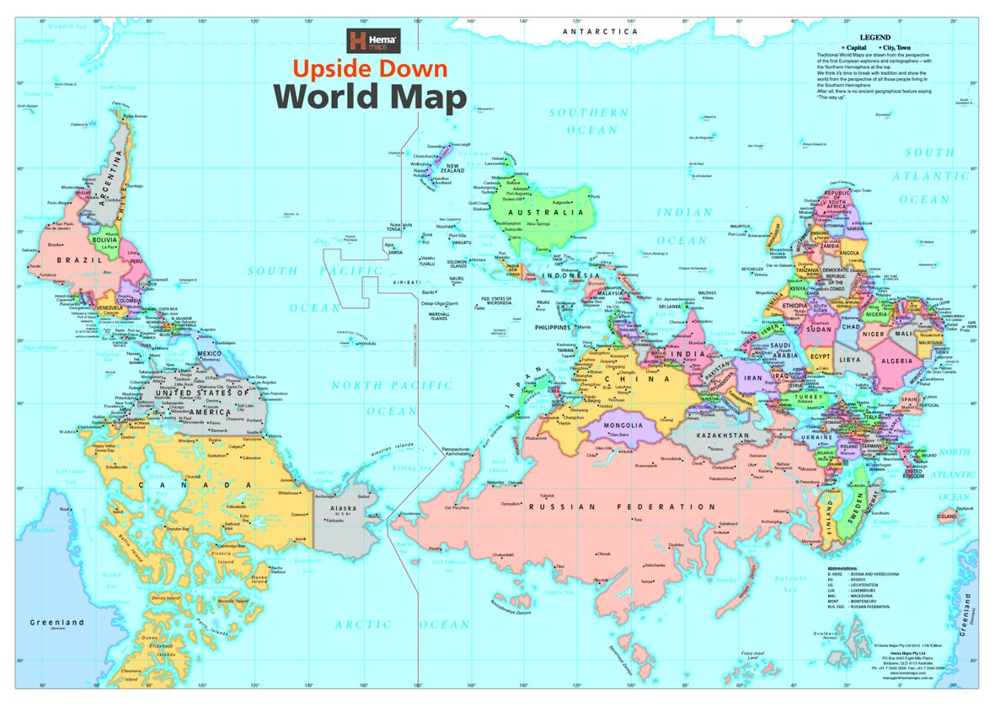

Slide 3
Let’s have a quiz
https://datatopics.worldbank.org/world-development-indicators/stories/the-classification-of-countries-by-income.html

Slide 4


Slide 5

https://upgrader.gapminder.org/t/sdg-world-un-goals/c/sdg-world-un-goals-main

Slide 6
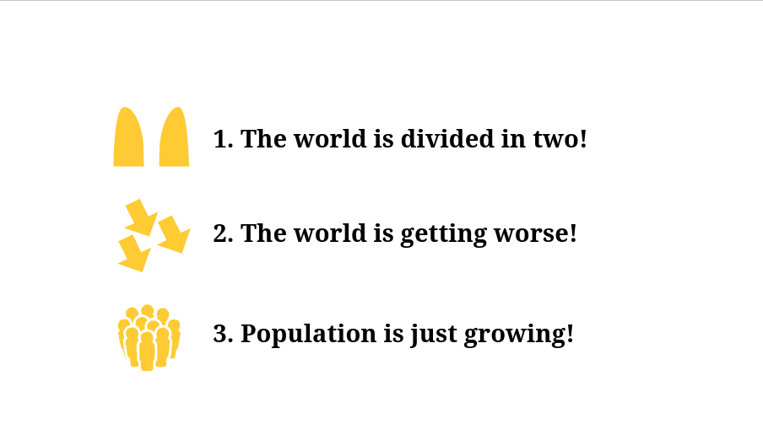
Common misconceptions

Slide 7
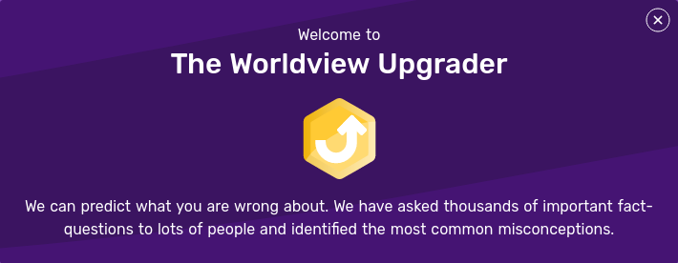
https://upgrader.gapminder.org/

Slide 8
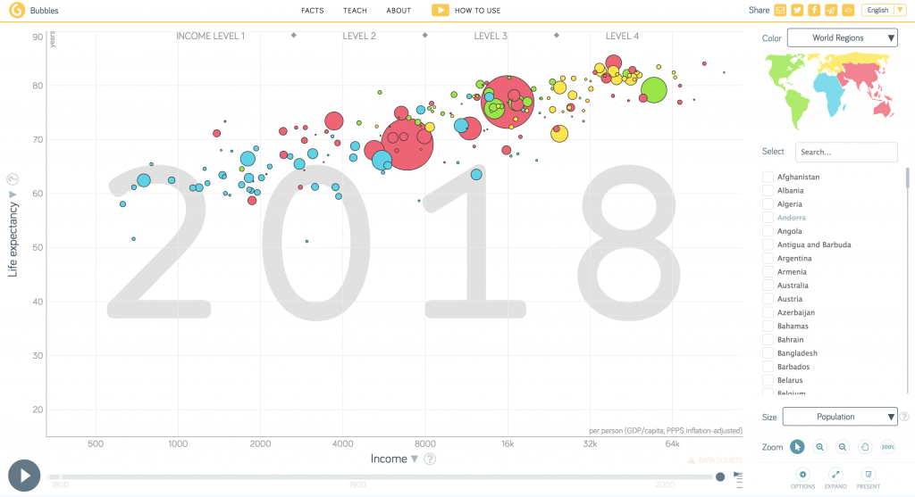
https://www.gapminder.org/tools/#$chart-type=bubbles&url=v2

Slide 9
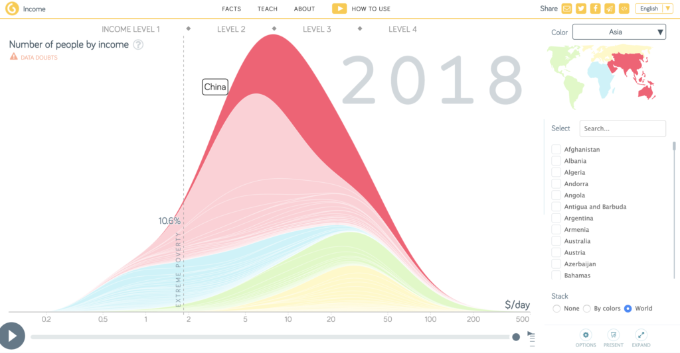

Slide 10
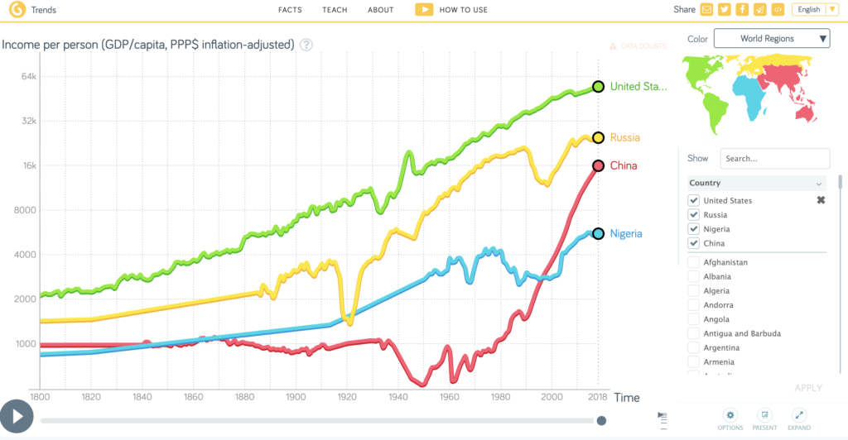

Slide 11
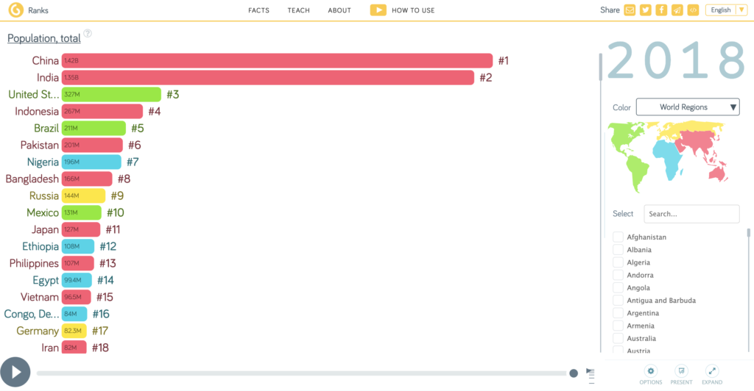

Slide 12
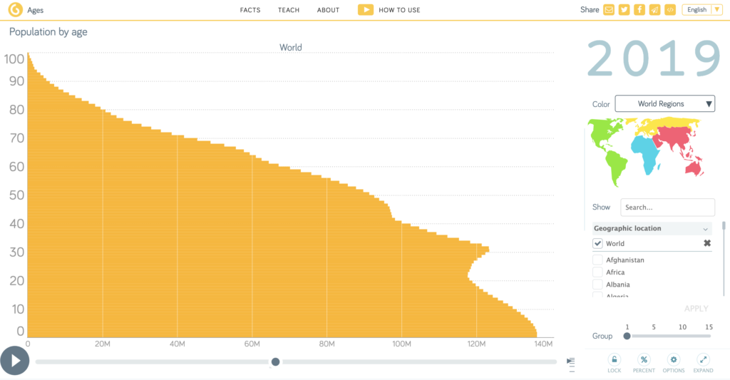

Slide 13
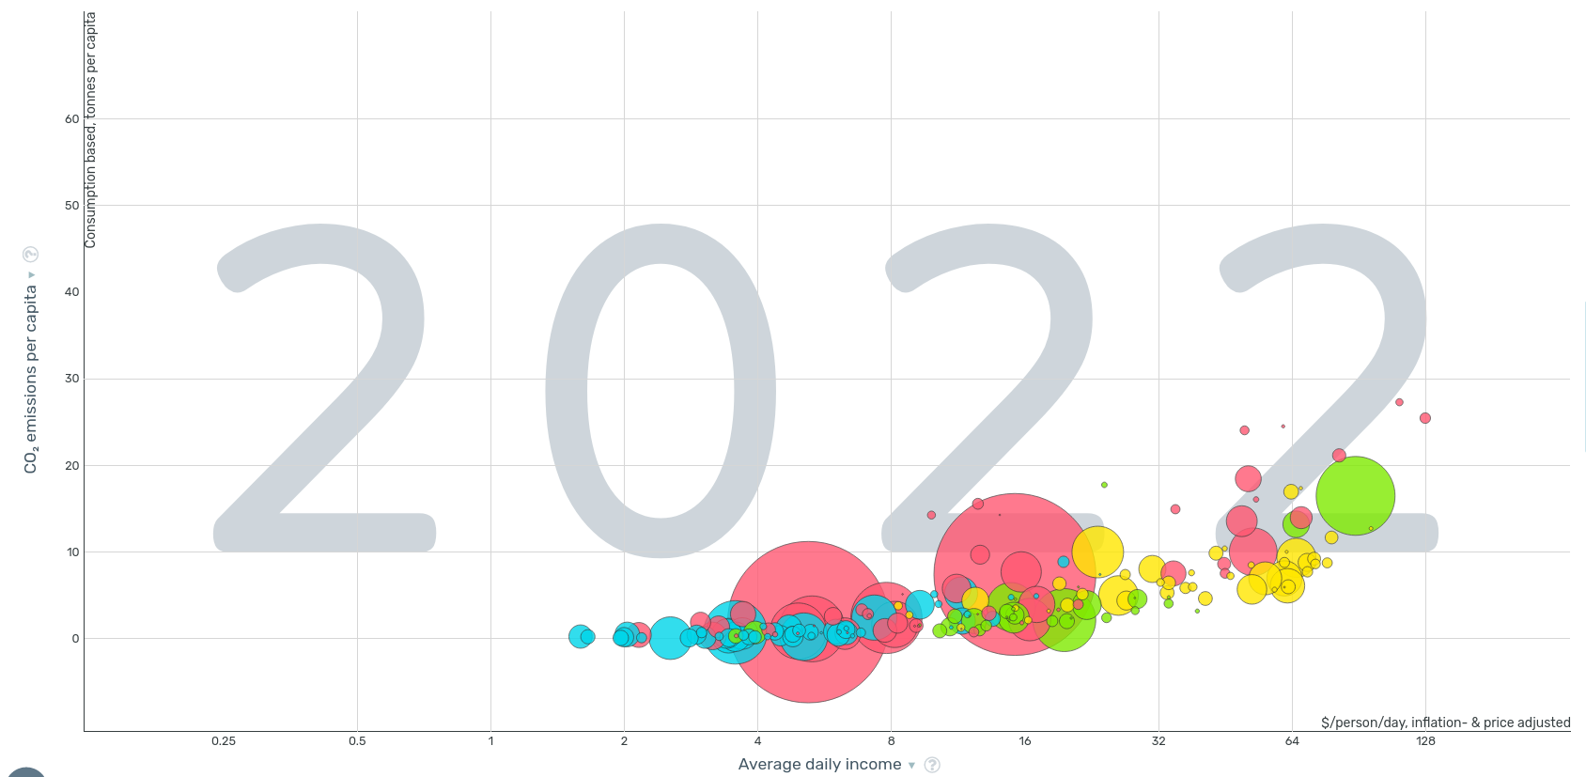
https://www.gapminder.org/tools/#$model$markers$bubble$encoding$y$data$concept=co2_pcap_cons&space@=geo&=time;;&scale$domain:null&zoomed:null&type:null;;&x$data$concept=mincpcap_cppp&space@=geo&=time;;&scale$domain:null&zoomed:null&type:null;;;;;;&chart-type=bubbles&url=v2

Slide 14
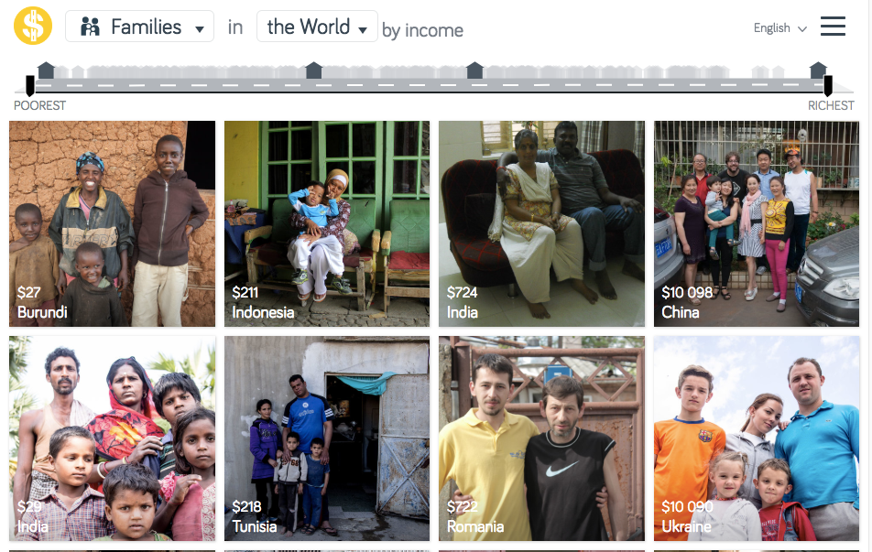
https://www.gapminder.org/dollar-street

Slide 15
Presentation to be downloaded
https://tinyurl.com/polites-world

Slide 16
