Slide 1
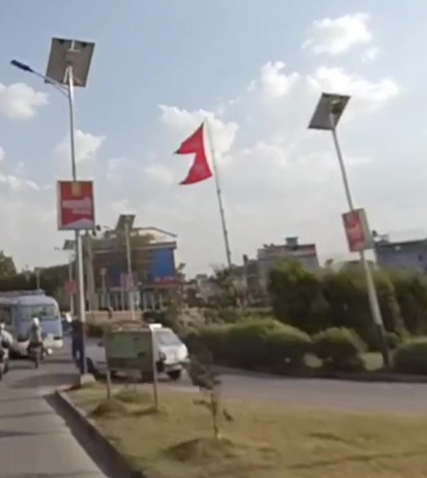
Katmandu, Nepal

Slide 2
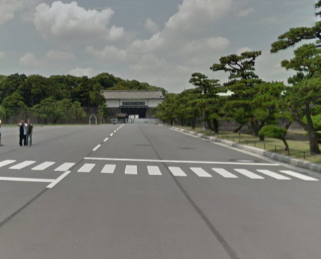
Imperial Palac Tokyo

Slide 3
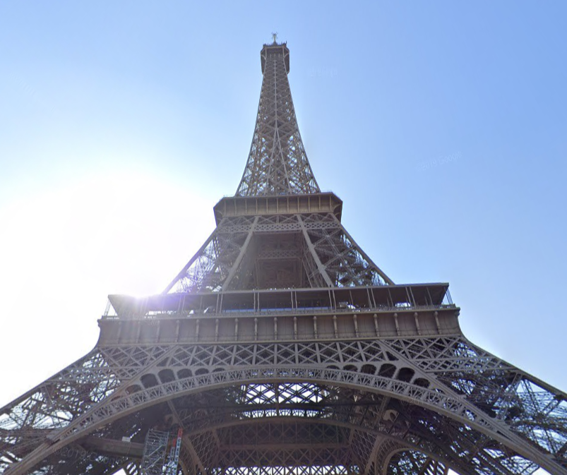
Eiffel Tower in Paris

Slide 4
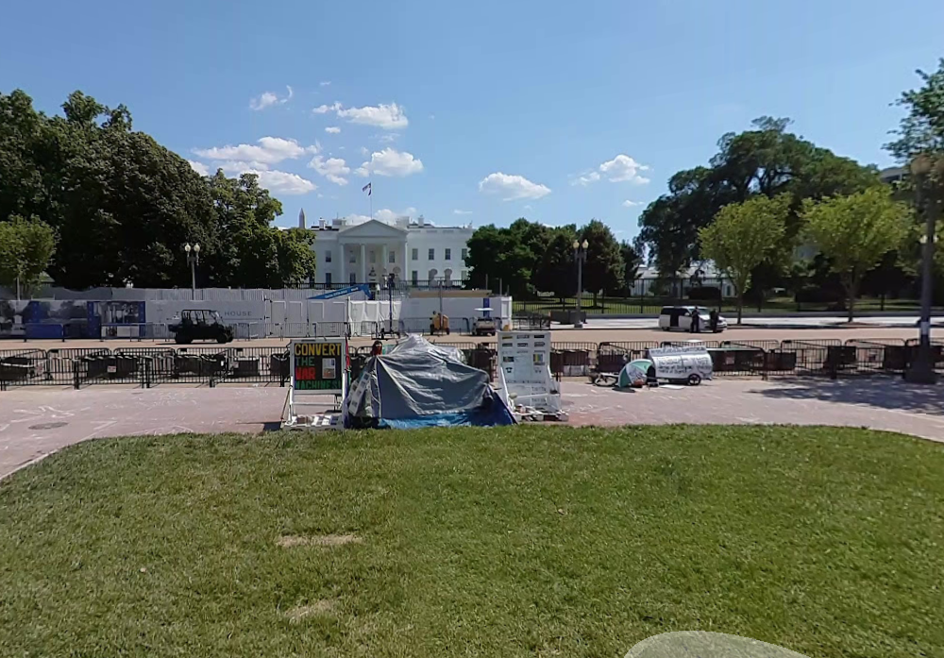
White House, Washington

Slide 5
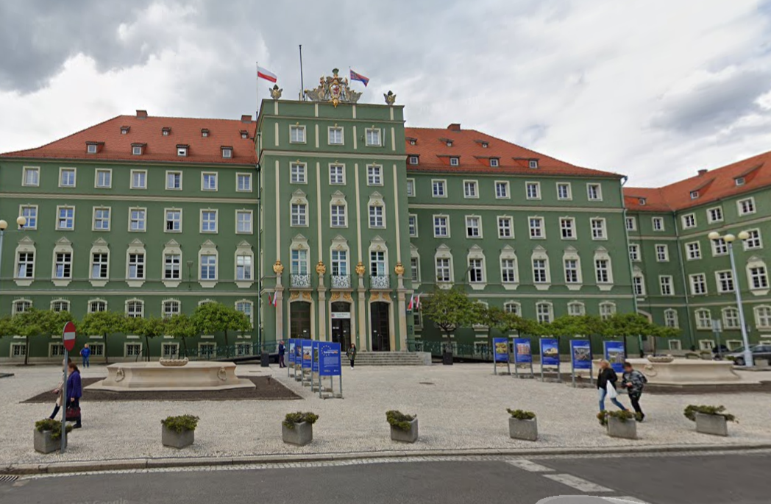
Urząd Miasta, Szczecin, Poland

Slide 6
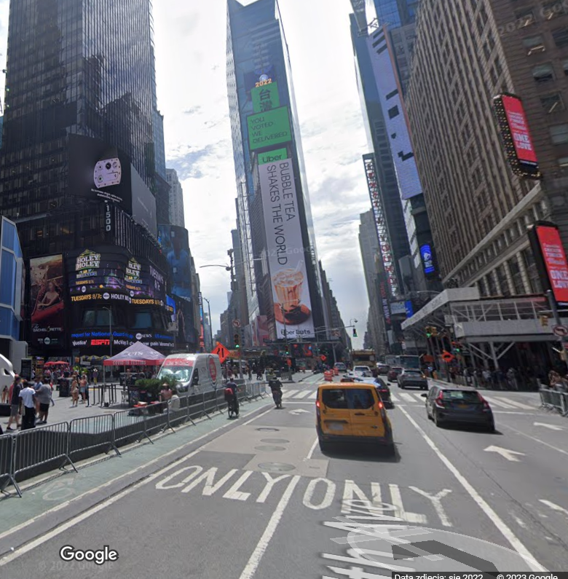
Times Square, New York

