Slide 1
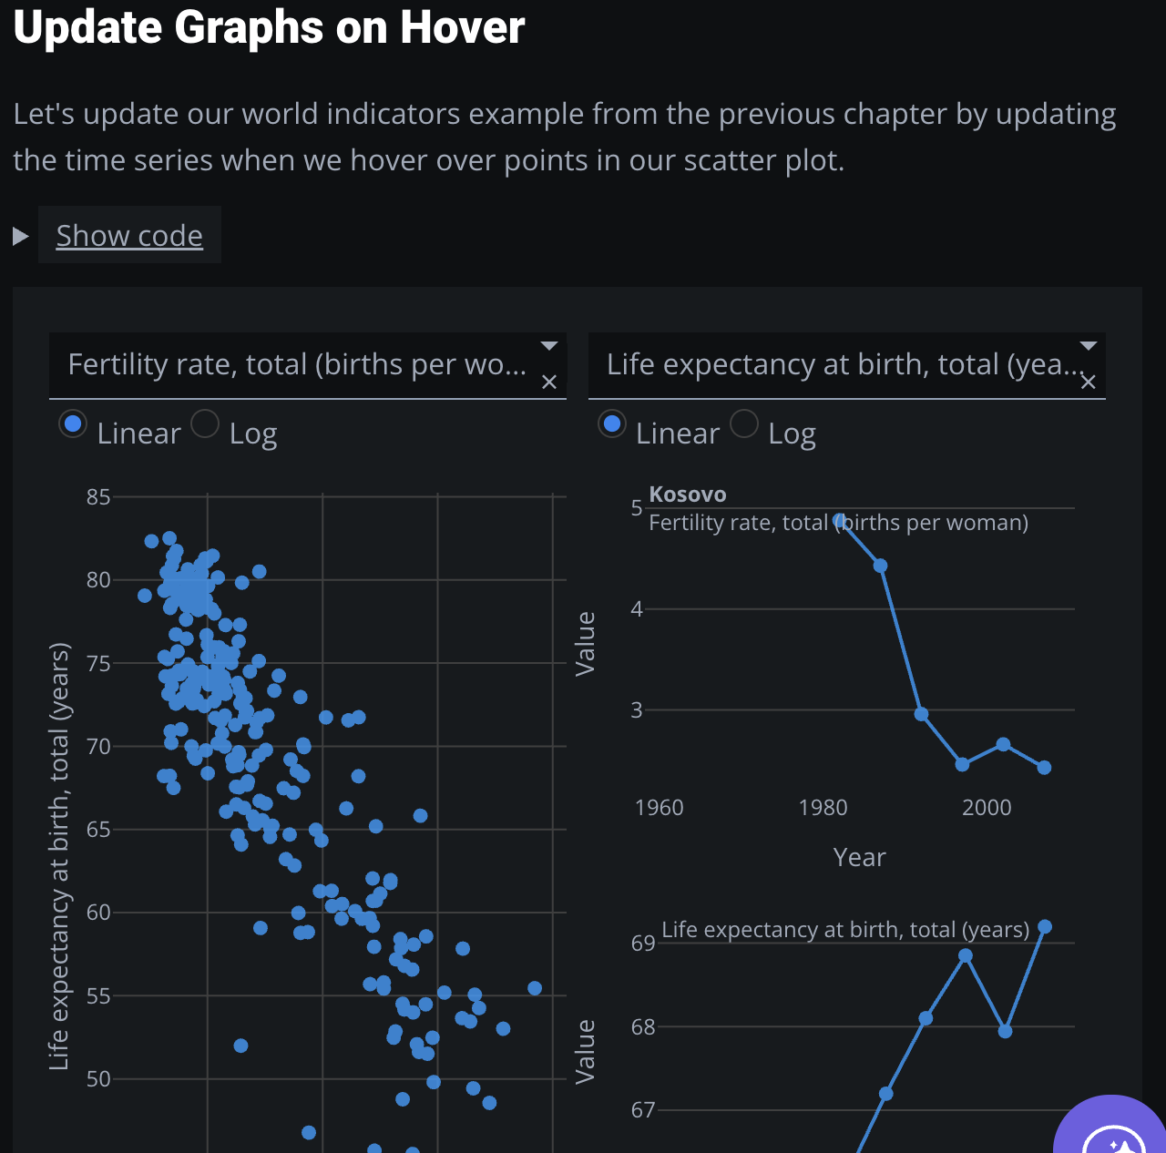
Exposure at hover
Different etf charts

