Slide 1

2022-2 Network Media
20180363 Sukyung Kim

Slide 2
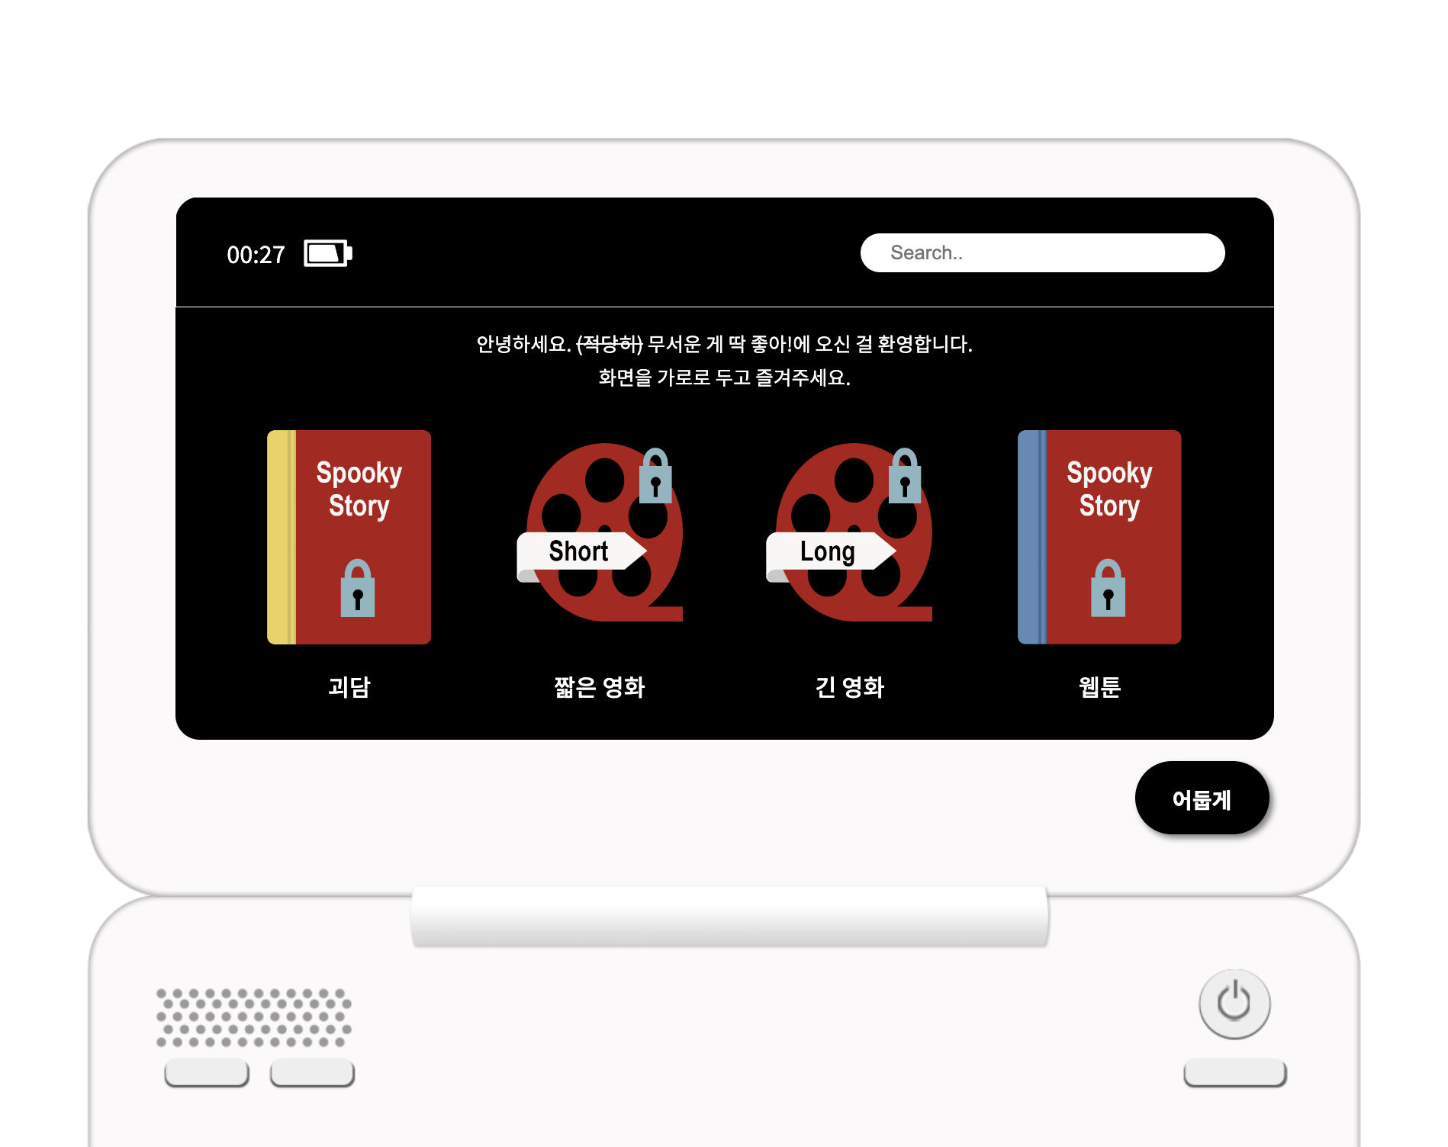
Introduction
A Webpage for all cowards who wants to read not too much scary novels or to watch moderate movies.
4 categories: novel, short films, movies, webtoons.

Slide 3
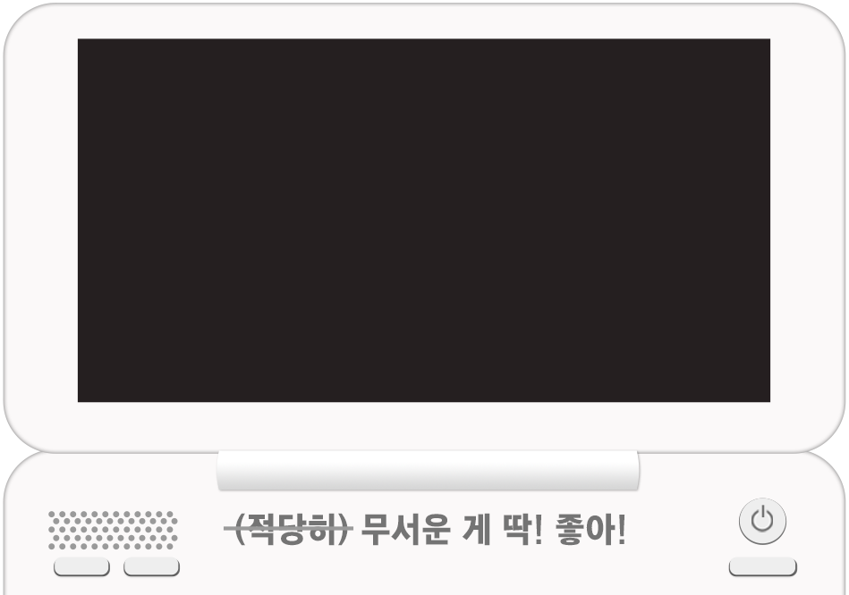
What is changed?
A digital Dictionary

Slide 4
Challenges
This is the first time to make a real webpage by myself
Making 3 view modes: dark/light/cute
Adjust size for all phone’s screens
Next Goal
More visual effect
Filling with more contents

