Slide 1
Preparation
Well in advance
Mail invite (Zoom or in-person) – Be mindful of the size of group
Have two F5’ers on the day (Trainer and helper/knowledge sharer)
Day before
Recommend you present with two monitors (one to present, one for notes)
Create Remote Desktop Server
Startup BIG-IP
https://cdn.f5.com/product/bugtracker/ID1353957.html
Install latest AS3 RPM
As a reminder – Walkthrough the course on your own
Create the Tools Access Training Spreadsheet

Slide 2
Day 1 workshop - 4 hours
Introductions – Yourself, any other F5’ers, and the trainees
While trainees are introducing themselves, add them to the Tools Access Training Spreadsheet
Presentation – Slidedeck Intro into REST-API, terminology, and AS3
Break
Start the Hands-On
At the end of the day review any outstanding questions to takeaway and address
Inform them that the BIG-IP/RDP will be left on for a few more hours so they can experiment further

Slide 3
Day 2 workshop - 4 hours
Address any fresh questions customers have
Address/Demo any questions from the day before
Cover the Ansible section
Introduce the toolchain process with OLTRA
At the end of the day review any outstanding questions to takeaway and address
Inform them that the BIG-IP/RDP will be left on for a few more hours so they can experiment further
Day 3 (Post workshop) – Send an email to all attendees with Slidedeck and other pertinent/useful material (example will be provided)

Slide 4
Details

Slide 5
Email Invite - Sample
Below are the links to downloads and installation guides of the tools needed. If you have any problems installing the tools prior to the workshop, please contact me directly.
All Windows and Mac Users:
Microsoft VS Code: https://code.visualstudio.com/download
https://code.visualstudio.com/docs/remote/wsl
Postman: https://www.getpostman.com/downloads/
Git client: https://git-scm.com/download
Register and create a github account: https://github.com/
Mac users:
· Ansible: https://docs.ansible.com/ansible/latest/installation_guide/intro_installation.html
Windows 10 Users:
· Linux Ubuntu subsystem: https://docs.microsoft.com/en-us/windows/wsl/install-win10
· Install Ansible into Linux: https://www.jeffgeerling.com/blog/2017/using-ansible-through-windows-10s-subsystem-linux
Windows 7 Users:
· Cygwin & Ansible: https://everythingshouldbevirtual.com/automation/ansible-using-ansible-on-windows-via-cygwin/
· Or… use a Linux VM and install Ansible.
It’s not a big deal if you can’t install Ansible… you can still create the playbooks, but won’t be able to run them. Also note that a RDP session can be provided to allow you to run this session if you cannot run them from your machine.
Look forward to seeing you on the workshop.
Regards
Shareef Qureshi
s.qureshi@f5.com
Hi there, thank you for registering and I would like to confirm your space in the two-day virtual hands-on automation workshop we are running on the 25/26 April.
Due to the large number of registrations/interest the group has been split in two, and you are part of Group B. Group A’s session has already taken place. Please note this is an Automation 101 level training, so this is an initial level of training to ensure that all students are familiar with BIG-IP/AS3 and use of the tools that will progress your journey in automation.
Please read the whole invite to ensure you are ready for the workshop – there are pre-requisites. Also confirm your attendance for the session.
. During the workshop you will have an opportunity to use Git, Postman and Ansible to deliver application services programmatically.
. You will be required to access a BIG-IP in AWS/Azure so please ensure that you are in a workplace that will allow you to connect to it.
. If you feel there will be restrictions trying to connect to external sites/tools, then consider working from home
. We can provide RDP access to the tools needed for this workshop, and this may be the simplest way to participate. In actual fact Group A found this method ideal.
. Of course having these tools on your own workstation will enable you to continue your learning post the workshop, so it is worth attempting to install the tools
. If you are a Windows user, please be aware that the installation process is involved and its important to work through all the steps required
. If you have any doubts on access from your workplace and wish to test beforehand then please contact me.
. You will need to create accounts on Github and for the postman application. It is worth doing this beforehand.

Slide 6
Invitation Email
First you need to send the invitation. This is the original template email, which I have modified to state that the focus is on *using*, rather than *installing* the tools:
<PREAMBLE>
I would like to invite you to a half-day hands-on automation workshop we are running on Wednesday 1st May @ our London EBC. During this 4 hour interactive session you will have an opportunity to use Git, Postman and Ansible to deliver application services programmatically, learning how automation can be used to deliver applications faster and more efficiently than ever before.
Our automation strategy is based around use of the F5 automation toolchain (https://www.f5.com/products/automation-and-orchestration). It allows for traffic management and application security to be managed programmatically, through simple, declarative APIs – allowing L4 – 7 application services to be deployed in the same manner as the applications they support. At the core of the F5 Automation Toolchain is the Application Services 3 Extension (AS3) which enables administrators and developers to automate layer 4–7 application services. Available free of charge from GitHub, It provides a sustainable foundation to enable F5’s Infrastructure as Code (IaC) strategy as well as supporting future integration with third-party orchestration, SDN, and NFV solutions.
During the 09.30 until 14.00 session, we will cover;
· Introduction to the F5 Automation Toolchain and Application Services 3 extension
· Using Postman to deploy a simple AS3 application
· Using VS Code and Ansible to deploy a simple AS3 application
· Using Git as the basis for an Infrastructure-as-Code approach to deploying application services
A working lunch will be provided
Please register and reserve your space by clicking this link
We look forward to seeing you on the 1st.
Kind Regards,
etc. etc.

Slide 7
Targeted Email to Registered Attendees
Prior to the event, you need to email the prerequisites for the workshop. The intention is for everyone to bring their own laptop with all the correct software installed, so they can walk away from the workshop ready to automate!
Some more information on the software required for the workshop
All Windows and Mac Users:
· Microsoft VS Code: https://code.visualstudio.com/download
· Postman: https://www.getpostman.com/downloads/
· Git client: https://git-scm.com/download
· Register and create a github account: https://github.com/
Mac users:
· Ansible: https://docs.ansible.com/ansible/latest/installation_guide/intro_installation.html
Windows 10 Users:
· Linux Ubuntu subsystem: https://docs.microsoft.com/en-us/windows/wsl/install-win10
· Install Ansible into Linux: https://www.jeffgeerling.com/blog/2017/using-ansible-through-windows-10s-subsystem-linux
Windows - Install ubuntu subsystem
· /mnt/c
· Cd /mnt/c
Windows 7 Users:
· Cygwin & Ansible: https://everythingshouldbevirtual.com/automation/ansible-using-ansible-on-windows-via-cygwin/
· Or… use a Linux VM and install Ansible.
It’s not a big deal if you can’t install Ansible… you can still create the playbooks, but can’t run them.

Slide 8
Build the Environment (Day before workshop)
Recommend you deploy a single BIG-IP. This should be sufficient for the size of the class.
The additional benefit to using a single BIG-IP is that its less units to manage when checking customer progress/issues
Get latest RPM to install on the BIG-IPs - https://github.com/F5Networks/f5-appsvcs-extension
Create Remote Desktop Server
Use Terraform template
https://github.com/coddigger/terraform-aws-ubuntu-ec2-instance

Slide 9
Install and run Terraform for RDP host (Day before workshop)
Install Terraform
Get terraform plan from https://github.com/coddigger/terraform-aws-ubuntu-ec2-instance
Modify params in terraform.tfvars accordingly
f5_se, aws_region, aws_az
Connect to AWS – Get Access Keys
Run option 1 or 2 - or even both ;)
cd to where you downloaded the terraform repo and run the following
cd $HOME/Documents/Scripts/AWS/terraform-aws-ubuntu-ec2-instance-shq
terraform init
terraform plan
terraform apply
Should complete within 4mins – capture the variables – public_dns, public_IP, rdp_password.
Remember when Auto-workshop is complete run ‘terraform destroy’

Slide 10
Document the Attendees.
You need to present a spreadsheet with the attendees names.
Each person should have a unique subnet and a shared BIG-IP MGMT IP. I normally work on a 1:4 ratio of BIG-IPs to attendees.
Student # | First Name | Last Name | BIG-IP Mgmt IP | F5 Credentials | Subnet | Attended | RDP | RDP user | RDP Password
student1 | Patrick |  | 51.142.10.142:8443 | User = admin Password = N3wAutomation | 10.0.1.0/24 |  |  | student1 | iApMVdGoqR
student2 | Michael |  |  |  | 10.0.2.0/24 |  |  | student2 | iApMVdGoqR
student3 | Koen |  |  |  | 10.0.3.0/24 |  |  | student3 | iApMVdGoqR
student4 | Richard |  |  |  | 10.0.4.0/24 |  |  | student4 | iApMVdGoqR
student5 | Novak |  |  |  | 10.0.5.0/24 |  |  | student5 | iApMVdGoqR
student6 | Damien |  |  |  | 10.0.6.0/24 |  |  | student6 | iApMVdGoqR
student7 | johannes |  |  |  | 10.0.7.0/24 |  |  | student7 | iApMVdGoqR
student8 | Luuk |  |  |  | 10.0.8.0/24 |  |  | student8 | iApMVdGoqR
student9 | Dennis |  |  |  | 10.0.9.0/24 |  |  | student9 | iApMVdGoqR
student10 |  |  |  |  | 10.0.10.0/24 |  |  | student10 | iApMVdGoqR
student11 |  |  |  |  | 10.0.11.0/24 |  |  | student11 | iApMVdGoqR
student12 |  |  |  |  | 10.0.12.0/24 |  |  | student12 | iApMVdGoqR
student13 | shareef |  |  |  | 10.0.13.0/24 |  |  | student13 | iApMVdGoqR
 |  |  | RDP Host name | ec2-3-10-80-228.eu-west-2.compute.amazonaws.com

Slide 11
Present Automation Toolchain (Day 1)
You can get a copy of the presentation from the EMEA Solutions Engineering Sharepoint site – same location as this powerpoint.
I normally take 30 minutes to present this, depending on questions asked along the way.

Slide 12
Start Workshop (Day 1)
The last slide of the presentation (the clouddocs page) is the start of the workshop.
Ask the students to go to https://clouddocs.f5.com
Point them at the AS3 section…
Then to the User Guide, and finally, the Quick Start.
They should be told that the first few steps in the Quick Start are to install the RPM (which is already pre-installed in the cloud instances by default), so they can skip straight to step 3.
Explain that the URI in step 6 and the example declaration should be copied and used to create a Postman request…

Slide 13
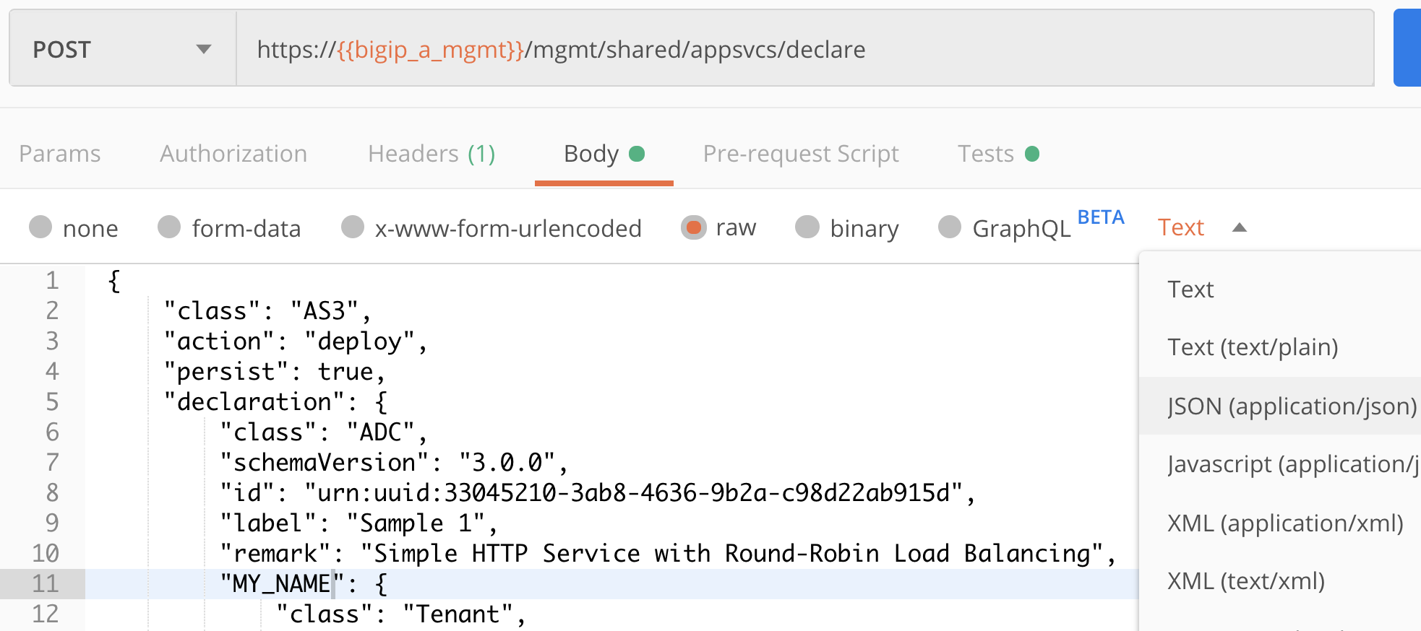
Create Simple Postman Request (Day 1)
They MUST modify the example to replace the tenant name “sample_01” with their name.
They MUST modify the IP addresses (VS and pool) to something allocated from their unique subnet.
Remember to remind them to disable SSL Cert Verification (Postman/preferences (Mac), File/settings (Win))
Remember to use ‘basic auth’ and set content-type to JSON, in order to get ‘pretty’ response:

Slide 14
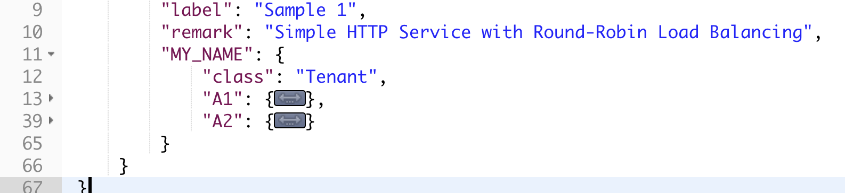
Modify Postman Request to Create Two Apps (Day 1)
Modify the declaration to create two applications (e.g. A1 and A2):
Note that you can (if your content-type is JSON), use the small triangle next to [line no.] ‘13’ to minimise and copy the correct section. Just add a comma and paste, then modify to A2 (along with the inner IPs)

Slide 15
Delete Tenant & Recreate (Day 1)
Ask one of them to see if they can figure out how to delete (It’s a trap!!).
If they don’t specify tenant everyone loses their work !!
No big deal just get everyone to resubmit in Postman
Discuss !!
Save your request, then issue a delete to ../declare/<tenant>
You can then redeploy your tenant because you saved the code! You have just achieved Infra as Code.
Talk about the use Patch to add additional Apps
Talk about the use of variables in Postman (e.g. graphic above) – {{username}} {{password}}
Talk about JSON Parsers https://jsonformatter.org/json-parser

Slide 16
AS3 Postman collections (Day 1)
Download Postman collection - https://github.com/F5Networks/f5-appsvcs-extension/releases/tag/v3.20.0
https://github.com/F5Networks/f5-appsvcs-extension/releases/download/v3.20.0/as3-3.20.0-3.examples.collection.json
Go to F5networks, AS3, then ‘Releases’ on right hand side, then 3.20.0 then find the collection.

Slide 17
Show examples of Shared Objects and reference one (Day 1)
Highlight objects can be created as shared
https://github.com/shqureshif5/AS3CommonShared/blob/main/AS3commonTest1.sh
Get the customers to reference ‘poolRoundRobin’ with application A2
Example - https://github.com/shqureshif5/AS3CommonShared/blob/main/AS3commonTest2.sh

Slide 18
Show ACC Chariot and F5 Extension in VSC (Day 1)
Use F5 Extension to open a BIGIP conf file
Find some interesting VIPs (maybe with an iRule)
Export using ACC Chariot (note iRule does not get parsed)
Highlight its not perfect
Find an iRule and export using ACC Chariot
Highlight that this is encoded

Slide 19
Prep for Ansible - Create a ‘Project’ Folder (Day 2)
Create (or identify an existing) project folder on your OS.
On ubuntu –
cd /home/<studentXX>
Then create Projects folder
mkdir Projects

Slide 20
Prep your Github repo (Day 2)
Login to your github account
Select Green icon (New) – Create a new repository
Give it a name e.g. ‘autows’
Keep it as ‘Public’
Tick box –> add a README file
Add .gitignore ‘Textpattern’
Choose a license ‘none
Select Green icon 'Create repository’
Select Green icon ‘Code’
Under HTTPS – ‘Copy URL to Clipboard’

Slide 21
Clone Git Repo into Project Folder (Day 2)
Open the Project folder in VS Code using ‘Add Folder to Workspace’…
DON’T JUST ADD A FOLDER!
Right-click the Project folder and ‘open in terminal’.
Windows users might have to change their default shell to ‘wsl’.
Once in the shell terminal, ‘pwd’ should show that you’re in the Project folder.
‘git clone <paste the git url>’
This should create a new folder called ‘autows’ and contain .gitignore and readme files.

Slide 22
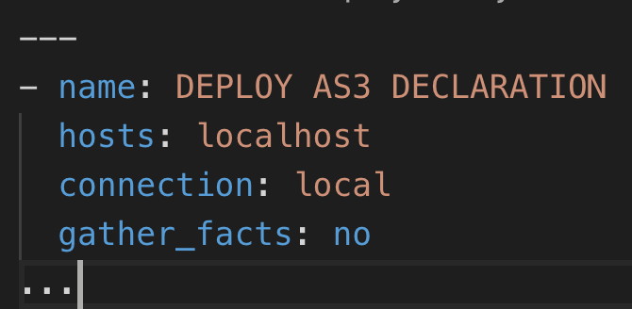
Create Ansible Playbook (Day 2)
Explain YAML (compare to JSON)
Computers can easily parse JSON
Humans can easily read YAML
The converse is not true
Correct indentation is critical with YAML. Two spaces is the standard.
Create a new file in ‘autows’ folder named ‘as3-playbook.yaml’
YAML standard tops and tails the file with --- and …
Add the first few lines:
dash space name: The dash at position zero. Any name for your playbook.
‘Hosts’ replaces an inventory file. Tells ansible to execute the task on the localhost.
connection: local also tells ansible to execute the task on the local machine.
gather_facts: no tells Ansible not to waste time collecting information about the machine (local)

Slide 23
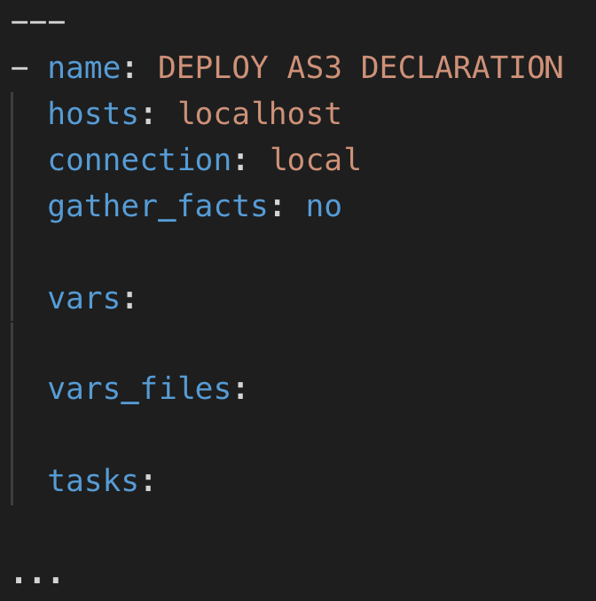
Create Ansible Playbook (Day 2)
Add the following high-level sections (and explain that we will populate them later:
vars
We can set variables in the playbook
vars_files
We can also pull in variables from separate files. There are actually many ways to access variables in Ansible: https://docs.ansible.com/ansible/latest/user_guide/playbooks_variables.html#variable-precedence-where-should-i-put-a-variable
tasks
This is where we tell ansible what we want it to do.

Slide 24
Create Ansible Playbook (Day 2)
Ask students to google ‘ansible modules’.
Show them the imperative bigip modules (many). Cmd-F (Mac) Ctrl-F (Win) ‘bigip’
Show them the ‘bigip_appsvcs_extension’ which is for AS3, but we are going to use the Ansible URI module. It is vendor agnostic and can be used to access any REST API (or any HTTP resource, for that matter)
Cmd-F (Mac) Ctrl-F (Win) ‘uri ’… that is, search the page for uri<space>.
Show them the uri module page, and notice how many of the parameters relate to what you have just done in Postman (body, body_format, method, status_code, url, etc.)
Drop a hint / ask a question about the validate_certs parameter (mirrors the disable SSL Cert Verification in Postman).
Show the Examples section, and then ask them to ‘Steal’ the code from one of the examples, the ‘Create a Jira Issue’.

Slide 25
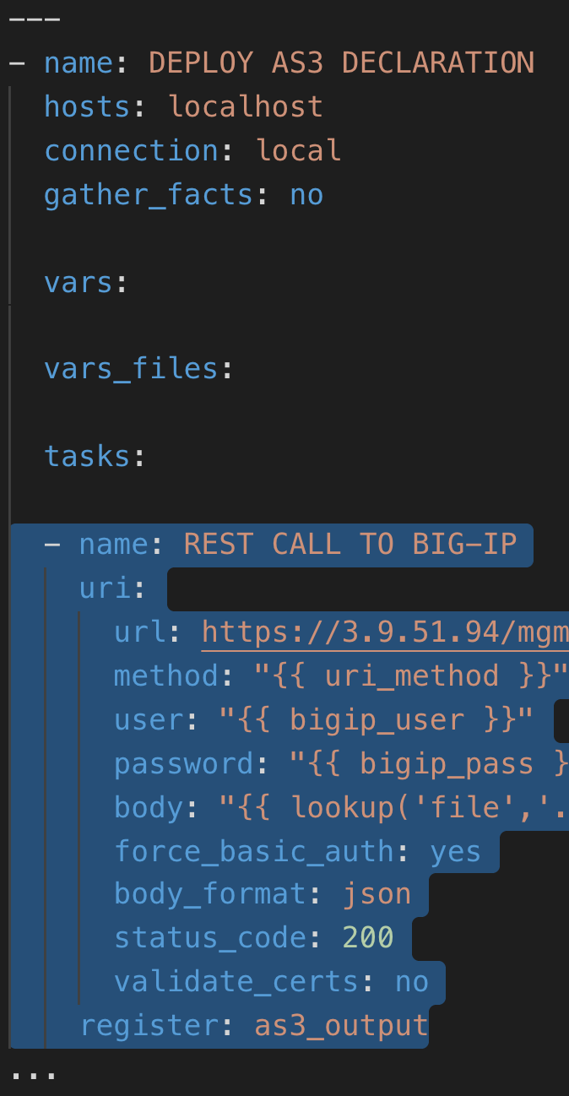
Create Ansible Playbook (Day 2)
Paste the Jira issue task into the ‘tasks’ section, and then indent to the right… select the text and then hit ‘tab’ or cmd/ctrl ‘]’
The task should start with space space hyphen space name:
Ask the students to modify the parameters to reflect what they have just done in Postman. Don’t modify the ‘body’ line yet.

Slide 26
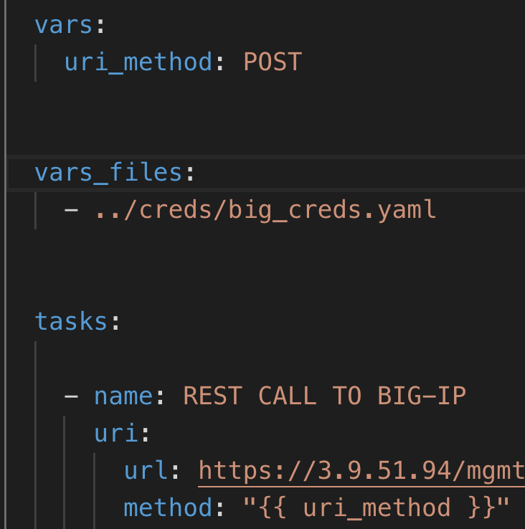
Create Ansible Playbook (Day 2)
Show how to define and use a variable… Replace:
method: POST
with
method: "{{ uri_method }}"
…and add
uri_method: POST
to
vars:

Slide 27
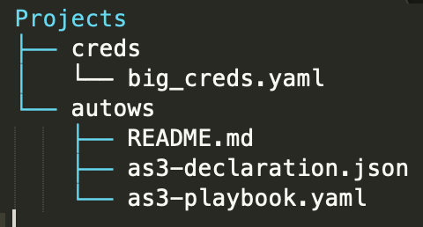
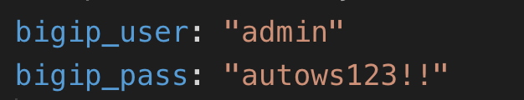

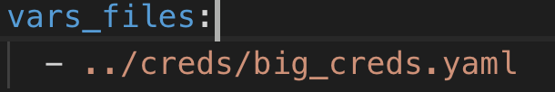
Create Creds Vars File (Day 2)
Ask what everyone has used as values for the “user” and “password” values.
Explain that you should never put values in there… even when testing. You might get interrupted and forget!
Creating a new ‘creds’ folder OUTSIDE our ‘autows’ folder means that it will not be pushed up to our public git repo.
Create a new file ../creds/big_creds.yaml and add two variables
Reference them in the playbook
Reference/import the vars from the big_creds.yaml file:

Slide 28
Create AS3 Declaration File (Day 2)
Create a new file ‘as3-declaration.json’.
Paste in the body from postman and SAVE!
Reference it in the body line of the task:
You can add the schema validation to the JSON https://clouddocs.f5.com/products/extensions/f5-appsvcs-extension/latest/userguide/validate.html
Demonstrate that it reports errors when you remove a comma or change ‘servicemain’.

Slide 29
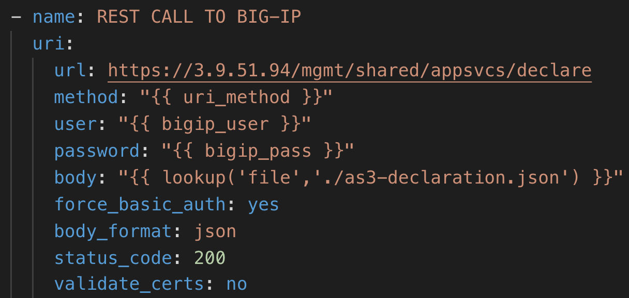
Check Ansible Playbook (Day 2)
Make sure the task (and the playbook) is correct… walk through it on the screen.

Slide 30
Run Ansible Playbook (Day 2)
Run ‘ansible-playbook as3-playbook.yaml’
Now help resolve any problems!

Slide 31
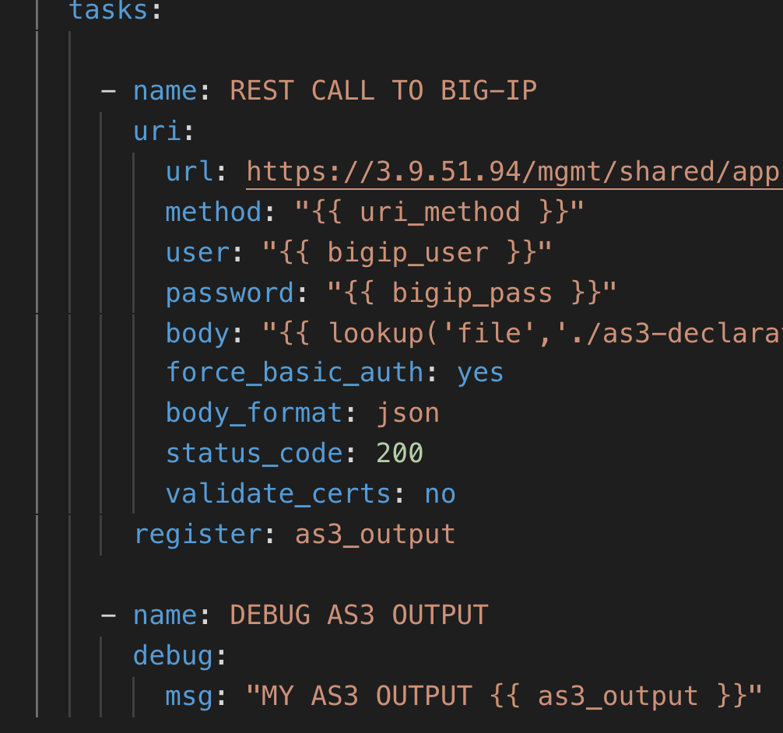
Output Data (Day 2)
Add ‘register’ to task..
Create a new task to show the debug output…. You can see the response!
You can also reference a specific JSON element in the response with {{as3_output.<JSON element name>}}

Slide 32
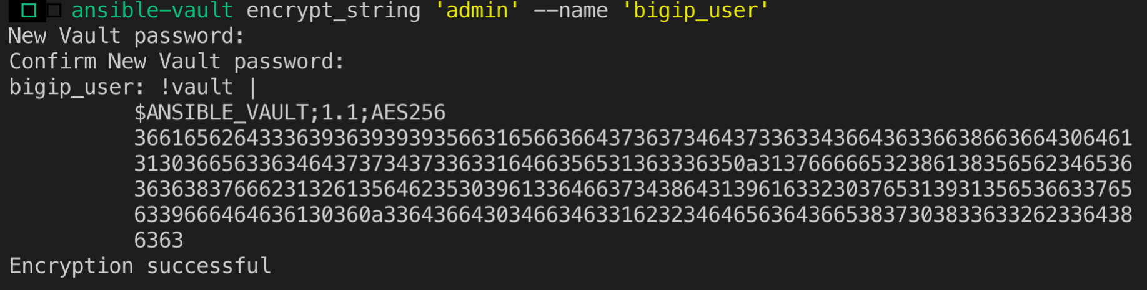
Encrypt Creds (Day 2)
Encrypt your username and password using the commands:
ansible-vault encrypt_string ‘admin' --name ‘bigip_user’
ansible-vault encrypt_string ‘autows123!!' --name ‘bigip_pass’
Enter your chosen passphrase, which is the encryption key (you need to use the same passphrase for all encrypted values referenced by the same playbook)…
It will output an encrypted value (that you can insert into your vars file) like this:

Slide 33
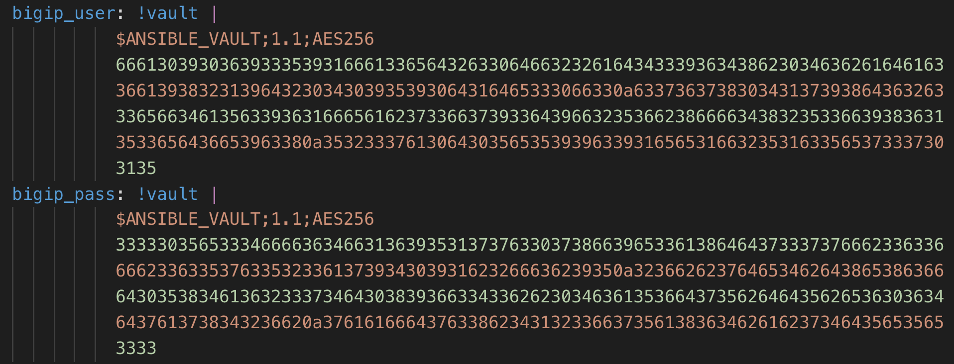
Encrypt Creds (Day 2)
Your original big_creds.yaml:
The new version with encrypted values:

Slide 34
Run Ansible Playbook (again) (Day 2)
Run ‘ansible-playbook as3-playbook.yaml --ask-vault-pass’
This time, you will be prompted for the passphrase, which will be used to decrypt all variable values that start with
“!vault |
$ANSIBLE_VAULT;1.1;AES256”
Like these:

Slide 35
Run Ansible Playbook (again) (Day 2)
Run ‘ansible-playbook as3-playbook.yaml --ask-vault-pass’
This time, you will be prompted for the passphrase, which will be used to decrypt all variable values that start with
“!vault |
$ANSIBLE_VAULT;1.1;AES256”
Like these:

Slide 36
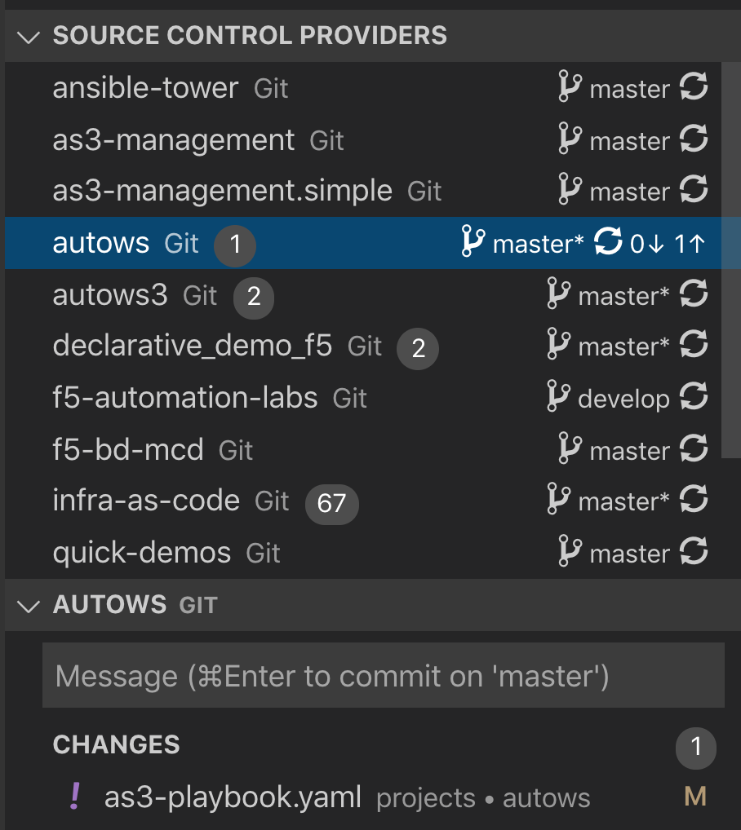
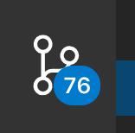
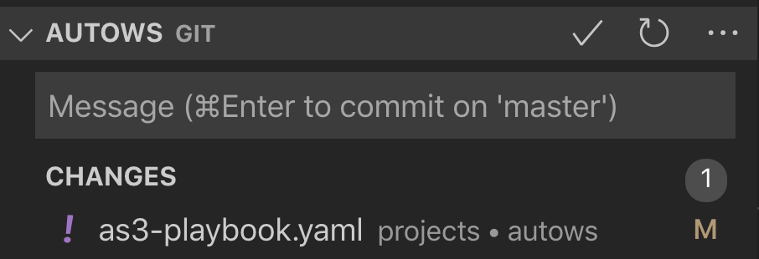

Push Changes Up to Git (Day 2)
If you click this icon in the left menu in VS Code:
You should be able to select ‘autows’… and see changes listed below.
You can click the check/tick mark to commit the changes.
You will need to enter a commit message.
Finally, you can click here:
That should push your change[s] up to your git repo.

Slide 37
Show an example of a full Automation Toolchain (Day2)
Whilst the audience should only be focused on BIG-IP/AS3/Ansible, there is always a desire to understand a working example of a full toolchain.
The below labs showcases this very well.
Allocate about 20mins to cover this demo (have your helper run this session).
https://github.com/F5EMEA/oltra/tree/main/use-cases/automation/bigip

Slide 38
Debrief mailshot to Attendees (Day 3)
This link is a useful one to keep in mind https://clouddocs.f5.com/products/extensions/f5-appsvcs-extension/latest/userguide/faq.html
For Github when synchronising config to the cloud, there are some initial steps when using a new workstation/setup
The first-time will error, and you will need to type two commands at the terminal prompt to ensure the config will push upto the repo
Check the log message and it will instruct you to run a couple of commands
Run these in the terminal window.
One thing I recently discovered is that you ensure that the 2 commands are run within the same shell that you ran the ‘git clone <repo url>’ from
Remember to document the changes made and click the tick button to the right of the window
Git will ask for some further user verification
YAML rules
https://docs.platform.sh/learn/overview/yaml/what-is-yaml.html#:~:text=YAML%20is%20case%2Dsensitive.,are%20preceded%20by%20an%20octothorpe%20%23%20
Using JINJA with Ansible
https://spacelift.io/blog/ansible-template
https://clouddocs.f5.com/training/community/automation/html/class14/module3/3.0-as3-intro/3.0-as3-intro.html
I hope you found it useful and please let me know if there is anything I have forgotten to send you, or would have liked to be included in the session.
Thanks
Shareef.
Thanks for joining last week and here is the powerpoint and other links to material to continue your AS3 journey 😊.
I’ve attached the powerpoint that I talked through on day 1
If you are interested in seeing my AS3 declaration (which includes some iRules in the example post) you can see this on GitHUB here - https://github.com/shqureshif5/autows
Also here are some more repo links, with further examples
Arch: https://github.com/s-archer
Shareef: https://github.com/shqureshif5
Nicolai: https://github.com/coddigger
F5 BIG-IP Declarative Collection for Ansible: https://github.com/F5Networks/f5-ansible-bigip
rSeries Postman collection
https://clouddocs.f5.com/api/rseries-api/rseries-api-workflows.html
https://github.com/s-archer/rSeries-ansible-gtm-ltm/
There was mention of using BIG-IQ to initiate automation, there are a few differences, primarily with authentication which is token based rather than basic auth - https://clouddocs.f5.com/products/big-iq/mgmt-api/v5.4/ApiReferences/bigiq_api_ref/r_auth_login.html#:~:text=Whenever%20you%20perform%20an%20authenticated,token%20expires%20after%205%20minutes.
Further BIG-IQ API methodology is here https://clouddocs.f5.com/products/big-iq/mgmt-api/v0.0/
Remember the useful tool in vs-code F5 ACC Chariot that allows you to take bigip config snippets and convert to AS3
Here is an example of how to use /Common/Shared - https://github.com/shqureshif5/AS3CommonShared
Some of you were interested in the declarative onboarding section - https://clouddocs.f5.com/products/extensions/f5-declarative-onboarding/latest/
I have some scripted examples here, that also upload the RPM via the script. https://github.com/shqureshif5/F5OS-DO-tenant

Slide 39
Pointers to be aware of and things to avoid
Do not be afraid of making mistakes – embrace it, be obtuse when asking them to run a task
They like solving/highlighting problems – encourages involvement
Customers will sometimes use their personal laptop for the training, and their work laptop for Zoom/Teams.
Not much can be done here, but convince them to use the RDP host, will give you a better chance to workout any problems they have.
Some customers will have restrictions on connecting to hosts that are self-signed
If this is a specific/single customer group session, always best to arrange a pre-test with a representative to make sure tools access is good
Customers seem to have a DMZ mechanism where they are allowed to do this. This can then be knowledge shared in advance.
Have the customers share their screen to highlight problems, or if they have something interesting to show (let them present)
Encourage (almost force) customers to interact verbally – this greatly improves the session – everyone gets involved
Use the Partition view as a means to check everyones progress

