Slide 1
Denver Crime Data
Team members: Yu Liu, Hui Du, Siyuan Ji

Slide 2
Dataset and motivation slide Why dataset was collected.
In order to count the occurrence of crime and accidents and how to keep away from crime and avoid accidents

Slide 3
Describe the meta data of your dataset.
This dataset is collect from [https://www.kaggle.com/paultimothymooney/denver-crime-data], which is collected all crimes happended in Denver recent years.

Slide 4
Research Questions What real world problem you trying to solve and why.
We are trying to analyse the most dangerous area and most dangerous time in Denver，and try to figure heatmap.
What is input and output of your analysis.
input: crime.csv (csv files store denver crime data)
output: 4 bar plots, two pie plots, 3 heat maps.

Slide 5
Data wrangling and statistical summary Unusual thing

Slide 6
Data summary statistics and interpretation
df['IS_TRAFFIC'].sum()
sum of traffic number is 118163
df[‘IS_CRIME'].sum()
sum of crime number is 336074

Slide 7
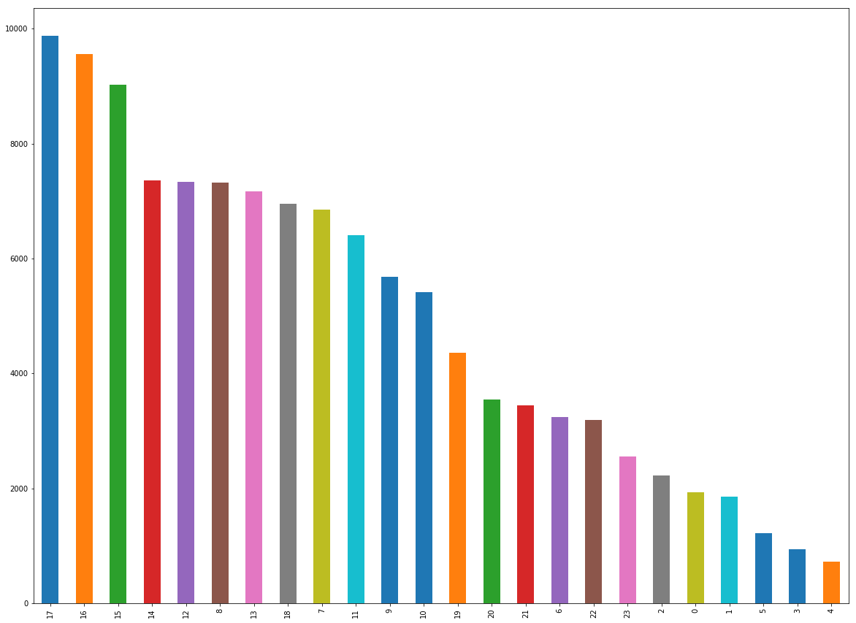
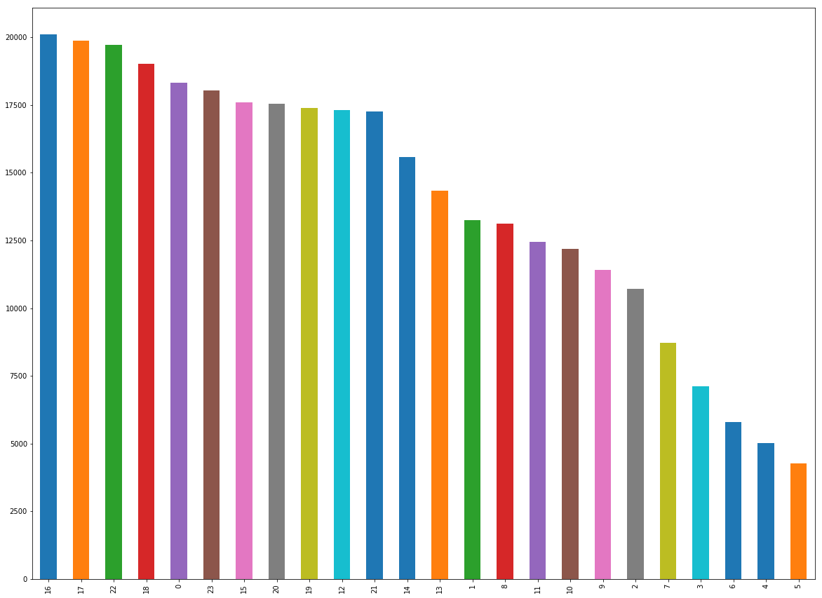
Main visualization
From this figure, we can see the 17 o'clock has the most frequency of traffic accident, and 4 o'clock has least frequency.
From this figure, we can see the 16 o'clock has the most frequency of crime event, and 5 o'clock has least frequency.

Slide 8
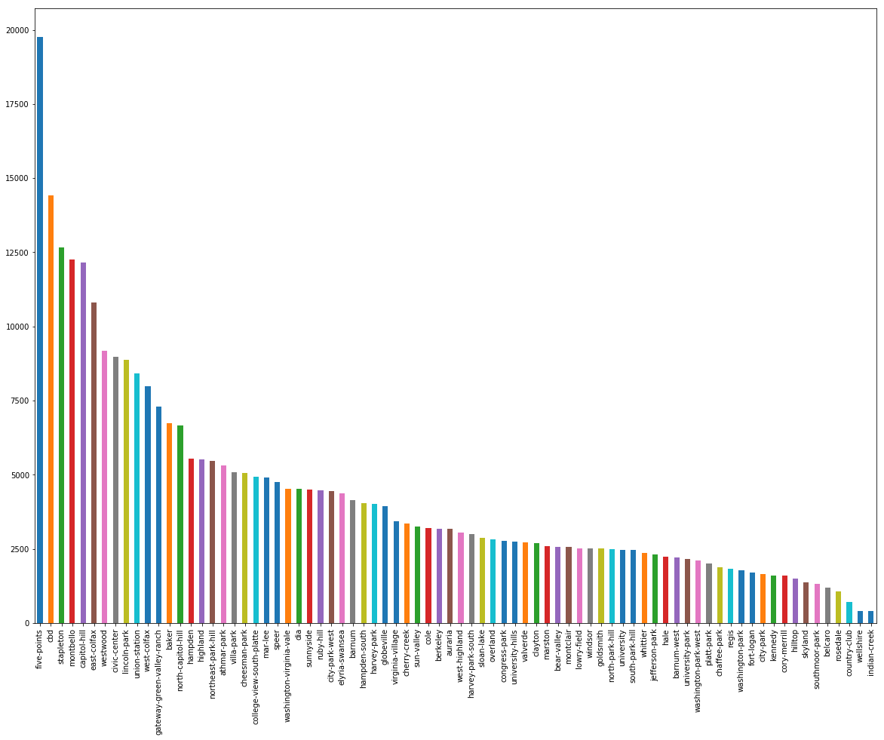
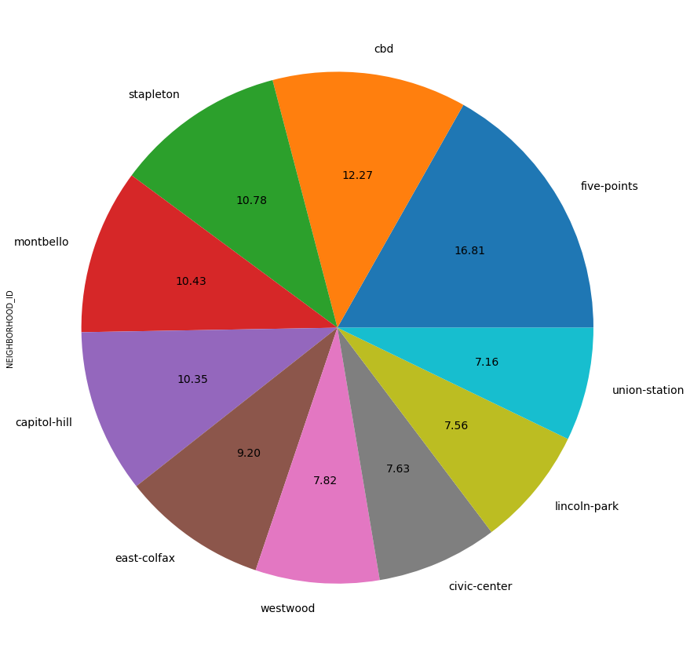
From this figure, we can see the five-point has the most frequency of crime neighborhood, and indian-creek has least frequency.
Figure: show most ten frequency crime neighborhood.

Slide 9
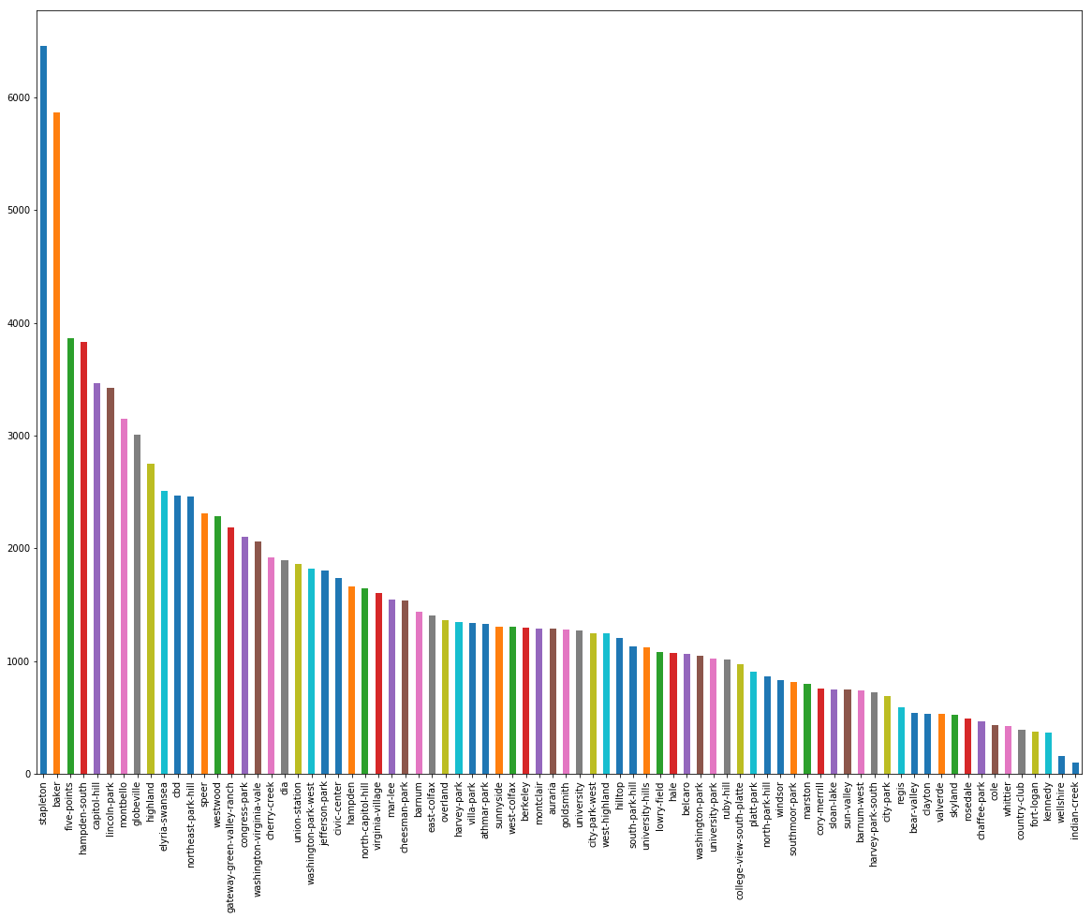
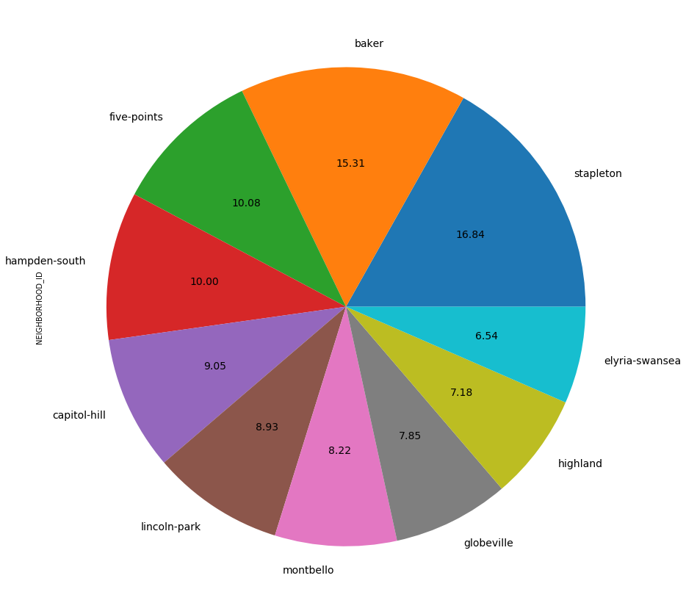
From this figure, we can see the stapleton has the most frequency in traffic accident, and indian-creek has least frequency.
Figure: show most ten frequency crime neighborhood.

Slide 10
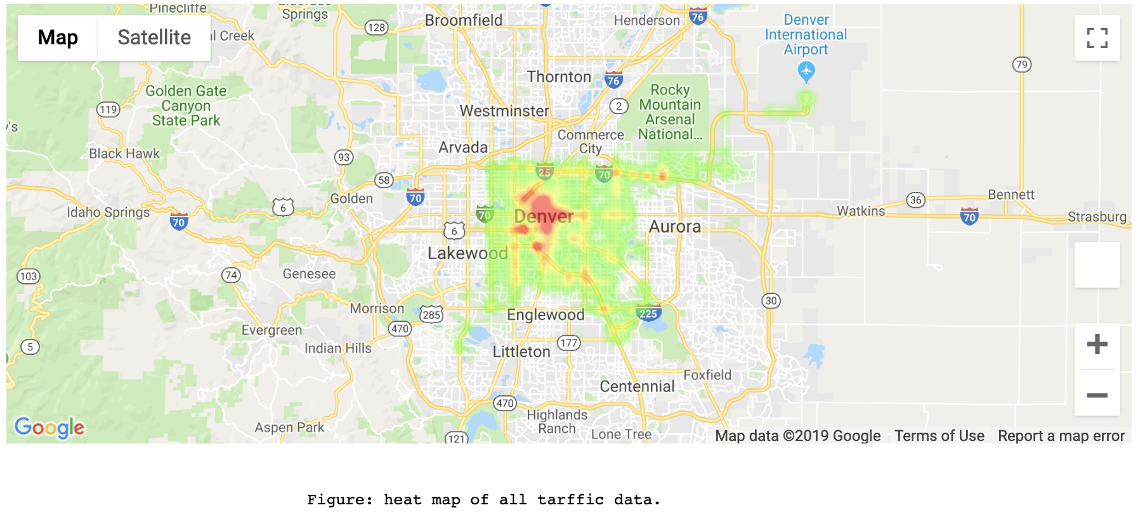

Slide 11
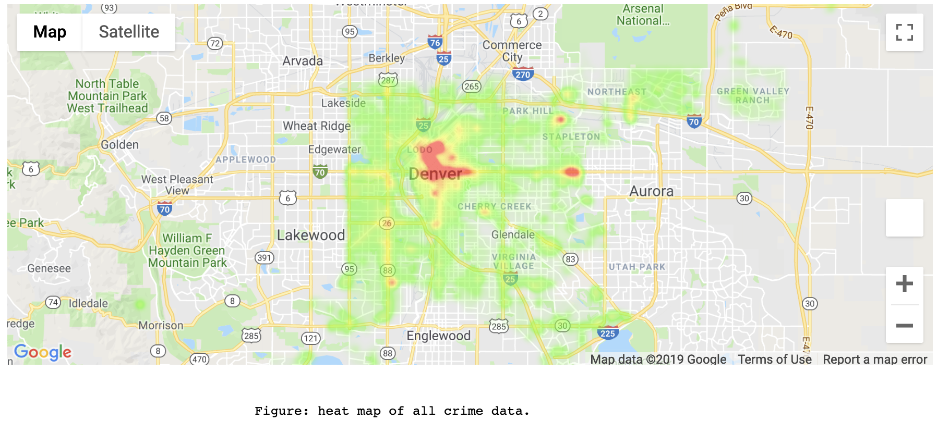

Slide 12
