Slide 1
Linux under attack
Chester Wisniewski
Senior Security Advisor
@chetwisniewski

Slide 2

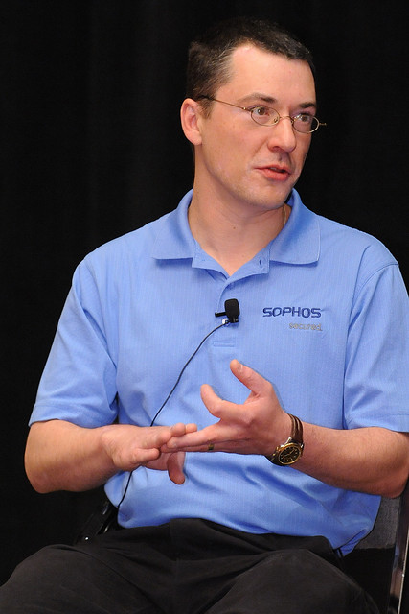

Who am I?
Notes:
CHET

Slide 3
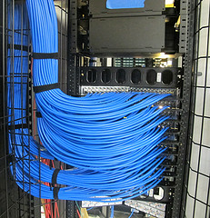
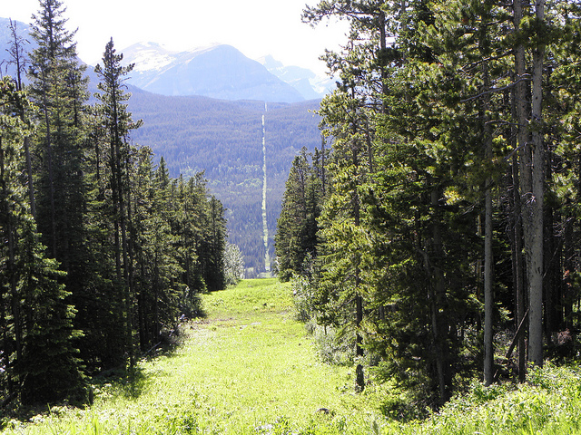

Why target Linux?
=
CC photo by NYC Department of Information Technology & Telecommunications
CC photo by Carolyn Cuskey
Notes:
AIDS Information Introductory Diskette 11-dec-1989
20,000 mailed to UK, Europe, Africa and Australia
$1200 PC Business World subscriber list
Dr Joseph Popp arrested in Cleveland,Ohio extradition
Held at Brixton Prison on 11 counts of blackmail
Wore a cardboard box over his head in court
Declared “public disgrace”
Claimed money to go to AIDS research
Jim Bates released AIDSOUT and CLEARAID
QuickBASIC3
Serial #'s generated from time/date
Fake DOS type read.me fake reboot
It was redumentarily packed

Slide 4
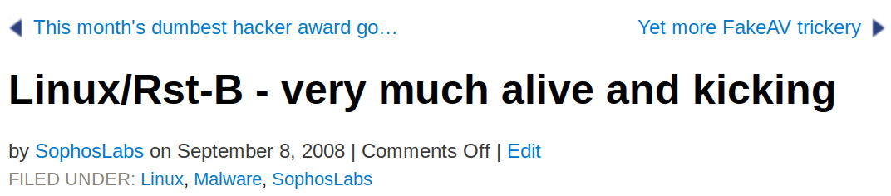
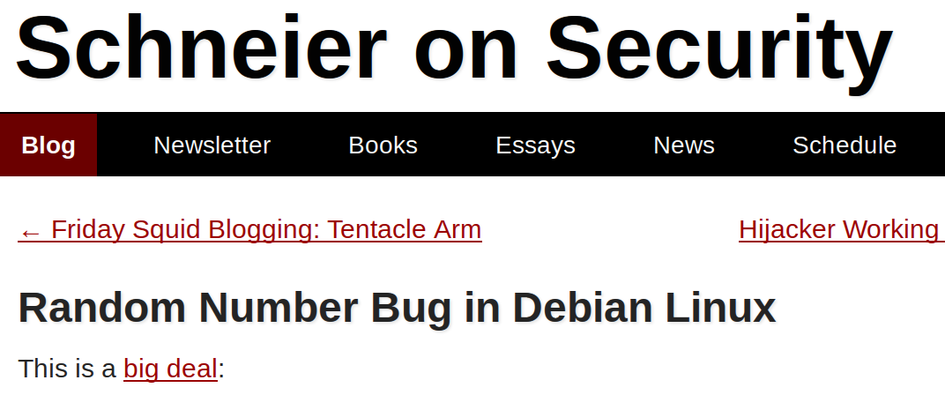

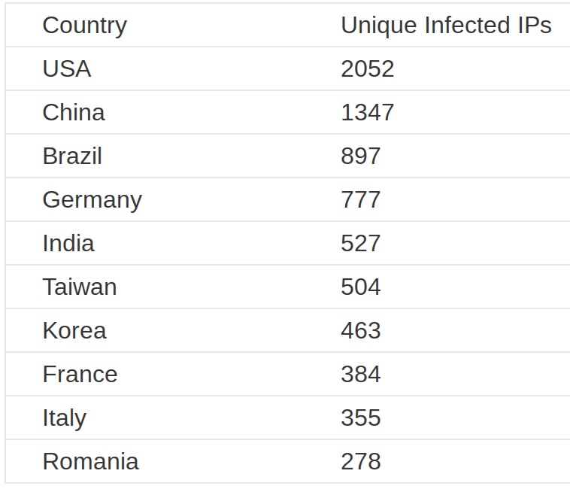
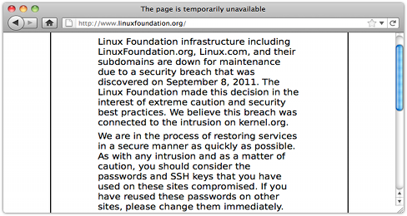

Not a new problem

Slide 5

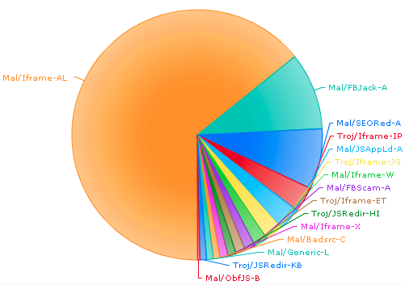


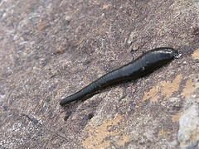
Darkleech draws attention

Slide 6





Methodology
01-Feb 00:00:00 UTC to
06-Feb 23:59:59 UTC
178635 total entries
2 Categories
    Infected (legit)
    Repository (KMD)
Totals (120,243 after dedup)
1,658 Infected domains
33,039 Infected URIs
6,448 Repository domains
79,976 Repository URIs
121,121 Total

Slide 7
Web server distribution - all
9.6%
36.5%
15.9%
20.1%

Slide 8




Web server comparison – Total vs. Netcraft
Netcraft | Malicious | Server | Difference
27.5% | 20.1% | Microsoft (IIS|UPnP) | -7.3%
39.7% | 36.5% | Apache httpd | -3.2%
14.6% | 15.9% | Nginx | +1.3%
2.3% | 9.6% | Google | +7.3%
16.0% | 11.7% | Other | -5.3%

Slide 9
Web server comparison – Infected vs. Netcraft
Netcraft | Infected | Server | Difference
27.5% | 17.3% | Microsoft (IIS|UPnP) | -10.2%
39.7% | 56.0% | Apache httpd | +16.3%
14.6% | 13.5% | Nginx | -1.1%
2.3% | 1.5% | Google | -0.8%
16.0% | 11.7% | Other | -5.3%

Slide 10
Web server comparison – Mal Repo vs. Netcraft
Netcraft | Malware Repo | Server | Difference
27.5% | 20.9% | Microsoft (IIS|UPnP) | -6.6%
39.7% | 28.5% | Apache httpd | -11.2%
14.6% | 17.1% | Nginx | +2.5%
2.3% | 12.8% | Google | +10.5%
16.0% | 20.5% | Other | +4.5%

Slide 11
Compromise methods - Apps

Slide 12

Infected sites - Detections
Detection type | %
SEO | 36.1
JSRedir | 26.1
Iframe | 18.7
BadSrc | 15.5
Other | 3.5

Slide 13
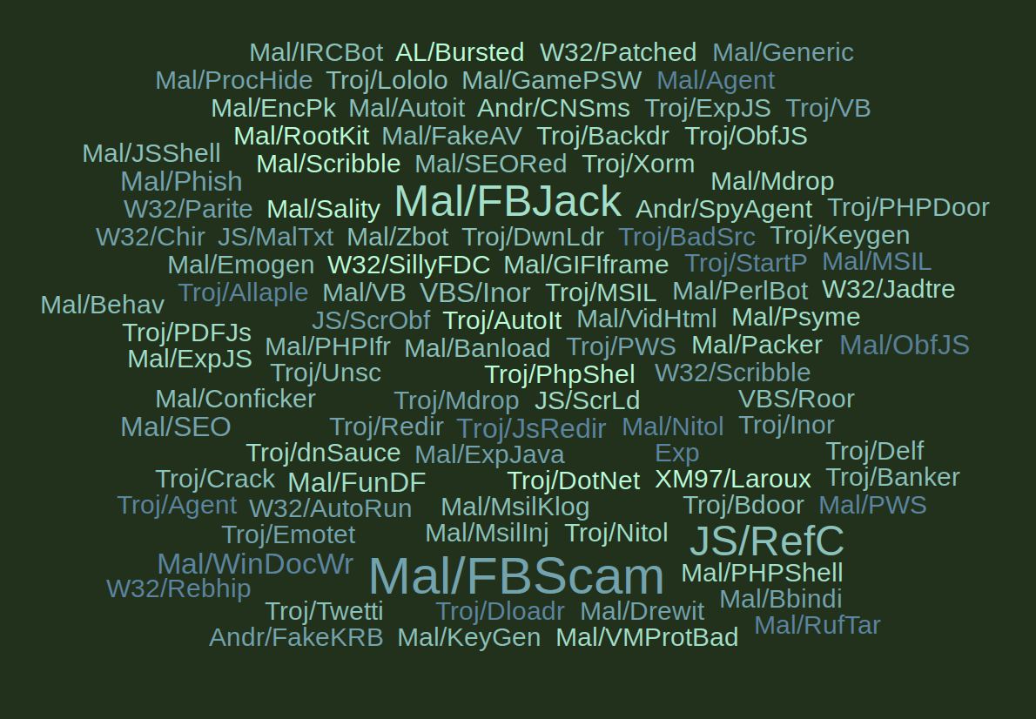
Repository sites - Detections
Detection Type | %
HTMLGen | 49.4
FB{Jack,Scam} | 28.4
Inor | 1.6
ObfJS | 0.9
Phish | 0.7
Exp | 0.2
Andr | 0.2

Slide 14
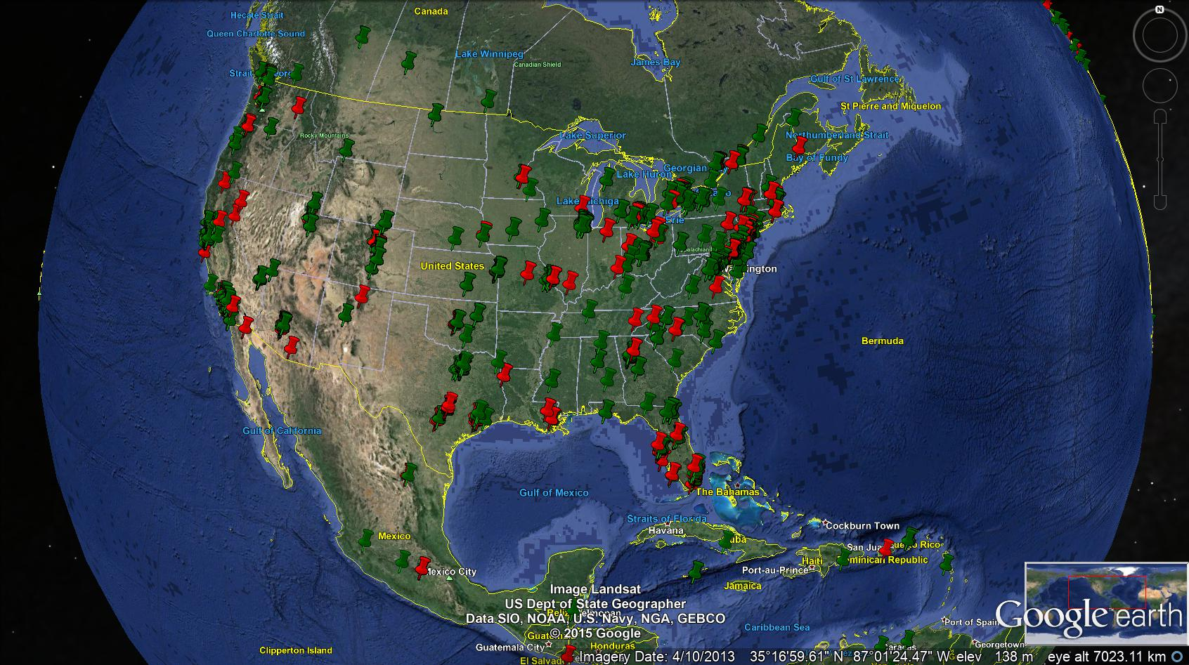
Is it regional? - North America

Slide 15
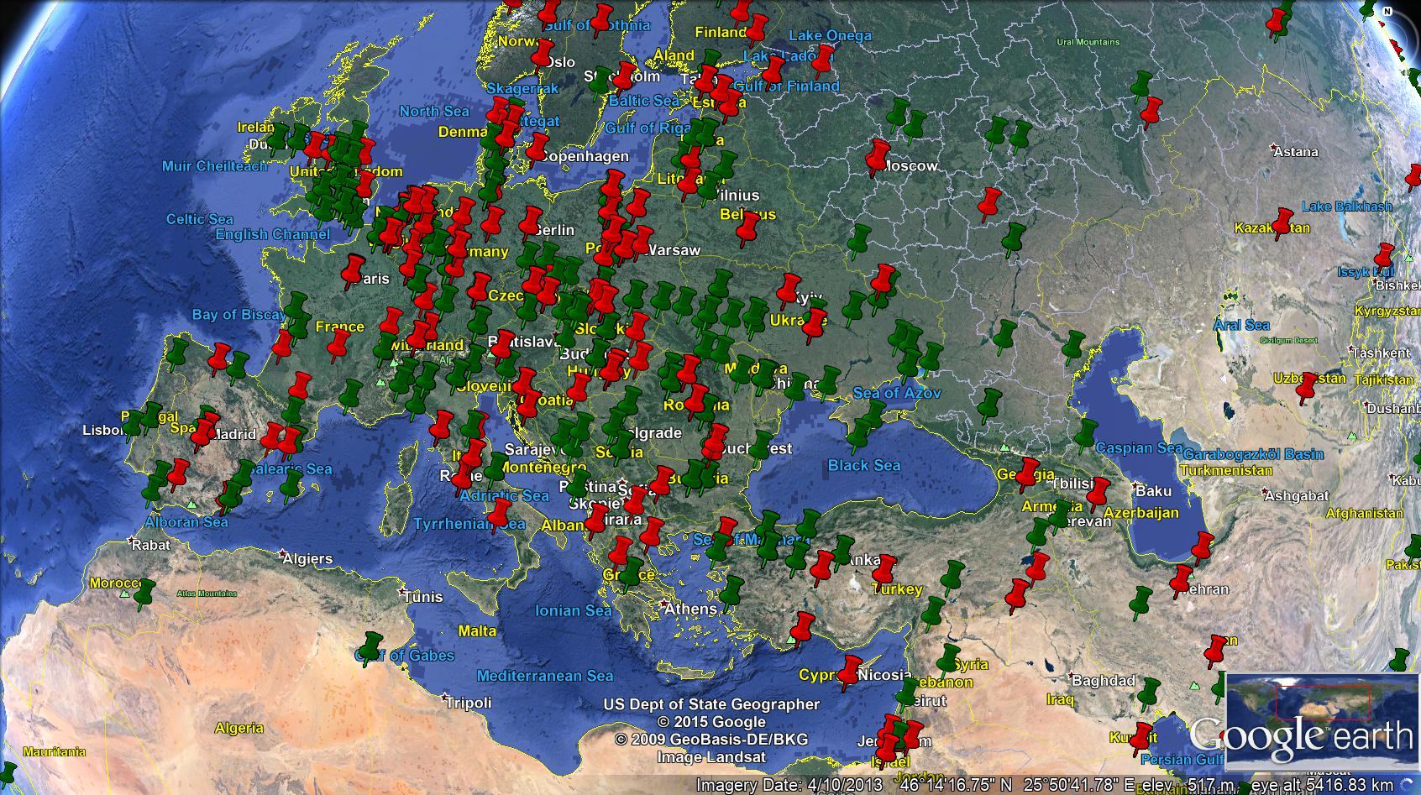
Is it regional? - Europe

Slide 16
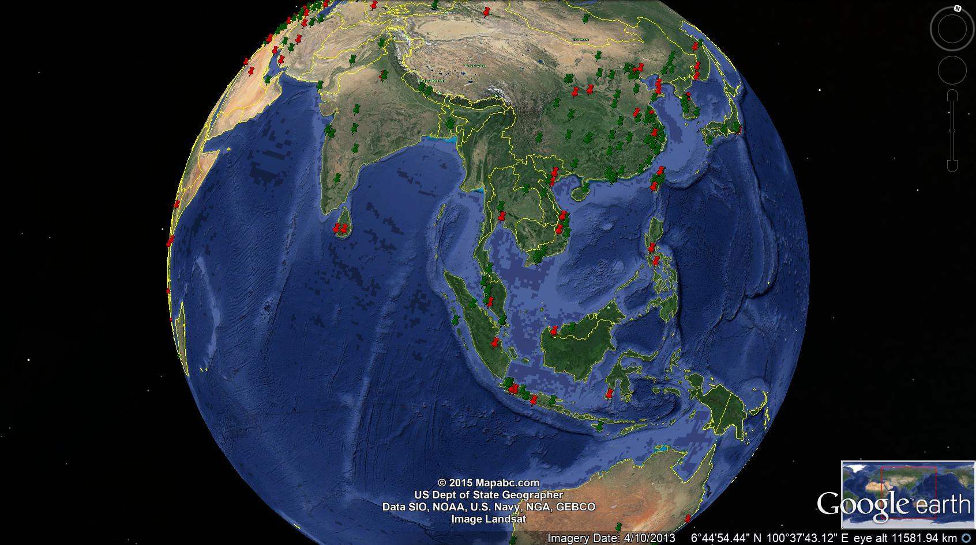
Is it regional? - APAC

Slide 17


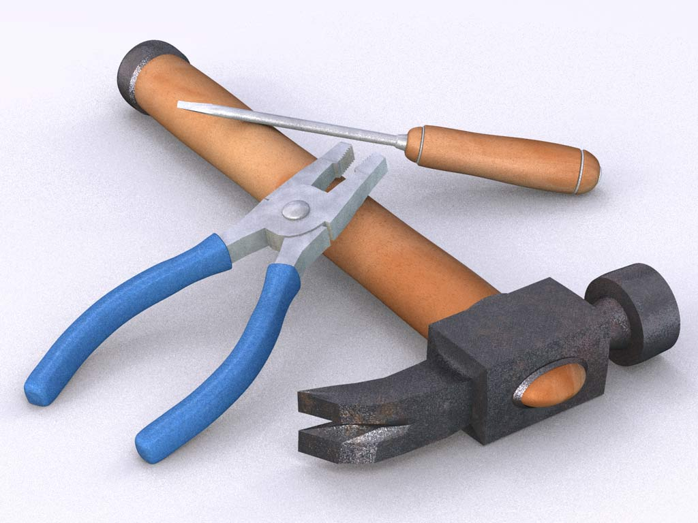



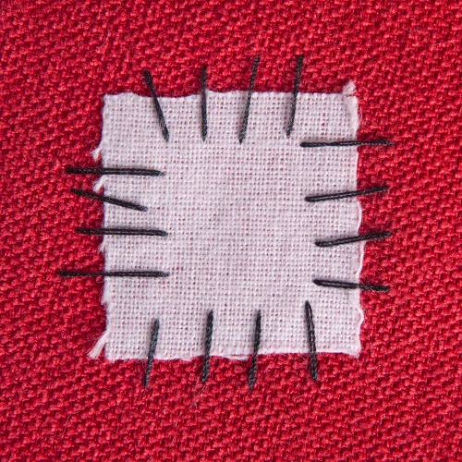
How can we minimize our contribution?

Slide 18
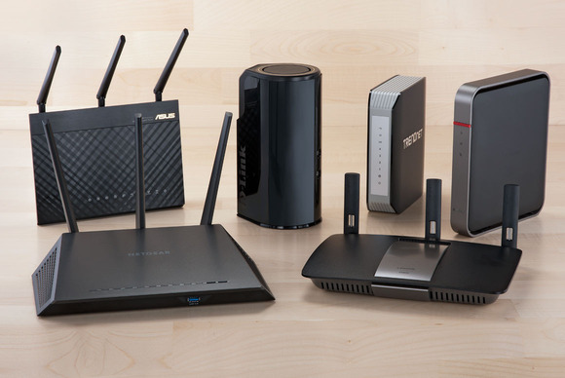



What's next?
?

