Slide 1
Looking for Patterns - Finding them with Regular Expressions
Presented by Keith Wright

Slide 2
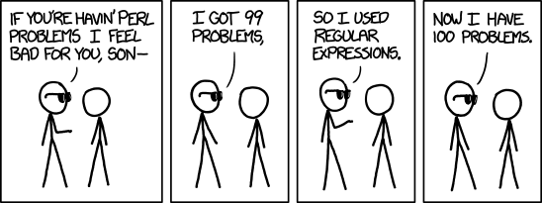
From http://xkcd.com/1171/
If this is how you think of regular expression now…
Regular expressions…

Slide 3
Regular expressions are…
Strings used to search for patterns in text
More powerful than wildcards
Available in many programming languages and programs
Also known as "regexp", "RegEx", and "RE"

Slide 4
Re dos and don'ts…
Input Validation
Data Extraction
Data Elimination
Search/Replace
Do this…
Don't do this…
Parsing
Allow publicly available searches
Use where better tools exist
Where using a procedure would be faster

Slide 5
Re are available in…
.NET
C#
Delphi
Java
JavaScript
Perl
PCRE
PHP
Python
Ruby
Tcl
PowerShell

Slide 6
posix programs using re
awk
  pattern scanning and processing language
find
  utility to search for files
grep
  utility to print lines matching a pattern
sed
  stream editor for filtering and transforming text

Slide 7
Posix programs support re…
Basic Regular Expressions (BRE)
  Character classes [ ]
  Named Character classes [[:digit:]]
  Asterisk *
  Dot .
  Carat ^
  Dollar $
  Backslashed Braces \{ \}
  Backslashed Parens \( \)
Extended Regular Expressions (ERE)
  Question mark ?
  Plus sign +
  Pipe symbol |
  Braces { }
  Parentheses ( )
  All other BRE

Slide 8
grep [options] 'pattern' [file…]
grep is command line tool for printing lines that match a pattern
Useful for demonstrating how regular expressions work
By default, grep interprets regular expressions as BRE
Using egrep, or grep -E interprets regular expressions as ERE
--color=auto highlights the part of the line that matched the pattern
-i is used to make grep case-insensitive
-c is used to have grep report a count of the lines that matched
-v is used to print the lines that don't match the pattern

Slide 9

basic re literals
Alphanumeric characters and non-regular expression characters match themselves
Regular expression characters will match themselves if preceded by the backslash character \

Slide 10

re dot (period)
The dot . will match any single character
To match the dot itself, it must be preceded by a backslash
The RE .* is used to match an entire string

Slide 11
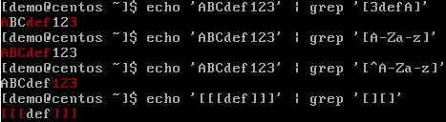
re character classes
Character classes match a single character in the list or range enclosed by brackets [ ]
If the first character enclosed is the carat ^, then the list or range is negated
To match the right square bracket ] it must be the first character enclosed. To not match it, it must be the second character after a carat
To match a hyphen, it can be the first or last character enclosed. To not match it, , it must be the second character after a carat

Slide 12
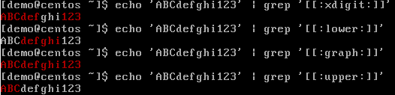
re named character classes
Named character classes must be enclosed in brackets like [[:xdigit:]]
Many are available: [:alnum:], [:alpha:], [:cntrl:], [:digit:], [:graph:], [:lower:], [:print:], [:punct:], [:space:], [:upper:], and [:xdigit:]

Slide 13
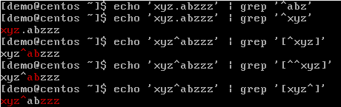
re carat anchor
The character after the carat character ^ must appear at the beginning of the text
If used as the first character in square brackets, it negates the list or range of characters
If preceded by the backslash, the carat character loses it's special meaning

Slide 14
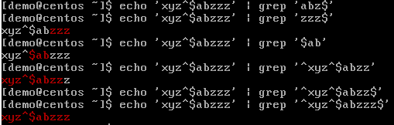
re dollar sign anchor
The character before the dollar sign character $ must appear at the end of the text
If not at the end of the regular expression, then the dollar sign loses it's special meaning
When combined with the carat character ^, the dollar sign character $ must match the entire text

Slide 15
re repetition
Basic Regular Expressions
* | preceding item repeated zero or more times or \{0,\}
\+ | preceding item repeated one or more times or \{1,\}
\? | preceding item is optional or \{0,1\}
\{n\} | preceding item repeated exactly n times
\{n,\} | preceding item repeated n or more times
\{,m\} | preceding item matched at most m times
\{n,m\} | preceding item matched at least n times, but not more than m times
Extended Regular Expressions
* | preceding item repeated zero or more times or {0,}
+ | preceding item repeated one or more times or {1,}
? | preceding item is optional or {0,1}
{n} | preceding item repeated exactly n times
{n,} | preceding item repeated n or more times
{,m} | preceding item matched at most m times
{n,m} | preceding item matched at least n times, but not more than m times

Slide 16
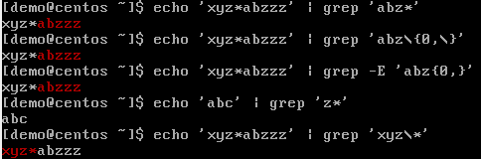
RE asterisk
The asterisk * will match zero or more of the item that precedes it
The asterisk is equivalent to the BRE \{0,\} and the ERE {0,} expressions for zero or more
A single item followed by an asterisk will always match
To match an asterisk, it can be preceded by a backslash

Slide 17
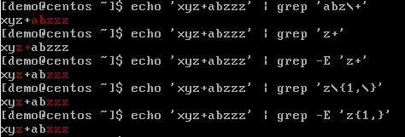
RE plus sign
In BRE, the backslashed plus sign \+ will match one or more of the item that precedes it
In ERE, the plus sign + will match one or more of the item that precedes it
The plus sign is equivalent to the BRE \{1,\} and the ERE {1,} expressions for one or more
In BRE, the plus sign matches itself. In ERE to match a plus sign, it can be preceded by a backslash

Slide 18
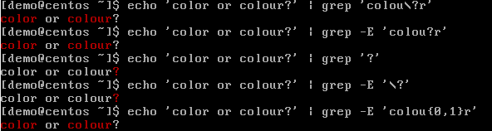
RE question mark
In BRE, the backslashed question mark \? optionally matches the item that precedes it
In ERE, the question mark will optionally match the item that precedes it
The question mark equivalent to the BRE \{0,1\} and the ERE {0,1} expressions for zero to one
In BRE, the question mark matches itself. In ERE to match a question mark, it can be preceded by a backslash

Slide 19
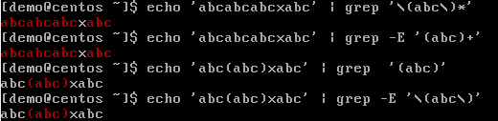
re grouping
In BRE, the backslashed parentheses \( and \) are used to create groups of characters that may repeat as specified by repetition expressions
In ERE, the parentheses ( and ) are used to create groups of characters that may repeat as specified by repetition expressions
In BRE, the parentheses will match themselves, and in ERE they can be matched if backslashed

Slide 20

Re alternation
In ERE, the pipe symbol | can be used to perform alternation
Alternation allows for two or more alternatives to match as separated by the pipe symbol |
In BRE, the pipe symbol | will match itself, and in ERE it will match if backslashed

Slide 21
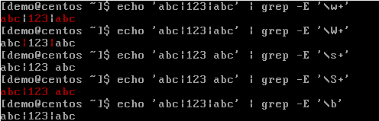
Perl character sequences
grep supports the perl character sequences in ERE except \d and \D
\w | Alphanumeric and _ (word characters)
\W | Not word characters
\d | Digit characters
\D | Not digit characters
\s | Whitespace characters
\S | Not whitespace characters
\b | Word boundaries

Slide 22
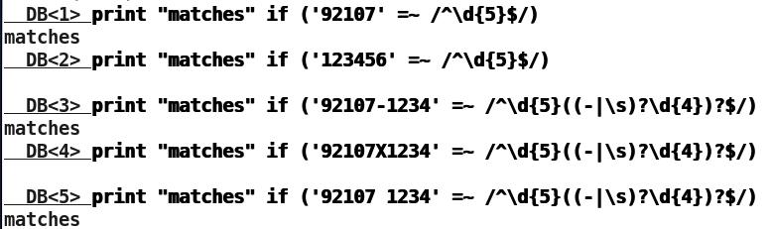
perl us postal code example
^\d{5}((-|\s)?\d{4})?$
  ^ - Starts with
  \d{5} - exactly five digits
  ()? - optional group (two)
  -|\s - hyphen or whitespace
  \d{4} - exactly four digits
  $ - Ends with
To use the perl debugger type:
  perl -d -e1

Slide 23
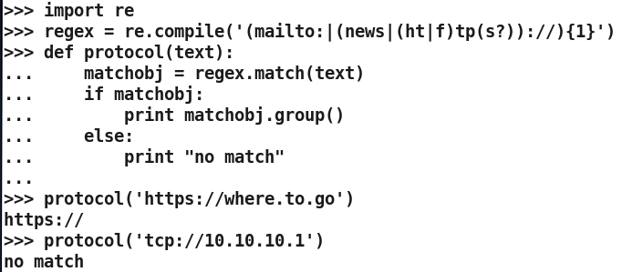
python protocol example
(mailto:|(news|(ht|f)tp(s?))://){1}
  (){1} - group repeats only once
  mailto: - mailto followed by a colon
  | - separates alternatives (4)
  news|(ht|f)tp - news, http or ftp
  (ht|f)tp(s?) - optional s added
  :// - added to news, http, https, ftp, or ftps
To start the python shell type:
  python

Slide 24

From http://xkcd.com/208/

