Slide 1
Open Build Service (OBS)
Peter Linnell plinnell@suse.com plinnell@opensuse.org plinnell@apache.org
Notes:
Hi my name is … and I work for … on the Open Build Service
This workshop is for packagers that want to use the OBS to produce binary packages of their or other peoples sources. Either for personal consumption or as part as a bigger project like a GNU/Linux distribution.
It's an interactive workshop and all you need to know to participate is how to install software on your machine. But don't worry I'm here to help you if you need me. Feel free to ask questions at any time!
After you've completed this workshop you will have learned how to create, build and collaborate on packages in the OBS.

Slide 2
About me:
Scribus Founder and Core Team Member since 2001
OpenSUSE Community member since 2006
OpenSUSE Board Member
Apache Bigtop Founder and PMC
Packager and contributor for many Open Source apps
Day Job – SUSE Sales Engineer in Silicon Valley
HPC/Big Iron Fan

Slide 3
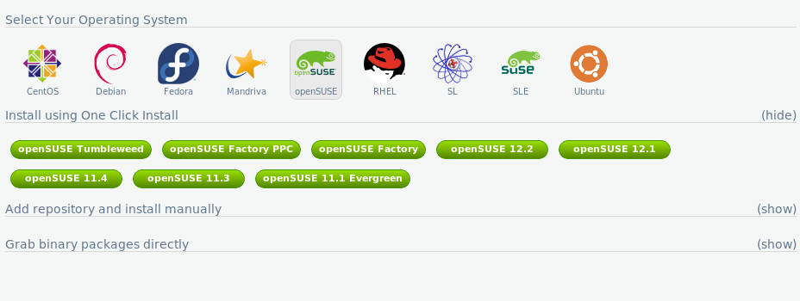
What is it?
A complete integrated package building service which has as it goals: reliable, scalable repeatable package builds for all major Linux distributions and architectures.

Slide 4
Features:
Saves Developer and System Administrator time and effort
Compliments Suse Studio and Suse Manager for package deployment on Suse Cloud, Bare Metal or VM's
Builds RPM, DEB and other package formats in a repeatable consistent manner
Automatic dependency handling and rebuilds
Support for multiple arches from ARM5+, x86, Power, Sparc and SystemZ s390 Mainframes
Maintenance model with tiered authorization
Extends QA with post-build checks including buffer overflow checking and usable logging for serious compiler warnings; permissions and file location

Slide 5
Features:
Sand-boxed builds (kvm/xen) on a build farm
Easy branching with automatic merges
Built-in revision tracking
Hugely scalable: Public OBS has 200,000 packages with > 30,000 users. On average 50,000+ package builds a day.
Extensible – One can add new arches or platforms
Extensible with open API
Can be used with Hermes for automatic mailing/messaging
Consistent, reproducible builds

Slide 6
User Interface
REST based API, so multiple interfaces can co-exist
Web UI
  Great to get an overview of a project
  Simple package fixes
OSC command line client
  Works like an SCM system (svn, git)
  Supports local builds for testing

Slide 7
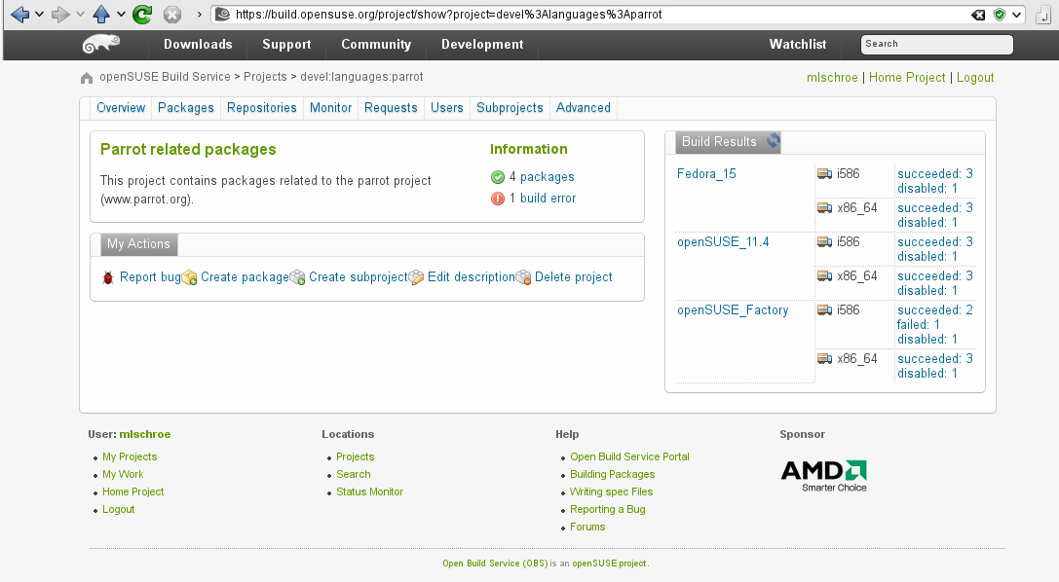
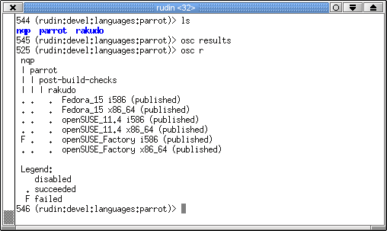
User Interface

Slide 8
Interconnect
Access Sources and Binaries of a remote OBS instance
  Support different architectures and distributions
  Proprietary sources that must not leave the company
Remote Instance is “mounted” in the project space
  Source and binary package caching
  Automatic merging & rebuilds also work with remote data
build.opensuse.org: connections from 90 other instances

Slide 9
How It Works
Notes:
Hi my name is … and I work for … on the Open Build Service
This workshop is for packagers that want to use the OBS to produce binary packages of their or other peoples sources. Either for personal consumption or as part as a bigger project like a GNU/Linux distribution.
It's an interactive workshop and all you need to know to participate is how to install software on your machine. But don't worry I'm here to help you if you need me. Feel free to ask questions at any time!
After you've completed this workshop you will have learned how to create, build and collaborate on packages in the OBS.

Slide 10
OBS In Six Easy Steps:
Create a project
Upload sources: tarball, .desktop file, patches
Upload rpm .spec file or .dsc file for .deb format
Select repositories e.g. SLES, openSUSE,
Select build arches
Trigger build
Profit!

Slide 11
Build Service Projects
Main organizational element: projects
  Contains a set of packages with sources
  Defines which repositories and architectures to build
  Defines access control
devel:languages:parrot
parrot
openSUSE_Factory
nqp
Fedora_15
rakudo

Slide 12
Build Service Projects
Repositories can build on top of other projects' repositories
  The “base” distributions are good examples
openSUSE:Factory
devel:languages:parrot
standard
openSUSE_Factory
Fedora_15
Fedora:15
standard
build with

Slide 13
Collaboration
Like SCM if multiple people have write access
Otherwise, create a branch:
devel:languages:parrot
home:mlschroe:myparrot
parrot
rakudo
nqp
rakudo
Source link

Slide 14
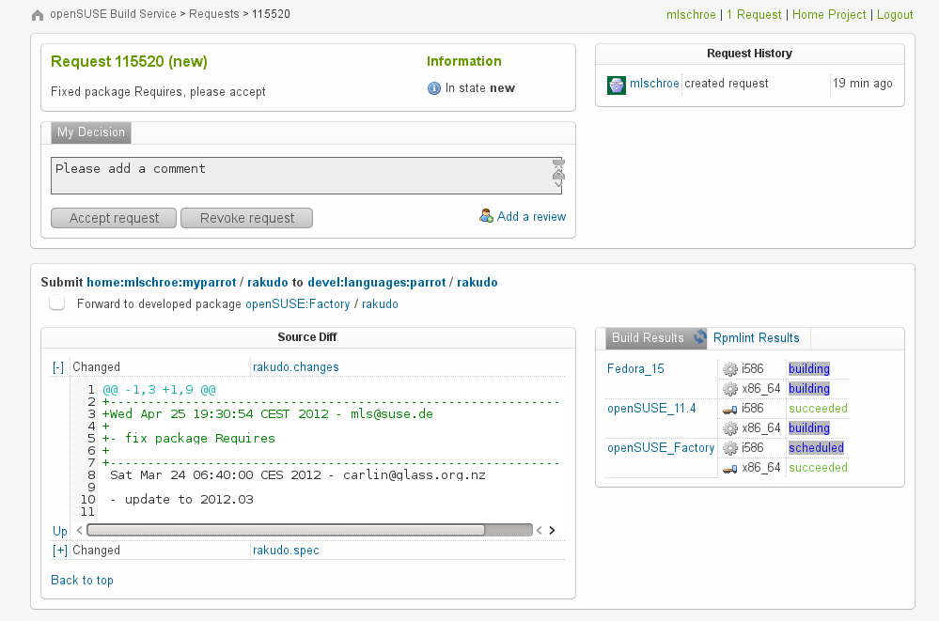
Collaboration
If you're done, ask to
merge your changes
with a “submit request”
Notification through mail
osc, Web UI

Slide 15
It's SHOWTIME!
Notes:
Go right into showing the SUSE Cloud dashboard.
Run a scenario with Operator and SysAdmin Roles
Show off the launching of an application and creation of a user etc...
Studio integration will come later.

Slide 16
OBS History
Created in 2005 as a rewrite of SUSE's internal autobuild system
  Goals: transparency, flexibility, openness
  First presented at FOSDEM 2006
2010: OBS-2.0 with features for the MeeGo project
2011: OBS-2.1 with workflow features for openSUSE source handling
Current Release: OBS-2.4
  Support for maintenance updates

Slide 17











Reference Users
Distribution development, Maintenance Updates
Open Source Communities
Add-Ons: Driver Developer and ISVs
Researchers/Universities
Administration Teams

Slide 18
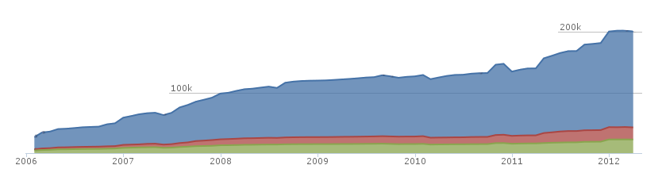
Development
Licensed under GPLv2
  https://github.com/openSUSE/open-build-service/
Lines of Code: > 150000
  Perl/Python/Ruby
Mostly maintained by SUSE, but many contributions
from community members & other companies

Slide 19
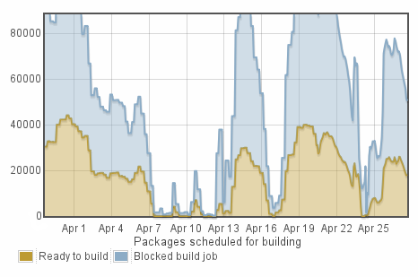
Numbers (from build.opensuse.org)
Confirmed Users: >32000
Package builds per day: > 51000
  Build farm: 38 hosts,
  310 workers
Storage:
  Sources: 3.3 TBytes
  Binaries: 6.9 TBytes

Slide 20
Future
2.5 Release
  Out now – Running on build.opensuse.org
  Product content tracking
  Cross build (implemented by B1-Systems)
2.6 Release
  Improved QA integration
  More package formats, other operating systems

Slide 21

Support
Community
  opensuse-buildservice@opensuse.org
  Irc: #opensuse-buildservice on freenode
Professional
  http://www.open-build-service.org/contact/
  B1 Systems (L3 backing by SUSE)
  North American Support to TBA
  (L3 backing by SUSE)

Slide 22
Learn more about the
Open Build Service
www.openbuildservice.org
Notes:
I hope this workshop was worth your time and you picked up how to create, build and collaborate on packages. If you have further questions, suggestions or feedback, don't hesitate to contact me or anyone else from the OBS team. Thank you for your participation!

