Slide 1
Understanding Free & Open Source Licenses
(without a lawyer)
Tom Callaway
Senior Software Engineer, Red Hat
tcallawa@redhat.com
@spotrh
CC-BY-SA

Slide 2
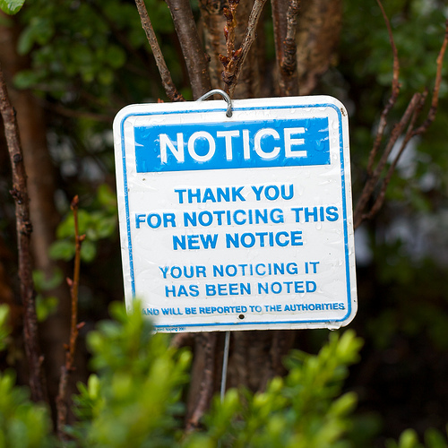
Disclaimer
I Am Not A Lawyer
(IANAL)
This is not
“legal advice”
Notes:
I did not go to law school, I have not passed the bar, I am not licensed to practice law anywhere.
I am not a lawyer. That said, I consult with lawyers on a regular basis on matters relating to free and ope n source, so I generally do know what I'm talking about.
“As a general matter, only a lawyer may give actual legal advice, whereas any non-lawyer may recite legal information. Furthermore, it is generally illegal for a non-lawyer or unlicensed attorney to offer legal advice or otherwise represent someone other than himself or herself in a court of law.”
(Findlaw)
Thus, everything I'm going to talk about is either general knowledge, my own opinions informed by years of experience working with FOSS communities, or “legal information” presented by a non-lawyer without pretense.
If you need legal advice, you should get a lawyer. I can recommend some.

Slide 3
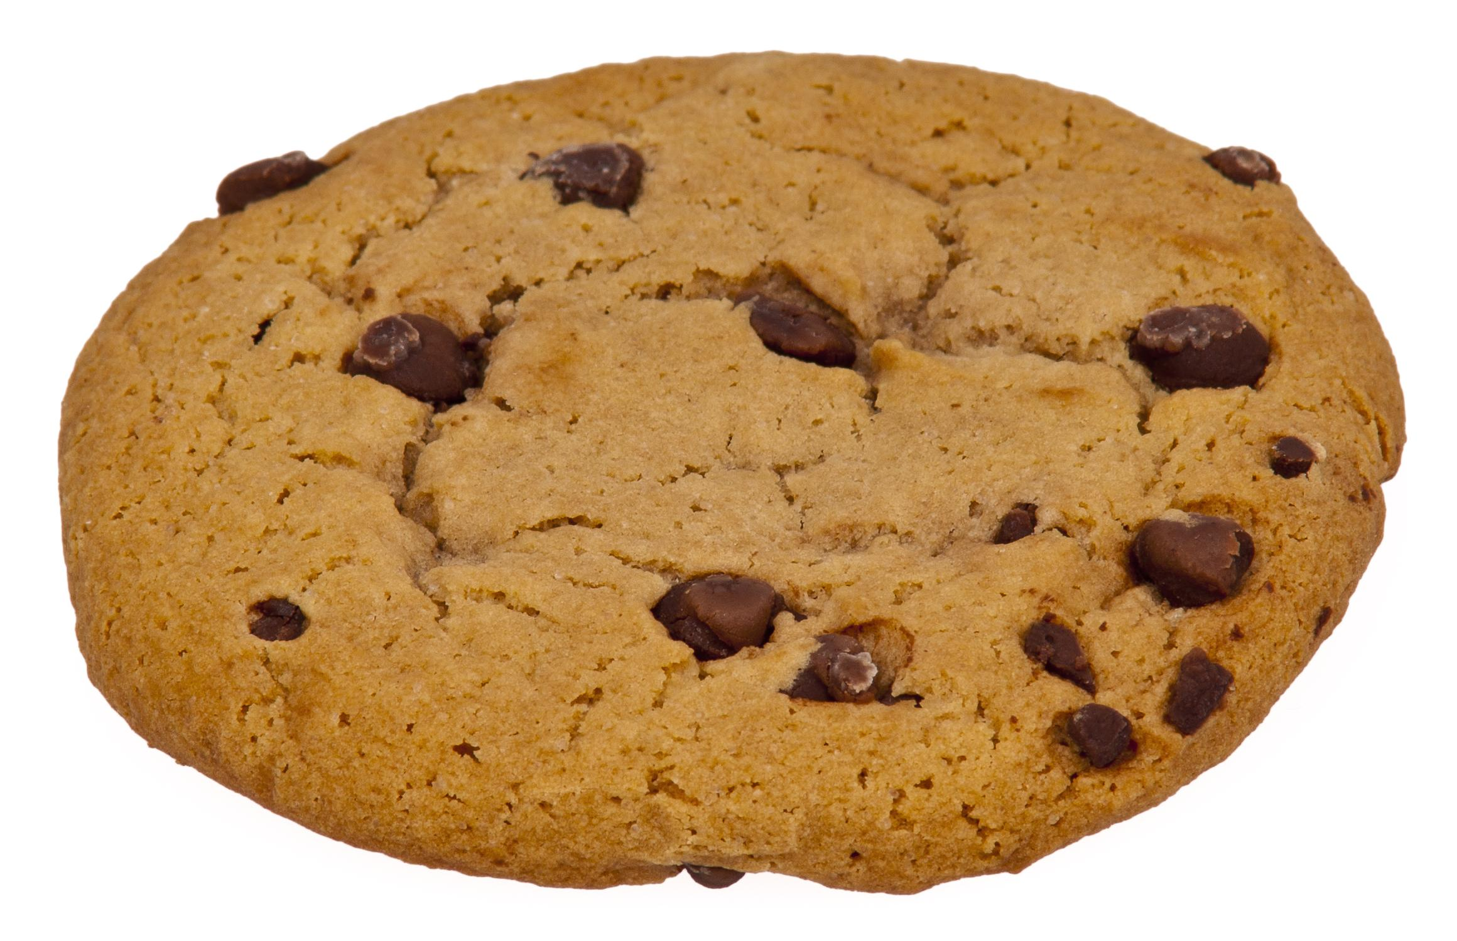
What is Open Source?
Notes:
Picture is a public domain photo of a cookie.
(Analogy is borrowed from Bryan Behrenshausen. CC-BY-SA, with bread replaced with cookies.)
Open Source is a giant cookie. Wait. Lemme try that again.
Imagine you've baked something for your friends. Maybe it's a loaf of bread, maybe it's a pizza, but for the sake of keeping with the picture, lets say it's cookies. By sharing these cookies with your friends, you've given them something that not only sustains them, but also strengthens your relationship with them. We'll just assume you make edible cookies. :)
But what if you share more than just the finished product? Suppose that in addition to the cookies, you also give your friends the recipe for those cookies.Now you've given them something even more valuable, the power to reproduce the gift you've given them and the opportunity to improve the lives of others as you've improved theirs.
If your friends like the cookies you've made them, they can now make more of them for themselves and their friends. If they like cookies with slightly different ingredients, they can modify your recipe, making something that suits their individual tastes. Maybe some of your friends have dietary restrictions and need to know exactly what is in those cookies before chowing down. Possessing the recipe means they can now make a more informed decision about whether to eat or not to eat.
Also, now that your friends have your cookie recipe, they can work with you to make more delicious cookies, increasing the number of people who are exposed to their deliciousness. You can bake cookies together, strengthening your relationships, and building a common shared bond. Before long, you've united all the world around delicious cookies! Okay, maybe that last point is a bit much.

Slide 4
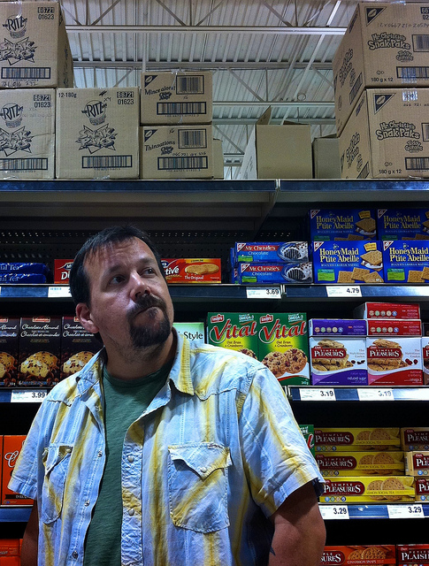
What is Open Source?
Notes:
Picture is CC-BY, flickr user “barkbud”:
https://www.flickr.com/photos/barkbud/4988355073
Sure, you can just go to the grocery store and buy cookies. There are lots of them there, and some of them are good. But none of themcome with the recipe. You can't make more Oreos. You can't make better Oreos. Those cookies aren't open source.

Slide 5
Core Concepts
share, collaborate, and remix
Notes:
Distilled down to a simple set of buzzwords, these are the core concepts of Open Source

Slide 6

share
Notes:
Picture is CC-BY-Sa, flickr user “ben_grey”:
https://www.flickr.com/photos/ben_grey/4582294721
Children share, often without thinking. It is only as we age that we develop the concept of ownership, of putting up walls and barriers.
By sharing our knowledge, our skills and talents, our insights, our experiences, and our resources, we can get to the places we want to go faster.
In the context of software, by sharing not just our binaries but also our source code, we also share control over that software.

Slide 7
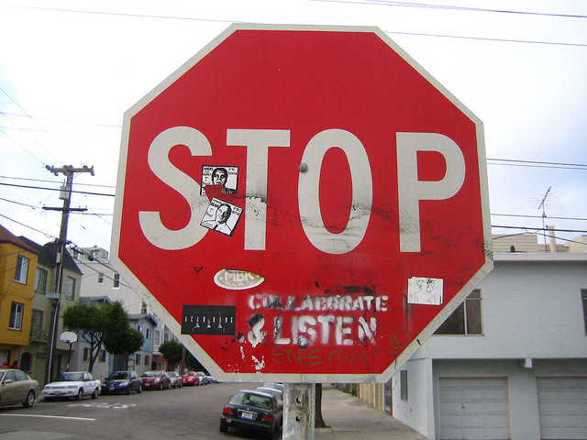
collaborate
Notes:
Picture is CC-BY, flickr user “spine”:
https://www.flickr.com/photos/spine/263214639
Our understanding of the universe has made it functionally impossible for anyone to be a jack-of-all trades. We each possess our specializations, our strengths and weaknesses. At the same time, our digital inter-connectivity makes it simpler for us to work together across languages, timezones, and societal barriers.
Collaboration in an open source context brings together people who have an itch to scratch and empowers them to build one excellent scratcher instead of 100 mediocre ones.
Linus's law (as coined by Eric Raymond) is “given enough eyeballs, all bugs are shallow”.

Slide 8
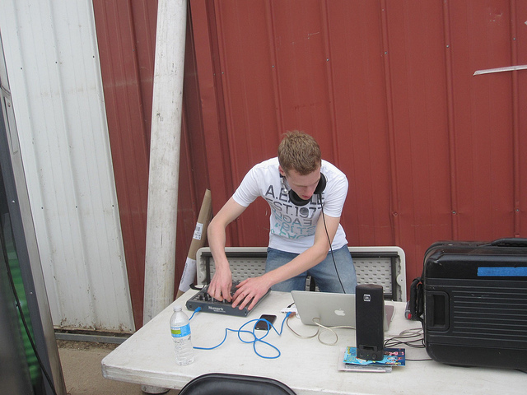
remix
Notes:
Picture is CC-BY-SA, flickr user “24019848@NO3”:
https://www.flickr.com/photos/24019848@N03/5295381326
We all stand on the shoulders of those who have come before us. Our parents, our teachers, all the way back to the first caveman to make his own fire. We take what we have, what we know, and we build o n that.
If you had Legos as a child, you eventually get to the point where you're spending more time building your own creations from the blocks than you do on the ones provided in the instructions.The very nature of Lego gives you the freedom to remix.
Art, music, cooking, gaming, all of these fields are derivative, we take what we like in what came before and change it into something new.
Why should software be any different?
This happens whether we want it to or not, barriers to remixing only slow this a little bit. I believe deep down within us all, we are all hackers of something. Open source says this is okay.

Slide 9
Terminology
Copyright – The legal rights granted to the creator of an original work by law.
Legalese – A cryptic language used by lawyers which seems to resemble English from a distance, but is not actually English.
Software License – A document written in Legalese which tells the user what they can (and cannot) do with the software they possess.
Notes:
In the United States, creative works are copyrighted when “fixed in a medium”
You do not need to register copyright to possess it, but its not bad idea to register it.
Copyright, at least in most of the world, grants the following legal rights to the copyright holder:
The right to make copies
The right to be credited
The right to determine who may adapt, perform, and/or benefit financially from the work
Essentially, the copyright holder has control over the work. The copyright holder is usually the creator of the work, but there are cases where this is not true. It is common for employment contracts to sign over copyright from employees to employer, for example.
Why am I telling you about this stuff? Because Open Source is all based on a clever legal hack.

Slide 10

A Magic Trick
Notes:
Photo is CC-BY-SA, flickr user “latitudes”:
https://www.flickr.com/photos/latitudes/66424863
A proprietary software license spends most of its text telling you what you cannot do with it. You cannot make copies of it and give it to your friends. You cannot change it. You absolutely cannot even see the source code that comprises it. Pages and pages of “cannot, do not, must not”.
The copyright law in the US (and most of the rest of the world) doesn't require that you do this. You don't have to do these things to “protect your copyright”.
Open source shuffles this around. Instead of telling you what you cannot do, it grants you permission to do things that the law doesn't automatically let anyone besides the copyright holder do.
The law gives everyone who has a copyrighted thing (legally) the right to use it. Open source extends that and also gives you the rights to distribute it, modify it, and distribute the modified version, without any restrictions.

Slide 11
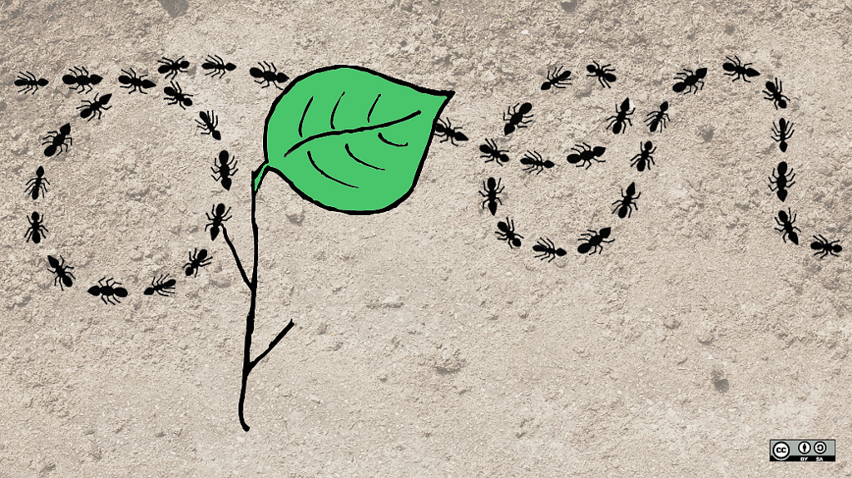
Open Source Definition
Notes:
Picture is CC-BY-SA, opensource.com.
What is open source?
Universal access to the design, universal redistribution of the design, and freedom to modify.
This is a simplified definition of open source.
The Open Source Initiative (OSI) says open source is anything that is available with:
Free Redistribution
Source Code
Permission to make and distribute derived works
No discrimination against persons, groups, fields of endeavor
No secondary license requirement
A license that does not require inclusion of a secondary work
A license that does not restrict other software
A license that is technology neutral

Slide 12
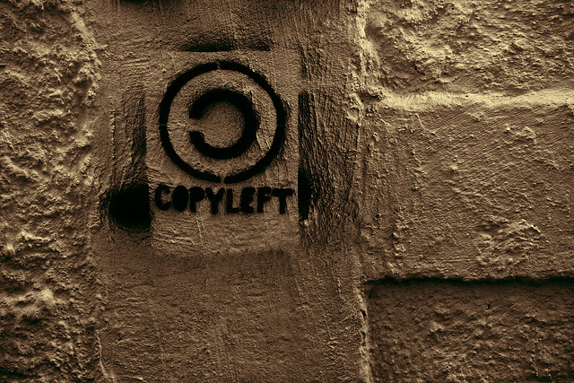
Free Software
Notes:
Picture is CC-BY, flickr user “eflon”:
https://www.flickr.com/photos/eflon/4143436615
Free Software goes farther than that. Free Software says use, dsitribute, modify, but when you modify, you must then make your modifications available under the same terms (assuming that you distribute your modification). This is called Copyleft, in that the license forces everyone participating to play by the same rules.
Ideally, this is how Open Source is supposed to work. Free Software and Copyleft make it a practical reality.

Slide 13
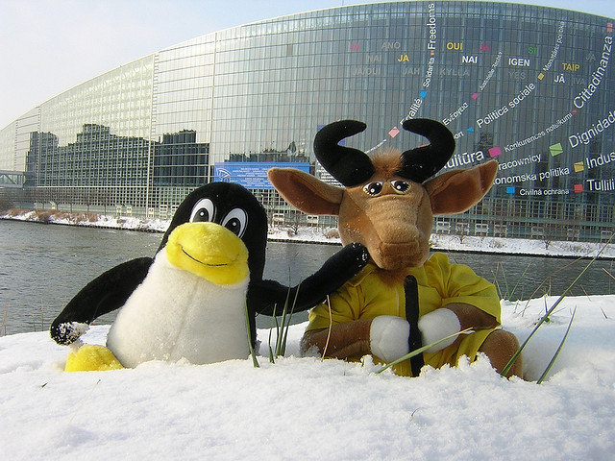
The Free Software Foundation
Notes:
Picture is CC-BY. Flickr user “frenchy”:
https://www.flickr.com/photos/frenchy/79366258
It is helpful to remember that while effectively all Free Software is Open Source, not all Open Source is Free Software.
The term Free Software was coined by Richard Stallman in 1985. Richard went on to create the Free Software Foundation, a non-profit dedicated to promoting software freedom.
The FSF also created the Free Software Definition, which defines four freedoms:
The freedom to run the program as you wish, for any purpose (freedom 0)
The freedom to study how the program works, and change it so it does your computing as you wish (freedom 1). Access to the source code is a precondition for this.
The freedom to redistribute copies so you can help your neighbor (freedom 2).
The freedom to distribute copies of your modified versions to others (freedom 3). By doing this you can give the whole community a chance to benefit from your changes. Access to the source code is a precondition for this.

Slide 14
MOAR Terminology
Trademark – A distinctive design, picture, emblem, logo or wording (or combination) used to identify a product and/or its manufacturer.
Patent (n)– A set of exclusive rights granted to an inventor for a limited period of time in exchange for public disclosure of their invention.
Patent (adj) – Obvious.
Notes:
.

Slide 15
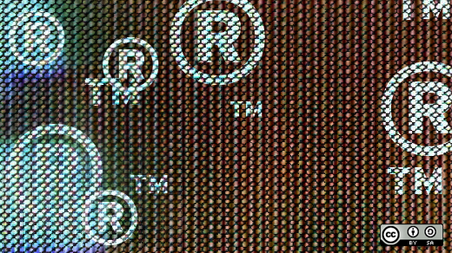
Trademarks
Notes:
Picture is CC-BY-SA, opensource.com
A trademark is branding. It says “this thing that you have, I made it”. The idea behind trademark is that consumers will see it and attach a positive connotation to the product bearing the trademark.
When you see the Coca Cola trademark on a bottle, there are quality and flavor expectations that you immediately have (assuming you've had a Coke before).
Trademark differs from Copyright in that trademark holders are required to proactively protect their trademark from infringement. They may license it to others to use, but they may not license it for anyone to use it however they choose.
This is called a “naked license”, and if you do this, it can result in the abandonment of the trademark, and the inability to protect your brand.

Slide 16
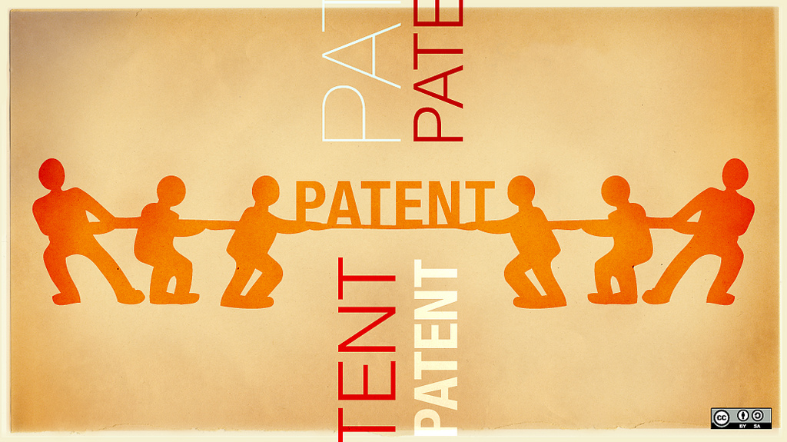
Patents
Notes:
Picture is CC-BY-SA, opensource.com
Section 8 of the US Constitution grants Congress the power to promote the Progress of Science and useful Arts, by securing for limited Times to Authors and Inventors the exclusive Right to their respective Writings and Discoveries;
This is the fundamental idea behind patents(at leastin the US): To promote progress.
Patents have a term, or the period of time that the patent is valid. Calculating this term is almost as tricky as doing your taxes, but as a general rule, patents filed on or after June 8, 1995 have a term of 20 years from the earliest claimed filing date.
I'm simplifying here quite a bit. Patent law is not simple.

Slide 17
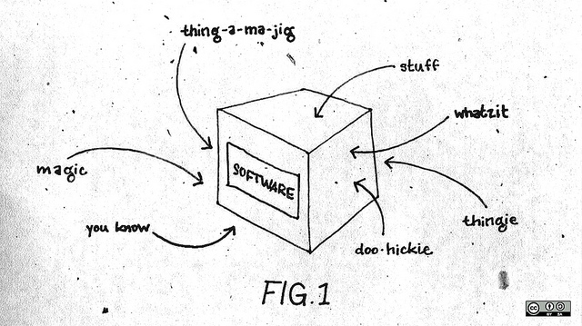
Software Patents
Notes:
Picture is CC-BY-SA, opensource.com
Patents are supposed to foster innovation, but Software Patents almost always have the opposite effect.
In 2011, Yale Law estimated in a study that there are around 40,000 new software patents issued in a typical year. http://papers.ssrn.com/sol3/papers.cfm?abstract_id=2016968
Microsoft announced that they had 10,000 software patents in February 2009 (In 1990, they had 5.)
Most of the important enterprise software in wide use today rests on ideas that predate the explosion of software patents in the 1990s
Lotus 1-2-3 released in 1982
Microsoft Word released in 1983
Oracle version 3 released in 1983
Windows 3.0 released in 1990
Patents are a big reason why we are unable to include some FOSS licensed software in Fedora. It is my opinion that software known by the author to be encumbered by software patents (whether they hold them or not) is not Free, regardless of the copryight license.

Slide 18
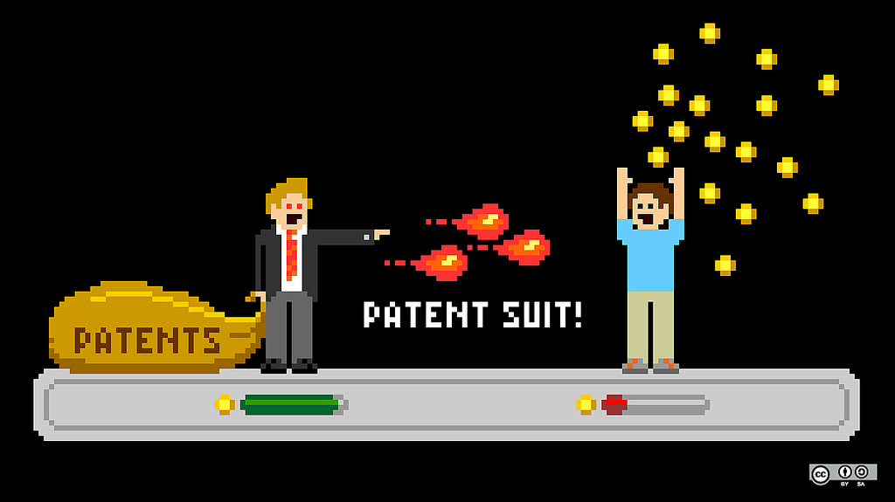
The High Price of Patents
Notes:
Picture is CC-BY-SA, opensource.com
Patent lawsuits are extremely costly
$3-5 million in attorneys fees
Possibility of enormous damages
In 2014, a jury found that Samsung needed to pay $119.6 million to Apple for infringing two patents.
Damages generally calculated based on the whole product, rather than the value of the patented invention that is only a part of the product
Possibility of treble damages for willful infringement (the court can triple the determined damage amount to “punish” the infringing party)
Many patent lawsuits are quickly settled out of court, due to the high costs and risk of higher costs if the case is lost at trial

Slide 19
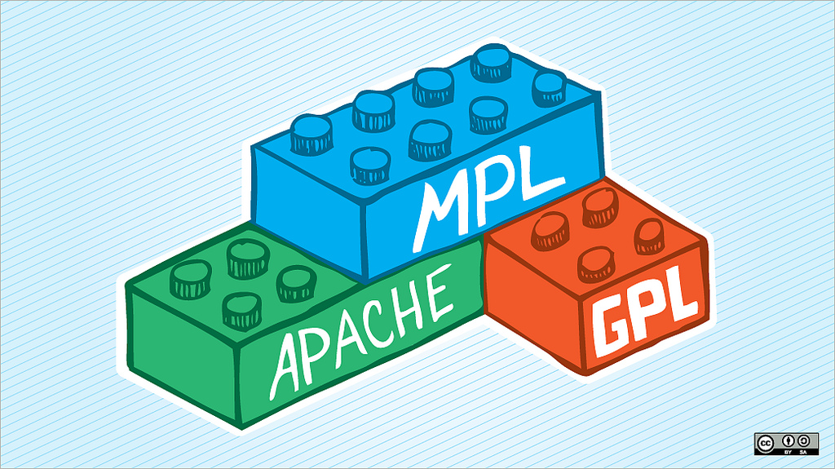
LICENSE SUPER HAPPY FUN TIME
Notes:
Picture is CC-BY-SA, opensource.com
Okay, enough fundamentals. Lets talk specific licenses.

Slide 20
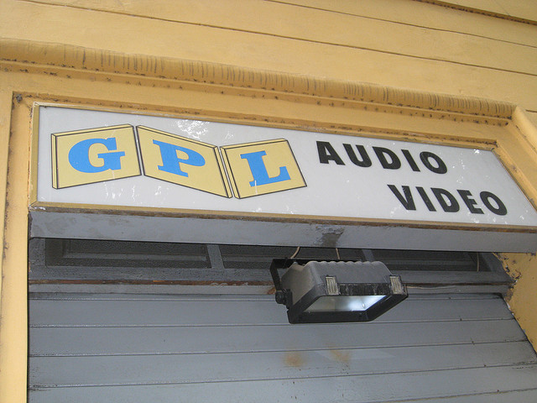
GNU General Public License
Notes:
Picture is CC-BY-SA, flickr user “sethschoen”:
https://www.flickr.com/photos/sethschoen/2562359590
The GNU General Public License (or GPL) is the most widely used Free Software license. It is estimated that anywhere from 50-65% of FOSS projects are GPL licensed. The GPL is also the most well known copyleft license, because it explictly requires others who modify your code (and distribute) to also share their changes. The intent of the GPL is to ensure the preservation of the freedoms outlined in the Free Software definition in both the work and in all distributed derived works.
Because of the wide use of the GPL, there is also more available information as to the compatibility between the GPL and other FOSS licenses, than for any other FOSS license.
The GPL has evolved over time, the original GPL text was written by Richard Stallman, based on the licenses being used in various GNU software tools at the time, but the second and third versions of the GPL were written by the broader community, lead by the FSF and finalized by lawyers. Practically, the only two versions of the GPL in use today are the GPLv2 and GPLv3.
Key differences between GPLv2 and GPLv3:
GPLv3 is written to make it easier to be compatible with other FOSS licenses (e.g. Apache 2.0)
GPLv3 contains regulations concerning Digital Rights Management, specifically stating that a GPLv3 code base does not count as an effective technological “protection” measure, minimizing the risk of breaking DRM on GPLv3 code
GPLv3 has stronger protection against patent threats
GPLv3 requires that distributors provide users with all the necessary information to install modified versions of GPLv3 licensed software preloaded on a device.

Slide 21
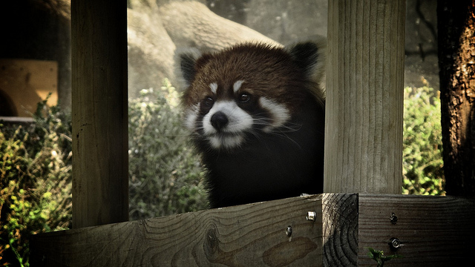
GNU Lesser Public License
Notes:
Picture is CC-BY, flick user “hahayoyoo”:
https://www.flickr.com/photos/hahayoyoo/7239050584
(This is a red panda, also called a “lesser panda”.)
The GNU Lesser Public License (LGPL) allows for the use and integration of LGPL software into other software without then requiring that other software to be released under strong copyleft terms.
LGPL is primarily used for software libraries. It was developed as a compromise between the GPL and more permissive licenses. The LGPL only guarantees the freedoms of modification for the code under the LGPL, whereas, the GPL is designed to apply to any dependent works.

Slide 22

Permissive Licenses
Notes:
Permissive licenses are the other common licenses in FOSS. These are licenses which are designed solely to grant permissive rights to users. As a result, they tend to be shorter than copyleft licenses, however, this is not always better.
Permissive licenses usually require the following:
You must retain the copyright notice
You must disclaim the copyright holder of any and all warranty
In return, they explicitly permit use, modification, and distribution. The most common permissive licenses are the BSD license and the MIT license (sometimes called the X11 license).
The biggest advantage to permissive licenses is their compatibility, they are generally considered to be universally compatible with all other FOSS licenses. The biggest disadvantage is that their very structure allows (some would say encourages) for anyone to take their code and redistribute it in binary form without ever releasing the corresponding source code, whether that code has been edited or not. This is not just a hypothetical either, there are many many cases of permissively licensed software being distributed in a way that makes it effectively proprietary.
The MIT license is noteworthy in that in most variants of it, it expliclty grants the permission to sublicense the work, meaning that you can apply additional license terms to the work.

Slide 23
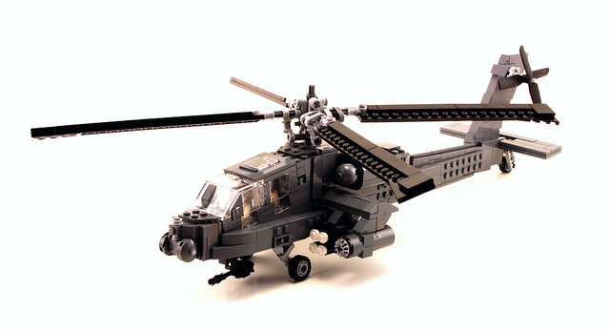
Apache License
Notes:
Picture is CC-BY, flickr user “pmiaki”:
https://www.flickr.com/photos/pmiaki/7443947216
The Apache license is a permissive license that also contains an express grant of patent rights to users. It is also drafted in pretty thick Legalese, including 10 defined terms. It is noteworthy because it also acts as a contributor agreement for the upstreams which use it. It implicitly says that any contributions made to Apache licensed projects are under the same Apache license terms, unless the contribution explicitly specifies otherwise. It also explictly states that Trademarks are not covered under the license, which is a bit of a no-op, but it probably made a lawyer happy. :)

Slide 24
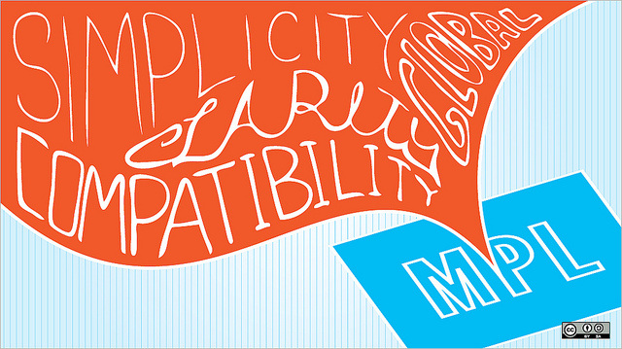
Mozilla Public License
Notes:
Picture is CC-BY-SA, opensource.com
The Mozilla Public License (MPL) is a hybrid license, a combination of the BSD and the GPL It allows MPL licensed code to be mixed with other licensed code, even proprietary code, but requires that MPL licensed code remain under the MPL and freely available in source code form. It also includes a patent grant for the work, a patent termination clause (if you sue us for patent infringement, you lose all your rights), and explictly disclaims applicability to trademarks.
The current version of the MPL (as of 2012) is MPL 2.0, which was reworked to make the license clearer, easier to apply, and more compatible with other FOSS licenses (most notably, GPL and Apache).
This license was clearly written by lawyers who really love Legalese. It is a solid license, but can be difficult for humans to parse. Mozilla provides a FAQ on their website that is helpful here.
MPL is often released in a “trilicense”, where works under the MPL are also available under the GPL or LGPL.

Slide 25
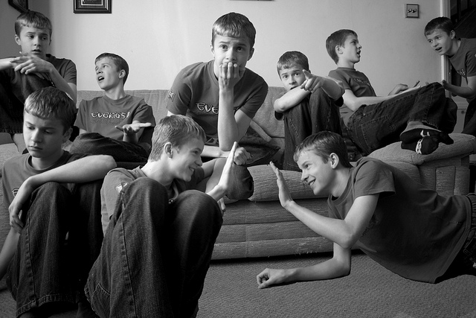
Multiple License Scenarios
Notes:
Picture is CC-BY, flickr user “lauralewis23”:
https://www.flickr.com/photos/lauralewis23/6802286765
Okay, this part is tricky. You could really have a whole talk about this.
Some code is under miultiple licenses, where the end user can choose which license they wish to be bound by. This is called a “OR” situation. The Perl license is a good example of this, as it provides the user with a choice of the GPL or the Artistic 1.0 license. Since the Artistic 1.0 license is considered to be non-free (though, Open Source), users who wish to use only Free Software can use Perl under the GPL terms.
Other code is under multple simultaneous licenses. This can occur when code is copied into an existing project under a different license. This is called an “AND” situation, because all of the license terms must be honored simultaneously. For source code, this is usually possible, because you can separate out the source code (either in separate files or via comments) and handle the license responsibilities independently. However, this is often impractical or even impossible to do in a combined binary work based on that source code.
To oversimplify, if one license says you must only paint your house blue and the other license says you must only paint your house red, you can't comply with both at the same time. This results in the binary work being non-distributable, and non-free.
The simplest way to avoid that state is to ensure license compatibility within the scope of a codebase.

Slide 26
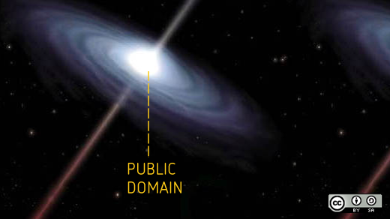
Public Domain
Notes:
Picture is CC-BY-SA, opensource.com
Public Domain is not a license. A work which is considered to be in the Public Domain is a work which is not under copyright. This occurs when:
The work is created by the US Government
The term of the copyright has expired (this no longer happens in the United States)
The copyright holder has abandoned their copyright
This is a tricky concept for a number of reasons. The most obvious is that in many places in the world, including most of Europe, you cannot legally abandon your copyright. You also cannot assume that any work generated or distributed by the US government is Public Domain, as they have a number of loopholes around this (most notably, the use of contractors to generate copyrightable works).
As a result, if you really feel like you want nothing to do with a work that you hold copyright on (or you want to permit anyone to literally do ANYTHING with it), instead of simply declaring it to be in the Public Doamin, consider licensing it under the Creative Commons Zero license. This is a license which was drafted explictly to provide the Legalese framework to mimic a true Public Domained work where copyright abandonment is impossible. Alternately, consider using a permissive license with a warranty disclaimer. If you simply declare a work to be in the Public Domain without a warranty disclaimer, you may still be liable for that work in some jurisdictions.

Slide 27
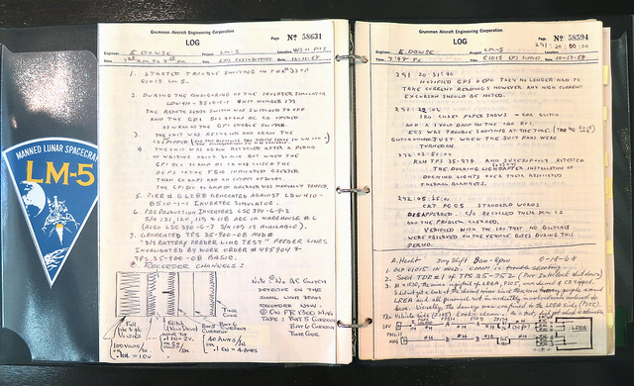
Documentation Licenses
Notes:
Picture is CC-BY, flickr user “jurvetson”:
https://www.flickr.com/photos/jurvetson/7610058658
Documentation often has source forms which get transformed and manipulated into other forms. There are a number of FOSS licenses out there specifically written to cover the nature of documentation files.
The GNU Free Documentation License (GFDL) is a coomon choice, as are the Creative Commons licenses, and the Open Publication License.

Slide 28
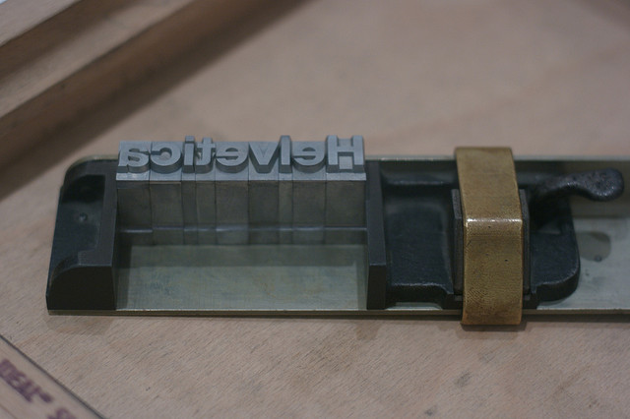
Font Licenses
Notes:
Picture is CC-BY, flickr user “mwichary”:
https://www.flickr.com/photos/mwichary/2140391908
Fonts aren't really software. They do have “source” and they're sometimes “compiled” into an object format, but they're really not software in the same sense that Firefox is. Fonts get embedded into documents all the time, and if you put a copyleft license on a font, it probably will not work the way you want it to.
Your best bet is to choose a Free font license like the SIL Open Font License. If you still want to use GPL, be sure you add the standard font exception to it.

Slide 29
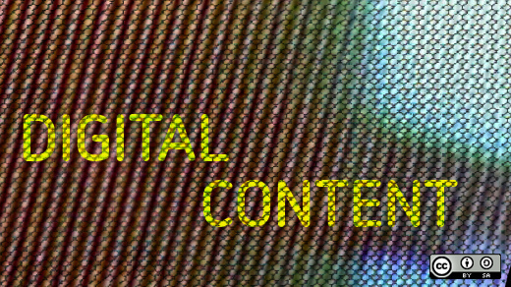
Content Licenses
Notes:
Picture is CC-BY-SA, opensource.com
When I say Content, I mean things that are not code, not docs, not fonts. Basically, this leaves us with things like artwork, music, sound files, video files. They're creative works, covered by copyright, but they may not have any source code to speak of. That said, most of these files can be manipulated, remixed, and modified, so we need a set of FOSS licenses for them as well.
The best choice here is the Creative Commons licenses, specifically:
CC-BY: Creative Commons Attribution license, which only requires that you give attribution to the copyright holder
CC-BY-SA: Creative Commons Attribution Share-Alike license, which requires attribution and that all derived works be under the same license.
There are other Creative Commons licenses, but they are not Free, notably, any of the licenses with the Non-Commercial or Non-Derivatives clauses.
If you dislike the Creative Commons licenses, you might also consider the Free Art License, which is a copyleft license structured specifically for artistic content works.

Slide 30
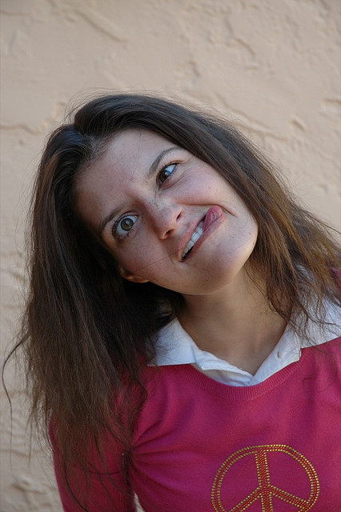
Crazy Licenses
Notes:
Picture is CC-BY, flickr user “thestarmama”:
https://www.flickr.com/photos/thestarmama/69575266
Okay. I know you came for the crazy licenses. Here's some of the weird licenses I've seen.

Slide 31
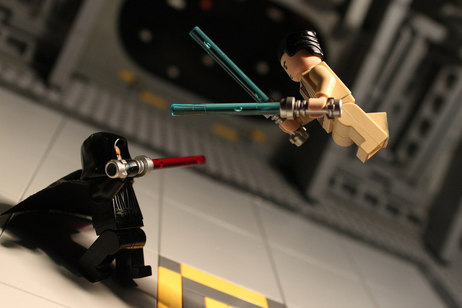
The JSON license
Notes:
Picture is CC-BY-SA, flickr user “bonaparty”:
https://www.flickr.com/photos/bonaparty/6188957269
The JSON license is a permissive license in all regards, derived from the MIT license, except for one added clause:
The Software shall be used for Good, not Evil.
Now, remember, licenses are written in Legalese, not English. When you capitalize a word in Legalese, it means that word is “special” and is supposed to have a definition, either in the law dictionary or provided by the legal document itself. There are no legal definitions for “Good” or “Evil”, either in the law dictionaries, or in the license.
What makes use Good or Evil? Who knows. A n argument could be made that the copyright holder is the only one who can answer this, another argument is that it cannot be answered at all. Either way, it means that practically, no one can safely use this software.
This license is not considered Free or Open Source as a result.

Slide 32
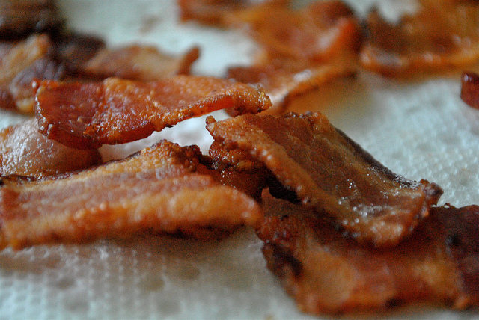
ExtTLD license
Notes:
Picture is CC-BY, flickr user “cookbookman”:
https://www.flickr.com/photos/cookbookman/6175755733
The Ext JS software license is GPLv3, however, to download ExtTLD, you have to also agree to an additional license where you agree to:
Not develop or manufacture products which involve animal testing
Not participate in the animal testing industry
Not produce any products which involve any animal product, by-product, or derivative
Not produce any genetically modified organisms
Not be involved with or profit from the use of animals for entertainment
Not be involved with the breeding or transport of animals for any of the previous conditions
These use restrictions make ExtTLD non-free.

Slide 33
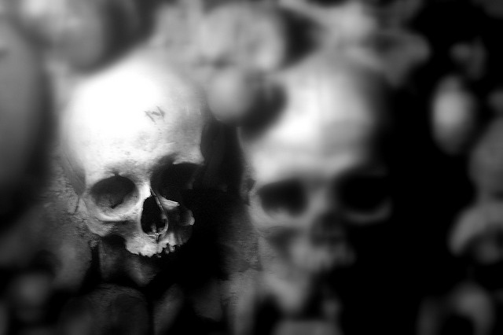
D&R License
Notes:
Picture is CC-BY, flickr user “myimage”:
https://www.flickr.com/photos/myimage/3278754860
The Death and Repudiation license states that “the software may not be used directly by any living being”. Yes, you have to be dead to use software under this license, and if you aren't dead, you will be punished to the fullest extent of the law. No ghosts or angels either.
The good news is that this license, while completely non-free and non-open source, is part of an OR multi-license case in the only known instance, and the other license is BSD.

Slide 34
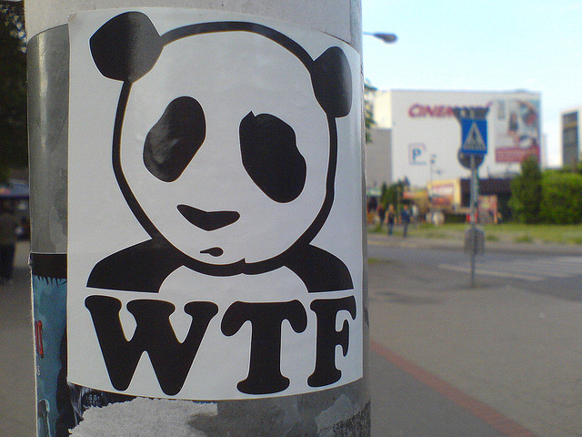
WTFPL
Notes:
Picture is CC-BY-SA, flick user “schoschie”:
https://www.flickr.com/photos/schoschie/2527918562
If there is anyone who is uncomfortable with naughty language, please cover your ears for a moment, we're going R rated.
The Do What the Fuck You Want To Public License (WTFPL) only has one real clause:
You just DO WHAT THE FUCK YOU WANT TO.
Really, this license is written pretty poorly. Whatt little legalese it does have strongly implies that the license applies only to the WTFPL license text and not to any software work. Nevertheless, the intent is clear..

Slide 35

CDL
Notes:
Picture is CC-BY, flickr user “aoifecitywomanchile”:
https://www.flickr.com/photos/aoifecitywomanchile/3828589507
This is the Chicken Dance License, or CDL. Not to be confused with Apple's Common Documentation License or Sunacle's Common Development Distribution License (CDDL).
The CDL is a BSD derived license, with the following additional clauses:
An entity wishing to redistribute in binary form or include this software in their product without
redistribution of this software's source code with the product must also submit to these conditions where applicable: For every thousand (1000) units distributed, at least half of the employees or persons affiliated with the product must listen to the "Der Ententanz" (AKA "The Chicken Dance") as
composed by Werner Thomas for no less than two (2) minutes
* For every twenty-thousand (20000) units distributed, one (1) or more persons affiliated with the entity must be recorded performing the full Chicken Dance, in an original video at the entity's own expense, and a video encoded in OGG Theora format or a format and codec specified by <OWNER>, at least three (3) minutes in length, must be submitted to <OWNER>, provided <OWNER>'s contact information. Any and all copyrights to this video must be transfered to <ORGANIZATION>. The dance featured in the video must be based upon the instructions on how to perform the Chicken Dance that you should have received with this software.
* Any employee or person affiliated with the product must be prohibited from saying the word "gazorninplat" in public at all times, as long as distribution of the product continues.
They also disclaim any liability for you injuring yourself while attempting to Chicken Dance.

Slide 36
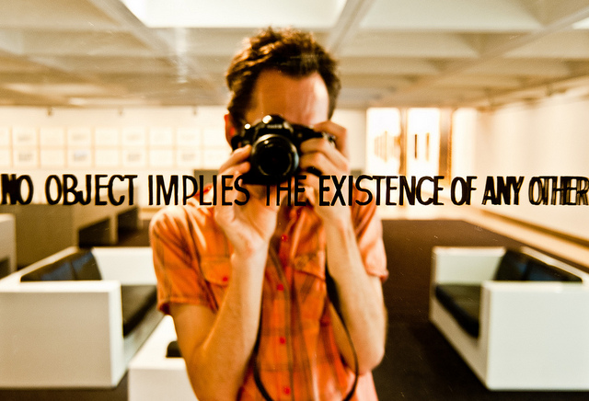
Solipsistic Public License
Notes:
Picture is CC-BY-SA, flickr user “unwisechoice”:
https://www.flickr.com/photos/unwisechoice/5396214669
This license requires that you accept that nothing besides you exists. Including the software, or the copyright holder, or even the license itself. Needless to say, it is non-free and non-open source.

Slide 37

Choosing the right license for you
Notes:
Picture is CC-BY-SA, opensource.com
Look. There is no right answer here.However, there are plenty of wrong answers. The most wrong answer you can have is “I'm going to write my own license”. Fedora has over 300 unique Free licenses. The chances are very very very slim that you are qualified to write your own license, the things you want your license to do will be Free or Open Source, and that no other license already serves those needs adequately.
Don't go changing just part of a license either. Remember, there is Legalese and there is English. The two look the same, but they are not.
Choosing a license is almost a philosophical choice. If you wish to simply permit others to freely use, modify, and distribute your work, a permissive license like BSD or MIT is fine. If you wish to ensure that changes to your code stay under the same license, a copyleft license like GPL is a good choice. If you're concerned about patents, you might consider a license with explicit patent clauses like Apache, Mozilla, or GPLv3. If you want your code to be copyleft, but also permit other code under any license they wish (even proprietary) to depend on it, look to LGPL or Mozilla. If you're building a web application and you want a strong copyleft, use Affero GPL (AGPL).
There are a fair number of license choosers out there, each with their own biases. Sometimes, they feel like you're asking the Pope which religion to practice. That said, choosealicense.com is a good start, as is creativecommons.org/choose.

Slide 38

Would you like to know more?
Intellectual Property and Open Source: A Practical Guide to Protecting Code by Van Lindberg (O'Reilly, 2008)
Notes:
Picture is CC-BY-SA, flickr user “83633410@N07”:
https://www.flickr.com/photos/83633410@N07/7658272558

Slide 39
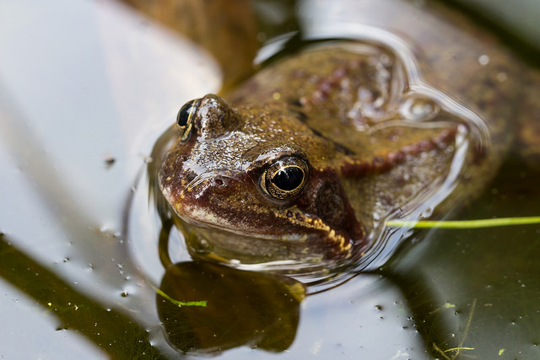
Questions?

