Slide 1
Where's Wayland
The post-X world
Jon A. Cruz – Senior Open Source Developer
Samsung Open Source Group
jonc@osg.samsung.com

Slide 2
Why Wayland?

Slide 3
Why Wayland?
X11...

Slide 4
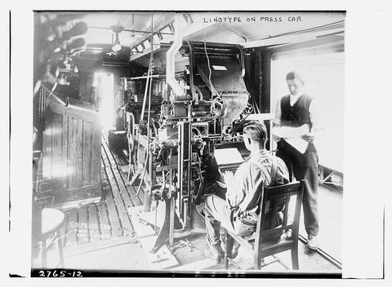
Why Wayland?

Slide 5

Why Wayland?
X11 perceived as old and crufty
  Protocol architecture/design is over 30 years old
  Server-side fonts, 2D drawing primitives, etc.
  Assumes clients are all trustworthy

Slide 6
Why Wayland?
X11 perceived as old and crufty
  Protocol architecture/design is over 30 years old
  Server-side fonts, 2D drawing primitives, etc.
  Assumes clients are all trustworthy
X.Org doing fair job at working around these things
  X.Org is "reference implementation" of the protocol and has become industry standard
  Modular extensions allows modernizing feature set (3D, compositing, etc.)
  Feature development continues at rapid pace

Slide 7
Why Wayland?
But what if we start from a clean slate?
  Protocol designed with compositing a core feature
  3D focused
  Application security by design. All clients are untrusted.

Slide 8
What does Wayland do?

Slide 9
What does Wayland do?
Basics/Minimalism
Compositing
Non-blocking

Slide 10
What does Wayland do?
Basics/Minimalism
Compositing
Non-blocking
But it doesn't do
  Drawing
  Fonts
  Printing
  Pseudo-OS

Slide 11
What does Wayland do?
Key point
  Wayland is a protocol
  Wayland is not a display server

Slide 12
What does Wayland do?
Key point
  Wayland is a protocol
    Replaces just the X protocol
  Wayland is not a display server
    In an of itself does not replace the X.Org server

Slide 13
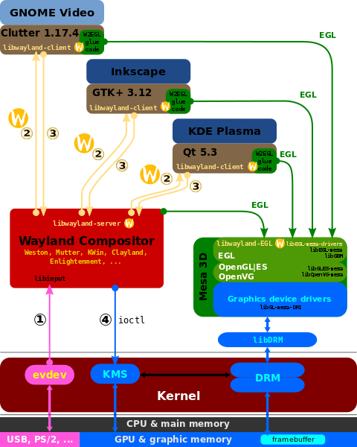
What does Wayland do?

Slide 14
Where is Wayland now?

Slide 15
Where is Wayland now?
It's Everywhere!
  Well, not quite but is moving in rapidly
  Higher-level and lower-level support
    Toolkits
    Desktop environments
    Mobile and Embedded

Slide 16
Where is Wayland now?
Toolkits
  Clutter
  EFL
    Under active development
  GTK+
    3.10 has complete Wayland 1.2 support
  Qt 5
  SDL
    Experimental added in 2.0.2

Slide 17
Where is Wayland now?
Desktop Environments
  KDE
  Enlightenment
  Hawaii
  GNOME
  MATE

Slide 18
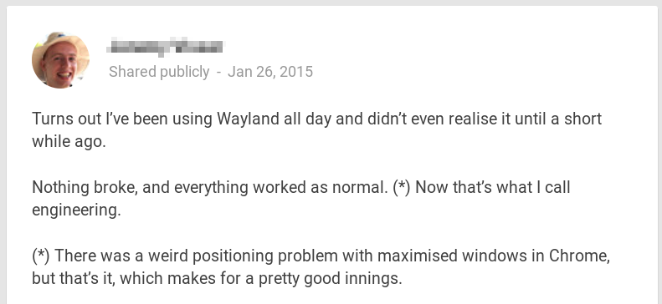
Where is Wayland now?

Slide 19
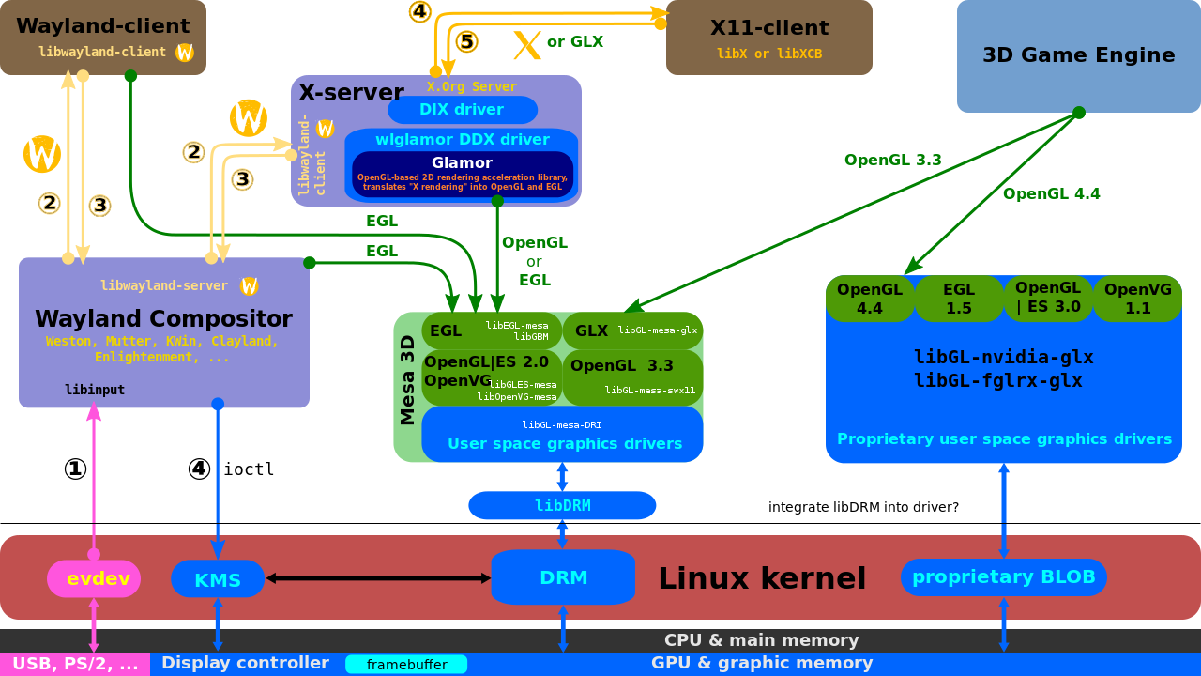
Where is Wayland now?

Slide 20
Where is Wayland now?
Mobile and Embedded
  GENIVI Alliance
    automotive industry consortium for in-vehicle infotainment (IVI)
  Tizen
  others

Slide 21
Where is Wayland going?

Slide 22
Where is Wayland going?
Hitting its stride
  Expanded by third parties
  Extensions and standardized features
    Much depends on how many people contribute
    Remote display has different options
  Stabilized and more polished

Slide 23
Weston and libweston

Slide 24
Weston and libweston
Weston
  Weston is...
    Reference implementation of Wayland
    Covers the basics and allows extension
  Weston's future?
    Currently under active discussion
    Many factors being considered
      Should it be minimalist/proof-of-concept?
      Should it be bells-and-whistles showcase?

Slide 25
Weston and libweston
Libweston
  Concept to break core Weston implementation out to be reusable
    Library for other compositors to extend
    Conceptually might be difficult
      Implementation might be tied to details
      Choices for one compositor might be wrong for another
    Probably requires significant refactoring

Slide 26
Clients

Slide 27
Clients
Weston example clients
  Built as weston-* in main weston directory
  Source present in Weston tree under 'clients'
  Samples written to highlight features of Wayland
  Using a 'toy' ui toolkit.
    Not meant for shipping clients, just for demo

Slide 28
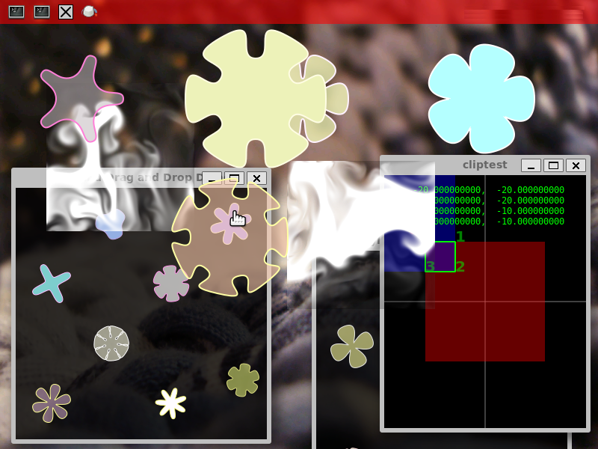
Clients

Slide 29
Clients
Finding 3rd party example clients
  More and more appearing
  Know to search for them outside of the Wayland/Weston project itself
Applications that work on Wayland
  Used to be fairly limited and simple to list
  Many now work, and more getting Wayland support added

Slide 30
Getting Help

Slide 31
Getting Help
IRC
Mailing lists

Slide 32
Getting Help
IRC
  #wayland on freenode
Mailing list
  http://lists.freedesktop.org/mailman/listinfo/wayland-devel

Slide 33
Questions and Answers

Slide 34
Thank you.

Slide 35
Images
  “Linotype on press car” public domain
    http://www.loc.gov/pictures/item/ggb2005013632/
  “Wayland display server protocol.svg” by Shmuel Csaba Otto Traian is licensed under CC BY-SA 3.0
    http://commons.wikimedia.org/wiki/File:Wayland_display_server_protocol.svg
  “The Linux Graphics Stack and glamor.svg” by Shmuel Csaba Otto Traian is licensed under CC BY-SA 4.0
    http://commons.wikimedia.org/wiki/File:The_Linux_Graphics_Stack_and_glamor.svg

