Slide 1
Introductions
Pipecut – an Interactive Pipeline editor
By David Maxwell
For Scale 13x – Feb 21, 2015

Slide 2
‘sysadmin’ track
In the conference program, this talk is listed on the sysadmin track.
I'm going to go into details that are outside of system administration.

Slide 3
‘sysadmin’ track
In the conference program, this talk is listed on the sysadmin track.
I'm going to go into details that are outside of system administration.
You have been warned.

Slide 4
How pipecut came about
Realized I wanted a more interactive way of working with the command line
Started writing the front-end user interface to address that desire
Ended up realizing that I needed a special backend representation for commands to support it

Slide 5
Neccessity -> Inspiration
In order to build the interactive UI, I needed to create a structure that hadn’t existed before –
I needed an Abstract Syntax Tree (AST) for representing the Unix Command line

Slide 6
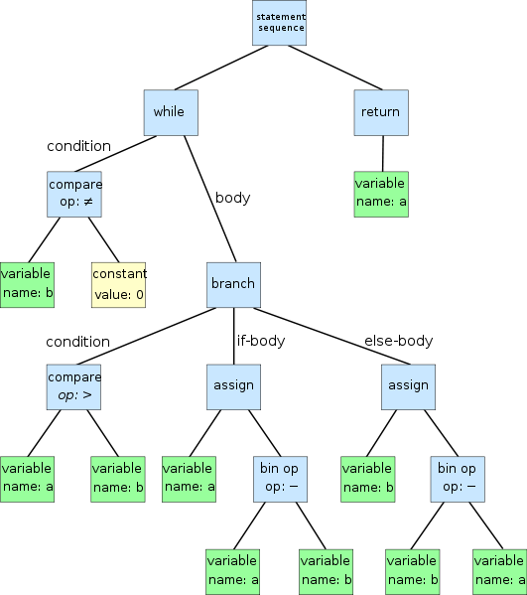
Abstract Syntax Trees

Slide 7
Traditional Shells
A command line is text
d | u |  | - | a | x | | | s | o | r | t |  | - | n | r

Slide 8
Traditional Shells
A command line is text
d | u |  | - | a | x | | | s | o | r | t |  | - | n | r
Shells commonly store history as
an ordered list of words, or 'tokens'
d | u
- | s | k
|
s | o | r | t
- | n | r

Slide 9
Traditional Shells
A list of words is very convenient for the shell, since the syscalls the shell uses to launch programs accept a list of arguments in that form.

Slide 10
What you get from ASTs
du -ax | sort -nr
This is a disk usage
command
The 'all entries' option
Is enabled
The 'do not cross
mountpoints' option
Is enabled
This is a sorting
command
The 'numeric sort key' option
Is enabled
The 'reverse (descending
order)' option is enabled

Slide 11
Encoding information
Once you have an AST representation, you can make use of it in many ways.

Slide 12
ASTs - Shortcutting
cat foo | sort | sort | sort | sort
A tool using ASTs can run that as just
'cat foo|sort' (or even just 'sort foo' )
It knows that sort produces sorted data, and that sort won't change data that's already sorted.

Slide 13
Categorize command utils into types: filters, UIs, Data sources, etc
An AST structure needs a way to describe each thing it has to represent
All of the 'type of object' and attribute information

Slide 14
But there are thousands of Unix utilities!
Build the common ones first
Support a generic 'we don't know what this does' “BLACKBOX” type for everything you haven't taught the system how to handle yet.

Slide 15
Ecosystem that emerges from having ASTs
Persistence | Transformation
Optimizations | Static analysis
Code generation | API interfaces
Need for other libraries | Reusable in different contexts

Slide 16
Need for more libraries
Now that you have a tool that can understand more about Unix commands...
You may also need a tool that understands more about input and output data

Slide 17
Libmoremagic
Reference to the magic switch story (look up 'magic' in the Jargon file)
libmagic is the backend for the Unix 'file' utility.
When you run 'file', it tells you what type of file you have.
% file sample/csv_cr_3jot100s
Sample/csv_cr_3jot100s: ASCII text

Slide 18
Libmoremagic
My libmoremagic does feature extraction (similar to techniques in OCR and computer vision) on a target file, so it can give more thorough answers.
% mmagic sample/csv_cr_3jot100s
delimited:CSV format:3 fields
Numeric:Numeric:Numeric

Slide 19
Project Jupyter digression
Formerly called 'iPython Notebooks', recently renamed Project Jupyter
Very nice way to present history of a working session on the web.
I'm planning to support this in pipecut so people can build tutorials easily.

Slide 20
Note on use/packaging of Peter Seebach’s sz string library
String manipulation in C is error prone.
I wrote several hardcoded string lengths into the POC for pipecut
I'm gradually replacing them using Peter Seebach's 'sz' String library.
Since 'sz' isn't widely packaged, it's bundled in with the pipecut distribution for now.

Slide 21
Ecosystem that emerges from having ASTs
Persistence | Transformation
Optimizations | Static analysis
Code generation | API interfaces
Need for other libraries | Reusable in different contexts

Slide 22
Sqlite: ~/.pipecut.db
Obvious choice for single-user persistence needs.
When you have structured data in an AST, persisting to a database (or other document structure) is trivial.
This provides one way of using 'macros' – use the append command in pipecut to extend your commandline with a previously saved toolset.

Slide 23
Open Questions and intentional limitations
Right now, I intentionally assume that all input comes from a file (first blade is always a 'cat')
Allows a lot of simplifications internally while I build up other capabilities.

Slide 24
Open Questions and intentional limitations
Shells have constructs that are problematic or challenging.
e.g. Multiple i/o redirects, Shell variables, and
subshells ().
For example, shell variables aren't always exported to child processes – so pipecut can't see them until you were to link it in to the shell itself.

Slide 25
Additional Feature Demos
Unleash the Crashin'!

Slide 26
Questions?
Project website: http://www.pipecut.org
Hashtag: #pipecut
Twitter: @David_W_Maxwell
First public release later tonight

