Slide 1
Getting to know Linux-IO
Kirk Kosinski

Slide 2
Contents
About me
Why care about shared storage?
Shared storage types
iSCSI basics
Free, “easy” solutions
Solutions included with OS
Linux iSCSI history
Preparing for Linux-IO
Installing Linux-IO
Configuring Linux-IO
Configuring Initiators
Troubleshooting Linux-IO
Q&A

Slide 3
About me
Citrix Systems / Cloud.com
  Senior Escalation Engineer
  Citrix CloudPlatform
  Apache CloudStack Committer
Twitter – @kirkkosinski
Blog – https://kirkkosinski.com/
Certs
  Citrix – XenDesktop, XenServer
  VMware – VCP 4, 5
  Microsoft – MCSA: 2003, 2008; MCITP: EA, VA

Slide 4
Why care about shared storage?
Common uses
  Clustering
  Virtualization
Learning
  Certs, personal development
Test / staging environment
Production

Slide 5
Shared storage types
File-based
Block-based

Slide 6
Shared storage types (continued)
File-based
  Shares
  “NAS”
  NFS, SMB/CIFS
Block-based
  LUNs
  “SAN”
  Fibre Channel, iSCSI

Slide 7
iSCSI basics
Software based
Client/server model
  Client is the “initiator”
  Server is the “target”
    3260/tcp
IQN
  iqn.2015-02.org.socallinuxexpo:targetname-1234
  iqn.1994-05.com.redhat:abcd1234
LUN
iSNS

Slide 8
Free, “easy” solutions
Openfiler
FreeNAS
Nexenta
StarWind

Slide 9
Free, “easy” solutions (continued)
Openfiler
  Linux
FreeNAS
  FreeBSD
Nexenta
  Solaris
StarWind
  Windows

Slide 10
Solutions included with OS
Linux
*BSD
Solaris
Windows

Slide 11
Solutions included with OS (continued)
Linux
  Linux-IO, md
*BSD
  istgt, OpenZFS
Solaris, OpenIndiana
  COMSTAR, ZFS
Windows Server
  2008 R2: Optional download
  2012: ISCSI Target Server role

Slide 12
Linux iSCSI history
IET
  http://iscsitarget.sourceforge.net/
SCST
  http://scst.sourceforge.net/
STGT
  http://stgt.sourceforge.net/
Linux-IO
  http://linux-iscsi.org/wiki/LIO

Slide 13
Preparing for Linux-IO
Install Linux
  Fedora, Ubuntu, Arch, etc.
Prepare disks
  Configure hardware RAID arrays, md, etc.
Configure firewall
  Open ports, allow IPs of initiators, etc.

Slide 14
Installing Linux-IO
Subsystem included with Linux kernel
  Enable CONFIG_ISCSI_TARGET
  target_core_mod, iscsi_target_mod
Libraries
  RTSLib
  “python-rtslib” package (Fedora, Ubuntu)
UI
  targetcli
  “targetcli” package (Fedora, Ubuntu)

Slide 15
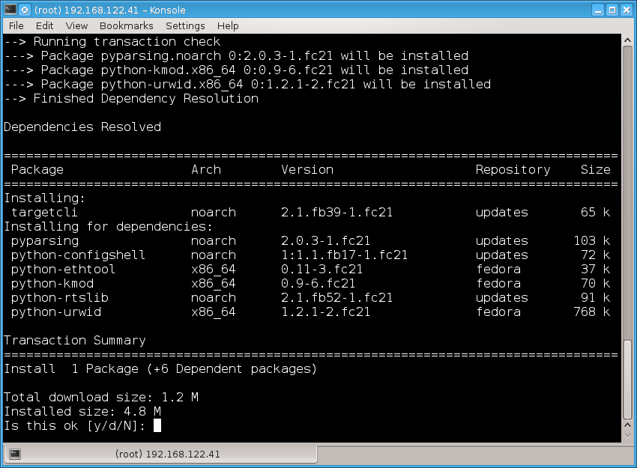
Installing Linux-IO (Fedora 21)

Slide 16
Configuring Linux-IO (basics)
target service
  Loads modules, applies the configuration
    /etc/target/saveconfig.json
targetcli
  Creates the configuration
  Follows some *nix conventions (e.g. ls, cd)
  Multiple modes
    Interactive shell
      Tab completion

Slide 17
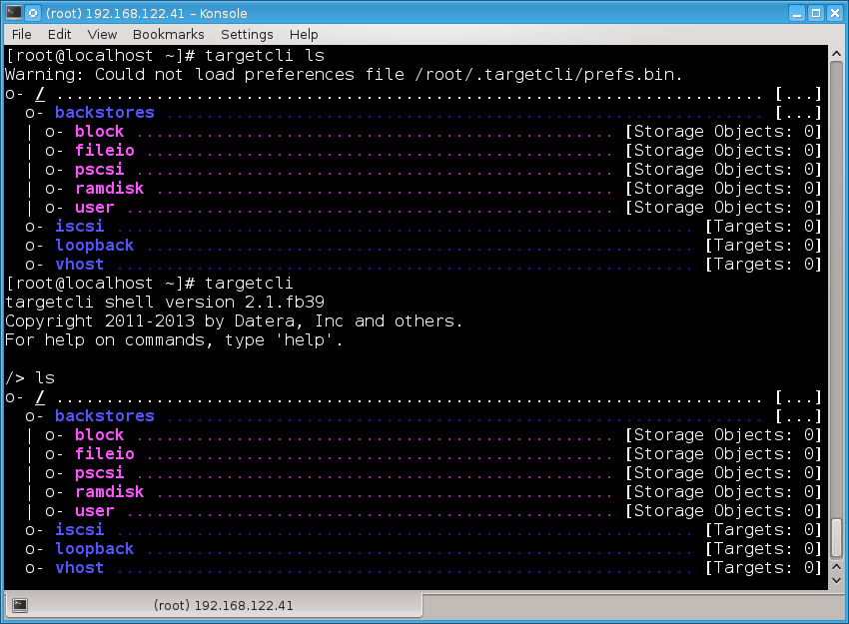
Configuring Linux-IO (targetcli use)

Slide 18
Configuring Linux-IO (overview)
Create backstore(s) (files, block devices)
Create target
Create portal group for target from 2)
Add initiators to portal group from 3)
Create LUN in portal group from 3) for backstore(s) from 1)
Configure or disable authentication for portal group
Save configuration
Configure initiators to access target

Slide 19
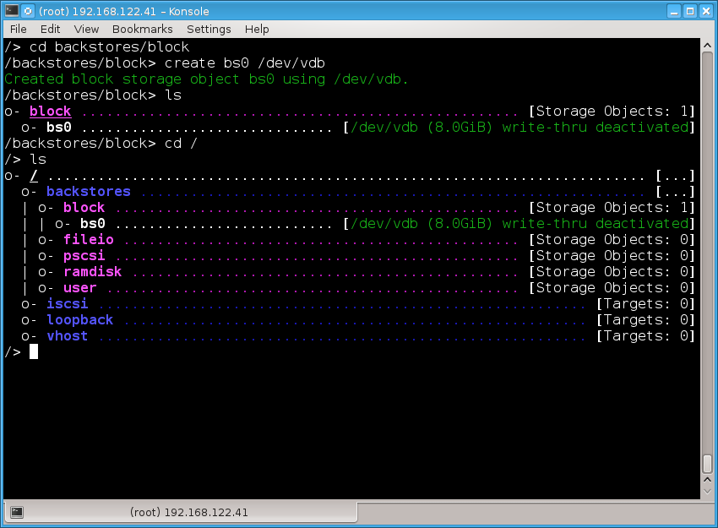
Configuring Linux-IO (backstore)

Slide 20
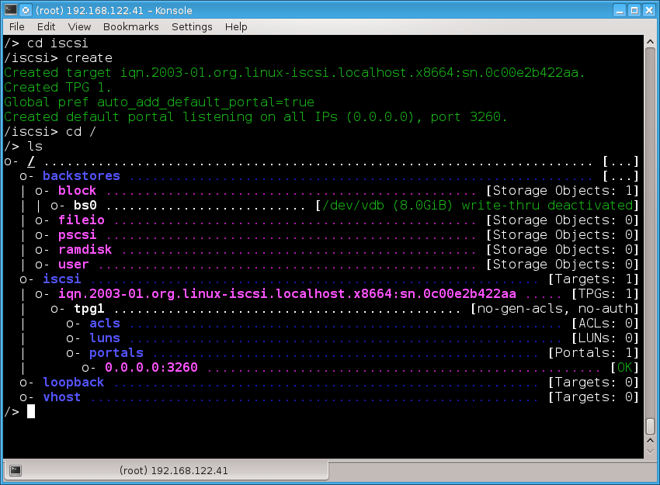
Configuring Linux-IO (target)

Slide 21
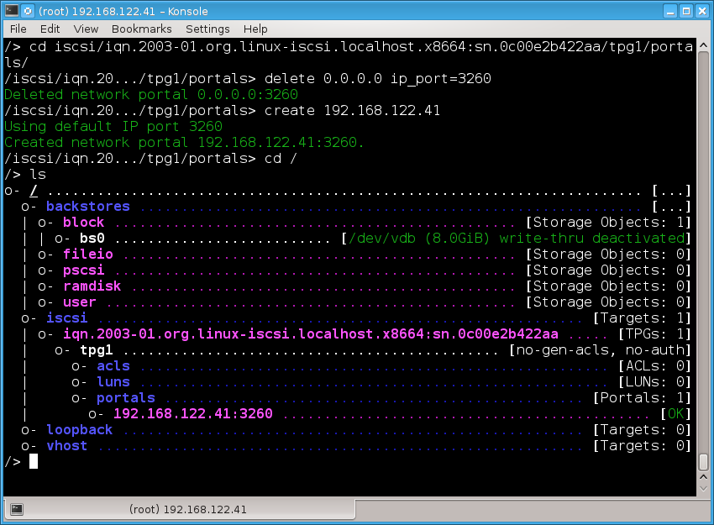
Configuring Linux-IO (portal group)

Slide 22
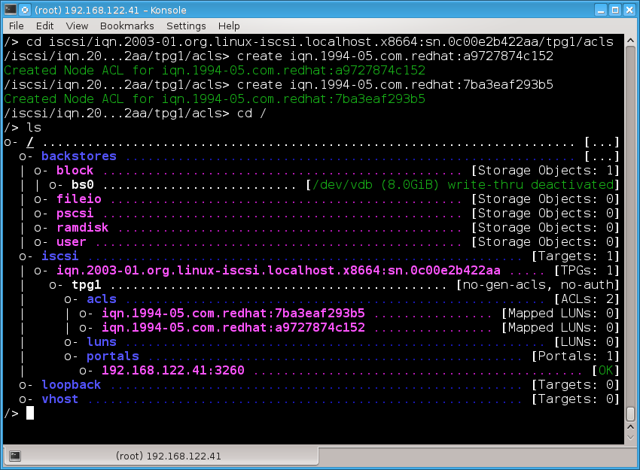
Configuring Linux-IO (initiators)

Slide 23
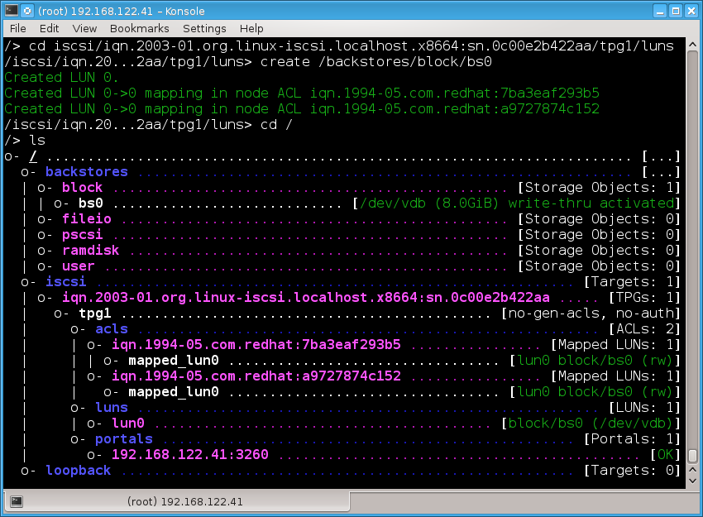
Configuring Linux-IO (LUN)

Slide 24
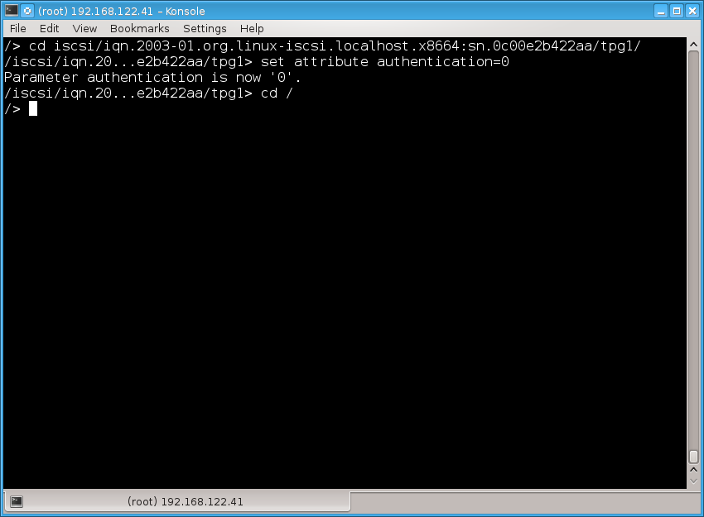
Configuring Linux-IO (authentication)

Slide 25
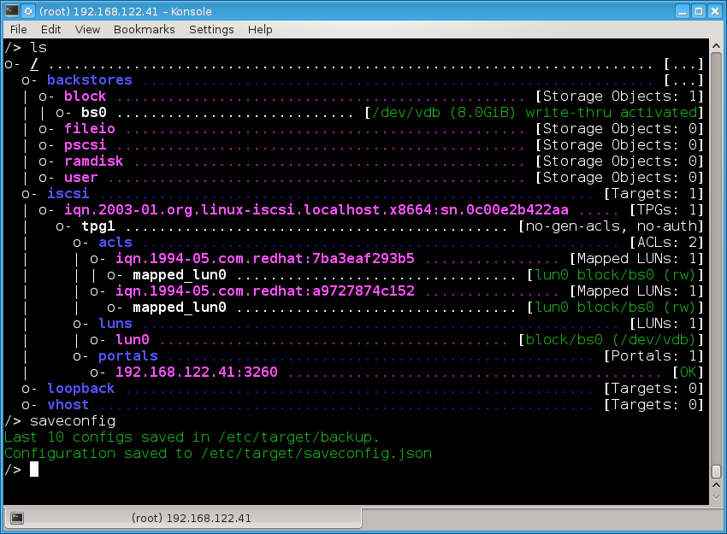
Configuring Linux-IO (save)

Slide 26
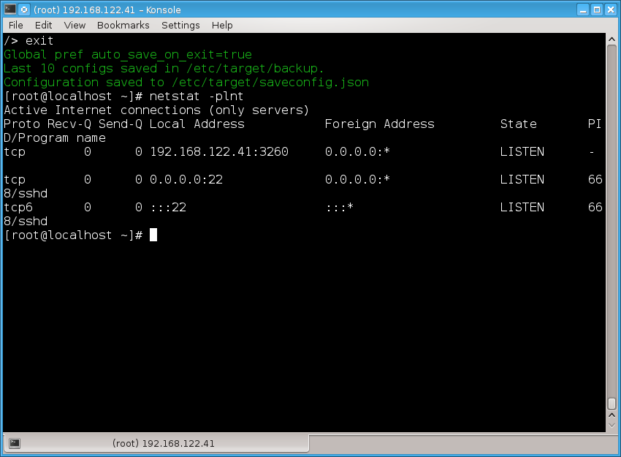
Configuring Linux-IO (check port)

Slide 27
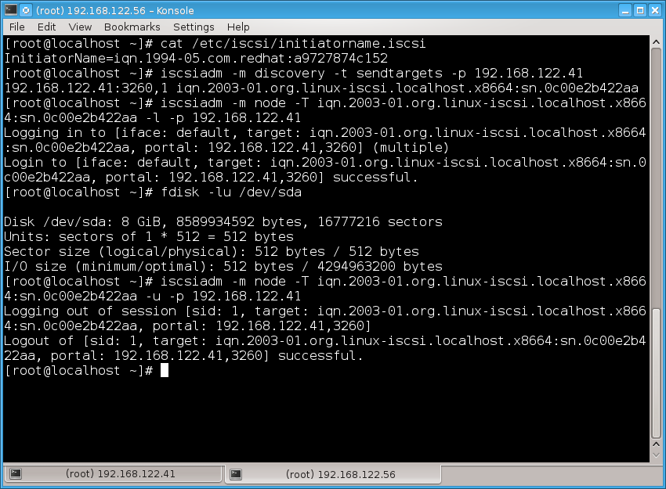
Configuring Initiators (Fedora)

Slide 28
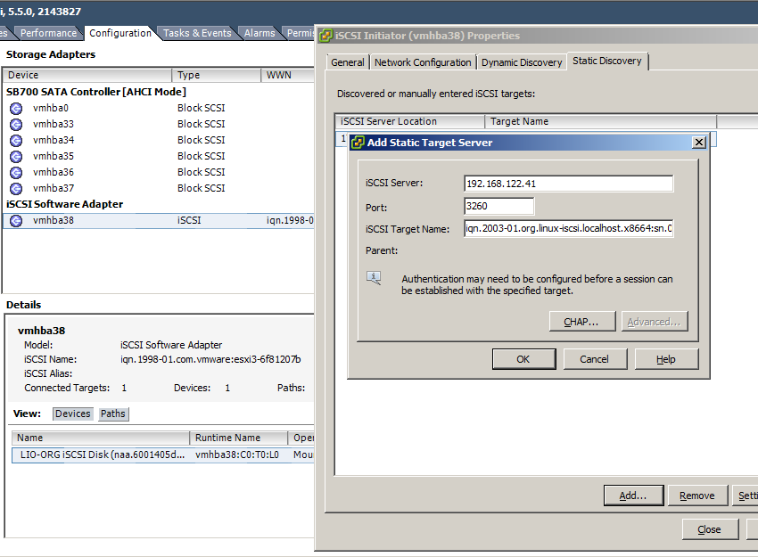
Configuring Initiators (vSphere)

Slide 29
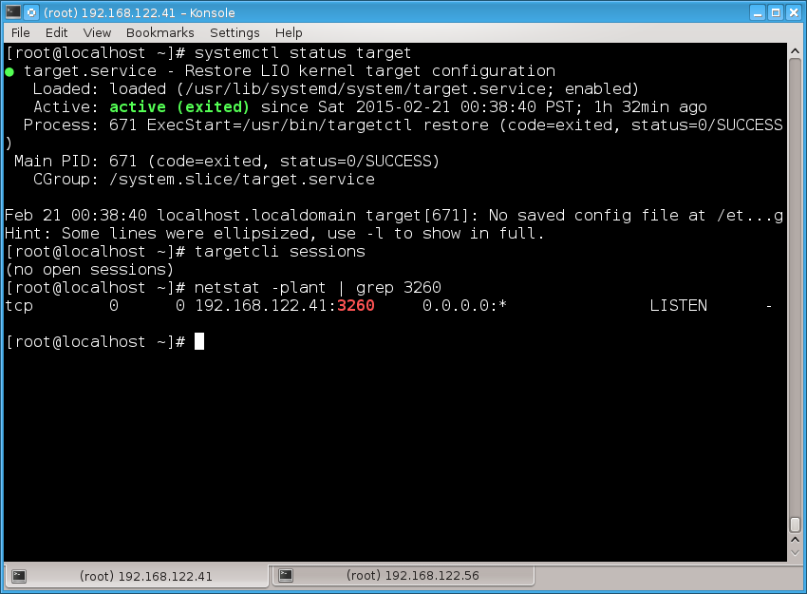
Troubleshooting Linux-IO

Slide 30
Q&A

