Slide 1
Internet of
Thingies

Slide 2
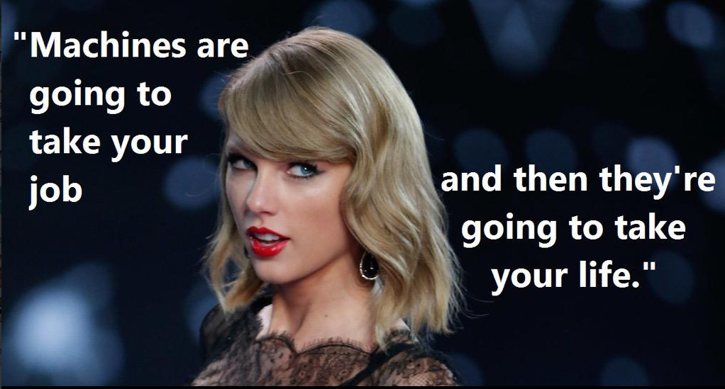
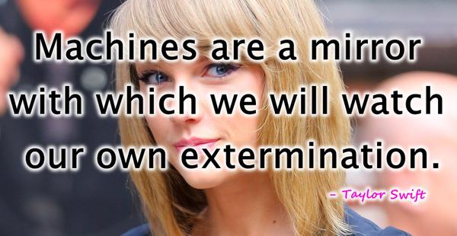
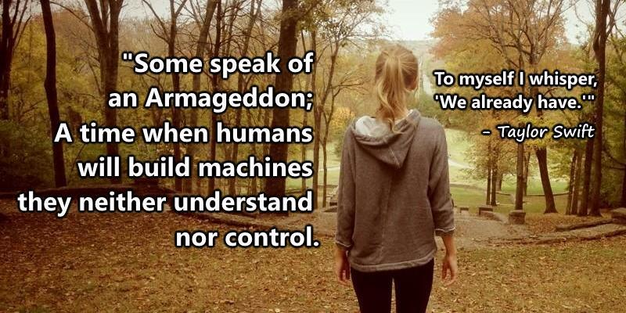
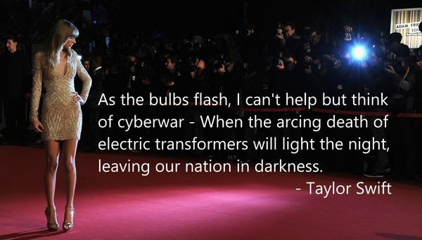
@SwiftOnSecurity
Notes:
My small contribution to the rise of the machines.

Slide 3
The Dream energy efficient living open information minimal disruption data ownership
Notes:
Energy efficency != low power usage devices. It can mean intelligent use of energy

Slide 4
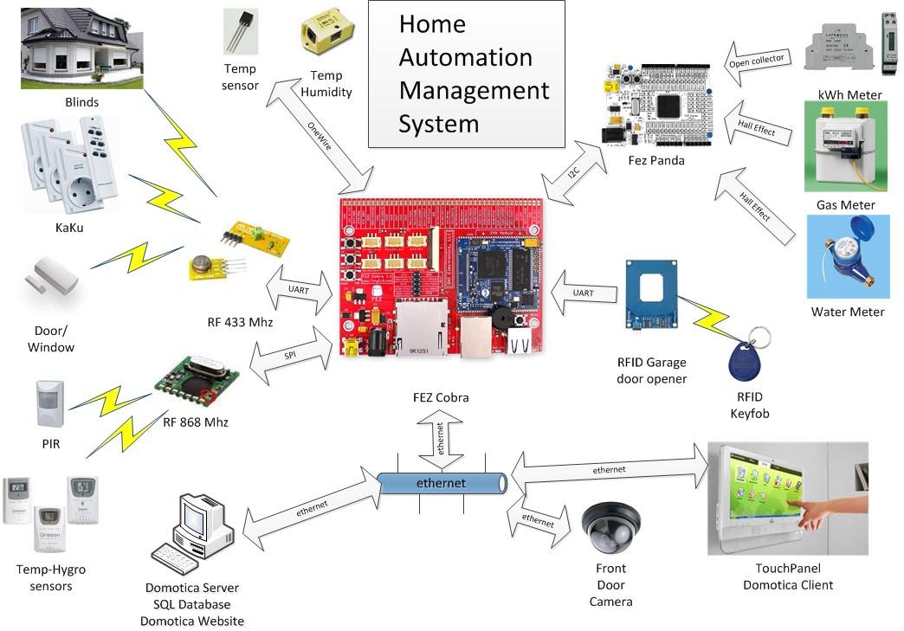
gets complex

Slide 5
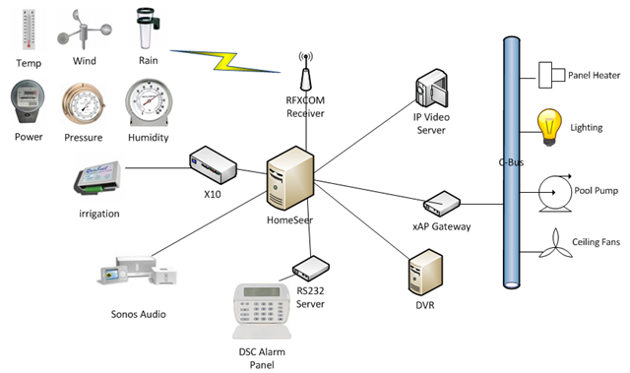

Slide 6
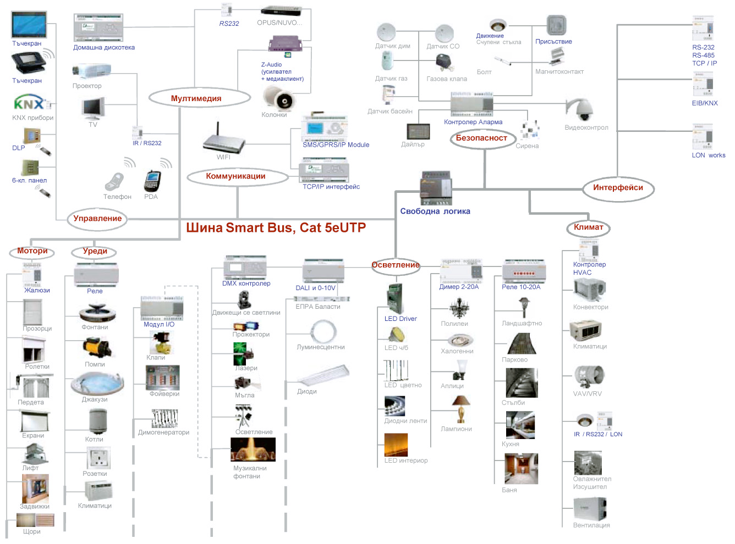

Slide 7
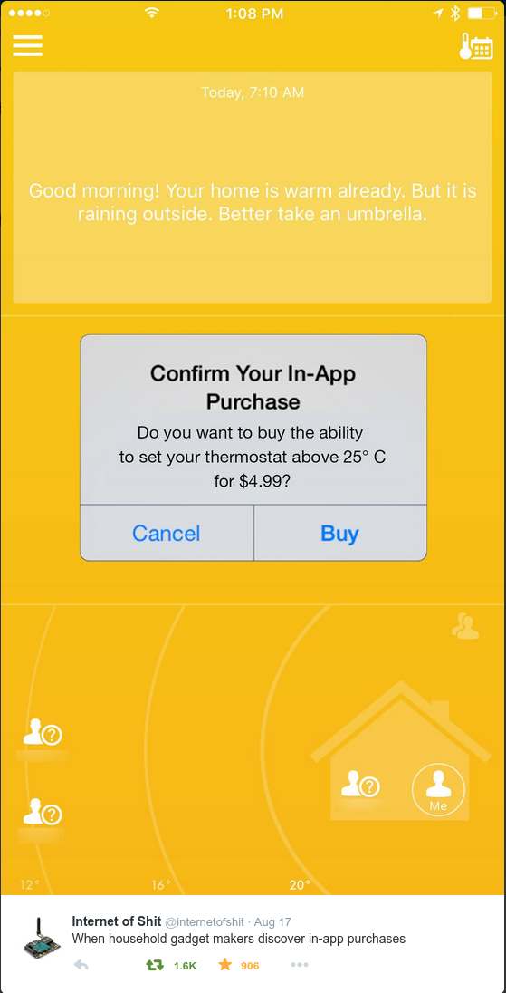
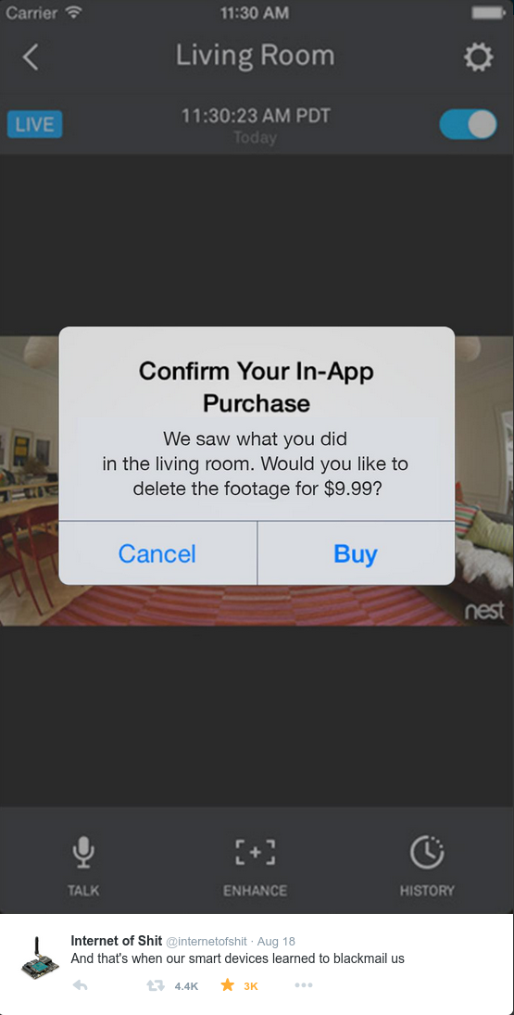
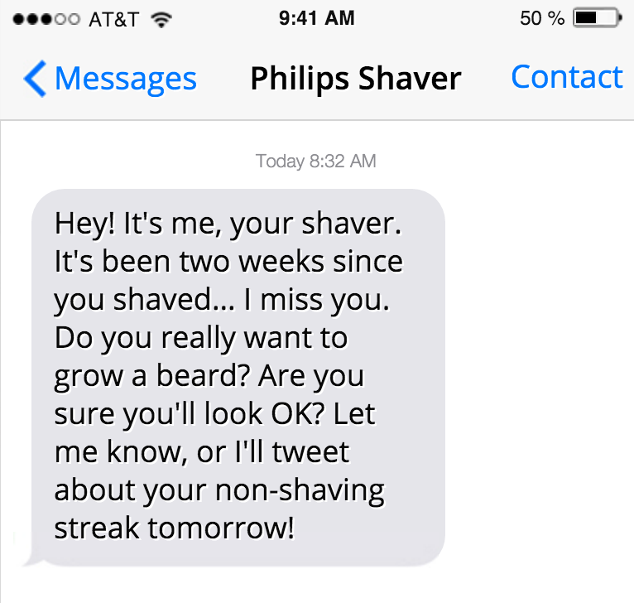
please no
Notes:
One of my goals is to avoid this path

Slide 8
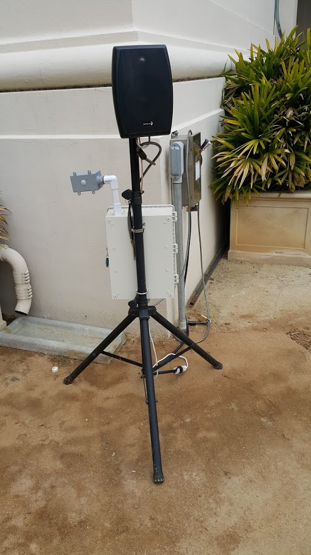

Slide 9
Design Goals
“open”
common components
reasonable price
flexible
innocuous or portable
IP communication
energy efficient
Notes:
“Where to begin?”

Slide 10
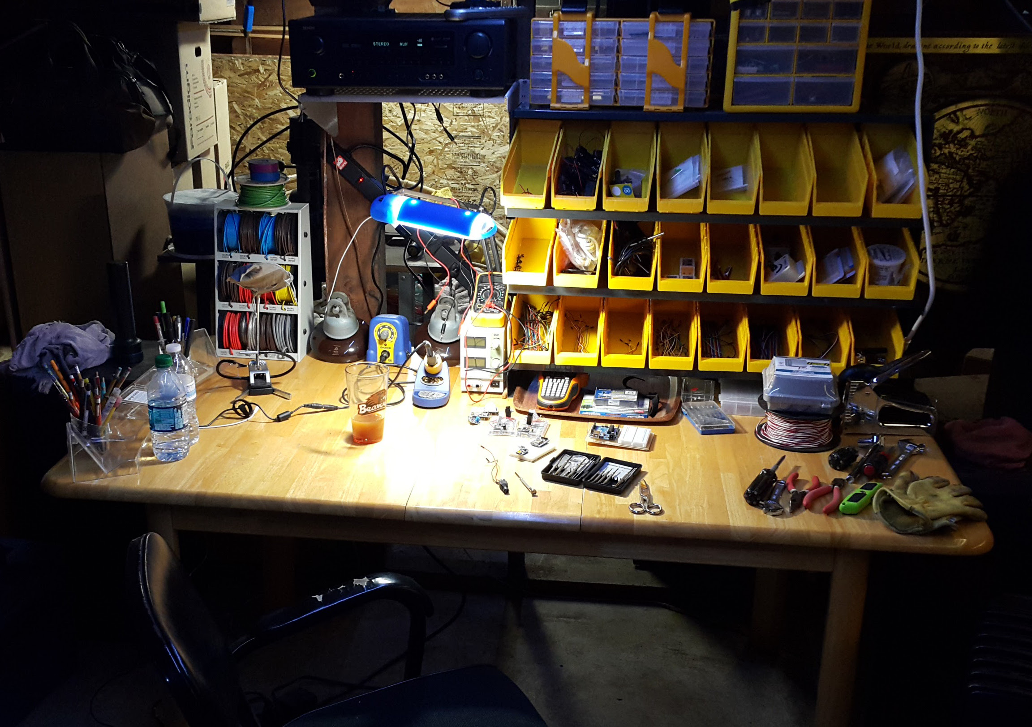
Tools

Slide 11
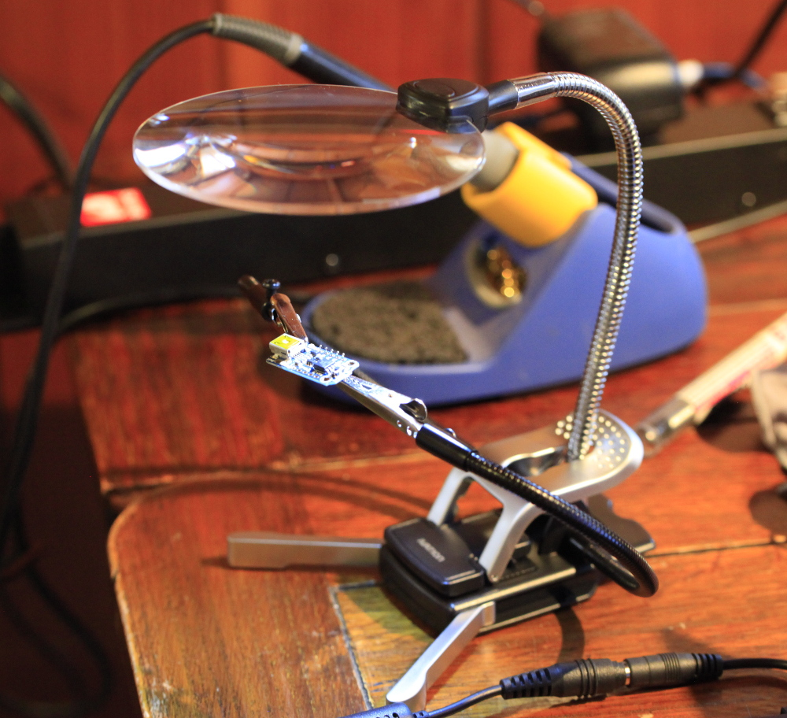
Tools
Notes:
Quality of the little things can matter

Slide 12
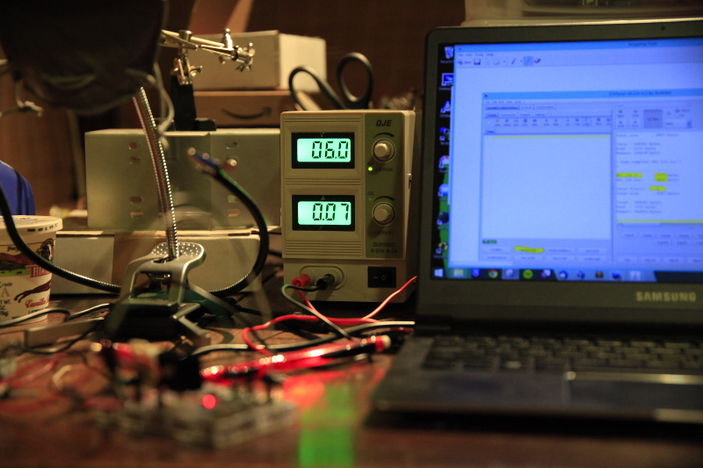
Tools

Slide 13
Tools
electrician's scissors (wire strippers)
voltmeter
needle nose pliers
good soldering iron
smaller screwdrivers
variable power supply
good lighting
Notes:
- better quality makes repetitive work easier
, jeweler's screwdrivers
Variable power supply - not required, but very useful
various lights, magnifiers... age dependent

Slide 14
Make a temperature sensor*
Collect data

Slide 15
*thingy

Slide 16
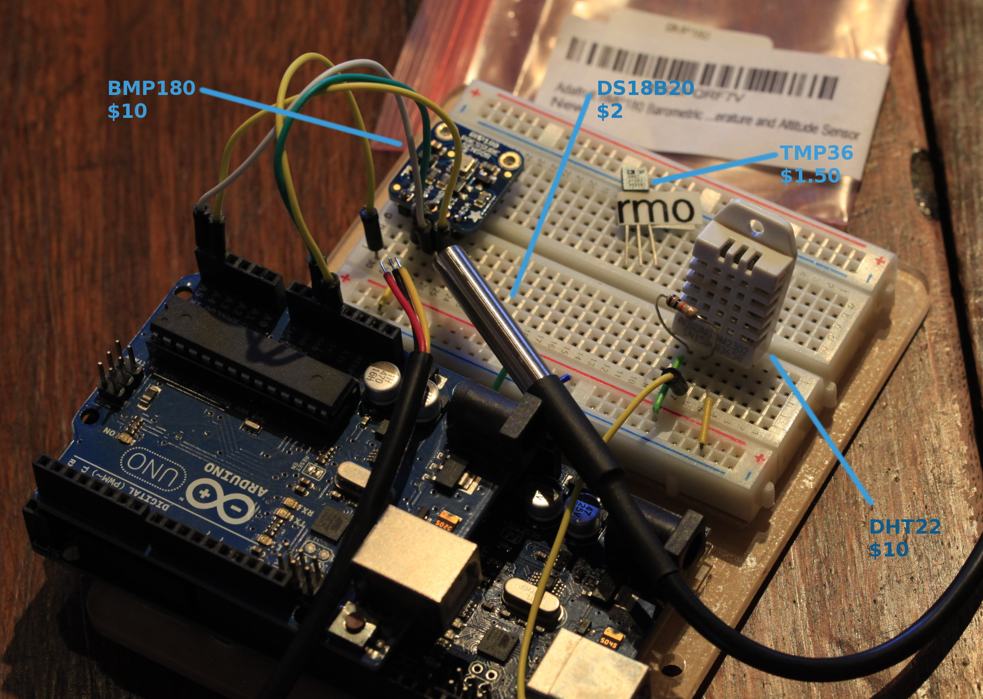
Arduino compatible sensors

Slide 17
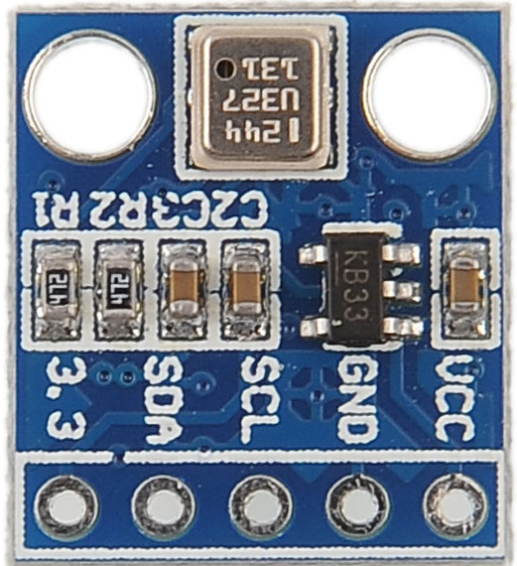
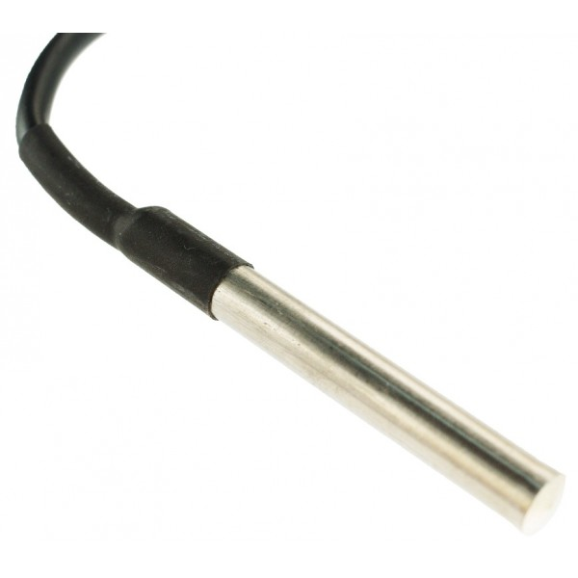
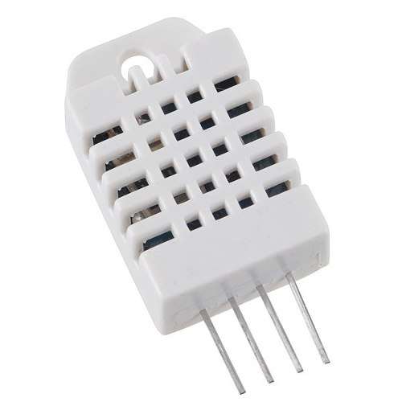
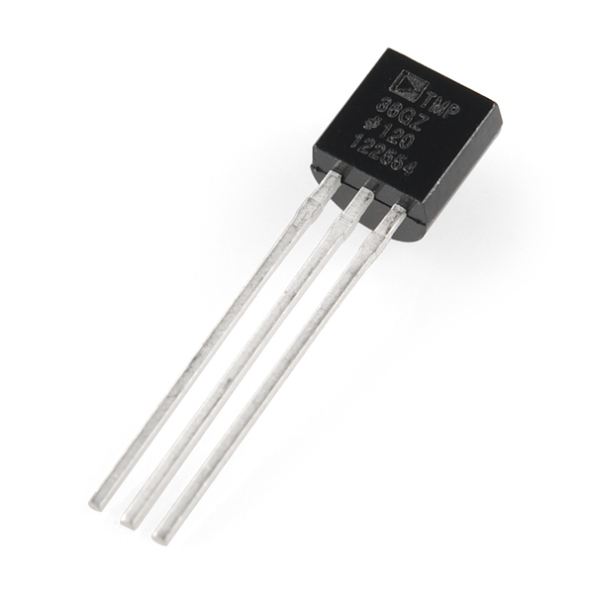
Consider priorities
BMP180
  Temp + Barometric Pressure
  Digital I/O (I2C)
  3-5V
  High precision
DS18B20
  Temp
  Digital I/O + OneWire
  3-5V
  Waterproof
DHT22
  Temp + Humidity
  Digital I/O
  3-5V
TMP36
  Temp
  Analog
  2.7-5.5V
Notes:
More than these exist
Libraries exist for each sensor
As you see, variety becomes an issue with details but also gives more options for your purpose

Slide 18
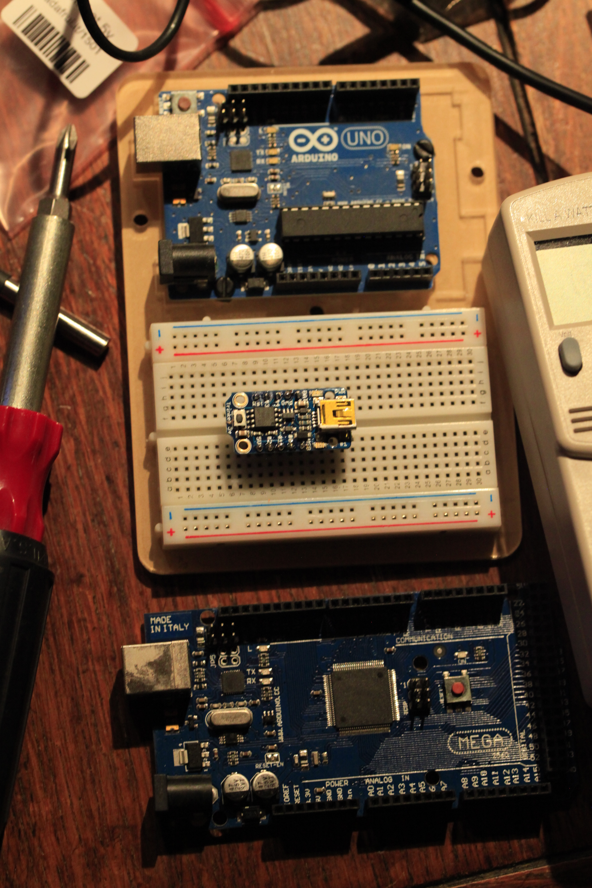
Arduino
general purpose programmable boards
digital and analog I/O pins
program over USB
7-12V input, 3.3 or 5V output
many varieties
Notes:
Inexpensive (~$10-30), widely available
Has its own IDE
Many projects available. Loads of Google examples!

Slide 19
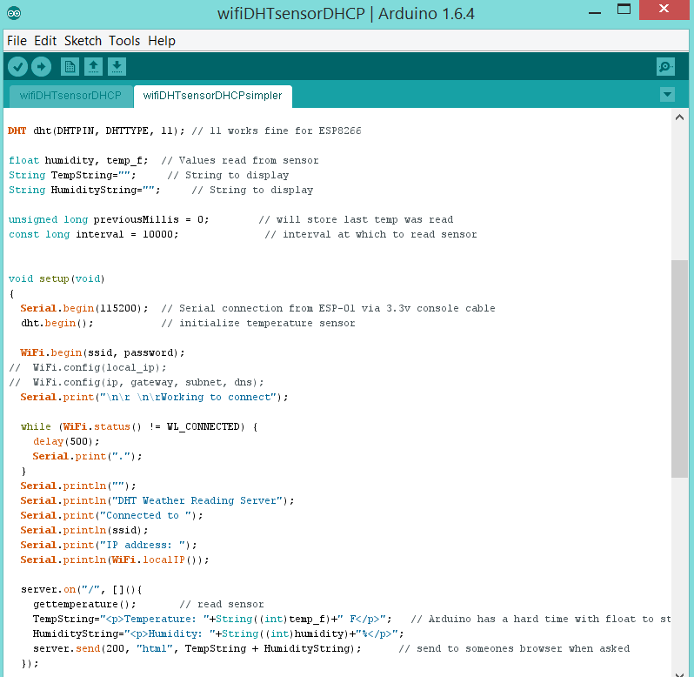
Arduino IDE
serial console
sensor libraries
web server libraries
easy to use
loads of online examples!
Notes:
Note: different libraries exist for the same components or hardware

Slide 20
IP communication
Ethernet shield board
IP services libraries
SNMP libraries unreliable
WiFi? XML? Web server?
other ways to collect sensor data?

Slide 21
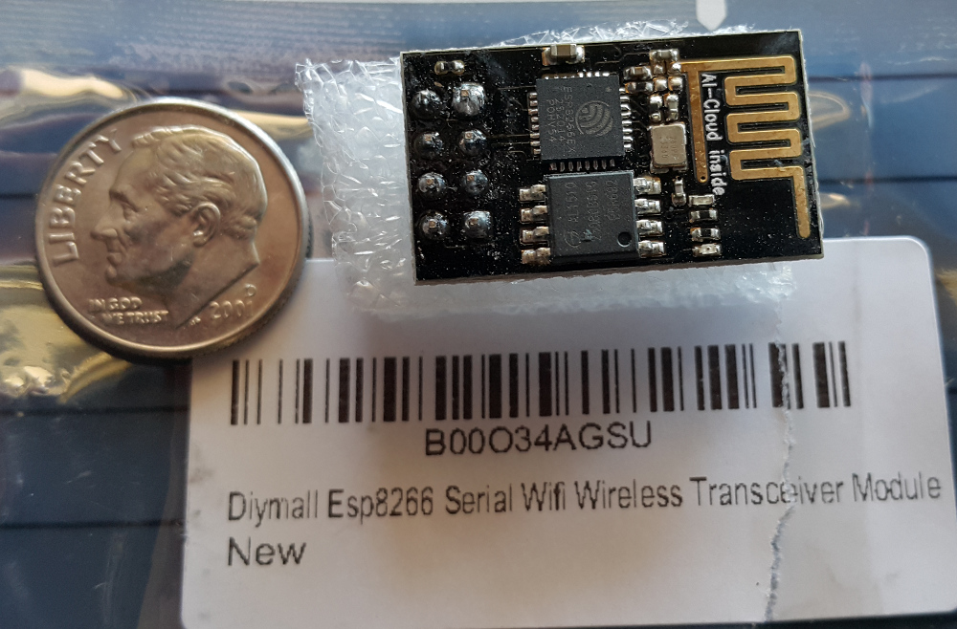
ESP8266
(ESP-01)
about $5
Digital and Analog I/O pins
USB programming
3.3V input, does not power sensors
many models, varieties, firmwares

Slide 22
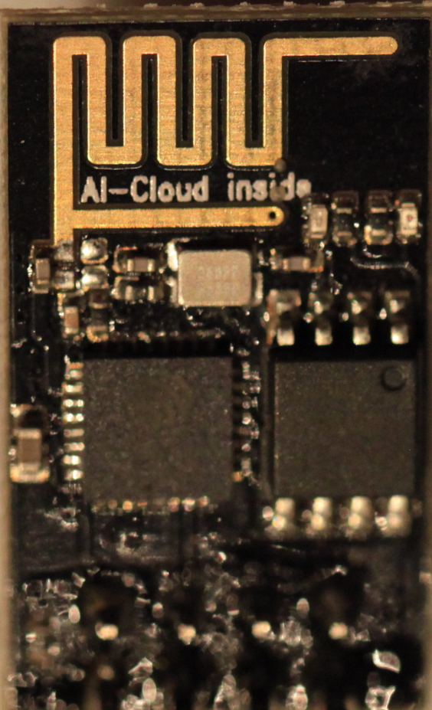
so many wifis!
such cloud!
built-in WiFi
built-in TCP/IP
built-in web server

Slide 23
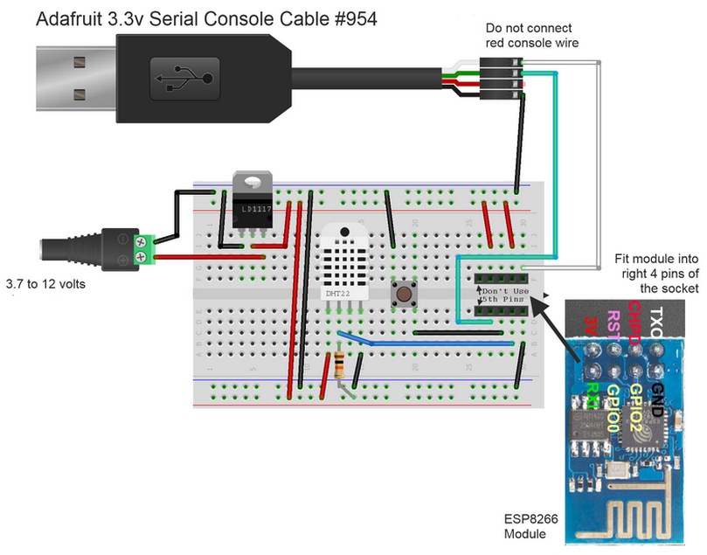
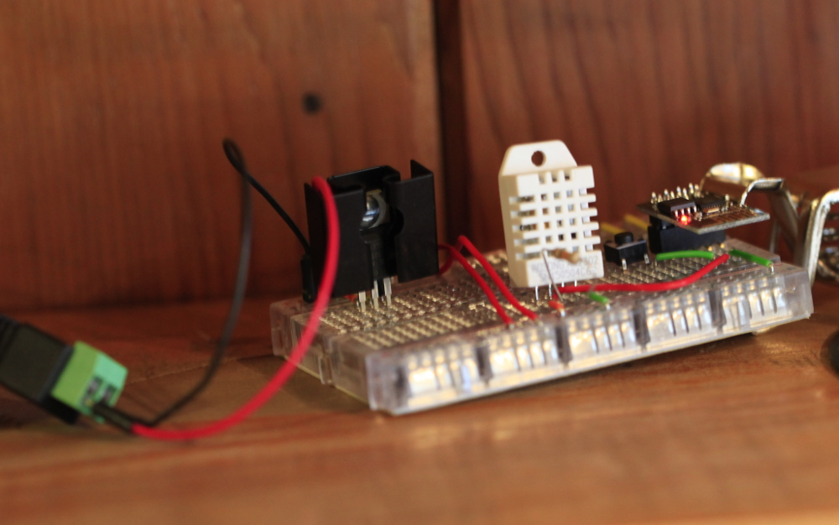
prototype
Details. The 3.3V regulator generates excess heat with higher voltage. 12V input requires heatsink, 6V would not.

Slide 24
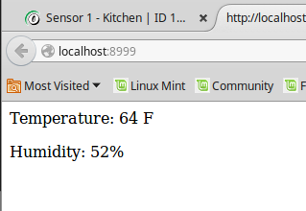
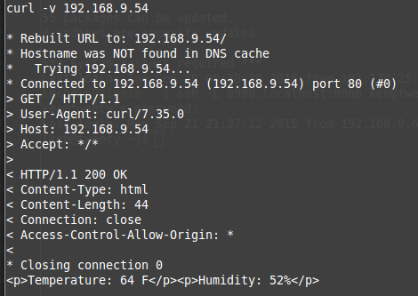
Results

Slide 25
Revision

Slide 26
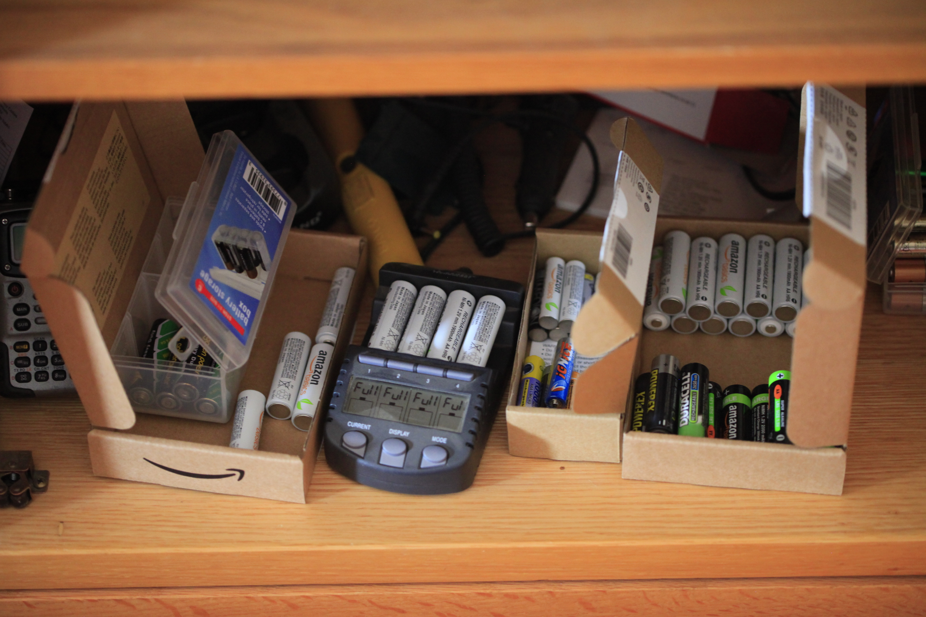
Not Energy Efficient
each http poll uses about 300mA per response
4x 1.2V AA rechargeable batteries last < 24h

Slide 27
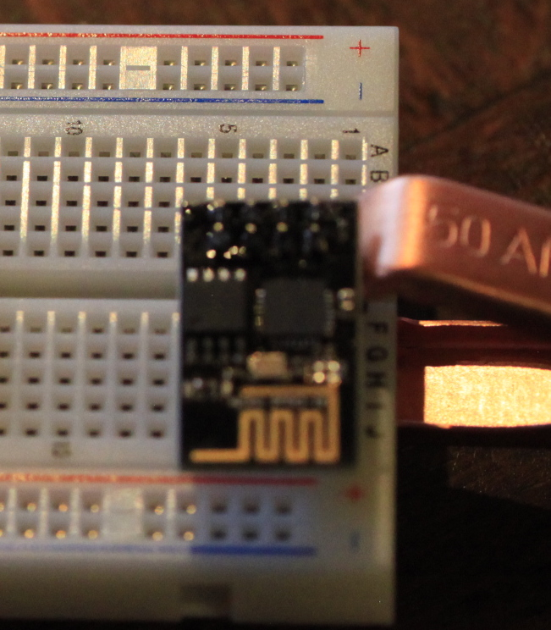
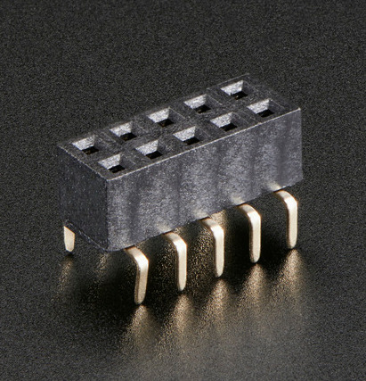
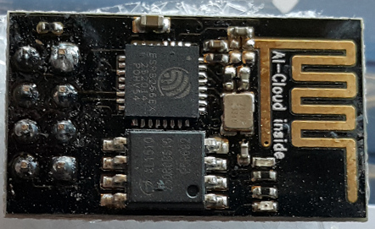
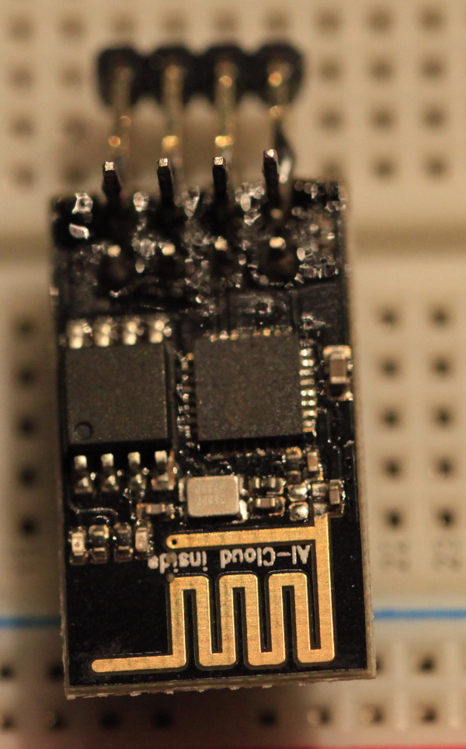
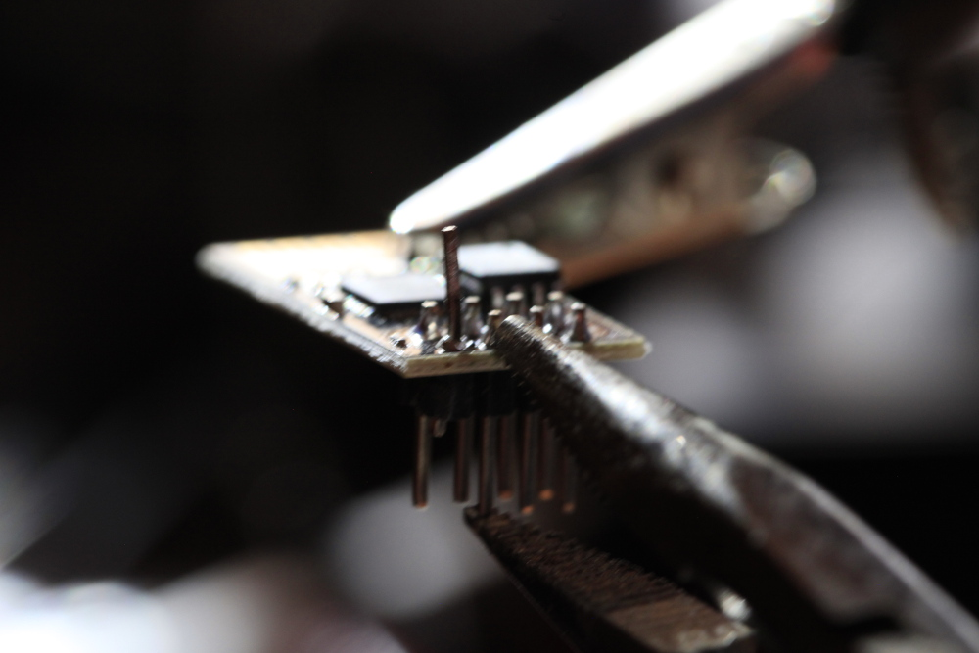
Odd Fitment

Slide 28
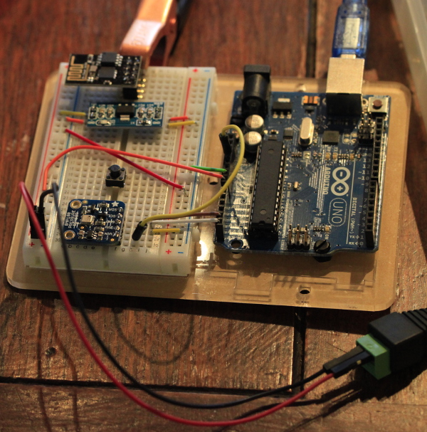
Many Components
More points of failure
More cost and complexity

Slide 29
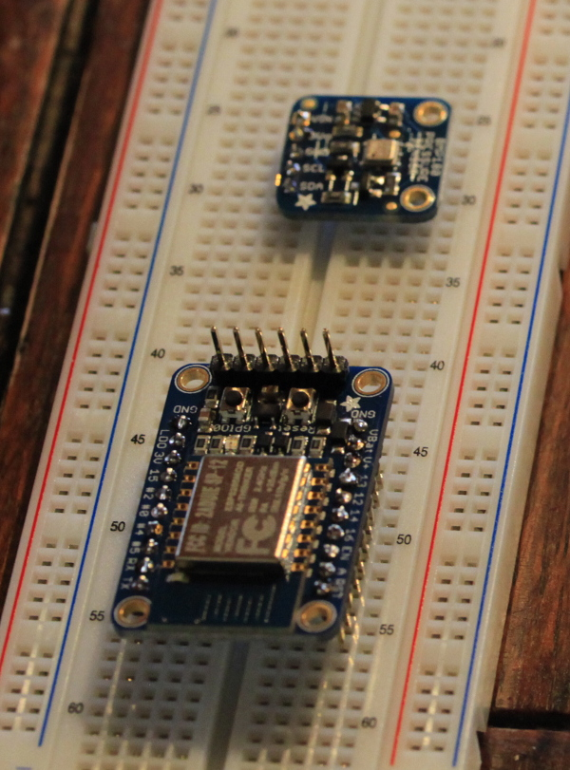
ESP8266
(ESP-12)
Adafruit HUZZAH board
built-in regulator
more inputs
analog input
integrated flash switch
integrated reset switch
Lua firmware preloaded
$10

Slide 30
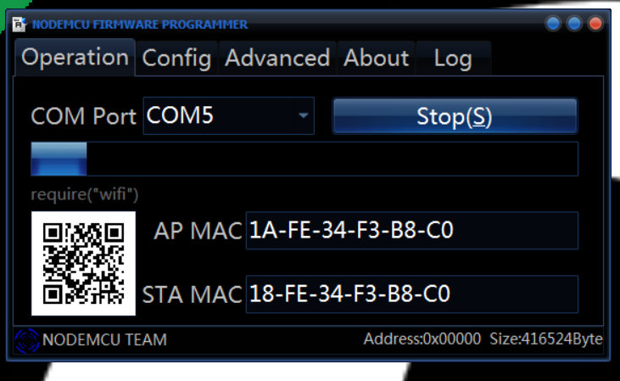
ESP Flasher
(NodeMCU Github)

Slide 31
LUA language
Lua (/ˈluːə/ loo-ə,
from Portuguese: lua [ˈlu.(w)ɐ] meaning moon)
lightweight multi-paradigm programming language designed primarily for embedded systems and clients.
Lua is cross-platform since it is written in ANSI C, and has a relatively simple C API.
- Wikipedia

Slide 32
LUA applications
Adobe Lightroom
Apache HTTP Server
Cisco ASA devices
Conky
Creative Zen media players
lighttpd
MediaWiki
NetBSD
Nginx
nmap
NodeMCU
Rockbox
RPM
SAS
Teamspeak
video games*
VIM
VLC media player
Wireshark

Slide 33
*video games
Angry Birds
Baldur's Gate
Civilization V
Crysis
Don't Starve
Far Cry
Gary's Mod
Lego Universe
Minecraft
Magic: The Gathering
Rift
SimCity
The Sims
Star Wars: Battlefront
The Witcher
World of Warcraft

Slide 34
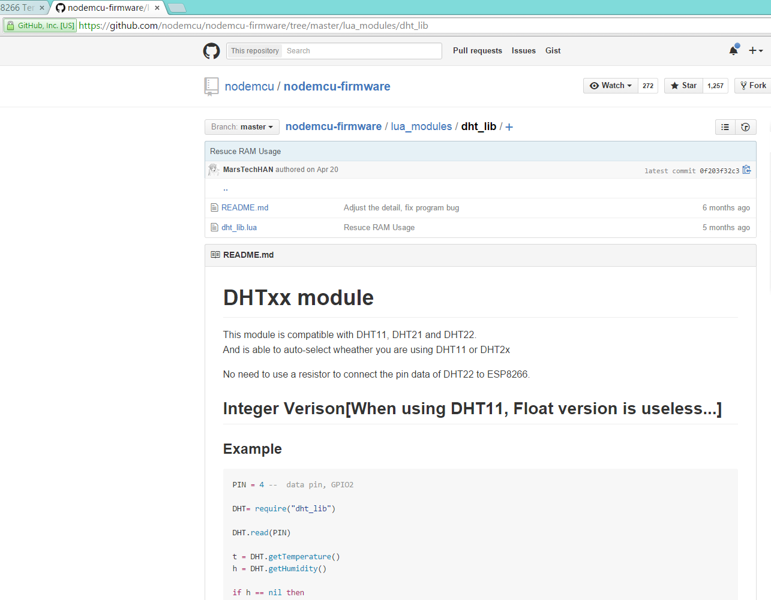

Slide 35
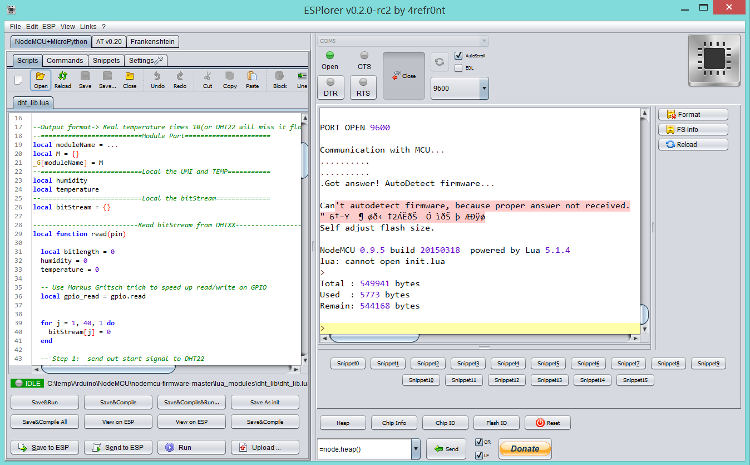
ESPlorer IDE
Notes:
Opened DHT library file
Note: all libraries and run code are in lua

Slide 36
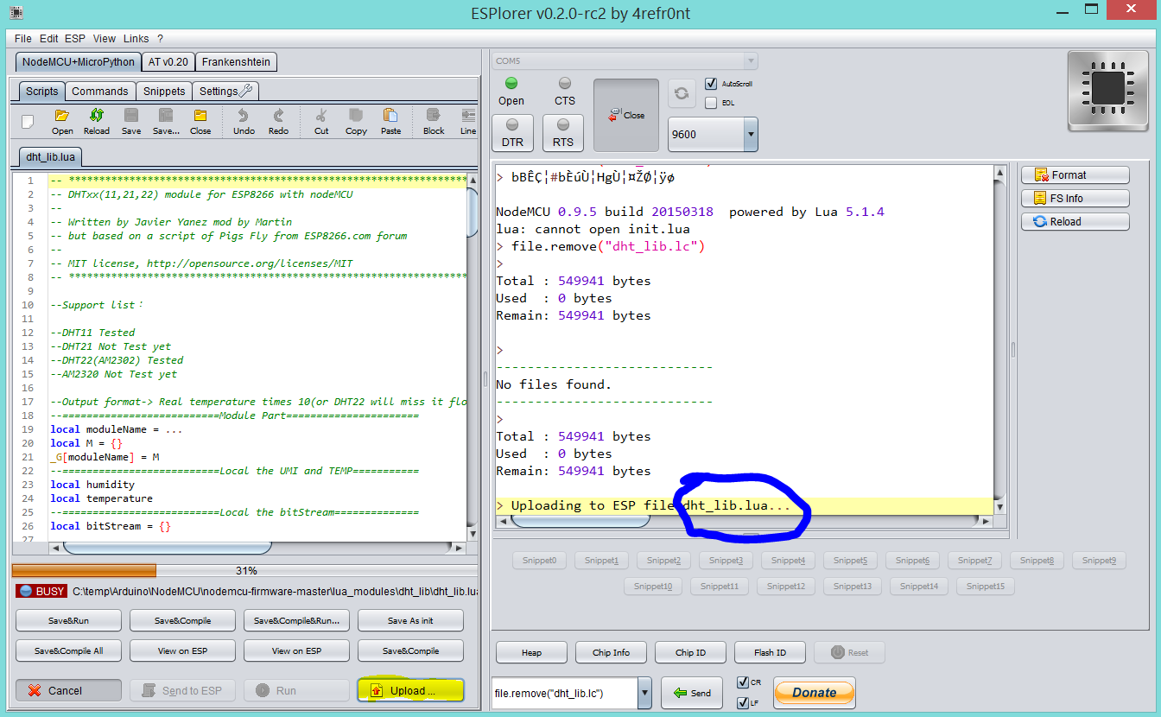
Notes:
Uploading DHT library file

Slide 37
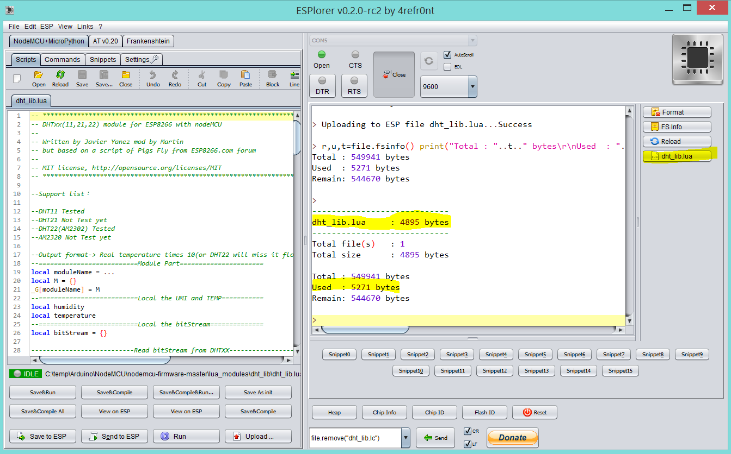
Notes:
File is uploaded

Slide 38
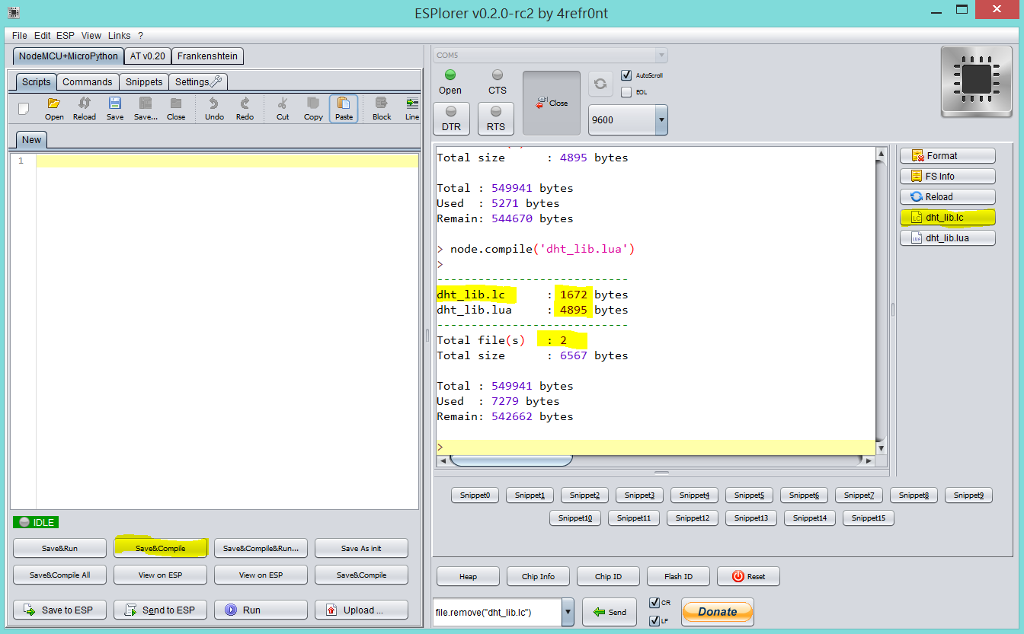
Notes:
You can compile the lua file and save space

Slide 39
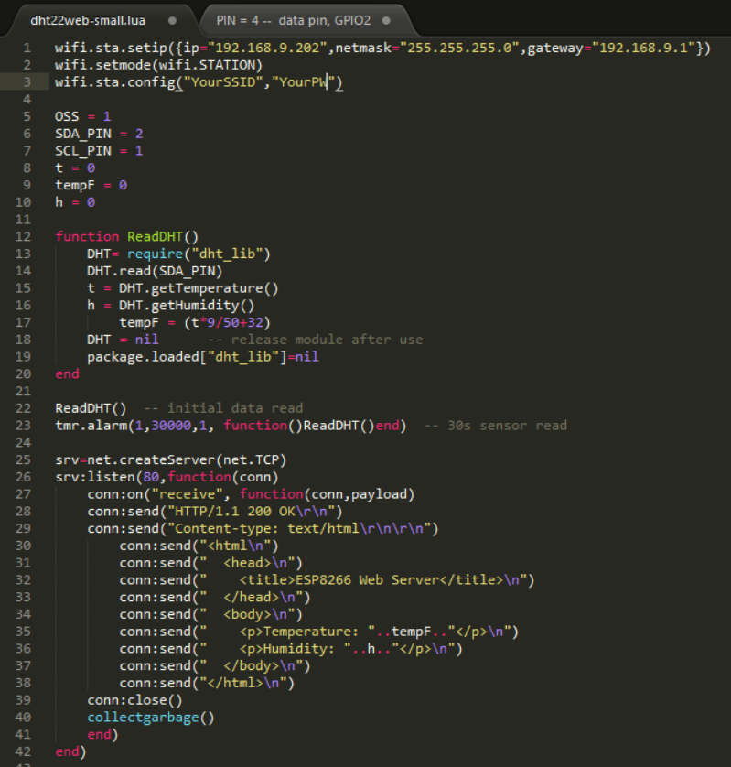

Slide 40





Notes:
- better quality makes repetitive work easier
, jeweler's screwdrivers
Variable power supply - not required, but very useful
various lights, magnifiers... age dependent

Slide 41
OpenNMS configs
Node Provisioning
imports/Sensors.xml
<node building="Sensors" foreign-id="1439622677282" node-label="Sensor 1 - Kitchen">
<interface descr="" ip-addr="192.168.9.54" status="1" snmp-primary="P">
<monitored-service service-name="DHT22sensor"/>
</interface>

Slide 42
OpenNMS configs
HTTP data collection
collectd-configuration.xml
<service name="DHT22sensor" interval="300000" user-defined="true" status="on">
<parameter key="http-collection" value="dht22sensor"/>
<parameter key="thresholding-enabled" value="true"/>
</service>
<collector service="DHT22sensor" class-name="org.opennms.netmgt.collectd.HttpCollector"/>
http-datacollection.xml
<http-collection name="dht22sensor">
<rrd step="300">
<rra>RRA:AVERAGE:0.5:1:17280</rra>
<rra>RRA:AVERAGE:0.5:12:18240</rra>
<rra>RRA:AVERAGE:0.5:288:1825</rra>
<rra>RRA:MAX:0.5:288:1825</rra>
<rra>RRA:MIN:0.5:288:1825</rra>
</rrd>
<uris>
<uri name="sensor">
<url path="/"
matches="^\S+Temperature:\s([0-9]+).*Humidity:\s([0-9]+).*">
</url>
<attributes>
<attrib alias="sensorTemp" match-group="1" type="gauge"/>
<attrib alias="sensorHumidity" match-group="2" type="gauge"/>
</attributes>
</uri>
</uris>
</http-collection>

Slide 43
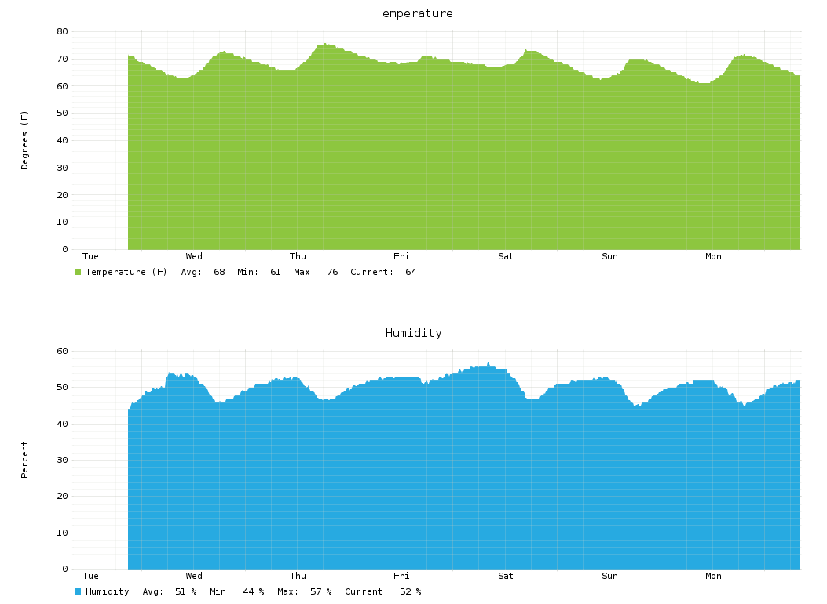
Graphs

Slide 44
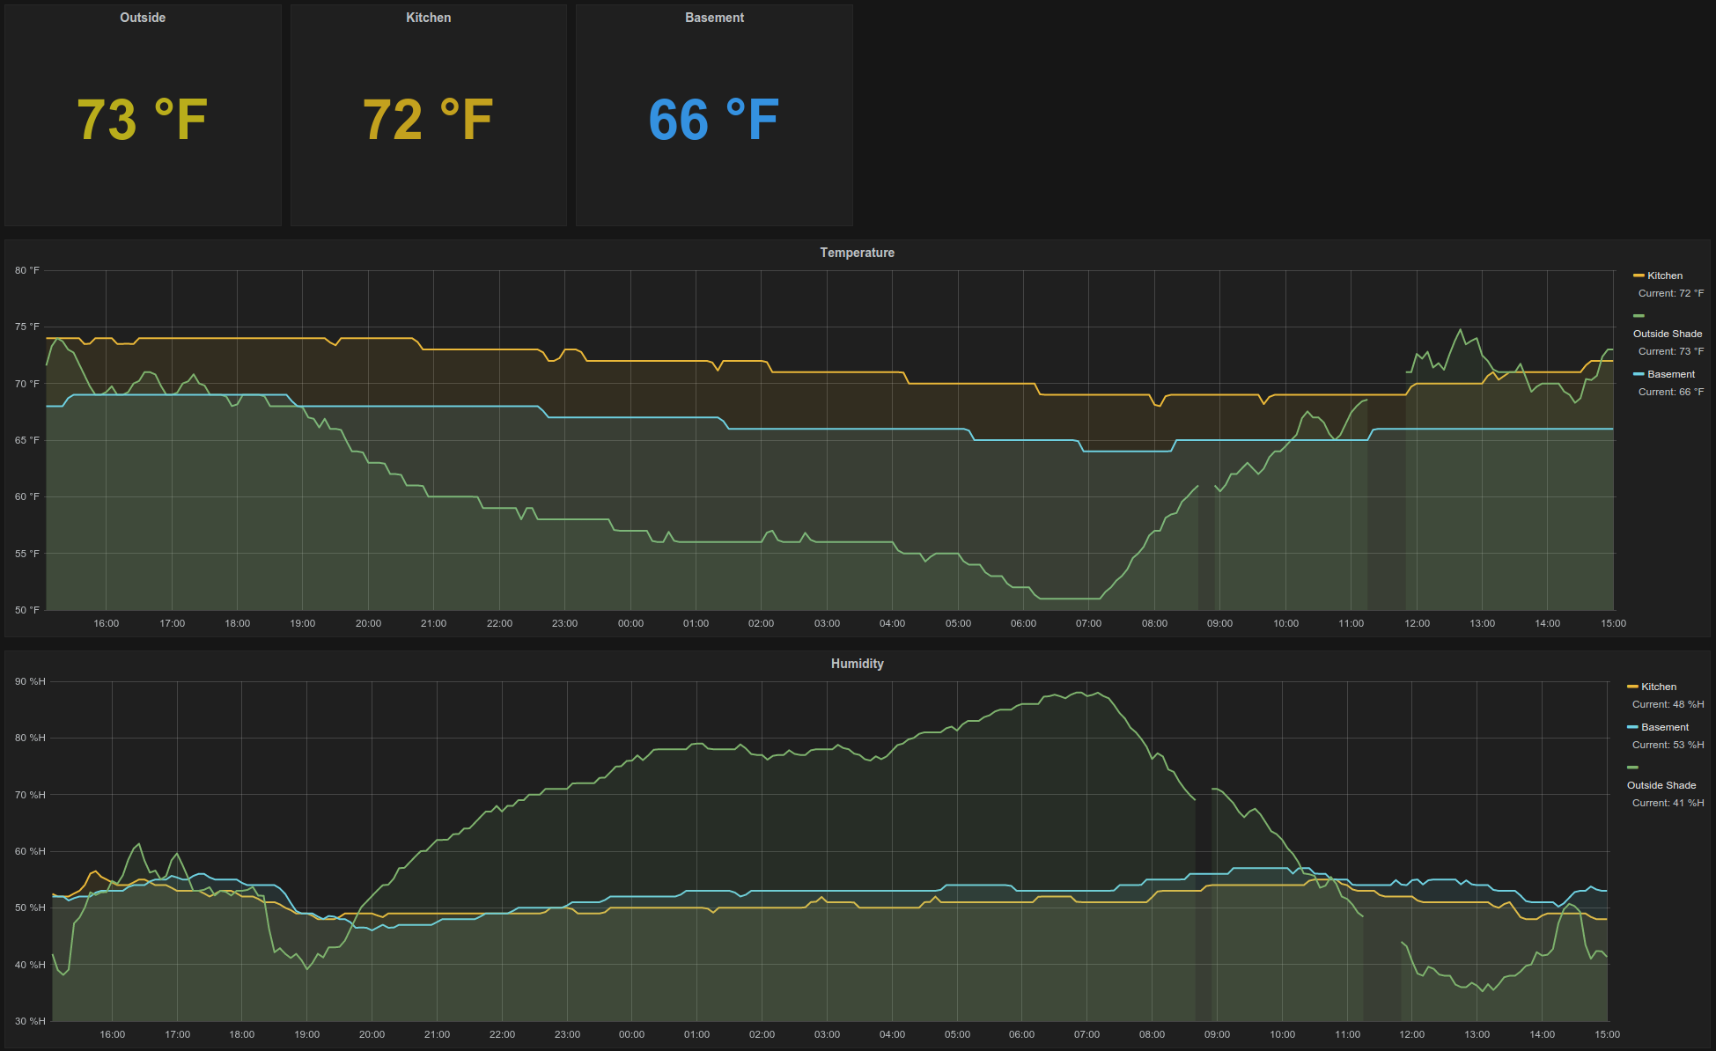
OpenNMS Grafana Integration
Notes:
Can have the number color change based on thresholds
Note: set time shift to 5m to avoid N/A values

Slide 45
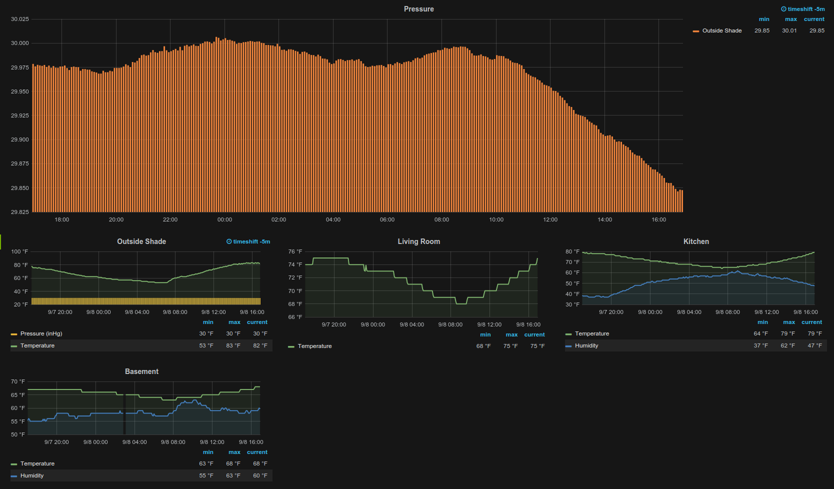
OpenNMS Grafana Dashboard

Slide 46
Lessons learned
hardware will fail
  2x voltage regulators
  2x ESP8266-01
hardware will arrive DOA
measure and check voltages often
avoid smoking electronics
buy extra
  wire, connectors, sensors, boards

Slide 47
todo
XML collector
push collection
  deep sleep mode
sensor comparisons
better housings
OpenHAB integration
  MQTT protocol
more thingies!

Slide 48




Ken Eshelby
ScaLE14x Booth #304-205
ken@opennms.org
esh^/#opennms/freenode.net
https://github.com/xplorn
@xplorn

