Slide 1
Writing and Publishing Books with Free Software
Nathan Haines
nhaines@ubuntu.com
Notes:
My name is Nathan Haines, and I’m here from Ubuntu.
I'd like to take some time to talk about writing and publishing books with Free Software

Slide 2
Nathan Haines
Computer enthusiast
  Programmer
  Gamer
  Computer technician

Slide 3
Nathan Haines
Ubuntu member
  California Local Community Team Leader
    Speaking engagements
    Installfests
    Release Parties
  Ubuntu Local Community Council

Slide 4
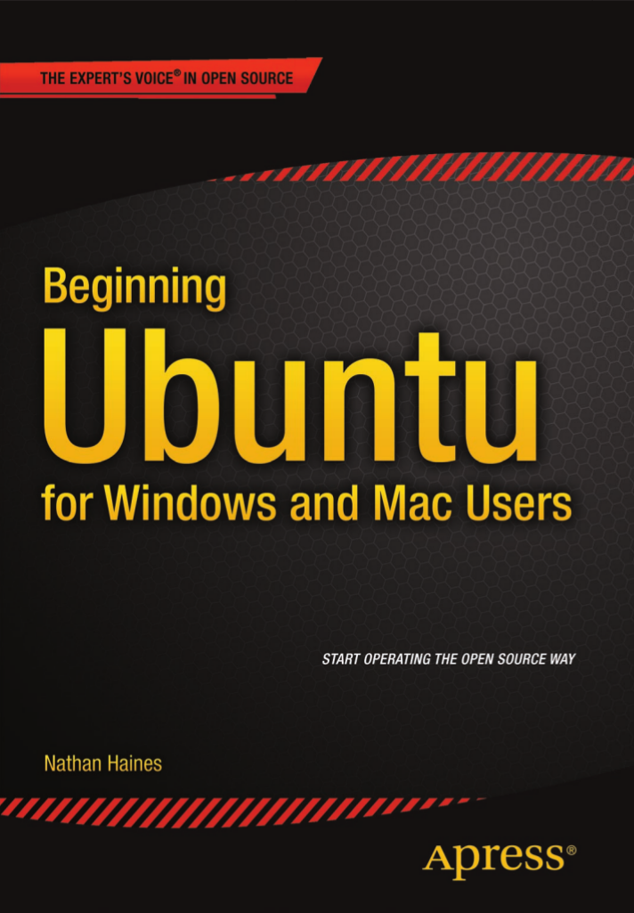
Nathan Haines
Author
  Introductory magazine articles
  Beginning Ubuntu
  for Windows and Mac Users
  (Apress; September 2015)

Slide 5
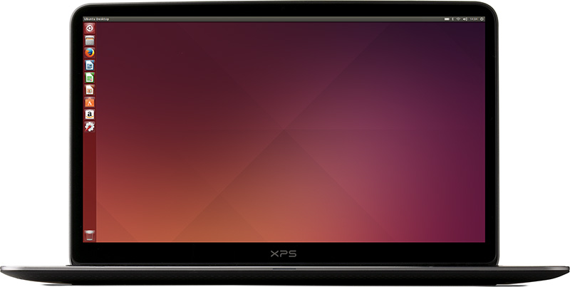
Ubuntu
A complete solution for your computer
Secure and up-to-date
Free and Open Source software
Notes:
Complete solution
Helps keep your computer secure from viruses and malware and all of your software up to date
Built entirely from Free and Open Source Software

Slide 6

Why publish a book?
Have a story to tell
Want to connect with others
Fame
Fortune
Notes:
“Everyone has a book in them”
Trying to tell a story
Want to connect with others emotionally or intellectually
Want to become well-known
Want to become rich

Slide 7

Publishing a book
Traditional Publishing
Self-publishing
Notes:
Two ways of publishing:
Traditional publishing
Printing press invented in 1440 – 575 years of tradition
Self-publishing
Fanzines, vanity presses, used to have a stigma
Independent author publishing platforms (KDP, Nook Press, iTunes, Google Play Books)

Slide 8
Traditional publishing
Write a manuscript
  Non-fiction books are sold by proposal
Submit manuscript to agents
Agent submits to publishers
Publisher offers a contract

Slide 9
Self-publishing
Write a book
Hire editor(s)
Hire cover designer
Hire layout designer
Publish the book

Slide 10

Royalties
Traditional publishing
  Publisher pays an advance on royalties
  Publisher collects 45-55% of gross profit
  Pays author 8-15% of net profit
    Agent receives 10-15% of author’s profit

Slide 11
Royalties
Self-publishing
  Author receives 100% of net profit
    35-70% of gross profit on ebooks
Notes:
CreateSpace: 300 page tech book $25.00 = $10.50
CreateSpace: 200 page pocket book $7.99 = $1.54

Slide 12
Royalties
Traditional publishing
  Team of experts work on your book
  Access to book stores and libraries
Self-publishing
  You find and hire your own team
  Keep creative control, rights, and marketing
Notes:
Recap: traditional vs. self publishing
All money flows toward the author.
DO NOT pay others to publish your book.

Slide 13

Time to write
Word processing software
  LibreOffice Writer
  FocusWriter
  Your favorite text editor
Notes:
When it’s time to write, focus on writing, not formatting.
Styles are good, but content is most important.
Even text editors are okay.

Slide 14
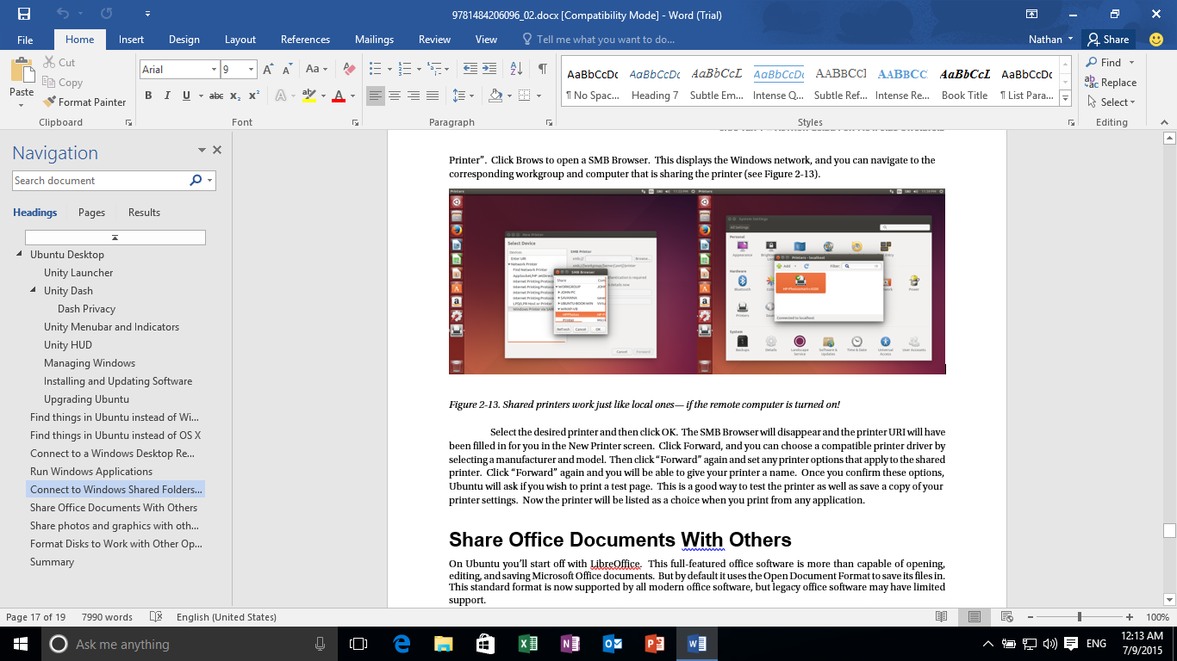
Editing in Word
Notes:
This is how my publisher expected me to write.

Slide 15
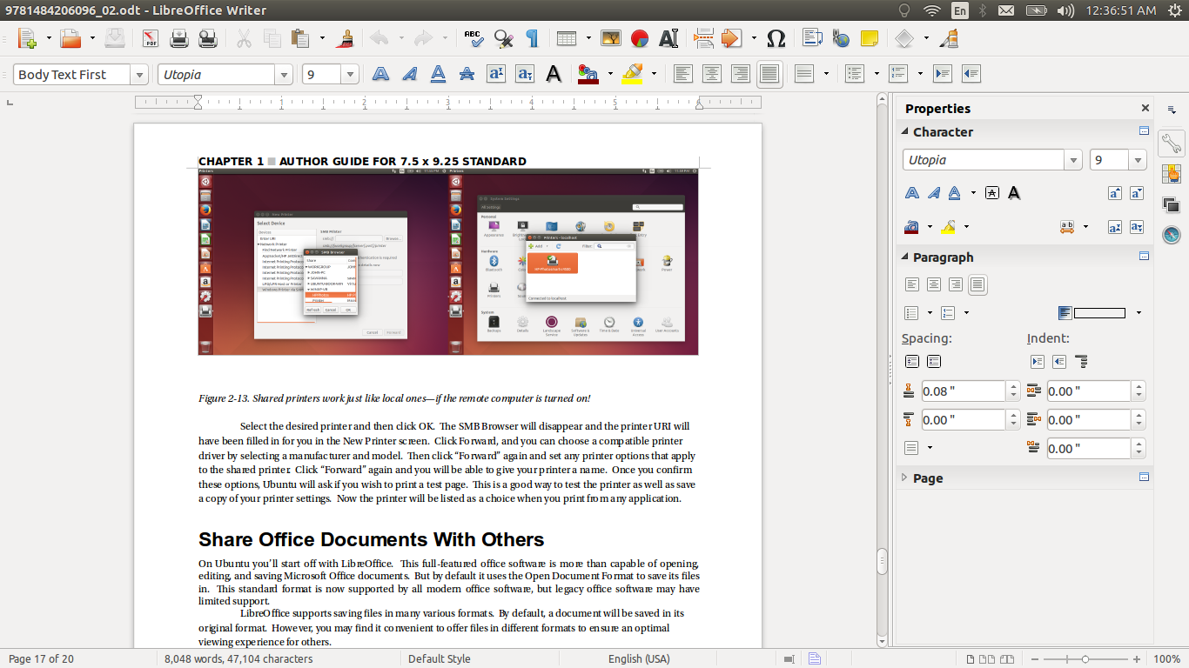
Editing in LibreOffice Writer
Notes:
This is how I actually write.
Fonts from template aren’t perfect even when using publisher-provided fonts, but they didn’t work in Office 2016 either.
Book goes through post-processing before print and this causes no issue.

Slide 16

Revision
LibreOffice Writer
  Track changes
  Compatible with Word tracking and comments
Source control
  Probably overkill
  Good for changes, not for comments
Notes:
LibreOffice lets you work with others, even if they’re using Word.
Your editors or beta readers can install LibreOffice for free.

Slide 17
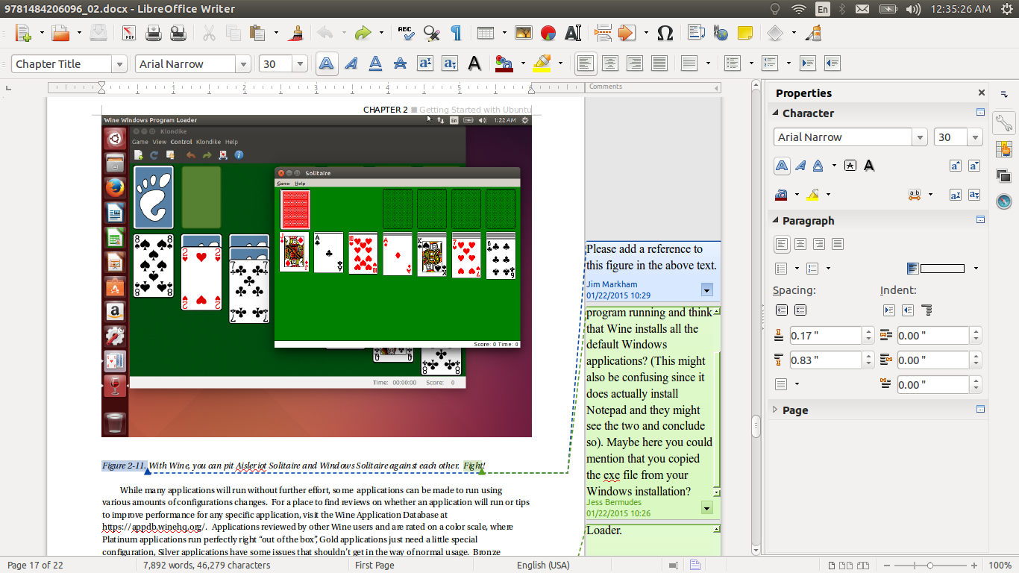
Revising in LibreOffice Writer
Notes:
Word comments and revisions display perfectly in LibreOffice.

Slide 18

Interior Layout
LibreOffice
  Styles and page formatting
Scribus
  Full desktop publishing solution
Sigil
  EPUB formatting for ebooks
Notes:
Interior layout design is the next step in the process once the content has been fully edited.

Slide 19
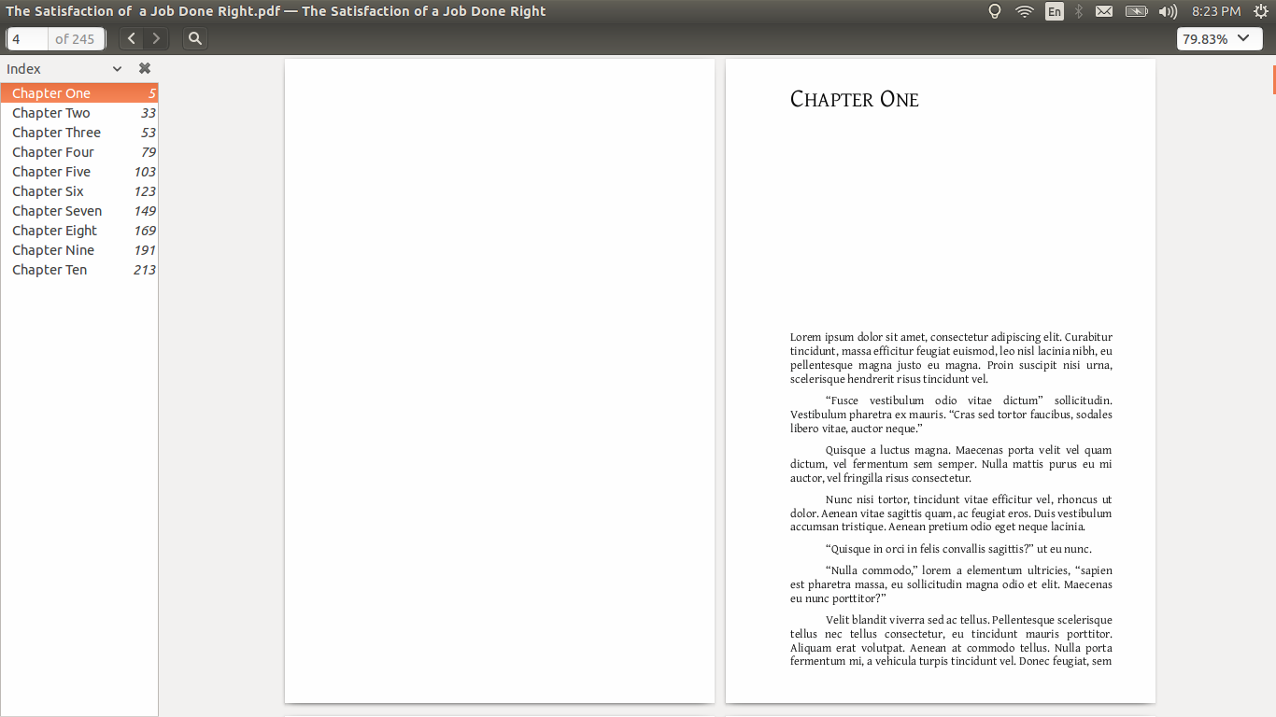
First page layout

Slide 20
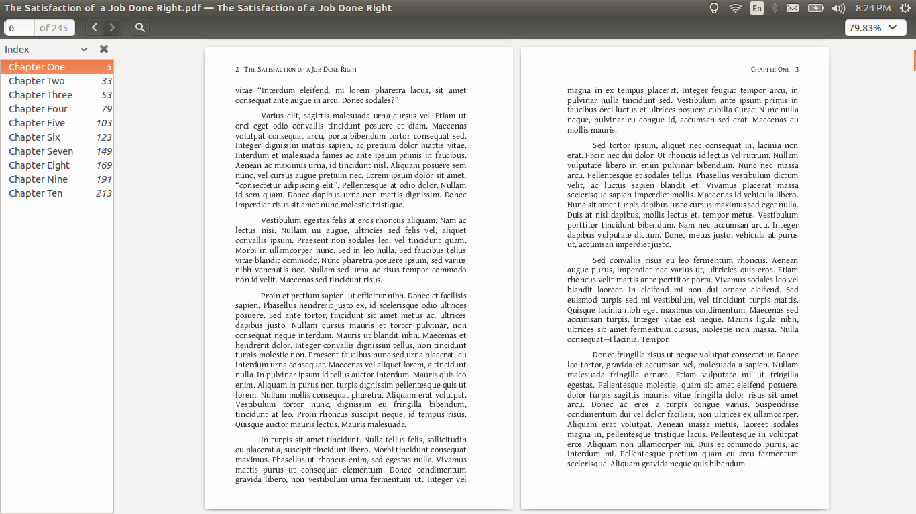
Interior page layout

Slide 21
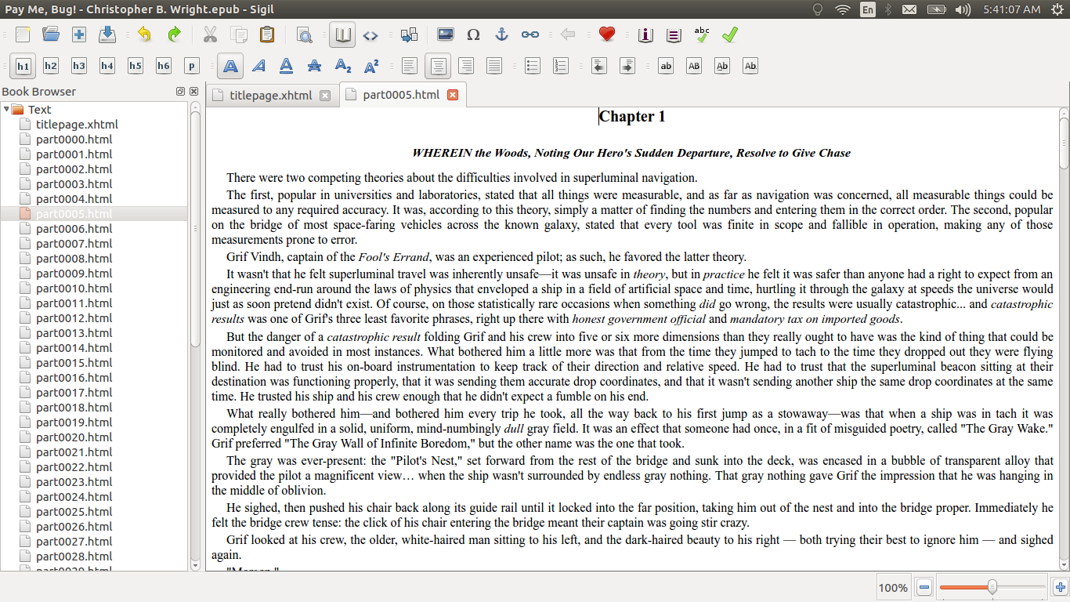
Ebook interior layout
Notes:
Example of Sigil and EPUB ebook layout.
EPUB is XHTML and CSS, so editor is very familiar. Complex formatting won’t work on ebook devices, so simpler is better, especially for electronic-only titles.
Pay Me, Bug! is by Christopher B. Wright and is licensed under the Creative Commons Attribution Non-Commercial Share-Alike 4.0 License.

Slide 22

Cover Design
Gimp
Inkscape
Front cover for ebooks
Wraparound cover for print
Notes:
Cover design is different between print and ebooks.
Print books need wraparound cover designs.

Slide 23
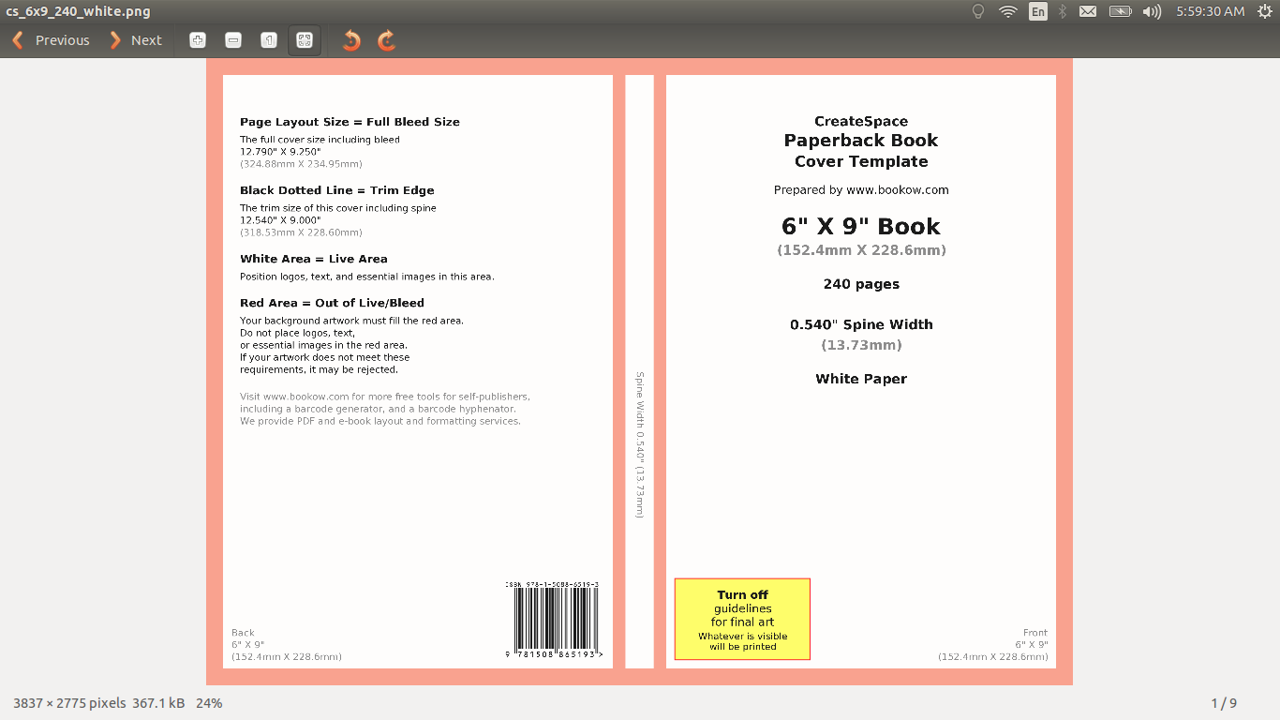
Print cover template
Notes:
Print covers must come last—size depends on physical layout and number of pages

Slide 24

Finished cover
Notes:
Example of basic print cover design. Important to hire a professional.

Slide 25

Publishing a print book
Publisher takes care of this step
Print-On-Demand prints PDF files
  CreateSpace
  IngramSpark
  Lulu Press

Slide 26

Publishing an ebook
Most ebook stores accept Word or EPUB
  Amazon Kindle Direct Publishing
  Nook Press
  Smashwords
  iTunes
  Google Play Books

Slide 27

Digital Rights Management
Digital Restrictions Management?
  Only affects paying customers
  Can be automatically stripped in seconds
Notes:
Traditionally published books give the publisher the final say on DRM.
Recommend that DRM is not helpful for self-published books.

Slide 28
Questions?

