Slide 1

Why Is Linux Like A Player Piano?
By
Jon “maddog” Hall
Linux® International®

Slide 2
Warning!
Talk may contain some generalizations!

Slide 3
Why and How?
Trying to make a long story short
Mr. Groom
Popular Mechanics
Dining Room Furniture
The Beehive
Ken Thompson

Slide 4
In The Beginning.......
There was no music that could be played in the home by a non-musician
No radio
No phonograph
Before surround sound
Before stereo
Before Hi-Fi
Before turntables
Before 8-track!!!
Music boxes......yeah, well.....
Notes:
This is a little presentation to show the importance of standards. I hope you enjoy hearing it as much as I enjoyed creating it.

Slide 5
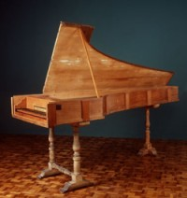
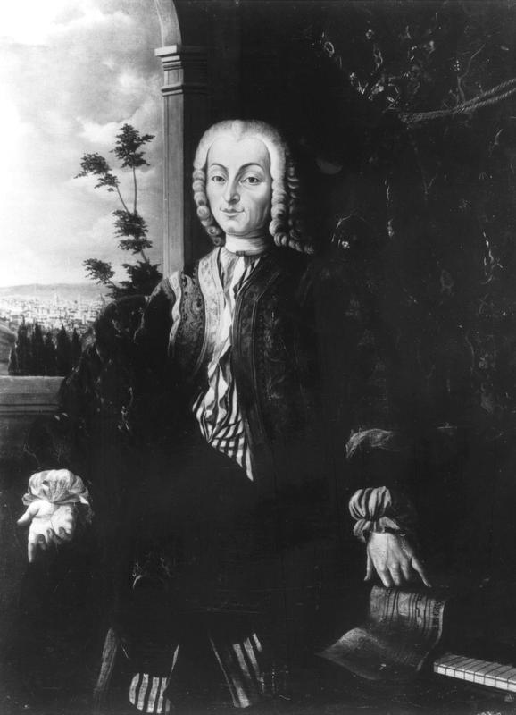
There were instruments, of course..
1703 – Florence Italy
Bartolomeo Cristofori
Harpsichord maker
  Could only play one loudness
Piano Forte – soft and loud
Cristofori could patent it and make a FORTUNE!
But Cristofori had a problem…..

Slide 6
NO MUSIC!
It was an expensive instrument
No one would buy it if there was no music
No one would make it if there were no buyers
No piano-fortes to play if there was no music
No music would be written if no piano-fortes
Catch-22

Slide 7
Give It Away!
Publish exactly how to make a piano!
Instrument makers would each make one or two
Sooner or later, music would happen!
But Cristofori had another problem...

Slide 8
No Italian Publisher Would Touch It
Cristofori went to Germany
German publishers printed how to make it
  Ability to patent was “ruined”
German instrument makers made piano-fortes
German musicians wrote music

Slide 9
Uptake Was Slow
It took almost 100 years to replace Harpsichord

Slide 10
In 1880 the first player piano was created
Used paper roll (Software)
Foot-powered bellows provided vacuum (before electricity!!!)
Vacuum to power take-up reel and keys
Not a major success
88 keys on piano
56 holes in paper
.....did not meet minimum requirements for functionality
Notes:
This is a little presentation to show the importance of standards. I hope you enjoy hearing it as much as I enjoyed creating it.

Slide 11
In 1890 Major Breakthrough:
88 note player piano
88 holes
Sustain hole
Bellows guided paper over path
Notes:
This is a little presentation to show the importance of standards. I hope you enjoy hearing it as much as I enjoyed creating it.

Slide 12
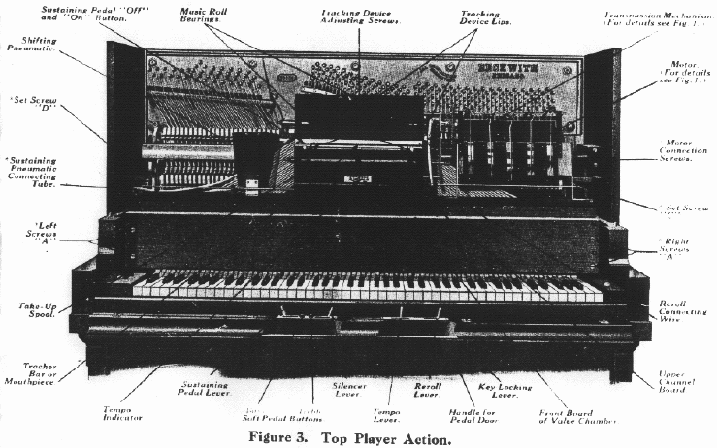
The Player Piano
Notes:
This is a little presentation to show the importance of standards. I hope you enjoy hearing it as much as I enjoyed creating it.

Slide 13
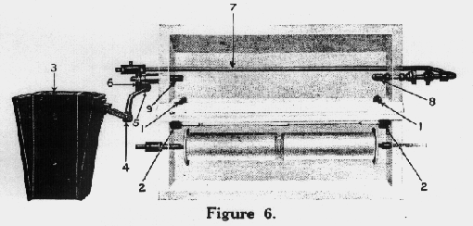
The Read Head and Feedback Mechanism
Notes:
This is a little presentation to show the importance of standards. I hope you enjoy hearing it as much as I enjoyed creating it.

Slide 14
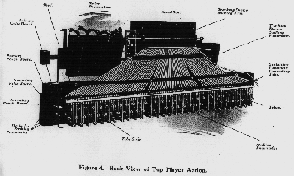
Bus Lines from Read Head
Notes:
This is a little presentation to show the importance of standards. I hope you enjoy hearing it as much as I enjoyed creating it.

Slide 15
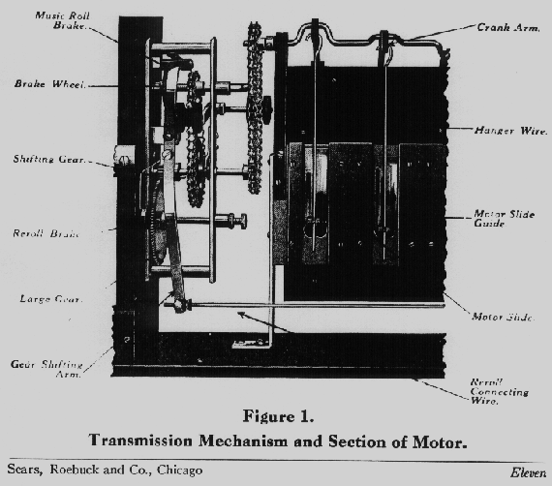
Device Driver
Notes:
This is a little presentation to show the importance of standards. I hope you enjoy hearing it as much as I enjoyed creating it.

Slide 16
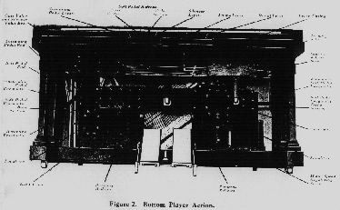
Bottom Part of the Piano
Notes:
This is a little presentation to show the importance of standards. I hope you enjoy hearing it as much as I enjoyed creating it.

Slide 17
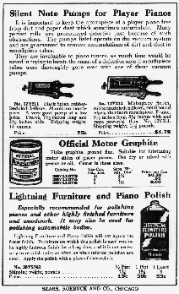
Piano Accessories
Notes:
This is a little presentation to show the importance of standards. I hope you enjoy hearing it as much as I enjoyed creating it.

Slide 18
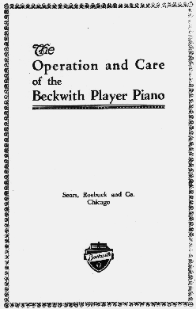
The Instruction Manual (never read)
Notes:
This is a little presentation to show the importance of standards. I hope you enjoy hearing it as much as I enjoyed creating it.

Slide 19
However…..
People already had pianos!

Slide 20
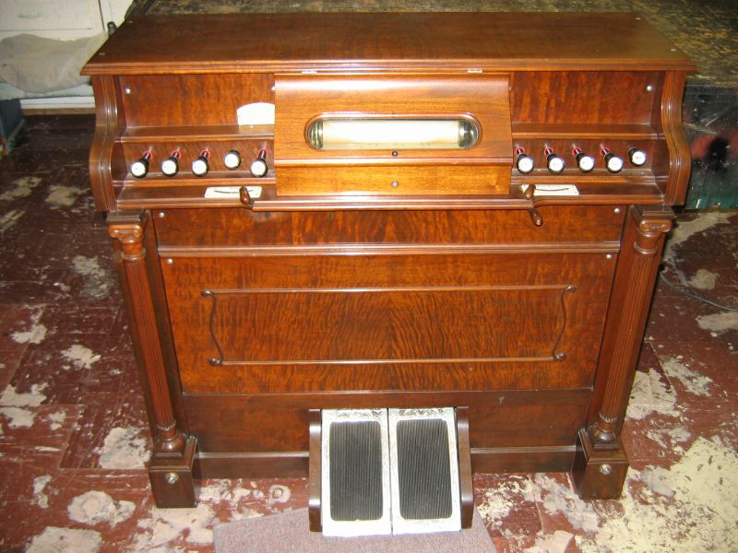
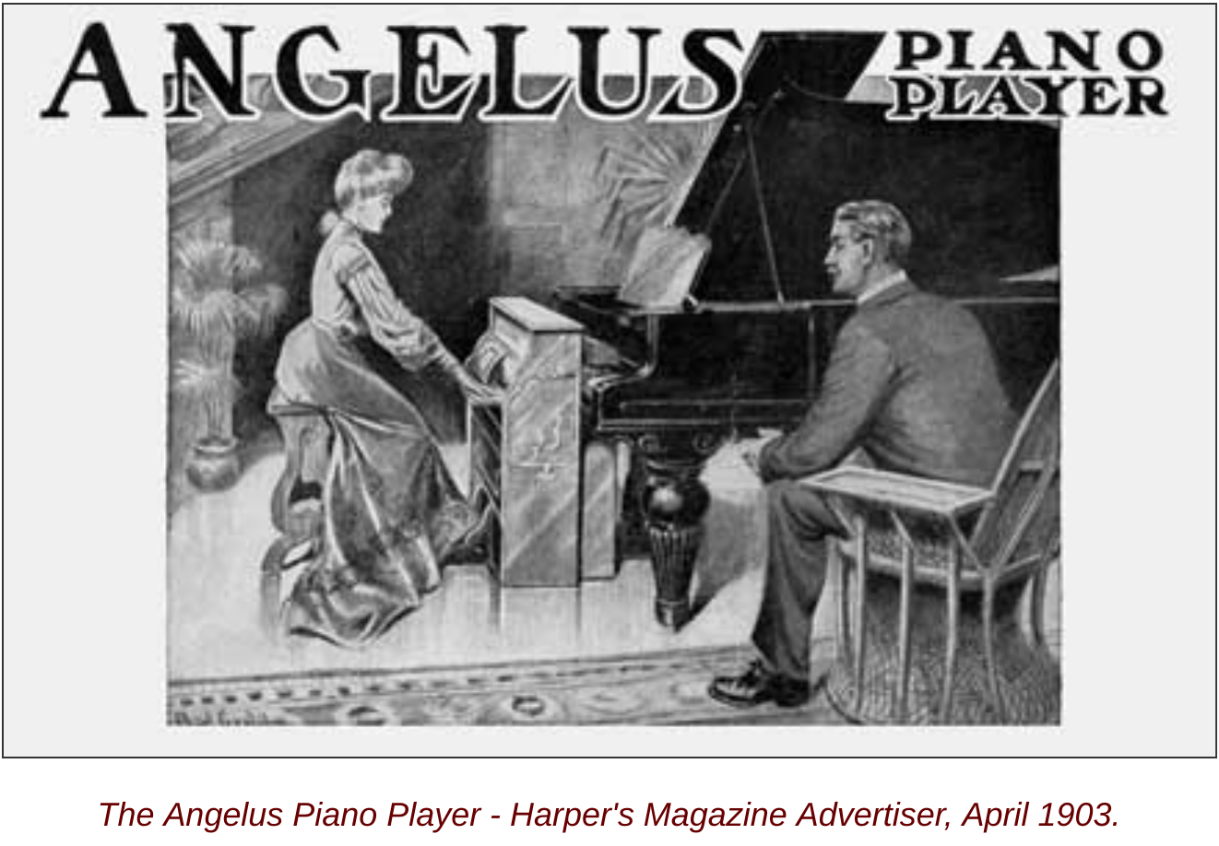
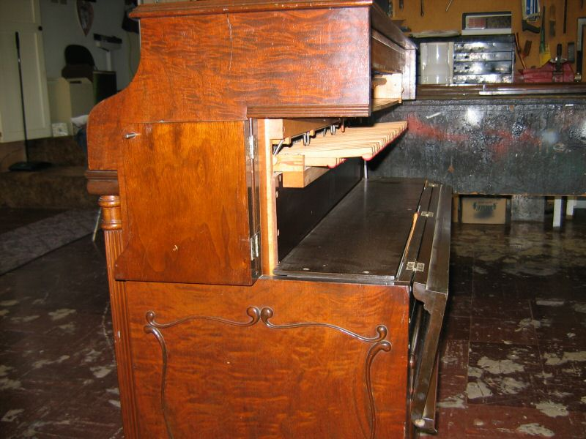
So Came The Pushup!

Slide 21
Between 1890 and 1930 (the Great Depression )....
2.5 Million Players
Huge number considering the population of U.S.
Huge market invited duplication
88 note roll became "standard"
Other vendors made rolls
Other vendors made player mechanisms
Improvements to mechanisms and rolls
.....but 88 note "standard" was maintained
Notes:
This is a little presentation to show the importance of standards. I hope you enjoy hearing it as much as I enjoyed creating it.

Slide 22
Why So Popular?
Pretend you live in Kansas...

Slide 23
Reproducing Player Pianos
Some manufacturers thought players could be improved
88 note piano always hit note with same force
    Not the way an artist plays a piano
"Reproducers" were created
More holes in paper
More parts
Much more expensive
Four vendors, four "standards"
Notes:
This is a little presentation to show the importance of standards. I hope you enjoy hearing it as much as I enjoyed creating it.

Slide 24
Public Rejects Reproducers
Not enough selection in rolls
Too much extra cost for perceived value
Hard to find service
Reproducer Pianos were “proprietary”
Notes:
This is a little presentation to show the importance of standards. I hope you enjoy hearing it as much as I enjoyed creating it.

Slide 25
Depression Hits (1930)
Most piano firms go out of business
Player Pianos never recover market
Radio, Phonograph and TV overwhelm
Notes:
This is a little presentation to show the importance of standards. I hope you enjoy hearing it as much as I enjoyed creating it.

Slide 26
Pianos were in living rooms, move to basements.....
Leather bellows rot
Rubber hoses rot
Mice!! (another correlation)
“Come and take it away!”
Notes:
This is a little presentation to show the importance of standards. I hope you enjoy hearing it as much as I enjoyed creating it.

Slide 27
1960s Revival
Pianos still in homes
Restoration begins
Revival in roll business
QRS
Playwrite
Old songs re-generated
New songs created
Even new player pianos (Seneca, Pennsylvania U.S.A)
Notes:
This is a little presentation to show the importance of standards. I hope you enjoy hearing it as much as I enjoyed creating it.

Slide 28
But 88-note only
Not enough market for reproducers
Pianos too expensive
Restoration too expensive
Rolls too scarce and expensive
Notes:
This is a little presentation to show the importance of standards. I hope you enjoy hearing it as much as I enjoyed creating it.

Slide 29
So it is with Linux
High value for low price
Functionality implemented in a standard way across vendors hardware platforms
Improvement in the implementation of the standards without breaking the standards
Notes:
This is a little presentation to show the importance of standards. I hope you enjoy hearing it as much as I enjoyed creating it.

Slide 30
Time Moves On
I belong to the Automated Musical Instrument Collectors Association (AMICA)
We wanted to put some mp3 of our music up on the Internet
To show people how the instruments sound
To preserve and archive dying rolls
I chose "Greensleeves"
Ancient melody
but.....

Slide 31
No Rolls
Arrangement is copyrighted
“Editing” is copyrighted
“Punching” is copyrighted
All sorts of “phonorecord” laws that no one can understand
I no longer sing in the shower

Slide 32
Patents Are Also There
Basic piano is not patented
Modifications to basic piano are sometimes patented
WTF?

Slide 33
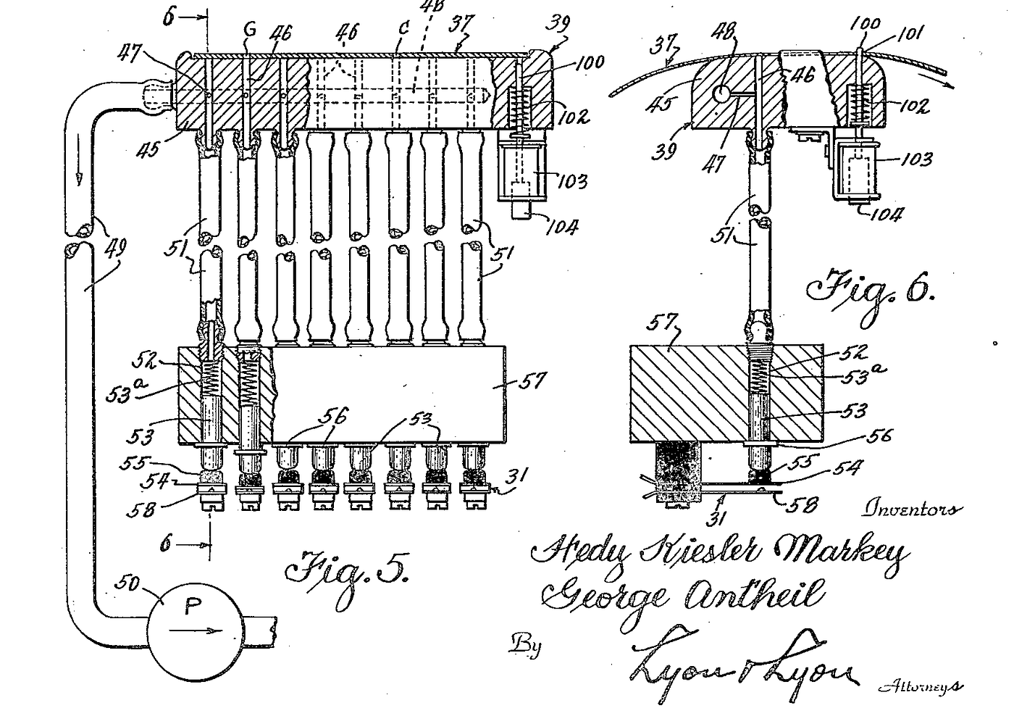
Addendum - 1942
George Antheil experimenting with automated control of musical instruments
  Synchronized player pianos on stage
Hedy Lamaar worked with him to create “frequency hopping” (Patented August 11, 1942)
Later used in spread-spectrum communications technology
Idea was not used until 1962
Electronic Frontier Foundation recognized her in 1997

Slide 34
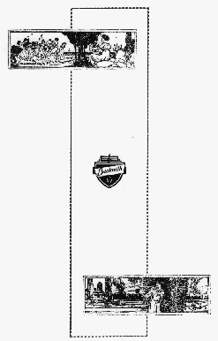
Questions?
Notes:
This is a little presentation to show the importance of standards. I hope you enjoy hearing it as much as I enjoyed creating it.

