Slide 1
Project Cauã
by
Jon "maddog" Hall
Board Chair, Linux Professional Institute
Founder, Project Cauã
Co-Founder, Caninos Loucos
Executive Director
Linux® International®

Slide 2
Who Am I?
Half Electrical Engineer, Half Business, Half Computer Software
In the computer industry since 1969
  Mainframes 5 years
  Unix since 1980
  Linux since 1994
Companies (mostly large): Aetna Life and Casualty, Bell Labs, Digital Equipment Corporation, SGI, IBM, Linux Professional Institute
Programmer, Systems Administrator, Systems Engineer, Product Manager, Technical Marketing Manager, Educator, Author
Extremely large systems to extremely small ones
Pragmatic
Vendor and a customer

Slide 3
The Problems
Students can not afford gratis university
  Often tuition is gratis
  Everything else is not
40% of qualified students can not accept
Part Time jobs (hotel clerk, waiting tables)
  Do not pay well
  Not what students are studying
Often students give up

Slide 4
User Problems
Small Business
  Need computers
  Just want to use computers
    Do not want to learn about computers
    Can not pay for full time systems administrator
    Have no advocate (at mercy of hardware/software vendors)
  Do not know of low-cost/free solutions
Home owners - clueless

Slide 5
2015
“How can I make money with Free Software?”

Slide 6
Answer:
Project Cauã
Not a single world-wide company with millions of employees…
…..but millions of world-wide collaborative companies with one or two employees.

Slide 7
People Do Not By Hardware OR Software….

Slide 8
People Do Not By Hardware OR Software….
….they buy solutions to problems

Slide 9
Some Students….
Have been using computers since the age of eight…and they know how to:
  Change a disk
  Install and upgrade and operating system
  Set up WiFi
  Attach printers and other devices
  Read error logs and take backups
  Search the Internet for answers
Fix computers for family and neighborhood

Slide 10
What Students Do Not Know….
How to set up a business
How to make a contract
How to find customers
How to advertise
How to sub-contract
How to make products….

Slide 11
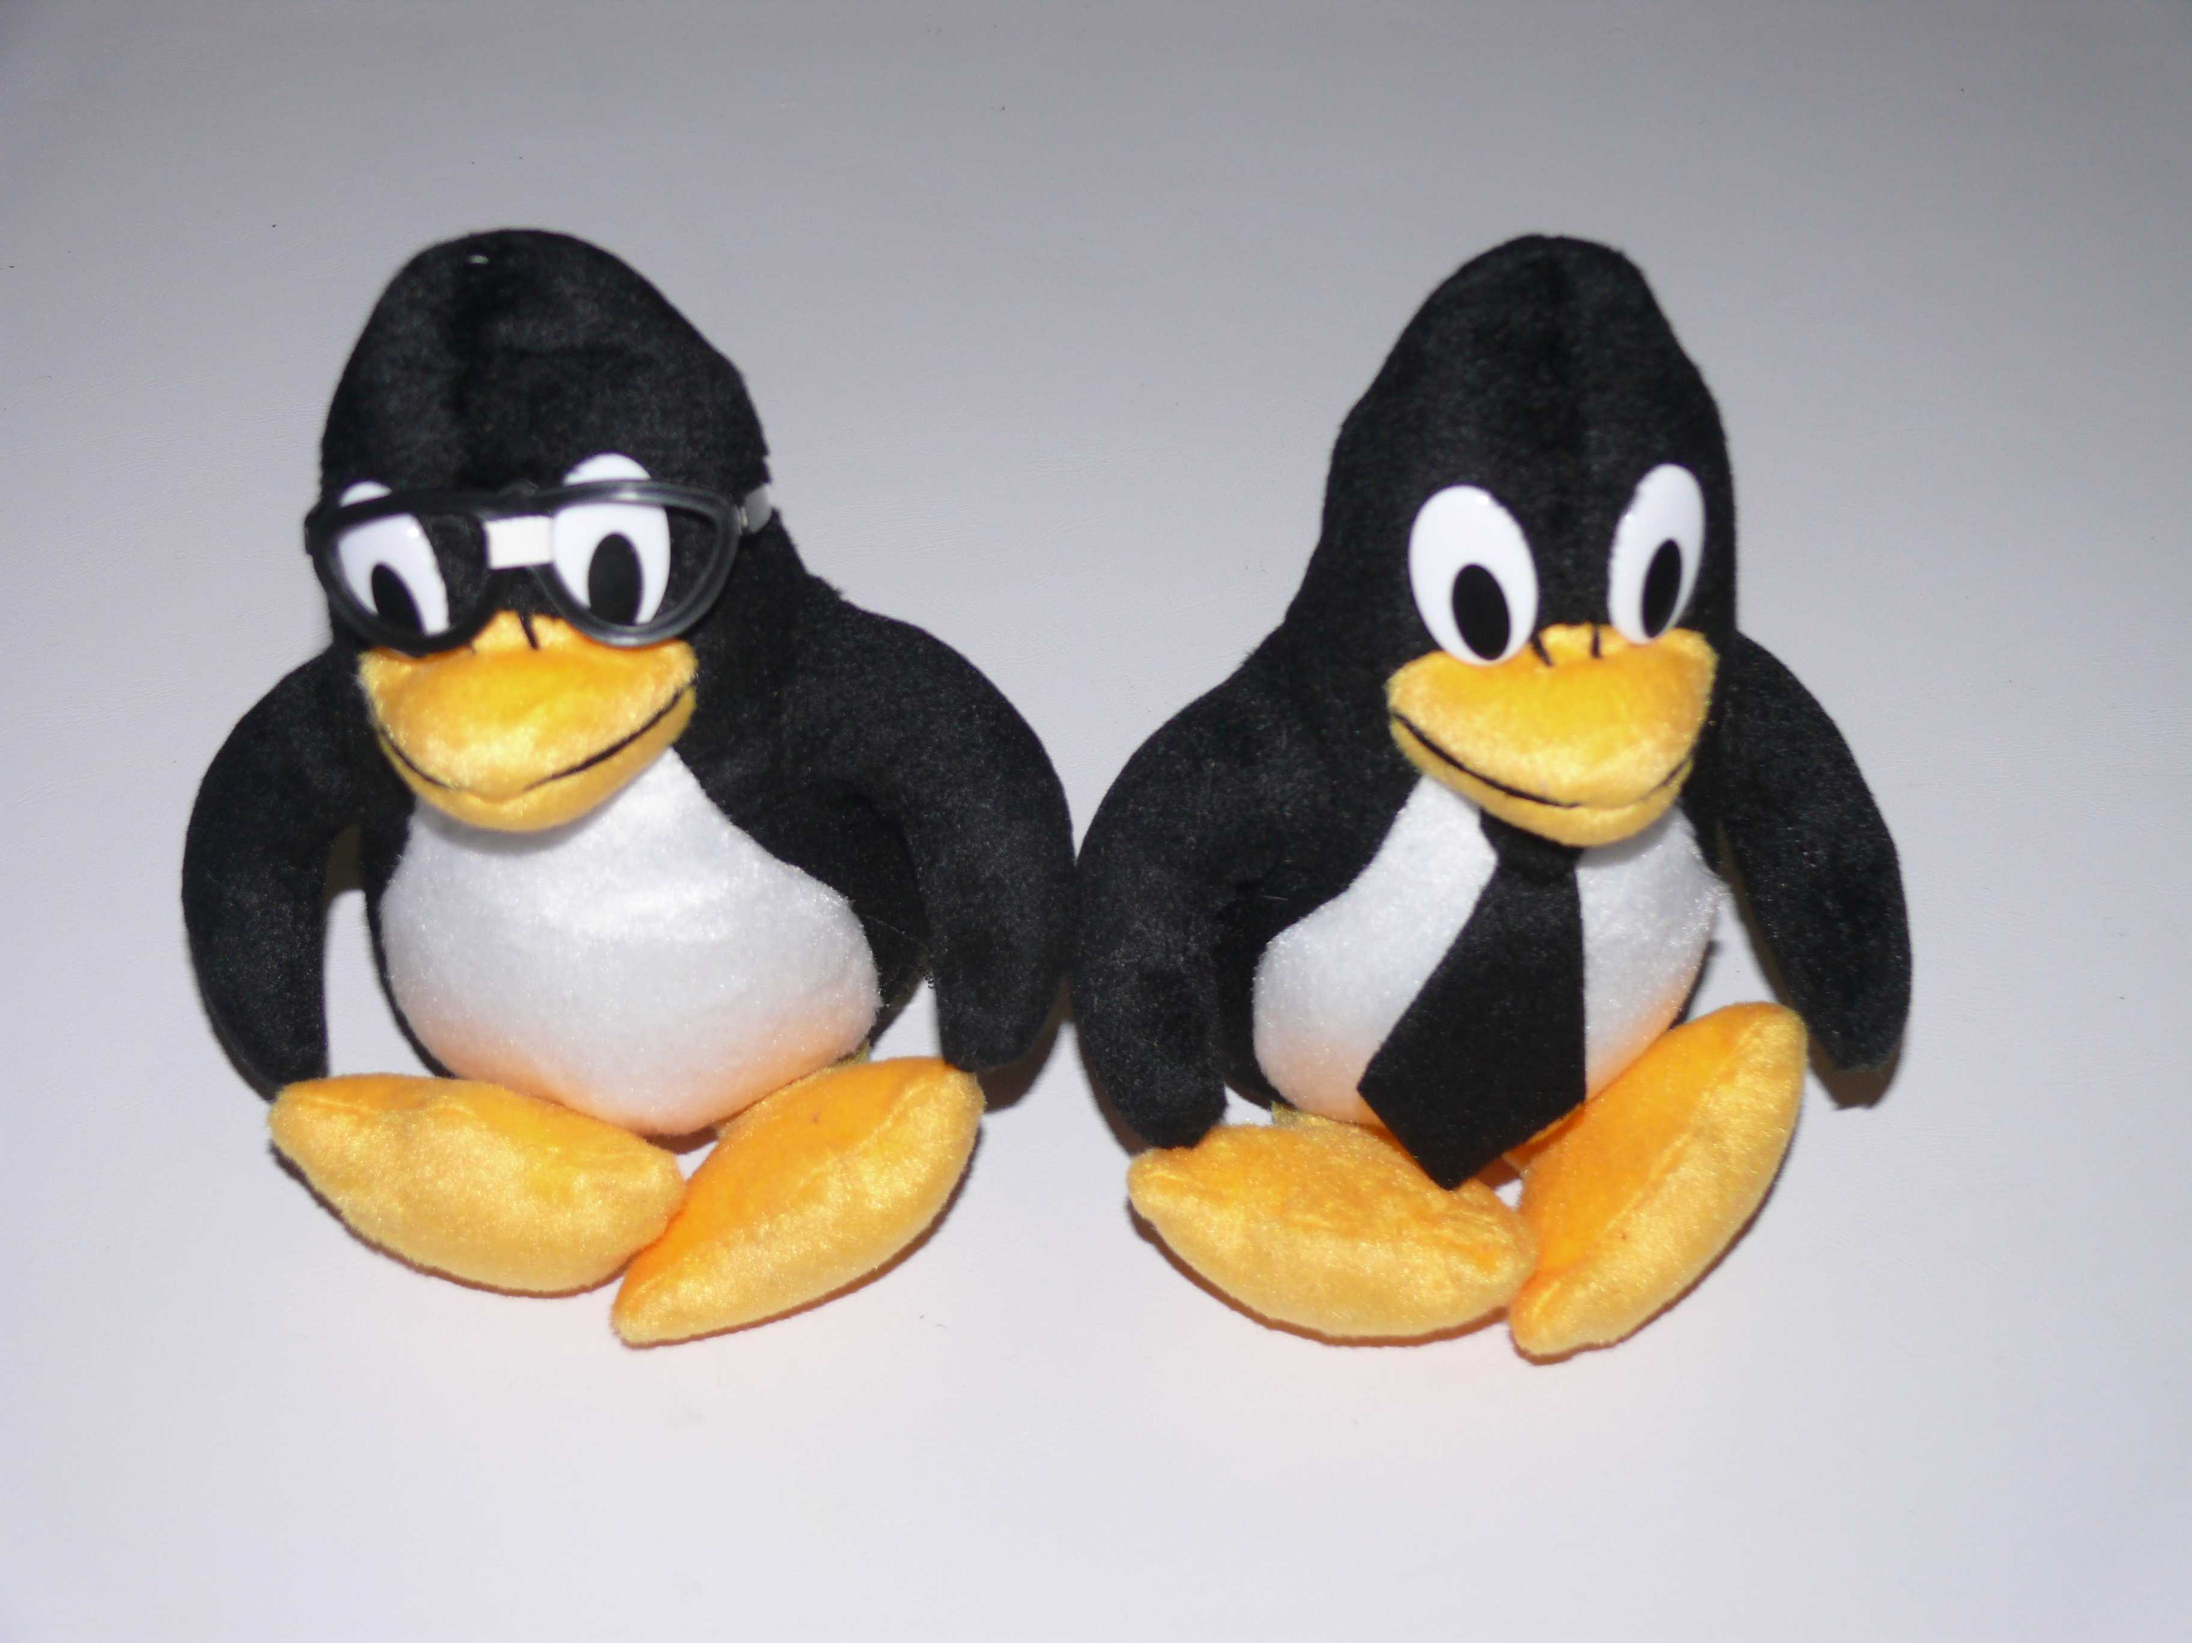
We Need Project Cauã

Slide 12
Project Cauã Professionals (PCPs)
High school and university students that sell products and services to a small number of contracted customers
  Not “break and fix”
  Local to where students live or go to university
Four hours of contact per week per customer – 20-24 hours a week of work
Should generate enough living money

Slide 13
Levels of Project
Worldwide project goals and techniques are the same
Each Country has a module that covers taxes, advertising and product availability
Local modules under each country links clusters of students with a volunteer mentor
  Over time successful PCPs become mentors

Slide 14
Types of Products
PCP Community Does Major Integration
Odoo – Point of Sale (POS) and Enterprise Resource Planning (ERP)
Freedombox Personal and Community Server
Kodi/Home-Assistant.io
  Home entertainment
  First Connection to Internet
  IoT and security system
Any hardware capable of running Debian

Slide 15
PCPs Wanted Products As Well As Service offerings
Low cost and industry standard Open platforms
  Raspberry Pi (raspberrypi.org)
  Caninos Loucos (caninosloucos.org)
Debian

Slide 16
Odoo – POS/ERP System https://www.odoo.com/page/community
Favorably compared to SAP and Oracle
  Modular
  Fraction of the price
  Free Software
Runs on variety of systems - Debian
Hundreds of second and third level support companies around the world

Slide 17
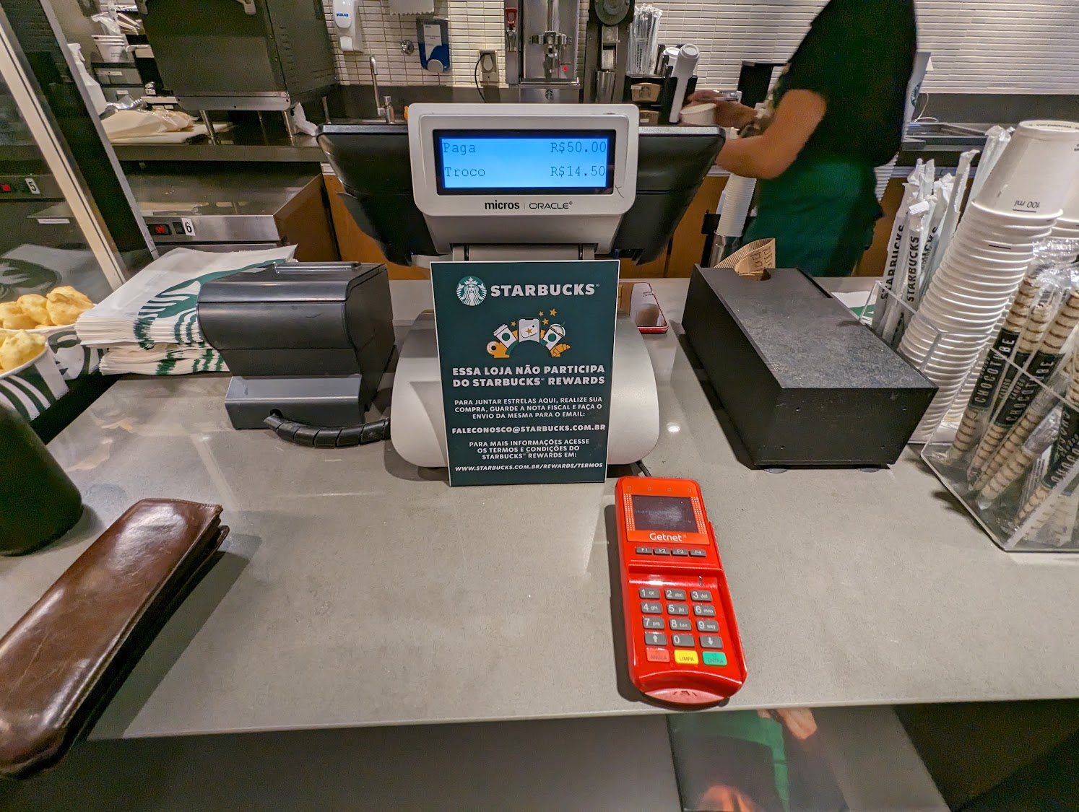
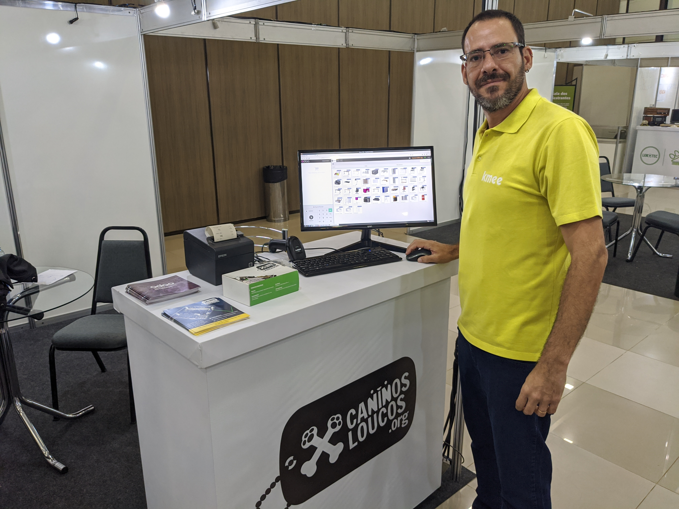
Odoo POS/ERP

Slide 18
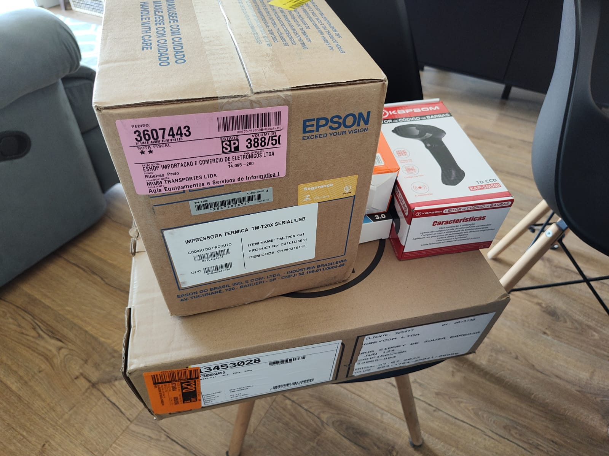
Hardware Ordered Over Internet

Slide 19
Personal/Community Secure Server – Freedombox/Solokey
Freedombox.org – easy to use secure “cloud” server
  Blobless Software based on Debian
  Panel to install, set up and control features
Optional NextCloud.com and Fediverse.party Software
Optional gratis certificate authentication
Optional Solokeys.com MFA keys using FIDO2 standard (currently made in Italy)

Slide 20
Home Entertainment/IoT/First Connection
Kodi Multimedia - https://kodi.tv/
  Store and show photos, music, videos
  Inexpensive hardware for 2.1, 5.1, 7.1
  4K LCD or projection TV through HDMI
  OTA, Cable or Internet Video transmission
Browse Internet
Home-assistant.io home automation - https://www.home-assistant.io/
Security with motion-detect webcam

Slide 21
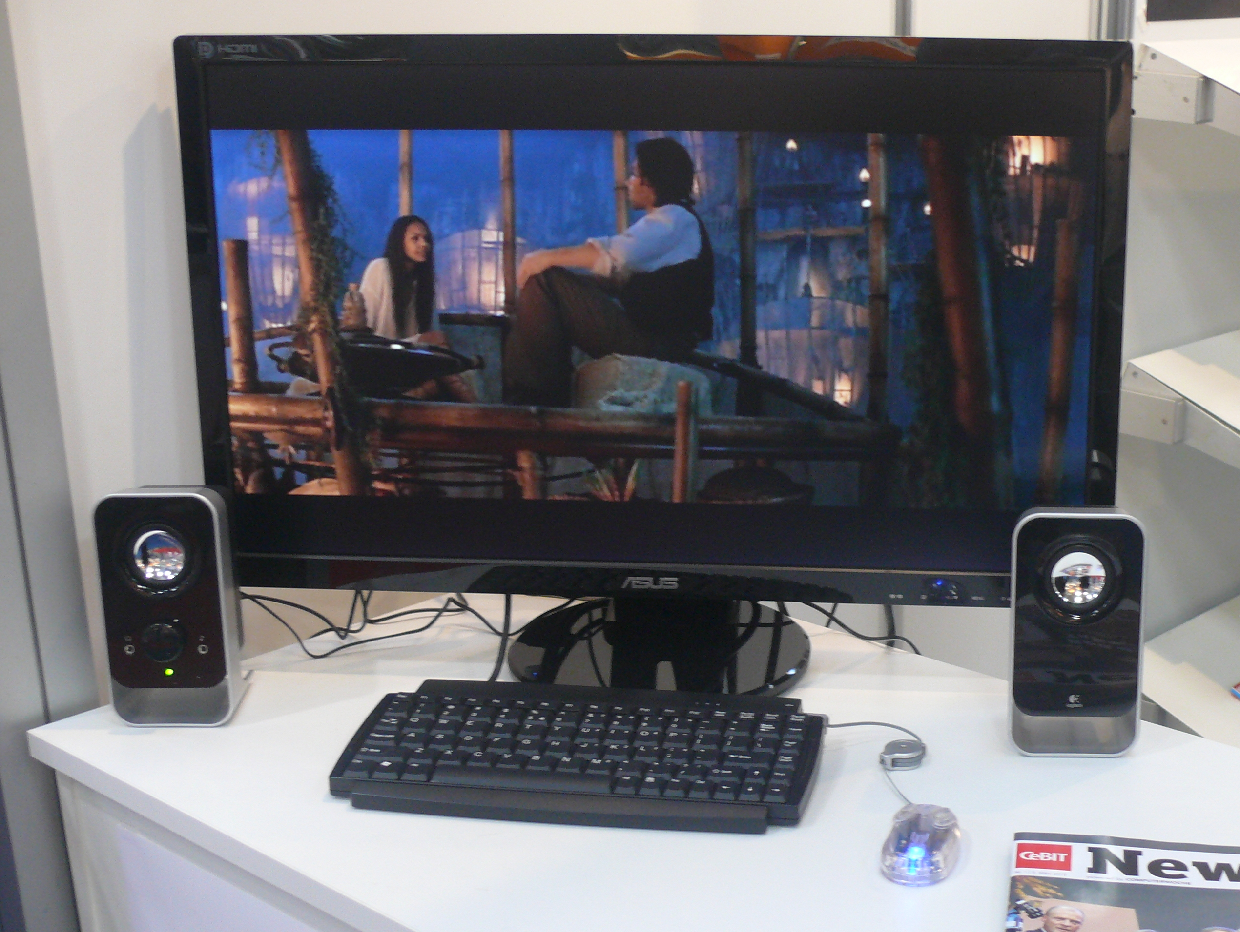
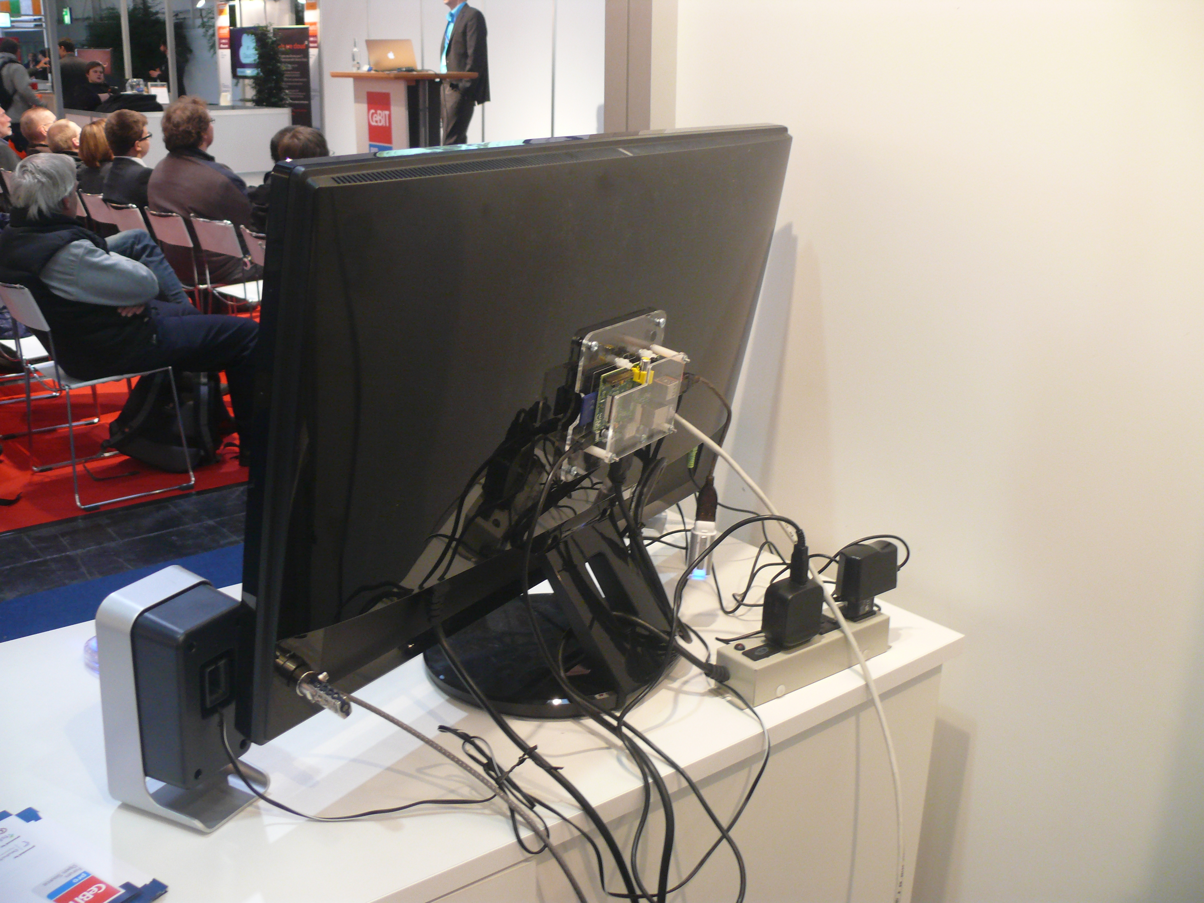
Simple to Complex

Slide 22
Hundreds of Additional Open Products in Future
Based on 400,000+ Open Source Projects

Slide 23
What Is Cost to Student?

Slide 24
What Is Cost to Student?
Nothing!

Slide 25
Website Available to All!
All Information will be available without even logging in
To Interact (ask questions) free login will be needed after agreeing to Code of Conduct.
Project Cauã Professional will require Professional Code of Conduct
  This will gain access to discounts and use of Project Cauã logos and trademarks

Slide 26
Optional for PCP
Discounted vouchers for LPI Certifications
Discounted Professional Insurance for Certified PCPs
Discounts on books and training from LPI partners

Slide 27
The Community of PCPs
Independent business people
Contracted with 5-6 businesses or home owners
Have no employees other than themselves (or one partner)
All revenues other than expenses are theirs
Expected to help (not compete with) other PCPs

Slide 28
The Community of Mentors
Mentors do not have to be technical
  They help the students help themselves
  Mentors are successful business people
    Could be from Free Software, but do not have to be
    Could be from university or civic groups
  Mentors meet with PCPs once a month
Universities can use Project Cauã as internship program

Slide 29
When?
In the past we had several pilots:
  Rio de Janeiro, Brazil
  Ubatuba, Brazil
Today you can start looking at the product software
Soft Launch June 24th, 2024
  Website ready
  Pilot groups running
Full Launch July 4th, 2024

Slide 30

Questions?

