Slide 1

What is (Application) Clustering and Why do you Want to Use it?
February 2005
Eero Teerikorpi
CEO

Slide 2
Today’s Agenda
Clustering Definitions
Application versus Compute Intensive
Mission-Critical Open Source
Application Clustering
Some Application Clustering Pitfalls
Solutions
Questions

Slide 3
Definitions (1)
Beowulf Cluster
  High-performance, massively parallel computer built primarily out of commodity hardware components, running a free-software OS
  “Supercomputer” built from low TCO parts.

Slide 4
Definitions (2)
Storage Cluster
  Large disk farm sitting behind any number of servers
  One copy of the data and all applications/users see this same copy.
  Do not provide high reliability: data can be lost, requiring it to be restored.
  Do not provide disaster recovery or load balancing
  Typically very expensive to build and operate

Slide 5
Definitions (3)
Application Clusters
  Middleware sitting between the client applications and backend servers
  Performs load balancing and failover
  Provides scalability and reliability
  Logically replicated data to insure that all users see the same data at the same time

Slide 6
Clustering
Compute Intensive
Some business apps
Supercomputing
Single copy of data
Shared Storage
Application Clustering
Applicable to
General business apps
HA Services

Slide 7
Mission Critical Open Source

Slide 8
Business Drivers
Drive for lower TCO
  Lower TCO means LAMP and LAMJ-based apps
  Lower TCO means low-cost, commodity hardware components
  Do-it-yourself IT
Applications still required to be “enterprise class”
  Capability missing from open source stack
  Need solution for reliability, scalability and manageability
  Oracle® RAC without Oracle or RAC!

Slide 9
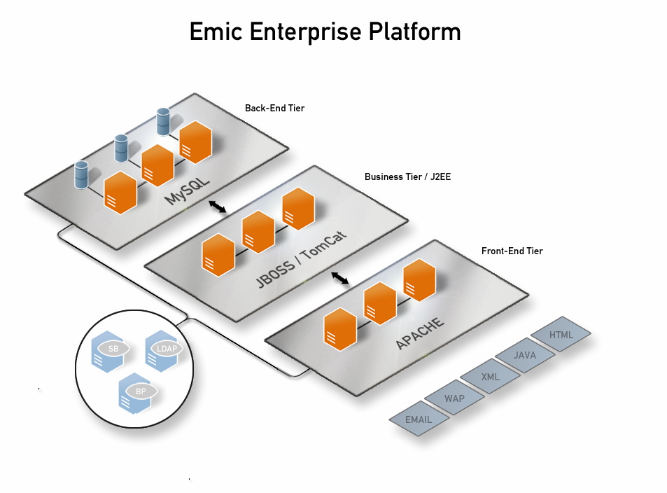
Mission Critical Open Source
Transparent
High-availability
  Full application clustering
  Hot standby with fail-over
  Disaster recovery
  Automatic fail-over for user connections
  On-line maintenance
Scalability
  Dynamic load balancing
  New servers added seamlessly
  Near-linear scaling
Manageability
  Performance monitoring
  Health checks and alerts
  Node state management

Slide 10

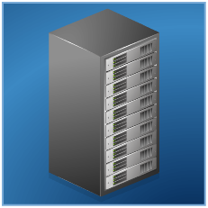

High-availability Services
Problem:
Single Point of Failure
Single System

Slide 11
High-availability Services
Better: Hot Stand-by with
Fail-over or Disaster Recovery
Problem:
Single Point of Failure
Single System
Hot Stand-by

Slide 12


High-availability Services
Better: Hot Stand-by with
Fail-over or Disaster Recovery
Best:
Full HA,
No latency
Problem:
Single Point of Failure
Single System
Hot Stand-by

Slide 13
Scalability Services
Big Box
Load Balancing
Commodity HW
Auto-failover
Add new nodes

Slide 14
Scalability Services
Too Expensive
Best: Load Balancing
Commodity HW
Auto-failover
Add new nodes
Cost effective
Not Scalable

Slide 15



Management Services
Solution:
Health checks and alerts
Node management
Performance monitoring
Problem:
How to diagnose problems
How to have one consistent view

Slide 16
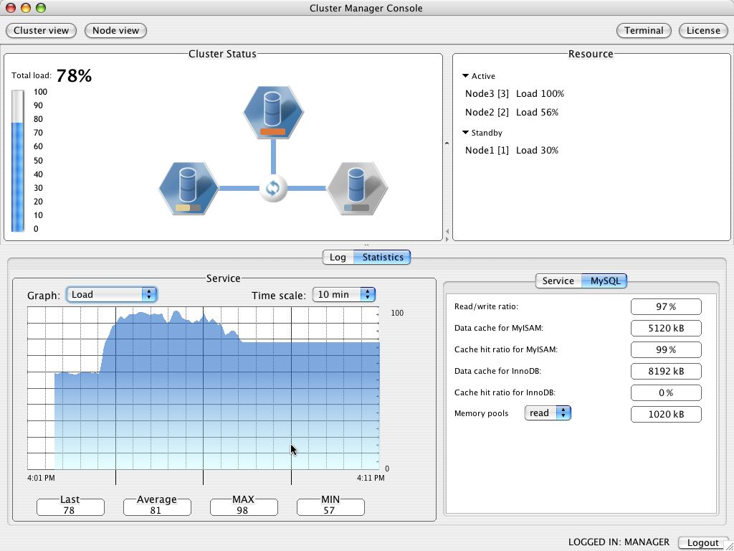
Simplified cluster management

Slide 17
Some Application Cluster Pitfalls

Slide 18

Database Tier: Master/Slave
Problem: Slaves can be overwhelmed
Web
Front-end
App
Server
Master

Slide 19
Database Tier: In Memory Solution
Problem: In memory-only DB limits database size, too expensive, no load balancing or failover
Web
Front-end
App
Server
In Memory Only

Slide 20
Database Tier: Big Box/Big Database
Problem: Too expensive, counter to Open Source
Web
Front-end
App
Server
Database
Well-known
database
vendor here

Slide 21
Database Tier: Shared Storage
Problem: Single point of failure, very expensive
Web
Front-end
App
Server
Shared
Disks
Another well-known
database vendor

Slide 22
Solution

Slide 23
Database Tier: App Cluster
Best Solution: No single point of failure, redundant, scalable,
and HA, cost effective, no loss of data
Replication
Reliable
Global Total Order
Web
Front-end
App
Server
L
O
A
D
B
A
L
A
N
C
I
N
G
F
A
I
L
O
V
E
R

Slide 24
Emic’s Mission
To develop and market a complete suite of
high-availability, scalability and manageability services for Open Source solutions in order to allow you to run mission critical applications on low-cost Open Source and Commodity Hardware platforms
Mission Critical Open Source

Slide 25
Background
Founded in 2000
Products
  Emic™ m/cluster
  Emic™ a/cluster
  Emic™ lamp/cluster
  Emic™ lamj/cluster
Customers
  100 installations in 12 countries
Offices
  HQ: San Jose, CA
  US Offices: NJ, CO, CA, MI, WI
  European Offices: Helsinki
Partners
  IBM, RedHat, Novell, MySQL

Slide 26
Emic Application Clustering
Plug ‘n’ play transparent middleware
Supports full application stack
  MySQL, Apache, JSP/J2EE
High Availability
  Transparent, removes single-points-of-failure
  No data loss in fail situations
Dynamic load balancing
  No external hardware
One “virtual” database
Fast synchronized replication
Extensive fault detection
  Automatic fail-over
  Hot Standby
Reliability
Scalability
Manageability

Slide 27





Customer References
Low TCO
1/5 of or less than traditional solutions!

Slide 28
Securities America
Internet-based financial advisory platform
Accessibility and reliability is crucial
Logon and authentication is critical point of failure
Selected Linux, MySQL platform with Emic running on HP Compaq servers
Emic enabled fault resilience at lowest cost
  ”We chose Emic because it met our strict uptime and performance requirements”

Slide 29
Canada Drugs
On-line fulfillment and distribution of prescriptions
15-step work flow with multiple review points
Reliability and data protection critical to customer confidence
Three-tier LAMP-based web platform with Emic
Emic ensure continuous availability of application
and data
  ” Emic provides an innovative, advanced and cost effective solution for cornerstone open source business applications.”

Slide 30

What customers say about Emic
  ”MySQL is a vital component of our website and EAC adds a whole new dimension to MySQL’s reliability and scalability”
  ”In every project we undertake, we use the best technology available to help us deliver optimum quality products and services”
  ”We can get more performance from the database with less work... the system has already been tested with 40 million hits without any hiccups”

Slide 31
Emic Application Clustering Provides
High-Availability | Emic
Application always running | ✓
Hot back and or disaster recovery | ✓
On-line maintenance | ✓
Scalability
Add new nodes seamlessly | ✓
Dynamic load balancing | ✓
Near Linear scaling | ✓
Manageability
Node state management | ✓
Performance monitoring | ✓
Health checks and alerts | ✓
Low Cost Components | ✓
Transparent | ✓

Slide 32
Q&A
Contact Info
Headquarters
560 Winchester Blvd., Suite 500
San Jose, CA 95128
Tel (408) 998-7878
Fax (408) 998-7881
sales@emicnetworks.com
Product Development
Espoo, Finland
EMEA Sales
Espoo, Finland

