Slide 1

Open Source Opportunities in Small Schools
Kim J. Brand & Matthew S. Hartmann
Computer Experts, Inc.
Indianapolis, IN
info@comp-exp.com

Slide 2
Overview
Introduction, background & experience
The small school market
The appeal of the open source option
Problems & distractions
Typical platform & services
Marketing yourself to small schools
Resources

Slide 3
The small school market
No tax subsidies: parents pay
Fewer non-core classes
  Computers achieving core status rapidly
Quicker sell cycle / decision making
Rely more on fund raising & grants
Greater dependence on volunteers
  Good news / Bad news

Slide 4
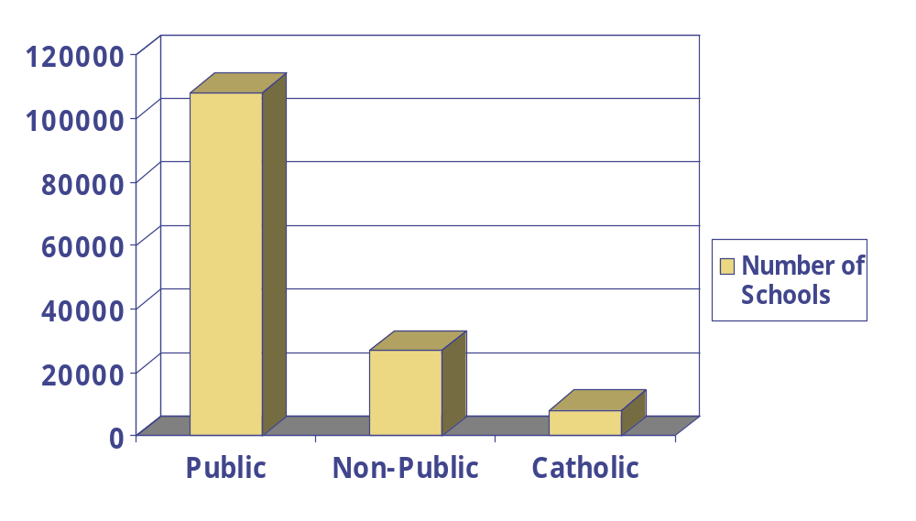
Public, Non-Public, Catholic schools

Slide 5
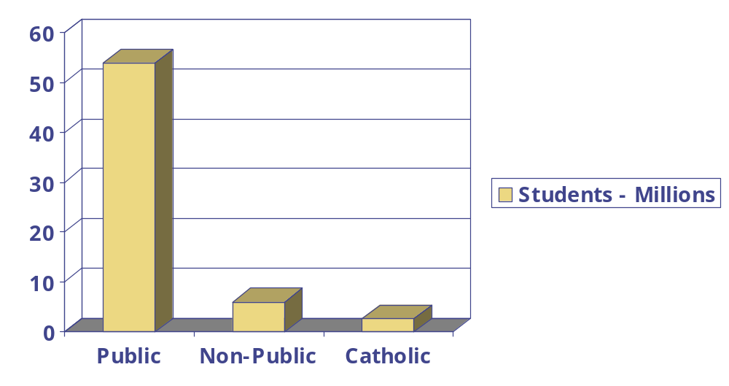
Public, Non-Public, Catholic school enrollment

Slide 6
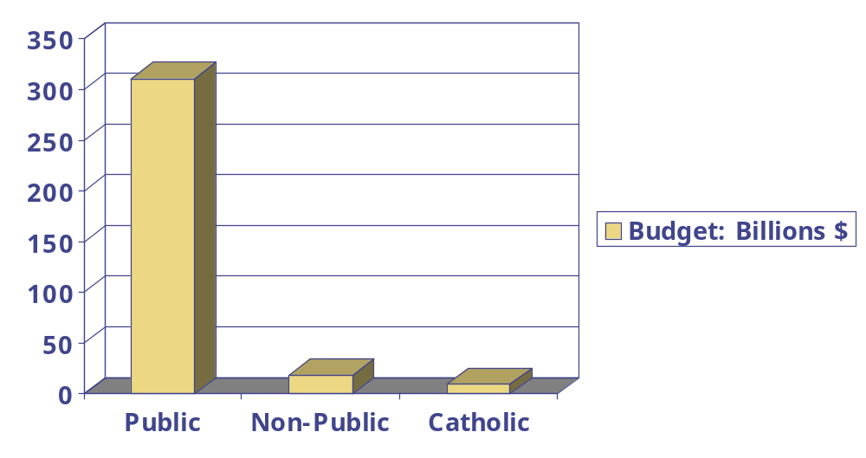
Public, Non-Public, Catholic school expenditures

Slide 7
The appeal of the open source option
License relief
  Zero-administration yields significant benefits . . . donated computers a serious problem
Reliability
  Fewer staff mandates greater up-time / lower maintenance
Cost
  Academic pricing cuts this Open Source advantage
The Linux horde: student power!

Slide 8
Problems & distractions
Well healed volunteers & misinformed grant administrators
Microsoft FUD
Lack of coherent tech plan or vision
E-Rate: Universal Funding
Child Internet Protection Act: CIPA
Money

Slide 9
More Problems & distractions…
Keys (as in locks everywhere!)
Playgrounds
Desktop lock-down software
Software vendor attitudes
Staff development challenges
Old buildings; 18” thick walls, no electrical outlets

Slide 10
Typical platform & services
E-Mail
  Sendmail & Qpopper
DHCP
DNS & NTPD
Samba
  With NT Domain Logins & Lockers
Squid & SquidGuard
  Internet filtering
CD-RW for backup
  tar, mkisofs, cdrecord
WebMin
RAID1 (3Ware IDE)
SSH: remote admin
UUCP: mail transfer
Kaspersky AV

Slide 11
Typical platform & services continued…
Let router do NAT so entire system operates in private IP range: 192.168.X.X
UUCP to reduce ‘exposed services’ risk
WebMin for tech-coordinator; can add/remove hundreds of users
Hearbeats provide off-site monitoring
CD-RW backups provide inexpensive, portable, easy-to-use data security
Apache could offer substantial advantages

Slide 12
Marketing to small schools
Tech-Club Mentoring
Inservice training of teachers
Tutorials at conferences
System administration training for free
Donating equipment & services
Tech-Committee membership

Slide 13
Resources
www.Comp-Exp.com: Articles and white papers based on Computer Expert’s experience
K12Linux.org: K-12Linux Project
K12ltsp.org: K-12 Linux Terminal Server Project
K12os.org: K-12 Open Source Project
www.seul.org/edu/: Simple End-User Linux
www.ncea.org: National Catholic Education Assn
nces.ed.gov: National Center for Education Stats
www.inpea.org: IN Non-Public Education Assn
www.kaspersky.com: AntiVirus protection for Linux

Slide 14
More Resources…
www.squid-cache.org: Proxy Server
www.squidguard.org: Internet Filtering service
www.eudora.com/qpopper: POP3 service
www.isc.org/products/DHCP: DHCP service
www.lfsp.org: Linux for schools project; lesson plans & student home page tutorials using PHP & MySQL
linux.lexilog.org.uk: Personal experience from the trenches; Linux advocacy slide presentation
www.thestuph.com/litc/: Linux in the classroom meta-site
www.eecis.udel.edu/~ntp/: NTPD service

Slide 15
Thanks!
SuSE Linux for contributing 10 copies of 7.2 to Scecina High School
The SAMBA Team
Rob Rash, principal of Our Lady of Lourdes Catholic School, Indianapolis
Linus Torvalds
The GNU Project & Richard Stallman

