Slide 1
The Policy, Planning and Pragmatic Reasons for the Massachusetts Move into Open
SCALE
February 10, 2006
Peter Quinn
Former CIO Commonwealth of Massachusetts
AKA “Open Doc Man”

Slide 2
Agenda
Background
State-of-the-State
The Challenges
Massachusetts Approach
The Path to “Open”
Lessons Learned
Where is Massachusetts now?
Final Thoughts and Comments!

Slide 3
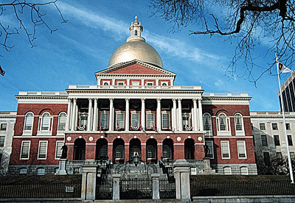
Background
Massachusetts stats:
  6.5 million residents
  3 branches of government
    Executive (173 Agencies)
    Legislature (House and Senate)
    Judicial
  6 Constitutional Offices (Auditor, A.G., Treasury, Sec. of State, MA DA’s, Governor’s Council)
  20 Authorities/ Quasi Public-Private

Slide 4
Background cont.
$24.4 billion budget (think Fortune 60 size company with 200 business units)
90,000 employees and contractors
Annual IT spend of approximately $700mm
IT is currently funded through:
  Direct appropriations
  Capital
  Grants
  Federal Re-imbursements

Slide 5
The Challenges
Flat or declining investment in IT
Human capital demographic:
  30% will retire in five years due to age
  Another 20% will be eligible due to time in government
Agency centric solutions.
Every man for themselves.
No strategic plan or tactical plan.
Budgets/
Resources
Technology
Increased
Efficiency
All Levels of Government
Services
Accountability

Slide 6
The Challenges cont.
Massive legacy systems.
Limited meaningful maintenance.
Few sustainable work processes.
No performance measurements.
Limited learning investment in employees.
95% of IT employees are union employees.
“If someone made one and someone sold one, we bought it.”

Slide 7
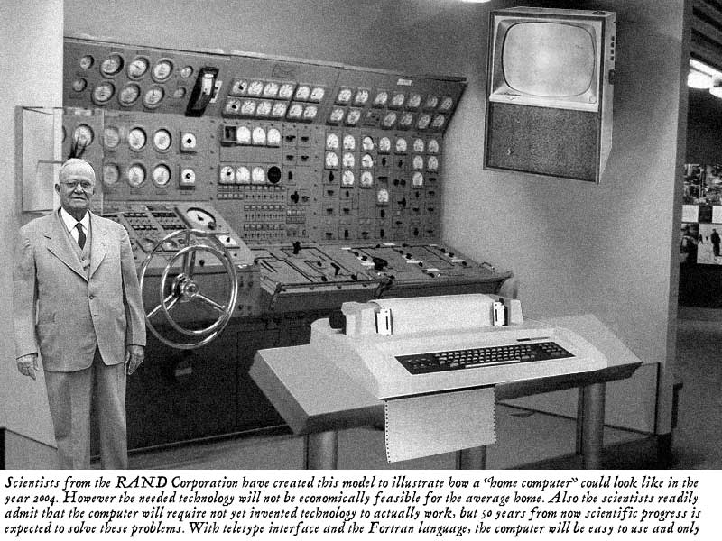

Slide 8
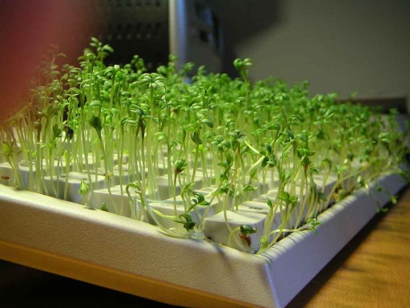

Slide 9
The Challenges cont.
We, in Government, have the responsibility to:
  Preserve history for all time
  To preserve this information in a format that is accessible by all
  And in a format that is not technically restricted
Revenues will remain challenged because of health care costs
Application development requires at the sustainability of COBOL

Slide 10
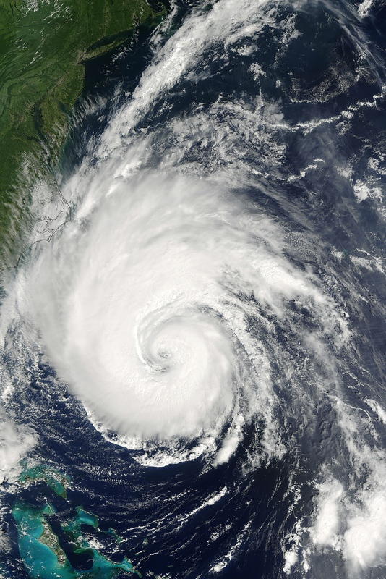
Massachusetts Approach
Perfect Storm analogy:
  Difficult fiscal environment
  IT Commission
  New Administration
The “Big if”….if we could meld these three disparate events, we had an opportunity that only comes around every 15 or 20 years to truly transform IT.

Slide 11
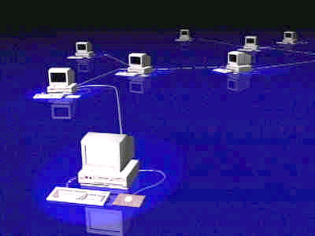
The Path to “Open”
Starting Initiative:
  Freeware within the Commonwealth; you built it everyone else could have it.
  License software at the Commonwealth enterprise level.
  Continued to try to share code of proprietary applications with other states through negotiating individual contracts; untenable because lawyers make it very difficult to get to “yes.”

Slide 12
The Path to “Open”
The Edict 9/25/2003:
  Forum – Monthly agency CIO meeting
  Eric Kriss Secretary of ANF issues “New Open Policy” memo to me to share with CIOs.
    Effective immediately, we will adopt, under the CIO’s guidance, a comprehensive Open Standards, Open Source policy for future IT investments and operating expenditures.
    To be reflected in both FY04 capital and FY05 operating and capital budgets.

Slide 13
The Path to “Open”
The Edict continued:
  Open Standards = Appliance Computing
  Open Source = Free ($ maybe; freedom yes!)
  Two development tracks:
    New applications must follow Open Standards and Open Source.
    Existing applications will be evaluated for encapsulation or migration to Open Standards, Open Source.

Slide 14
The Path to “Open”
In tandem, we are constructing our Open Standards/Open Source Enterprise Technical Reference Model (ETRM) (based on NASCIO and Feds models).
Within 1.5 months we release formal policy for public comment.
Major pushback from members of the Massachusetts Software Council, the Legislature and some advocacy groups.
Support from many other organizations from around the world.

Slide 15
The Path to “Open”
30 software company CEOs from the MA Software Council come in for a public vetting.
Ultimately, we separated Open Standards from Open Source.
Included Open Source as part of the best acquisition value policy.
2nd release of the ETRM effective May 17, 2004
  2 public comments 1 & 1
  More expansive in all areas
  Focuses on platform flexibility

Slide 16
The Path to “Open”
December 2003 called to testify at a Senate Oversight Committee Hearing
2.5 hours of grueling and accusatory comments
Well prepared by industry proprietary advocates
I was not; told no big deal; would be out in 10 minutes
Ma was very much by itself in this endeavor

Slide 17
Lessons Learned
Naiveté can be a great thing.
Know that some folks will attempt anything to stop these initiatives

Slide 18
Lessons Learned cont…
You are business people…..beware of those that march to the mantra of “Changing the Software Industry”…….the change in the industry will come as a result of acting prudently and successfully within a business context
Your presentation and professionalism will make you credible
PR Open Source Congress – no credibility?

Slide 19
Lessons Learned cont.
Demonstrated sustainability will get people to listen:
  Microsoft changes their Office 2003 license:
    Patented XML documents can be opened and read by any reader
    License is now in perpetuity

Slide 20
Massachusetts Mis-conceptions
This was not driven by the Attorney General’s Anti-trust efforts against Microsoft
This was not an anti-Microsoft Agenda
We do not subscribe to the ABM movement: Anybody But Microsoft
We were driven by the business of best value and good government

Slide 21
Massachusetts: Where are they today?
Open decision and practice no longer being questioned……by anybody
Edit: Everything that comes into the ITD Datacenter that is not “open” requires a variance signed by the DC Manager
All procurements specify “Open Standards” and request incorporation of Open Source alternatives
Request “specifics” (i.e. contractual commitment) on when “Open” will be there

Slide 22
Massachusetts: Where are they today? cont:
Linux: Across all platforms
Open Source applications (pure and blended) prevalent in many parts of the operation especially in network operations
Creating a “pure” Open Source development group strategically focused on very rapid vignette solutions
Institutionalizing all adoption and support through meaningful and sustainable business processes and under umbrella of ITIL

Slide 23
Massachusetts: Where are they today, cont.
GOCC: Government Open Code Collaborative
  Nationwide repository for Gov software apps
  Scale & Complexity: Low
O/S: Debian Linux
Web: Apache
Application and DB: Zope
Content Manager: Plone
Monitoring: Big Brother

Slide 24
Massachusetts: Where are they today, cont.
.e-Licensing:
  Standardize delivery of licenses (hair dressers to engineers)
  Scale & Complexity: Medium
O/S: SuSE Linux on z890 mainframe
Web: Apache
Application: JBOSS
DB: MySQL 5.0
Monitoring: Big Brother
Environment Tools: z/VM to provision, dev, test and stage as needed

Slide 25
Massachusetts: Where are they today, cont.
MASS.gov:
  In-source; upgrade/replace software; business continuance
  Scale & Complexity: Medium
O/S: Red Hat Linux AS 2.1 on Blade technology
Web: Apache
Application: Java 2 Runtime ModJK 1.4; Apache Jakarta TomCat connector JK1.2; Oracle 9i client; Vignette Application Portal using TomCat clustering
DB: Oracle 9i on Mainframe
Dev and Staging: Apache 2.0; Oracle 9i client; JBOSS TomCat, MQ Series & CommBridge
Monitoring: Big Brother & HP Open view

Slide 26
Massachusetts: Where are they today, cont.
Virtual Gateway:
  Single point of entry for authentication, application of services and tracking of services across entire HHS Agencies; 1 Portal
  Scale & Complexity: High
Identity Management:
  O/S: Red Hat AS 2.1
  Application: SunOne
Application Portal:
  O/S: HP UX
  Application: WebLogic, various Java frameworks
  DB: Oracle 9i
  Messaging: JMS-MQ
  Monitoring: Big Brother, Log4J for logging, HP Openview

Slide 27
Massachusetts: Where are they today? cont.
Desktop:
  ITD: FireFox on every desktop (eat your own cooking)
  Open Office 2.0 being deployed on every desktop
Developing issues list:
  Excel, etc.
  Apps built to proprietary products, etc.
  Most disruptive piece of technology with most questionable immediate ROI

Slide 28
Massachusetts: Where are they today? cont.
Our “View” of the future:
  Evolving enterprise behaviors we see:
    Service Oriented Architecture
    Email and Calendaring critical (killer?) apps
    Substantive browser
    Majority of users are content consumers, not content creators
    Evolving trend of shorter messages as emails vs. Suite generated content
    Smarter folks than us say there is research that supports these trends and suggests that our number of 75% fall into the behavioral patterns above is reasonable

Slide 29
Massachusetts: Where are they today? cont.
Our “View” cont.:
  Desktop of tomorrow:
    Substantive browser
    Email and calendaring
    Readers
Is the Suite, as we know it, not necessary, not applicable in the new order?
Is the Suite dead?
Simplicity allows for simplified, significantly less disruptive migration of desktop as part of the infrastructural renewal

Slide 30
Massachusetts: Where are they today? cont.
Last major initiative was ”Open Formats”
Driving factors: Preserving history for all time with its original tonality and accessible by all (i.e. it should be as accessible as walking into the State Library or Archive to look at a historical document and free)

Slide 31
Massachusetts: Where are they today? cont.
Open formats initiative complicated by:
  History is being generated at an unprecedented rate (and lost by the way!!!), too often in proprietary formats
  50,000+ desktops in enterprise
  Useful, practical formats were not ubiquitous
  We, in government, must accept a variety of formats from our constituents, very often dictated by the marketplace

Slide 32
Massachusetts: Where are they today, cont.
Formats had been the object of our angst for 18 months
Produced Comment ETRM Version 3.5 early 2005 (included MS XML Format)
Eric Kriss addressed Ma. Software Council 1/15/05; alluded to changes to MS License
Firestorm of criticism for including MS XML
Published V 3.5 without Format piece
Continued due diligence

Slide 33
Massachusetts: Where are they today? cont.
Open Formats Summit June 09, 2005
“Quietly” have assembled the best practical (?) thinkers we know (represented by suppliers, standards, independents, staff)
Goal: What formats should we use that will be meaningful to the enterprise and successfully adopted, with continued sustainability, that truly embarks Massachusetts on the road to effectively preserve history for all time, with accessibility for all?

Slide 34
Massachusetts: Where are they today? cont.
Open Formats outcome:
  XML is the ticket
  Formats must be “Open”
  Open is a continuum
  Everyone in the room presumed upon MS to “open” their formats and compete on technological prowess or advantage

Slide 35
Massachusetts: Where are they today? cont.
August 29, 2005:
  Public Comment period on adopting the OASIS Open Document Format
  157 comments; 97 endorsements; 46 critical (several concerning visually impaired access); 13 constructive;
  All corporate endorsing except Microsoft
September 21, 2005:
  Final policy adopted and published
Now:
  Commitment is still on

Slide 36
Repercussions & Stuff
Senate Oversight Hearing: Questioned process, cost, authority
Testimony:
  Linda Hamel and I: Advocated our position but not sure we were heard
  Alan Cote:
    There is no crisis in e-records
    Save stuff in a variety of formats (My comments: There is no digital archive; digital information goes to Iron Mountain)
    That we do not have the authority; we did

Slide 37
Repercussions & Stuff cont.
Disability advocates:
  Fair criticism in our minds; we thought we had engaged the correct people and we did not get them all; my mistake
  Myra Beltoff: fair and balanced statement
Auditors’ Office (John Beveridge):
  Charged by Oversight Committee to review
  Will focus on process, impact, inclusion and costs
  John is fair and ITD has an excellent working relationship with the Auditors’ Office and would expect a credible analysis

Slide 38
Repercussions & Stuff cont.
Economic Stimulus Bill Provision:
  Originally:
    Strips ITD of all power to create standards and policy
    Gives all records issues to SEC
    Hands all policy and standards control to private sector entity
  Now hands over to Supervisor of Records (authority extends to municipalities)
Analysis:
  Unconstitutional? In its original form
  Current proposal creates total gridlock!!!!!!!!!
  Defies logic and all nullifies all best practices

Slide 39
Repercussions & Stuff cont.
Boston Globe Investigation:
  Questions started after hearings and a procurement decision at HHS to purchase Novell licenses.
  Linkage?
  Questioned vendor influence, travel, use of state funds, attendance records, authorization
  Front page for accusations; in Metro Section for exoneration; 100% clean bill of health; no dangling participles

Slide 40
Repercussions & Stuff cont.
Boston Globe Investigation cont:
  Numerous requests for Ombudsman to investigate by outside people (to no avail)
  Everyone saw it for what it was: a blatant attempt to discredit the format initiative
Understand that some folks will stop at nothing to destroy “Open Format” as they tried with Open Source

Slide 41
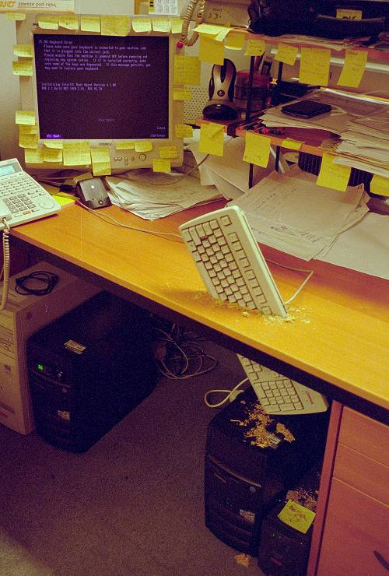

Slide 42
Numerous Blogs & Headlines
Two favorite headlines:
  Boston Globe:
    Microsoft Bows to Massachusetts (MS has gone to ECMA for approval of XML Schema)
  London Inquirer:
    Open Doc Man: “Cleared of Smear”

Slide 43
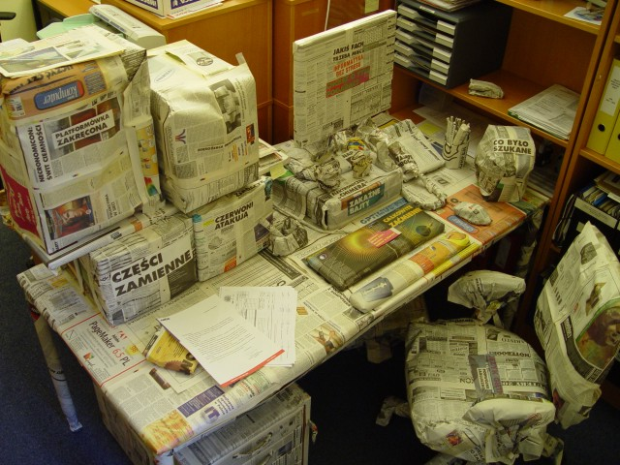

Slide 44


Slide 45
Continued Personal Initiative
Make accessibility as an issue disappear
Presumed on Industry to “Commit and act on Open Standards” and leave the religious Open Source debate at the door
Coalesce as I, we, know you can and create serious agreed upon actions and execute
Important to the community to lower the price point; if solutions are Open Sourced, the community can do its own work
And everyone in this room will need it

Slide 46
Last Comments
Is Government technology mired in a state of palliation? Where we treat the symptoms but not the disease?
Have our technologies morphed into horrible states because of habituation by employees, citizens and IT workers into believing mediocrity is the best we can achieve?
Is Open Source “the” or one of the paths to technological prophylaxis?

Slide 47
Last Comments cont.
“Open Source” is one avenue of a multi-faceted pincer strategy to create meaningful sustainability of IT with a very different cost structure in government.
“The cost of Government is not sustainable in its present form.”

Slide 48
One Last Question cont.
Should we really be talking about preserving history in accessible formats and on media that will stand the test of time?
Should we really be talking about application development that results in systems that at least have the sustainability of COBOL?
Should we really be talking about the Open Source tenets of collaboration and innovation and building ubiquity in government applications that span state boundaries?

Slide 49
Final Thoughts….
“If you want to know your past, look at your present conditions. If you want to know your future, look at your present actions.”
        - Chinese Proverb
Our present actions must continually apply pathophysiological practices and adapt what we learn to insure success of our future state.

Slide 50
Final Final Thought
There are risks and costs to a program of action. But they are far less than the long-range risks and costs of comfortable inaction. John F. Kennedy
US Democratic politician (1917 - 1963)
Twenty years from now you will be more disappointed by the things that you didn't do than by the ones you did do. So throw off the bowlines. Sail away from the safe harbor. Catch the trade winds in your sails. Explore. Dream. Discover.
  <date/time>Mark Twain

Slide 51
Remember the Request
Formats should be entirely open and inspect able
Uninhibited by proprietary schema and or licenses
Reviewed by a jury of its peers (i.e. recognized standards bodies)
This is very simple and reasonable request

Slide 52
Some Opposition Comments and My Final Thoughts
“Ma. CIO's Office has presented itself to the world as a “regulator of MS'” activities
Retort:
  At one level this is offensive because it presumes ITD isn't qualified to issue IT Policy
  Effective IT (public and private) policy had always come out of IT organizations; where policy making and operations is bifurcated, IT is impudent
  As “regulators” was never in our thoughts

Slide 53
Some Opposition Comments and My Final Thoughts cont.
They are regulated, inconsistently all over the world and Ma. Adds another layer through IT Architecture and Standards for (Government) Procurement
Retort:
  To name a couple of industries, how about International Banking or Securities
  Price you pay to play internationally
  And what is the real “role” of the CIO and IT?

Slide 54
Some Opposition Comments and My Final Thoughts cont.
They would say every IT policy should be taken to the Legislature
Retort:
  This process would clearly gut effective and rationale IT
  And is this a favoured direction because Open Format Opponents feel their influence is really with Legislatures?

Slide 55
Some Opposition Comments and My Final Thoughts cont.
That Ma. Was intent on establishing “another point of light” to cause problems internationally for MS
Retort:
    Furthermost from our minds
    We undertook a very thoughtful and inclusive journey to arrive where we did
    We were not “ABM”
    Given all the other constant challenges of continually trying to effect consistent and substantive IT, nobody had the time to focus on MS

Slide 56
Last Editorial Comment….really!!!!!!
We would say the following to put this issue in context:
  Ma was the first state with a public school
  Ma was the first state with a public library
    Both are about access to information
  Ma is the first state to establish standards for open formats insuring information access for future generations
Is this initiative any less compelling?

Slide 57
Resignation and What Now?
Resigned because I have become a lightning rod for everything in IT
Goal was always to have IT be apolitical
Now IT is a political football
Unrelated issues like the Bond Bill, Second Data Center are in jeopardy because of me
With me gone, I am hopeful the noise level will drop significantly and it will be business as normal
Next for me?

Slide 58
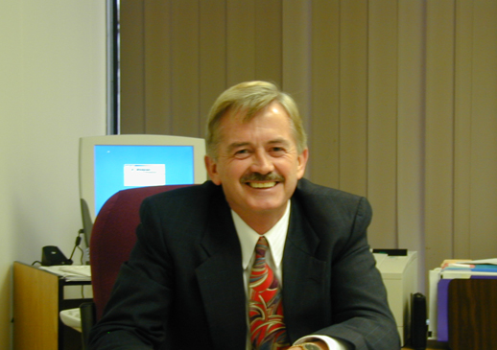

Slide 59


Slide 60
Thank You
wrpjquinn@comcast.net
617 770-1460

