Slide 1

Planning for Systems Interoperability: Another « Mission Impossible » for Public Servants?
Susy Struble
IT Interoperability and Standardization, Office of the CTO
Sun Microsystems
Notes:
P

Slide 2
Sides of a Multi-Faceted Coin
When I say interoperability, I also mean:
    Interchangeability
    Access
    Control
Notes:
Point of this presentation is to further clarify what's meant by open standards, to help inform educated decision making by policy makers, and hopefully to be a little provocative too
Examples of why interoperability is important:
1. Reference the tsunami emergency system problems that were discussed in the Harvard/Berkman Open ICT Ecosystems
2. Reference the e health record issues the US faced with hurricane Katrina: story of doctors not being able to access key information on patients even though the info was saved on servers that weren't damaged. But b/c the info wasn't in a standard definition, no applications could access it except those applications that were on the doctor's office systems, which were washed away. The doctor had thought that he was smart in putting this info on a server, thought this would mean it was easily accessible. But he learned that reliance on one vedor with a proprietary specification meant that his system was very inflexible and fragile.
And the problem is growing as IT becomes increasingly embedded in our daily lives – talk about the great notion of « convergence »
3. A very provocative example of how important this issue is and will continue to be w/ convergence - Reference the US Congress bill re: «Right to Repair » for auto mechanics and the IT systems in cars. http://www.righttorepair.org/

Slide 3
Points To Think About....
The role of interfaces in interoperability
Interoperability “Hot Spots”!
Policy implications
Notes:
I hope to provoke thought and discussion on the following points, and Sun welcomes further collaboration
- why it's the interface that's so important to interoperabilty, and how a focus on the interface can help make system-wide interoperability a reality
- I hope that « tarpit » translates well! We have some suggestions for fixes that would perhaps avoid the immediate deeply political issue of software patents themselves. That's a huge issue in itself, but we can create a system that works despite what might happen around software patents with just a few fixes to how licenses are treated.
- and then I suggest a few specific functional areas in which there will likely be enough political will to address issues of non-interoperability

Slide 4
IT Interoperability is a Public Policy Issue
Government as a user
    Intra- and Inter-agency collaboration
Government as a creator
    Collaboration with the Public
    Services: E-gov't, healthcare, emergency
Government as a steward
    Documents and data
Government as stimulant
    Industrial, economic, social policies
Notes:
Point of this presentation is to further clarify what's meant by open standards, to help inform educated decision making by policy makers, and hopefully to be a little provocative too
Examples of why interoperability is important:
1. Reference the tsunami emergency system problems that were discussed in the Harvard/Berkman Open ICT Ecosystems
2. Reference the e health record issues the US faced with hurricane Katrina: story of doctors not being able to access key information on patients even though the info was saved on servers that weren't damaged. But b/c the info wasn't in a standard definition, no applications could access it except those applications that were on the doctor's office systems, which were washed away. The doctor had thought that he was smart in putting this info on a server, thought this would mean it was easily accessible. But he learned that reliance on one vedor with a proprietary specification meant that his system was very inflexible and fragile.
And the problem is growing as IT becomes increasingly embedded in our daily lives – talk about the great notion of « convergence »
3. A very provocative example of how important this issue is and will continue to be w/ convergence - Reference the US Congress bill re: «Right to Repair » for auto mechanics and the IT systems in cars. http://www.righttorepair.org/

Slide 5
The Crisis for Public Policy
Lack of “off-the-shelf” interoperability
The rate of our global standard setting system hasn't kept pace
The gap is easily exploited
    Land grabs for interface control points
    Proliferation of IPR in “open” standards
    Standards organization increasingly troubled
  “Convergence” exacerbates the situation
    End-users suffer limitation of choice, increased cost, complexity and confusion
    Innovation suffers, economy suffers
    Loss of the “network effect”
Notes:
So let's quickly give some background:
The web and the internet changed all that.
The internet provided the infrastructure, and the web made it usable.
The Web is one of the fastest adopted of all technical inventions/changes.
More and more people began to use it; more and more people came to depend upon it. And fewer and fewer of these people knew about intellecual property; they just assumed if something was in a standard, it was open and they could use it.

Slide 6
How We Got Here
Basis of IT standardization is in industrialization and its requirement for interoperable systems
  Railroads needed standardized time & rail gauges
  Commerce needed ways to transfer goods
  Users needed reliability
ICT Standardization system built for large, industrial users
  Slow and expensive
  Allows exchange of IPR through complex cross-licensing
  The Golden Age of RAND licensing
Notes:
Only when major industrialization began did the need for standards really start.
Basically,
Interdependancies create the need for standards. As a society or a technology or a transportation system becomes more and more complex, interaction and standards to prescribe and control the interaction become necessary.
Howeve, in the US, the government disavowed governemntally driven stanadrds. The private sector was left to create them.
Within ICT, the larger players had the people, the money, adn the need to drive standards. Processes to protect the big players from one another were created.
IPR was cross licensed between large companies – such as IBM, DEC, HP, Burroughs, AT&T and so on.
Reasonable was assured because everyone subscribed to sort of a « mutual and assured destruction » school of licensing. Rogues were sued; otherwise, it was quiet backroom deals.

Slide 7
What Has Changed
The Internet and World Wide Web
  Increased pace of innovation and change
  Participating companies differ wildly in size, composition and background
  The ability to broadcast code and information is hugely expanded
  More and more “eyes” are available and participating
Ease of use and necessity of using the Web and Internet increases the value of interdependence (the “network” effect)

Slide 8
Unraveling Concepts
Interfaces (API's, Protocols, Schema)
  Specified ingredients and methods for a particular function (recipe)
  Restricted vs. Open Specifications
Implementations (Code)
  The implementation of a function
  Does the work
  Proprietary (Restricted) vs. Open Source
There are (typically) many possible implementations that support the same interface
Notes:
This is about as technical as I'll get in this presentation, so bear with me. This is a terribly important concept to understand.
interface is defined as the boundary between two entities across which information and data are passed, plus a set of rules (aka specifications) for successfully interacting across the boundary..
Things only need interface standards when they're going to be part of something bigger, more complex, more interdependant.
They establish boundary layer raquirements – allowing innovation inside the boundaries.
Finally, if impelmented correctly, they make business people feel less threatened

Slide 9
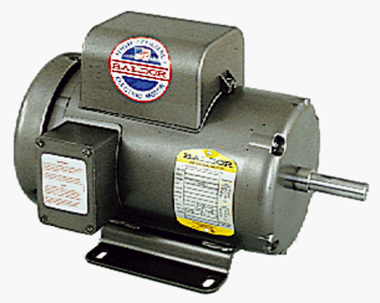
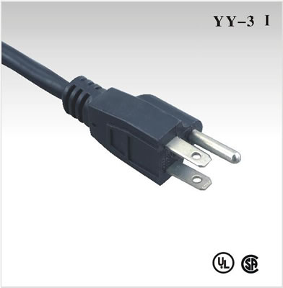
Implementations vs. Interfaces
Notes:
Interfaces make independently designed, heterogeneous systems work together
Lower substitution costs
Lower market entry and exit costs
Spur innovation at more useful levels (e.g. Where interoperability isn't threatened)

Slide 10
Would you rather own a patent on...?
If you control an interface,
you can exclude
ALL possible implementations!

Slide 11
Internet Interfaces: A Radical Proposal to Improve Interoperability
If your protocol is designed to be carried over the Internet...
    ...it can be freely reverse-engineered
    ...it can't be protected by patents
    ...and this includes data formats and their encoding
Notes:
Open Interfaces are critical to the industry- to all industries.
The benefits are obvious – but they are all systems focused.
Things only need interface standards when they're going to be part of something bigger, more complex, more interdependant.
They establish boundary layer raquirements – allowing innovation inside the boundaries.
Finally, if impelmented correctly, they make business people feel less threatened

Slide 12
Interoperability Is ...
.... the ability of a computer program to communicate and exchange information with other computer programs and mutually to use the information which has been exchanged. This includes the ability to use, convert, or exchange file formats, protocols, schemas, interface information or conventions, so as to permit the computer program to work with other computer programs and users in all the ways in which they are intended to function.
Notes:
Last speaking point on this slide will be about the complex intra-licensing among the players and mess of patents ensures that new players can't enter, and flexibility and innovation are lost. Consumers aren't going to be able to choose a product or service they want; rather, they're aligning with a company's particular business model and locked into their partnerships.
.

Slide 13
Interoperability Hot Spots
EInvoicing
Egovernment
Digital Rights Management
Data formats
    Medical imaging, business data
Document formats
OpenDocument Format
Notes:
So Denmark has already addressed einvoicing with UBL – trumpet that as a win, and figure out how you can keep the momentum going
We've heard a lot of discussion about ODF/office documents today and the value of ODF – formalize this campaign
Denmark is in the middle of gov't reform and consolidation– perfect timing for egov't

Slide 14
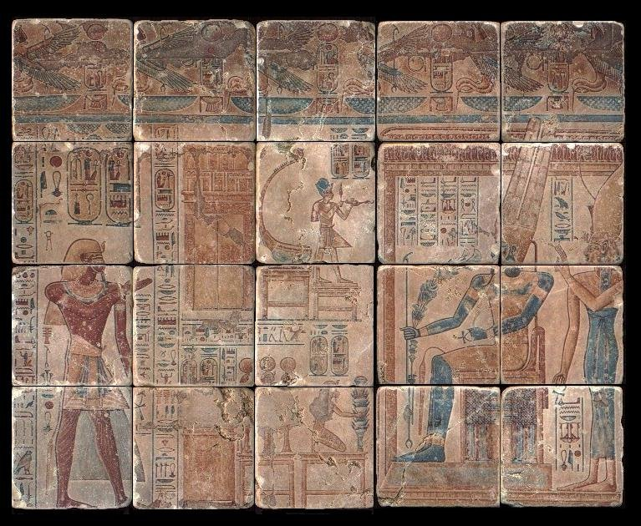
Two Views: A Well Preserved Record
Archiving at its best, with graphics and text, magnificent in its beauty
Notes:
So Denmark has already addressed einvoicing with UBL – trumpet that as a win, and figure out how you can keep the momentum going
We've heard a lot of discussion about ODF/office documents today and the value of ODF – formalize this campaign
Denmark is in the middle of gov't reform and consolidation– perfect timing for egov't

Slide 15
Two Views: A Well Preserved Record
Archiving at its worst, with graphics and text that could not be read and understood for centuries because the key to its content was irretrievable
Problem is the interface, not the implementation....
Notes:
So Denmark has already addressed einvoicing with UBL – trumpet that as a win, and figure out how you can keep the momentum going
We've heard a lot of discussion about ODF/office documents today and the value of ODF – formalize this campaign
Denmark is in the middle of gov't reform and consolidation– perfect timing for egov't

Slide 16
To Consider
It is impossible to predict the future.
Empires crumble, cults merge and disassemble, economies collapse or emerge, companies die.
In just a few years, applications have disappeared (remember WordStar?!) with no trace and with no hope of recovering the documents written with them.
The content is there, but the keys are lost...
Notes:
So Denmark has already addressed einvoicing with UBL – trumpet that as a win, and figure out how you can keep the momentum going
We've heard a lot of discussion about ODF/office documents today and the value of ODF – formalize this campaign
Denmark is in the middle of gov't reform and consolidation– perfect timing for egov't

Slide 17
So What is « Open »?
Characteristics of the standard itself
    Permissions about its use
    Without proprietary extensions
    Without application or platform dependencies
    Multiple competing implementations under different implementation licensing models
Notes:
So Denmark has already addressed einvoicing with UBL – trumpet that as a win, and figure out how you can keep the momentum going
We've heard a lot of discussion about ODF/office documents today and the value of ODF – formalize this campaign
Denmark is in the middle of gov't reform and consolidation– perfect timing for egov't

Slide 18
So What is « Open »?
Characteristics of its creation and management
    Developed by an open community
    Fully documented and publicly available
    Affirmed and maintained by a “participatory” standards body
Notes:
So Denmark has already addressed einvoicing with UBL – trumpet that as a win, and figure out how you can keep the momentum going
We've heard a lot of discussion about ODF/office documents today and the value of ODF – formalize this campaign
Denmark is in the middle of gov't reform and consolidation– perfect timing for egov't

Slide 19
«Open» in Policy and Procurement*
1. Open standards should be defined in terms of a desired economic effect: supporting full competition in the market for suppliers of a technology and related products and services, even when a natural monopoly arises in the technology itself.
2. Open standards for software markets should be defined in order to be compatible with open source licenses, to achieve this economic effect
  * “An Economic Basis for Open Standards” Rishab A. Ghosh, December 2005. Published by the Sixth Framework Programme of the European Union, managed by the eGovernment Unit of the European Commission's DG Information Society.
Notes:
So Denmark has already addressed einvoicing with UBL – trumpet that as a win, and figure out how you can keep the momentum going
We've heard a lot of discussion about ODF/office documents today and the value of ODF – formalize this campaign
Denmark is in the middle of gov't reform and consolidation– perfect timing for egov't

Slide 20
«Open» in Policy and Procurement*
3. Compatibility with proprietary technologies should be explicitly excluded from public procurement criteria and replaced by interoperability with products from multiple vendors;
4. Open standards should be mandatory for eGovernment services and preferred for all other public procurement of software and software services.
  * “An Economic Basis for Open Standards” Rishab A. Ghosh, December 2005. Published by the Sixth Framework Programme of the European Union, managed by the eGovernment Unit of the European Commission's DG Information Society.
Notes:
So Denmark has already addressed einvoicing with UBL – trumpet that as a win, and figure out how you can keep the momentum going
We've heard a lot of discussion about ODF/office documents today and the value of ODF – formalize this campaign
Denmark is in the middle of gov't reform and consolidation– perfect timing for egov't

Slide 21
In Closing
How can/should a massively connected world work with efficiency and stability?
    Systems interoperabilty is not “Mission Impossible”
    Public policymakers have a duty to address this issue
Suggest a combination of:
    Being clear about what constitues open and interoperable
    Methodically address interoperability “Hot Spots”
    Tie to programs and procurement
    Protect interoperability
Notes:
It's all about systems as we enter the partiption age.
Things must interwork; inclusiveness and cooperation are essentiall.
It requires a good deal of serious thought – and that's why I believe that this conference must succeed in starting the dialogue – in making people and communities and nations realize that cooperation is a much more successful strategy in the long run than competition.

Slide 22
This work is licensed under the Creative Commons Attribution-NonCommercial-NoDerivs 2.5 License. To view a copy of this license, visit http://creativecommons.org/licenses/by-nc-nd/2.5/ or send a letter to Creative Commons, 543 Howard Street, 5th Floor, San Francisco, California, 94105, USA.
Susy Struble
susy@sun.com

