Slide 1

Open source at the PBX Ready for prime time
January 2006
Notes:
Who I am
How many of you have heard of YATE? OpenPBX? Freeswitch, OPAL, Woomera? SipX? Bayone?
Asterisk is clearly where it is at.
We are a hardware supplier to the open source (and in fact also the closed source ) community, and we have no particular biases towards any projects
Asterisk and zaptel: Jim Dixon
Asterisk and closed PBXs. “The system doesn’t do that.”
Fear and trembling

Slide 2
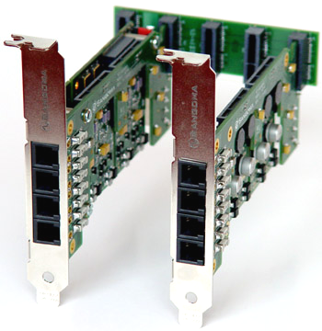
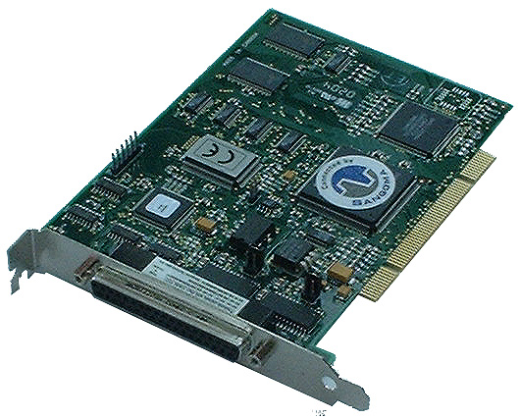
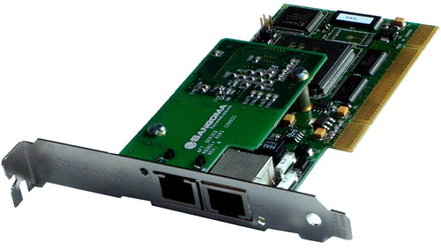
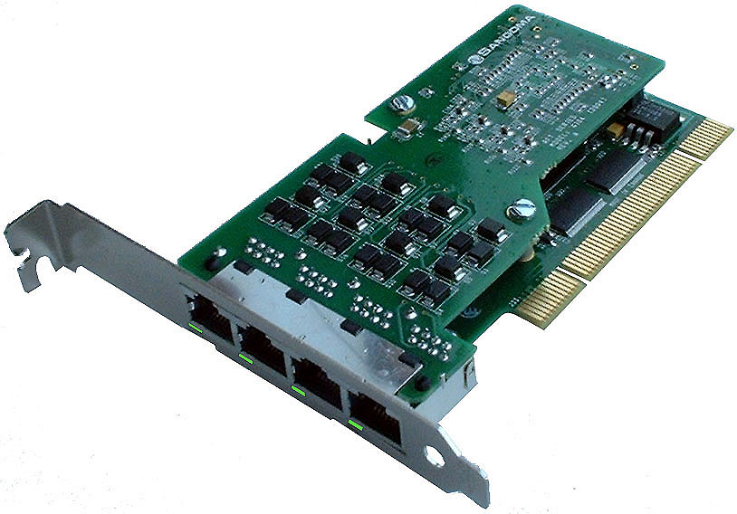
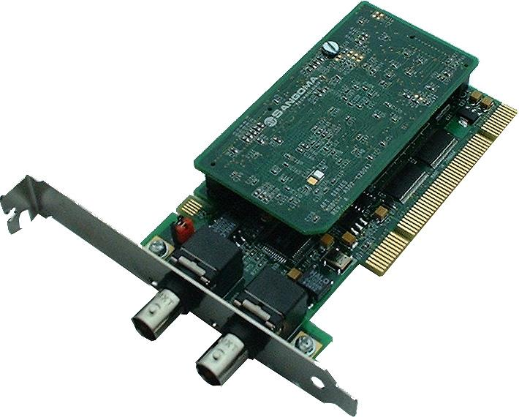
Sangoma connects PCs to Voice and Data Networks

Slide 3
Current Soft PBX structures
Telephony projects are complex, involving large disparate pieces of code and hardware interfaces
Tightly bound modules all developed as a unit by a broadly expert development team.
For licensing reasons, only employees of the organizations concerned, whether paid or unpaid, can work on the projects.
It is very difficult for commercial software to run on these projects
Typical of Asterisk™ and Yate™
Notes:
By broadly expert, I mean that the team does everything.
An employee is someone who works for the good of his employer. If you want to submit a patch you Yate, you have to donate the change to the owners before they will accept it. Some people, who do not mind GPLing their code, do not like giving away the fruits of their efforts to others.
The world does not only consist of open source projects: People have to make a living, and some of them do it by writing and selling software. But it is hard for someone with a neat closed source ap to integrate it with a system that is this tightly controlled. It is the old binary device driver problem of Linux that was eventually solved by simply ignoring it. Ignoring putative violations is not an option in this case.
This kind of thing is quite detrimental to the community, because you end up with all sorts of add-ons and patches like bristuff for ISDN or unicall faxing and signaling. As time goes on these patches will proliferate.

Slide 4
A move to “something else”: The Linux model
Why is Linux so successful?
Because although GPL, Linux has allowed contributions from everyone
All applications have been decreed to be “non-derivative” works
Even closed source kernel modules are “allowed”, or at least tacitly accepted
The result is an Open Source project that can grow organically, and one on which money can be made.
Notes:
The criterion for acceptance in the kernel is merit and usefulness. Each contributor retains the rights to his intellectual property, if he wants it.
An example is the zebra project: Open drivers that have been commercialized.

Slide 5
A move to “something else”: The Linux model
This is started as a response to a business need:
Providing a carrier-grade SS7 interface to Asterisk and others.
But it has implications far beyond the bounds of the project itself
It is a framework for organic change.
Perforce we have started at the most difficult end: The PSTN interface.
Other interfaces are much easier.
Notes:
Why is the PSTN interface hard? Because in a VoIP/PSTN system only the PSTN data is not already packetized and moving through the system over sockets and IP. The PSTN voice is not naturally packetized and even the signaling is not naturally socket based.
SS7 is very complicated, implementation specific and expensive to certify. It is something best supported commercially. While there are a few open ss7 projects on the go, at this time we have to use closed source.

Slide 6
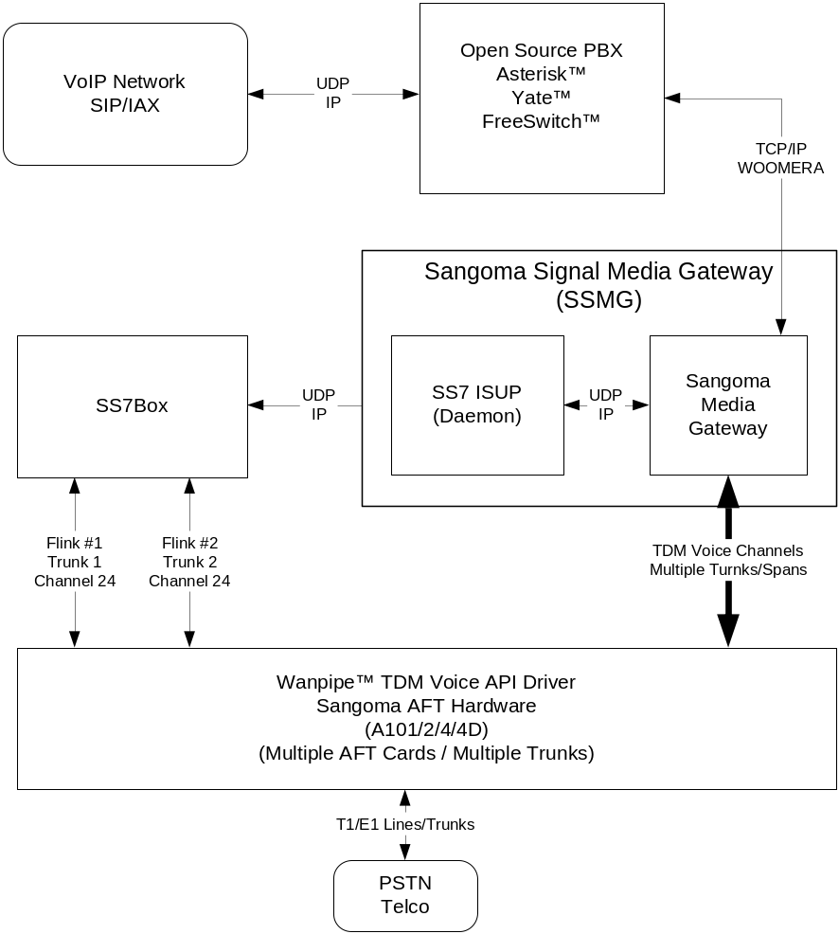
SS7 Box implementation with Woomera
SS7 Box
SS7 ISUP
(Daemon)
Raw socket connections
Notes:
Woomera is a channel design by Craig Southern of OpenH.323 fame. It is a nice signaling and traffic transport mechanism for our purposes because interfaces have been created to softPBX systems like Asterisk and Yate. It is a socket interface so it isolates code for purposes of the GPL.
Woomera has been around as a concept for a while, but I think this is the first practical application. At the end of this project it should have some of its wrinkles taken out.
In this scenario we have SS7Box which is very much a closed source application by Michael Mueller. The ss7Box module communicates via udp with the ss7ISUP daemon, also closed source. The Sangoma blocks are open source. The package connects to Asterisk via woomera sockets.
This arrangement replaces zaptel and libpri.
It is currently running in a number of locations.

Slide 7
PRI implementation with Woomera
PRI
Stack
PRI HDLC Frames

Slide 8
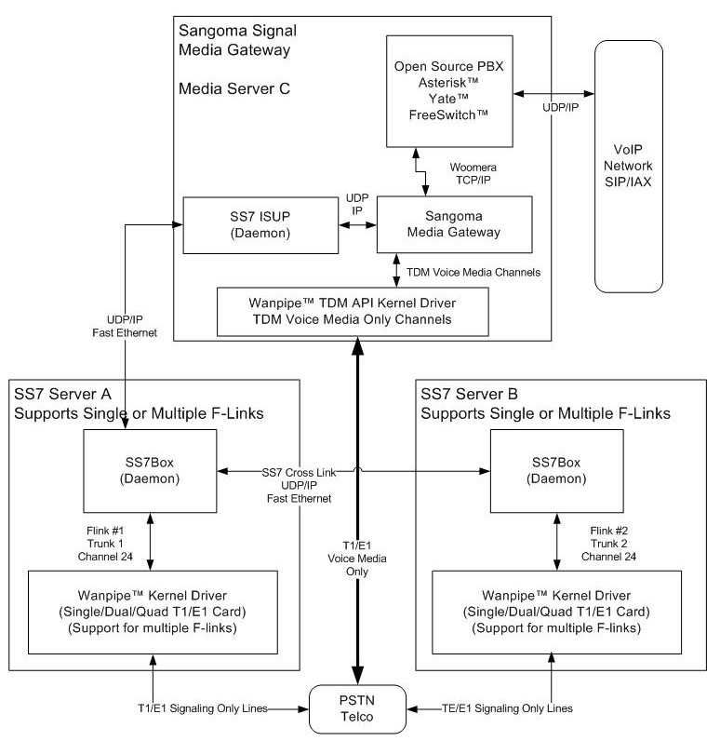
Redundant SS7 Box implementation
Notes:
This rather complicated diagram shows some other possibilities of the socket architecture. In this situation we have 2 redundant ss7boxes interconnected with fast ethernet. They both do ss7 signaling only on one or more T1 channels. Voice channels only go straight to the PC at the top of the diagram. Because the traffic ss7 control traffic is routed over ethernet, the ss7 servers can be physically separate from the voice hardware.

Slide 9
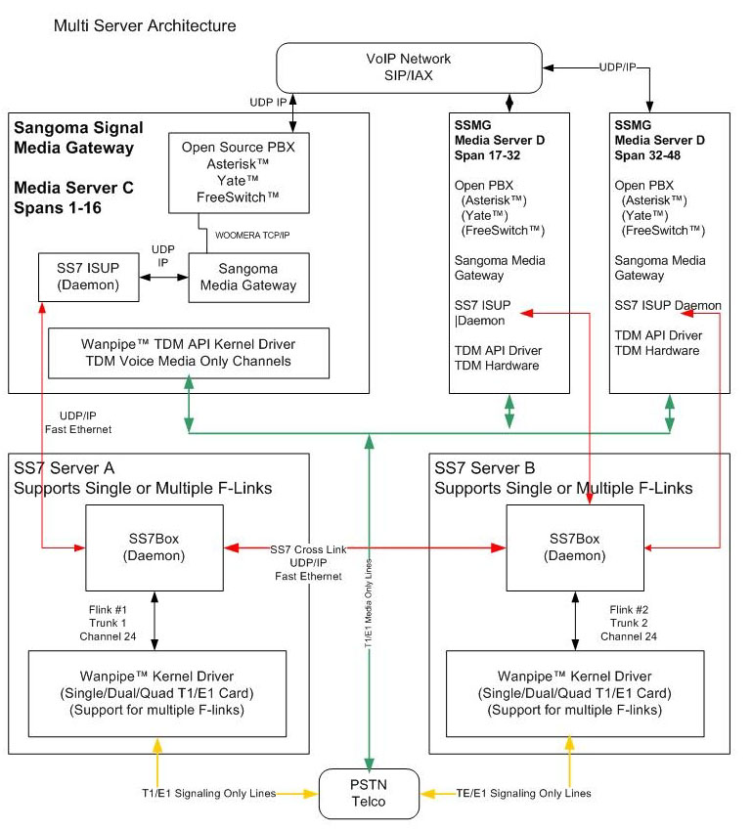
Multiple voice server with SS7
Notes:
To make proper use of SS7 you need to support many DS0 links, maybe hundreds. Each SSMG may be limited to, say 28e T1s, but here you can have many SSMGs, all controlled by a singe pair of redundant SS7Box servers.

Slide 10
Extending the model
In the same way as we have built an SS7 gateway for Asterisk™ and others, it is possible to build interfaces for other applications like H.323 or CDR, SIP.
Also services like FAX, modems, signaling protocols (MFC/R2), BRI support
Question: Is Pingtel’s SIPx is a fuller implementation of SIP than the one in Asterisk™?
If so, shouldn’t we all be using it? Why should we have so many different open source SIP implementations?
Notes:
Asterisk has its own SIP implementation, Yate has its own as does SIPx, OPAL

Slide 11
Future of Open Source Telephony
No need to “rewrite from the ground up”
Use existing projects for the bits that they do well and just add new functions organically
If there is a better implementation, plug it in
Some of the PBX projects are easier to work with than others, but they can all be made part of this model.
The Freeswitch Modular Media Switching Software Library is designed from the ground up with the idea of being able to plug in applications and modules.

Slide 12

Thank you for coming and contributing to this conference
Questions?

