Slide 1
Linux Virtualization
  Kir Kolyshkin <kir@openvz.org>
  OpenVZ project manager

Slide 2
What is virtualization?
Virtualization is a technique for deploying technologies. Virtualization creates a level of indirection or an abstraction layer between a physical object and the managing or using application.
http://www.aarohi.net/info/glossary.html
Virtualization is a framework or methodology of dividing the resources of a computer into multiple execution environments...
http://www.kernelthread.com/publications/virtualization/
A key benefit of the virtualization is the ability to run multiple operating systems on a single physical server and share the underlying hardware resources – known as partitioning.
http://www.vmware.com/pdf/virtualization.pdf

Slide 3
Ways to Virtualize
Hardware Emulation
Para-Virtualization
Virtualization on the OS level
Multi-server virtualization
Notes:
multi-server virtualization is actually not about virtualization; it's rather more about grid and clustering, so I'm not going to cover that.

Slide 4



Hardware Emulation
a.k.a. VM (Virtual Machine)
  VMware
  QEmu
  Bochs
Pros:
Can run arbitrary OS, unmodified
Cons:
Low density/scalability
Slow/complex management
Low performance
Notes:
Low manageability: many os to manage, must login to each, mass management is equally difficult to multiple physical.
Low performance is/will be mitigated by Intel's VT (aka Vanderpool) and AMD's Pacifica, so it's not really an issue.
After all, emulation approach looks strange: why do we run OS on top of another OS? OS is designed to be run on hardware, not something virtual.

Slide 5


Para-virtualization
Xen
UML
(User Mode Linux)
Multiple (modified) OSs run under a hypervisor (a.k.a. Virtual Machine Monitor), which shares the hardware resources between guests.
Pros:
Better performance
Cons:
Needs modified guest OS
Static resource allocation, bad scalability, bad manageability

Slide 6




OS Level Virtualization
OpenVZ
FreeBSD jails
Linux-VServer
Solaris Zones
(OS == kernel)
Most applications running on a server can easily share a machine with others, if they could be isolated and secured. OS Virtualization provides the required isolation and security to run multiple applications or copies of the same OS on the same server.
Pros:
Native performance
Dynamic resource allocation, best scalability
Cons:
Single (same) kernel per physical server

Slide 7
OSs evolution
Multitask
many processes

Slide 8
OSs evolution
Multitask
many processes
Multiuser
many users

Slide 9
OSs evolution
Multitask
many processes
Multiuser
many users
Multiple execution environments
many Virtual Private Servers
(VPSs, containers, guests, partitions...)
Notes:
This is a natural step in evolution of the Operating Systems, and Linux is the first one.
Virtualization is really needed by everyone, and will be a part of any OS kernel.

Slide 10
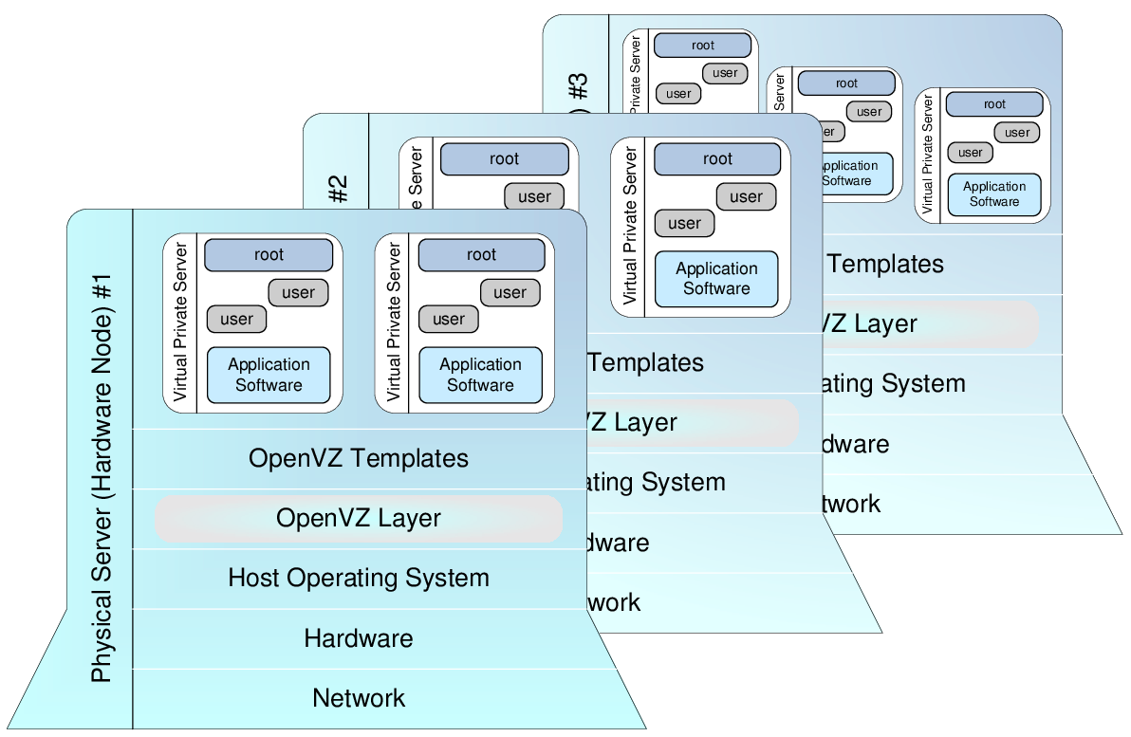
OpenVZ design approach
Notes:
It was first throughoutly thought about, then designed (in 1999) and implemented as per this design.

Slide 11
OpenVZ: components
Kernel
  Isolation
  Virtualization
  Resource Management
Tools
  vzctl: Virtual Private Server (VPS) control utility
  vzpkg: VPS software package management
Templates
  precreated VPS images for fast VPS creation

Slide 12
Kernel: Virtualization & Isolation
Each VPS has its own
Files
System libraries, applications, virtualized /proc and /sys, virtualized locks etc.
Process tree
Featuring virtualized PIDs, so that the init PID is 1
Network
Virtual network device, its own IP addresses, set of netfilter and routing rules
Devices
If needed, any VPS can be granted access to real devices like network interfaces, serial ports, disk partitions, etc.
IPC objects
shared memory, semaphores, messages
…

Slide 13
Kernel: Resource Management
Managed resource sharing and limiting.
User Beancounters is a set of per-VPS resource counters, limits, and guarantees
(kernel memory, network buffers, phys pages, etc.)
Fair CPU scheduler (SFQ with shares and hard limits)
Two-level disk quota (first-level: per-VPS quota; second-level: ordinary user/group quota inside a VPS)
Resource management is what makes OpenVZ different from other technologies.
Notes:
Resource management is a very important and very complex thing.

Slide 14
Tools: VPS control
  # vzctl create 101 --ostemplate fedora-core-4
  # vzctl set 101 --ipadd 192.168.4.45 --save
  # vzctl start 101
  # vzctl exec 101 ps ax
  PID TTY STAT TIME COMMAND
  1 ? Ss 0:00 init
  11830 ? Ss 0:00 syslogd -m 0
  11897 ? Ss 0:00 /usr/sbin/sshd
  11943 ? Ss 0:00 xinetd -stayalive -pidfile ...
  12218 ? Ss 0:00 sendmail: accepting connections
  12265 ? Ss 0:00 sendmail: Queue runner@01:00:00
  13362 ? Ss 0:00 /usr/sbin/httpd
  13363 ? S 0:00 \_ /usr/sbin/httpd
  ..............................................
  13373 ? S 0:00 \_ /usr/sbin/httpd
  6416 ? Rs 0:00 ps axf
  # vzctl enter 101
  bash# logout
  # vzctl stop 101
  # vzctl destroy 101
Notes:
I will actually show a two-minute live demo in a green-on-black terminal instead of this page.

Slide 15
Tools: Templates
  # vzpkgls
  fedora-core-4-i386-default
  centos-x86_64-minimal
  # vzpkgcache
  (creates templates from metadata/updates existing templates)
  # vzyum 101 install gcc
  (installs gcc and its deps to VPS 101)

Slide 16
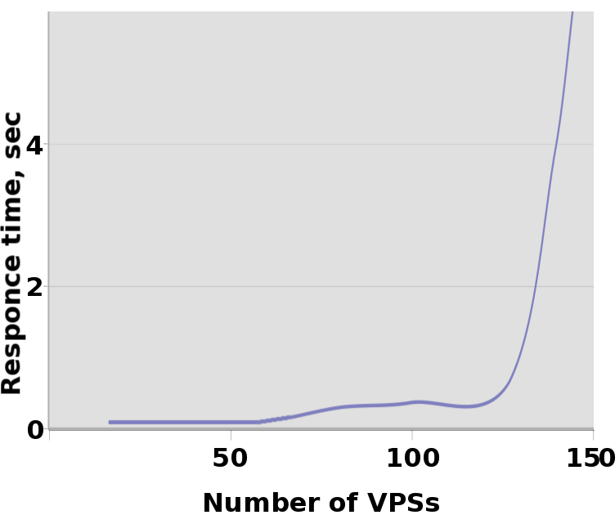
Scalability
  768 (¾) MB RAM - up to 120 VPSs
  2GB RAM - up to 320 VPSs
Notes:
Test used is «dynamic latency» test. Apaches were serving dynamically generated web pages (a simple CGI Perl script is run for each request).

Slide 17
Users Feedback
Hello all, just downloaded and installed OpenVZ, and i must say its a big improvement over other VPS systems that i have tested IMHO.
http://forum.openvz.org/index.php?t=msg&goto=646#msg_646
I use virtuozzo in my day job and openvz is very much the same. Just no windows GUI which I hate using anyway! Virtuozzo and openvz are wonderful - I don't know why more people aren't using them. I hear a lot of hype for xen and usermode but virtuozzo/openvz is so great for many common needs. I'm very happy to be using openvz - very good for my side projects that I can't afford real virtuozzo for.
http://forum.openvz.org/index.php?t=msg&goto=650#msg_650
Last week when we were in limbo about what to do, it was decided to try out XEN Virtualization. From what is written in the press the Xen system has alot of promise, <…> but was far too complicated to get working in our configuration. OpenVZ was the only virtual server system that was simple to install and get working.
http://forum.openvz.org/index.php?t=msg&goto=568#msg_568

Slide 18
Usage Scenarios
Server Consolidation
Hosting
Development and Testing
Security
Educational

Slide 19
Server Consolidation
A bunch of servers:
harder to manage
upgrade is a pain
eats up rack space
high electricity bills

Slide 20
Server Consolidation
A bunch of servers:
harder to manage
upgrade is a pain
eats up rack space
high electricity bills
A bunch of VPSs:
uniform management
easily upgradeable and scalable
fast migration

Slide 21
Hosting
Web server serving hundreds of virtual hosts
Users see each other processes etc
DoS attacks
Unable to change/upgrade hardware

Slide 22
Hosting
Web server serving hundreds of virtual hosts
Users see each other processes etc
DoS attacks
Unable to change/upgrade hardware
Users are isolated from each other
VPS is like a real server, just cheap
Much easier to admin

Slide 23
Development & Testing
A lot of hardware
Zoo: many different Linux distros
Frequent reinstalls take much time

Slide 24
Development & Testing
A lot of hardware
Zoo: many different Linux distros
Frequent reinstalls take much time
Fast provisioning
Different distros can co-exist on one box
Cloning, snapshots, rollbacks
VPS is a sandbox – work and play, no fear

Slide 25

Security
Several network services are running
One of them has a hole
Cracker gets through
Whoops...”all your base are belong to us”

Slide 26
Security
Several network services are running
One of them has a hole
Cracker gets through
Whoops...”all your base are belong to us”
Put each service into a separate VPS
OpenVZ creates walls between applications
Added benefit: dynamic resource management

Slide 27
Educational
No root access
Frequent reinstalls
DoS attacks

Slide 28
Educational
No root access
Frequent reinstalls
DoS attacks
Everybody and his dog can have a root access
Different Linux distros
No need for a lot of hardware

Slide 29
Future plans
Deliver checkpointing/restoring
and Zero DownTime Migration
Custom kernels for SuSE, RHEL, ...
Inject into Linux distros: Novell, Red Hat
Merge into mainstream kernel
This is just a matter of months.
ZDTM will work on a non-shared storage.

Slide 30
OpenVZ Project Role
Freely distribute and offer support to make virtualization technology accessible
Serve the needs of the community developers, testers, documentation experts, and other technology enthusiasts who wish to participate in and accelerate the technology development process
We hope many, many users will benefit from OpenVZ software technology, which helps increase server utilization
The OpenVZ website is an open door to operating system virtualization software built on Linux

Slide 31
Your role
Use OpenVZ
Contribute to OpenVZ, be a part of community:
  Programmer
    fixes
    enhancements
    new functionality
  Non-programmer
    bug reports
    documentation, how-tos
    answer support questions

Slide 32
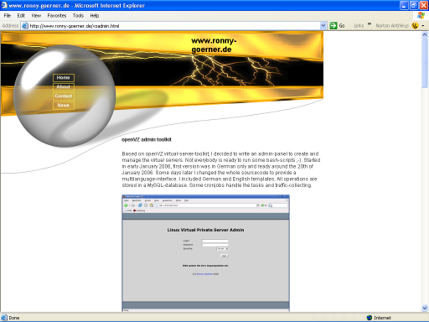
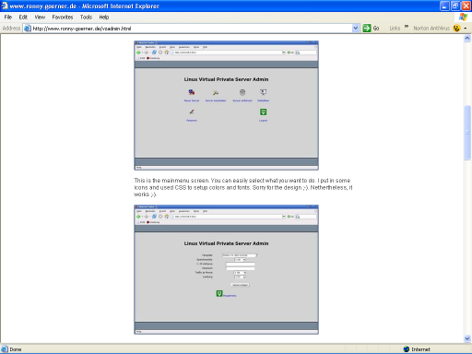
One example
Web Control Panel for OpenVZ

Slide 33
Project Links
Main site: http://openvz.org/
Downloads: http://download.openvz.org/
Forum: http://forum.openvz.org/
Bug Tracking: http://bugzilla.openvz.org/
Blog: http://blog.openvz.org/
Mailing lists:
  users@openvz.org
  devel@openvz.org
  announce@openvz.org

