Slide 1
Selling Free Software
Presented by
Tom Callaway
Fedora Engineering Manager, Red Hat
<tcallawa@redhat.com>
The contents of this presentation (except for the Fedora Trademarks) are available
under the terms of the Creative Commons BY-SA 3.0 Unported License, unless otherwise indicated.

Slide 2
There are only two differences between a car salesman and a software salesman:
1) The car salesman knows how to drive a car.
2) The car salesman knows when he's lying to you.
-- Unknown

Slide 3
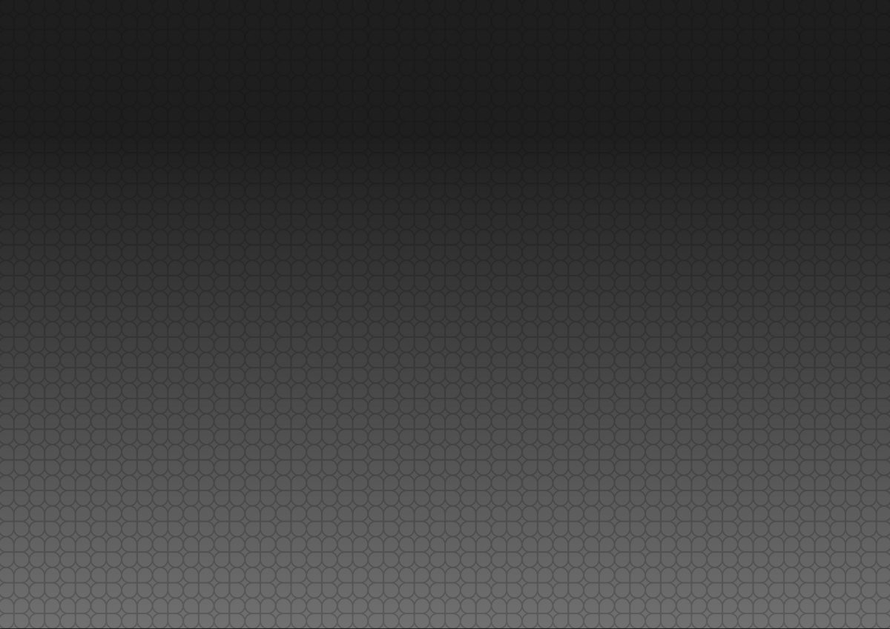
Today's Topics
My Backstory (summarized)
Uncomfortable Truths
How I Sold Free Software
(or How I Stopped Worrying and Learned to Love the Source)
Selling the Advantages of Freedom

Slide 4
My Backstory (summarized)

Slide 5

My Backstory (summarized)
I have no degree in Business or Sales. My college education was in Engineering and Computer Science.
In 2001, I was working for Red Hat Support, which was physically located next to Red Hat Inside Sales.
Red Hat Inside Sales would come over and ask us questions about the software. I answered a lot of them. I jumped on a few customer calls. They offered me a job.

Slide 6
My Backstory (summarized)
I sold for Red Hat Sales (Inside, then Outside) until 2007, when I moved into Engineering.
In 2005 and 2006, I was awarded Sales Engineer of the Year for Red Hat (based on revenue)

Slide 7
Uncomfortable Truths

Slide 8
Life Isn't Fair (and other cliches)
Selling isn't fair. Sometimes, it doesn't matter how good the code is, how smart you are, how much it costs, or how much you're loved, you won't close the deal.
People aren't logical. They often aren't reasonable. Sometimes, they're not even sane.

Slide 9

They Don't Get It
The average customer doesn't understand anything about Free Software, except that it is “Free”.
That's okay. It isn't what they do for a living.
  Unless they're in IT. And even then, they may not get it.

Slide 10
The Three Salesmen
The Liar – Will say anything to close a sale. Does it run on PPC? Of course. Will it make toast? Of course. Bugs? Never.
The Idiot – Cars, shoes, software, goats, whatever. It's just another sale. Doesn't know how it works, just knows it has a price.
The Thief – Ethics are just the rules that keep you from closing sales. Only suckers play fair.

Slide 11
How I Sold Free Software
(or How I Stopped Worrying and Learned to Love the Source)

Slide 12

Don't Evangelize
Honey badger Customer doesn't give a %#&@ about changing the world.
  They've got 99 Problems, but DRM ain't one.
For better or worse, “Open Source” has better brand recognition than “Free Software”.
  In the worse category, everyone and everything will claim to be “Open Source”, or try to confuse it “Open Standards”
  “Free” just takes you into a rathole on cost.
Most customers won't know that Open Source is different from Free Software. Won't care either.

Slide 13
Be Honest
Be Honest with yourself. What software do I know? And how well do I know it? Don't claim to know what you don't know. Don't guess.
  This means you need to spend a lot of time using and learning.
Be Honest with your customer. They aren't expecting it from a sales team. Even if it means you're not going to close the immediate sale.

Slide 14
Understand the world
Get familiar with as much other software as possible. Start with everything that touches the software you're trying to sell, and move out.
Know the most about the items that are closest to yours and the items that compete with yours.
Ask a LOT of questions. Don't assume anything. Take notes.
Listen. Let the customer talk. Even when they're wrong. Listen more than you speak.

Slide 15

The Lock-In Model
The traditional software sale is the lock-in model
  Once a customer, always a customer, because they can't escape, not because they don't want to.
FOSS makes it easy to escape, so don't try to lock your customers in.
  This resonates with every customer I ever talked to.
Compete on value

Slide 16
Solve Their Problem(s)
Traditional Software Sale: Assume that customer needs your software and get them to buy it, even if they don't really need it.
Solution Selling
  What problem does the customer have?
  How does my software (or combinations of my software with other software/hardware) solve the problem?
  Sell the solution.

Slide 17
Find Smart Customers
Proprietary Software thrives on the dumb customers. Find smart ones.
Smart Customers allow you to be in a partnership, as opposed to a vendor/consumer relationship

Slide 18
Risk Vs. Reward
This is an oversimplification, but it generally works.
What are the risks of this solution?
  Be candid with the customer, but be tactful.
  Some customers don't want to be the first to try something new... what is their competition doing?
What are the rewards of this solution?
  Some customers thrive on taking risks when there are big rewards as a result.
Knowing your customer will help you know where they fall on the risk/reward ratio

Slide 19
The Binary Files
You cannot sell the binary files. If you attempt to do this, you will fail.
  Why? Because they could just download them from the website.
This means you're selling everything except the binary files.
  Updates
  Support
  A partnership for success
Some people sell docs, but I've never believed in that.

Slide 20
Selling the Advantages of Freedom

Slide 21
How is FOSS different?
Proprietary Software Vendor is the only one who can support their SW. Not true for FOSS.
  FOSS forces the vendor to compete with others. Customer benefits from this.
FOSS usually moves faster than proprietary
  This can be good or bad for a customer.
FOSS is transparent
  See how it works rather than guess

Slide 22
How is FOSS the same?
Customers want support
  This means different things to different customers. Don't assume. Ask what they currently have on existing projects of similar scope and risk.
Customers expect reliability
  Again, this depends on the scope and risk, but very few serious uses of SW fall into the “it can break at random” category.
Customers want someone to blame

Slide 23
What Doesn't Work
“Since you have the source, you can hack on it to fix your own bugs!”
  This is true, but most customers simply don't want to do this, especially if the SW is complicated or in a critical space.
“You can contribute changes back to us!”
  Very few customers do this. They're not software developers, they're users. Demanding users, yes, but not coders.

Slide 24
Find the hidden FOSS
Have the customer walk you through their entire IT infrastructure (physically if possible)
FIND THE FOSS!
  It's there already, they may not know it. Know where to look for it.
  You may need this later to counter the “we don't use Open Source today” argument.

Slide 25
Prove it
If possible, look for problems where a FOSS solution is a “drop-in replacement” to a problematic area.
  Also good places to look: solutions with known workloads and quantified (measured) results
Offer to do “Proof of Concept” work either at a discount or for free.
  It means more to see it kicking butt in their env.
  Look for skunkworks projects, polish them and bring them into the light

Slide 26
Relationship Building
Sell transparently
  Customers will be pleasantly surprised
  Even if it means you have to admit you don't have a good solution to any of their current problems
Smart sales (IMHO a necessity for FOSS) is a long game, not a quick fix.
  Customers and industries have LONG memories.

Slide 27
Don't oversell
You want the customer to use free software.
  Even as a user who never contributes, this is a win for the ecosystem.
The quickest way to ensure they never seriously consider it is to oversell at the beginning.
  Know your software, and know its limits. Don't push it or promise things as “coming soon” to get it closed.

Slide 28
Common Responses
“We don't use $0 software.”
  You're not selling the bits, you're selling a solution, and that makes the costs less than proprietary solutions (usually), but it isn't $0.
“Open Source is unreliable.”
  Prove it to them, with their problem and their env.
  If possible, bring in their preferred hardware partner. They're usually eager to help, b/c it means they will close more HW sales in the solution. Also shows that their existing partner trusts you.

Slide 29
Win (and Lose) Gracefully
You'll get beat. You'll have shown them how much better it works, at a fraction of the cost, with risk minimized, and they'll buy Oracle anyways.
  Be polite, and keep in touch. Sometimes they come around. Don't be bitter or angry, just move on.
When you win, remember that you're only a reorg away from a loss. Stay involved, make sure they're happy and look for new problems to solve.

Slide 30

Be Willing To Walk Away
Look for red flags
  Is their existing infrastructure a mess?
  Is the environment toxic?
  Is the customer a major reference for your competition?
    They almost never jump ship when they are.
  Are they being unreasonable?
  Do they only care about cost?
WALK. Be graceful about it, but move on.

Slide 31
Questions?
Contact:
tcallawa@redhat.com
License statement goes here. See https://fedoraproject.org/wiki/Licensing#Content_Licenses for acceptable licenses.

