Slide 1
Getting Started with Git
Ron Toland
SCALE 2012

Slide 2
How is Git Different?

Slide 3
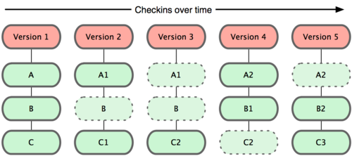
Snapshots, Not Deltas

Slide 4
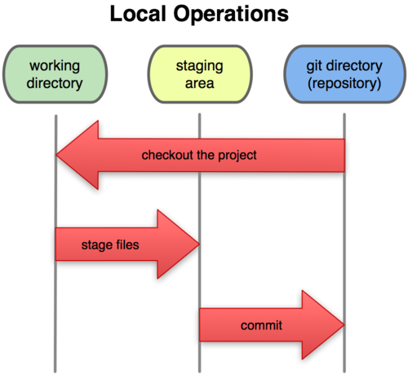
Modify, Stage, Commit, Push

Slide 5
Think Globally, Commit Locally

Slide 6
You Can't Push That Here.

Slide 7
Workflow Demo

Slide 8
Managing All Those Branches

Slide 9
The Trinity: Master, Staging, Production

Slide 10
Keep Production Locked Down

Slide 11
Tag 'Em and Bag 'Em

Slide 12
Share the Repo

Slide 13
Best Practices

Slide 14
Make Small Commits

Slide 15
Branch Early, Branch Often

Slide 16
Use the Status, Luke

Slide 17
All of git's a stage...

Slide 18
Please, Don't Ever Do These Things (Ever)

Slide 19
Don't Switch Branches with Uncommitted Changes!

Slide 20
Don't git pull With Uncommitted Changes!

Slide 21
Don't Do a Non-Specific Git Push!

Slide 22
Don't Develop in Master!

Slide 23
Further Reading
Pro Git by Scott Chacon: http://progit.org/book/
Github: https://github.com/
Git project: http://git-scm.com/

