Slide 1
Giving Linux a Boot
ARM Microprocessors
Schuyler Patton
Tom Rini
01/09/12

Slide 2
Agenda
What you will learn
Overview of the Boot Process
Boot Modes
SPL
U-Boot
Kernel
User Level
Further Reading

Slide 3
What You Will Learn
The elements involved in booting into a Linux Kernel
RBL Stage (ROM Boot Loader)
  Boot ROM Stage (boot mode determination)
  SD, NAND, NOR, USB, Ethernet, Serial ......
SPL Stage (Secondary Program Loader)
  Reads in U-Boot
U-Boot Stage
  Processor initialization
  Read in Linux Kernel
Memory Map of boot process
Kernel Stage - Kernel Initialization
Init process
Memory Map after Linux boots
User login

Slide 4
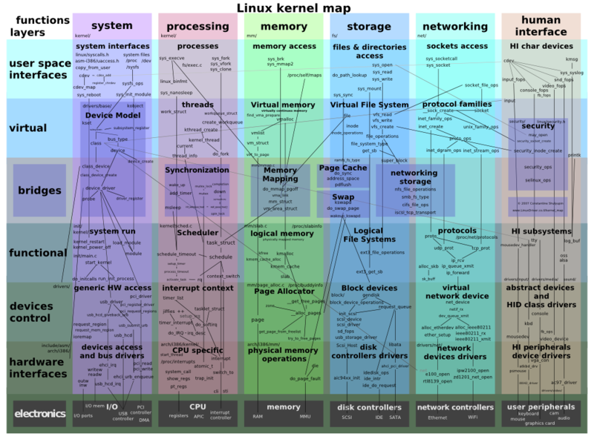
Go from nothing to Linux OS Environment
To this full OS
The different boot stages create the Linux OS “Stack”
Boot process enables the Linux environment of concurrent user applications, management of HW peripherals, common services.
Why are there stages to the boot process????
Starting with bare silicon

Slide 5
Overview of Any Bootstrap Process
Basic components to any processor boot –
Most processors boot through a chained loading method, each step gains functionality.
Processor POR jumps to reset vector in ROM after reset line is released
ROM Code initializes and reads persistent external storage source for bootstrap code into memory (maybe internal or external depends on ROM)
Processor jumps to load point of read in code, from here it’s the role of the bootstrap code to continue to perhaps read in more code to stage the boot process. Or perhaps this bootstrap code is all that is needed to start intended operation.

Slide 6
Why are there Boot Stages?
At POR the internal ROM code in the processor knows nothing about the system it is in. Therefore the processor uses pre-defined methods on where to find the boot code that can be accessed with a minimal standard configuration of external interfaces.
The internal RAM is limited in size and due to that only a portion of the boot process can be read into it. Subsequent stages are enabled from this partial boot from Internal RAM.
Biggest reason why is due to system configurations that can only be defined during the application design process such as memory DDR types and settings.

Slide 7
Linux Boot Process Components
Components of the Linux Boot Process (Stages)
RBL – ROM Boot Loader, Contained in the ROM of the Part, minimal capability to initialize the processor and read in from off chip into internal RAM the SPL.
SPL – Secondary Program Loader, called many different names depending on processor (UBL,Xloader) but is code of a minimal configuration specific to the target board that has the capability to setup the processor to be able to read in the next stage which is U-Boot.
U-boot – Enables most of the specific processor functionality for the target board and end application to configure the part for booting Linux and to load the kernel image from persistent storage.
Kernal image – Final stage of the boot process. Kernel initilization, MMU enable, Device Initilization, User Init process and finally user level applications.

Slide 8
4 Stages of the Boot Process
4 Stages to Boot Process – ROM, SPL, u-boot, Kernel
1 – ROM BL Reads from initialized persistent storage (selected by boot mode) SPL into internal Ram
2 – SPL does additional setup and reads from persistent storage the next stage u-boot into DDR
3 – u-boot continues the processor setup and reads the kernel into DDR
4 – Linux boot and initializes user run time environment
Persistent Storage – Readable by ROM
Processor
MMC
SPL
u-boot
kernel
Root FS
ROM BL
1
This particular scenario is related to the AM37x
Int. RAM
SPL
2
This is discussed later
DDR
U-boot
3
Kernel
4

Slide 9
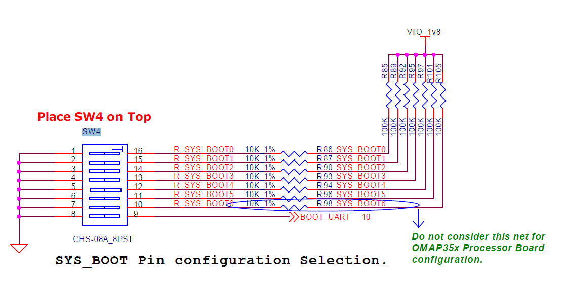
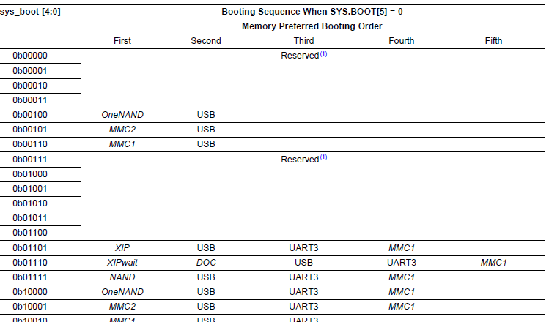
Overview – Processor Boot Modes
Boot Modes in TI perspective is strictly related to hardware and about where to read the next stage in the boot process. This is unrelated to traditional UNIX or Linux runlevels.
Boot Modes supported vary by device so please consult the data sheet. Typical boot modes are NAND, I2C, MMC, SPI, Serial, Ethernet.
Boot mode pins are read and latched once, typically the pins are muxed with another interface such as the video display lines, input on start and then output after that.
Each Processor has an app note on this topic

Slide 10
Overview – Boot Modes
Some processors support Boot Sequences based on the Boot Mode. This allows the ROM code to handle possible failure modes in case the primary selected persistent storage is not available. Please refer to the appropriate Data Sheet and Technical Reference Manual (TRM) for the part.
  AM37x/AM35x/AM387x/AM389x (Sequencing supported, good for sys dev)
  AM18x (Sequencing not supported)

Slide 11
4 Stages of the Linux Boot Process
(stage 1) ROM
(stage 2) UBL/X-loader/U-boot SPL
(stage 3) U-boot
(stage 4) Kernel
Each stage adds functionality.
Boot mode indicates to the ROM BL the order of boot modes to try.
ROM BL may indicate to SPL where it came from.
While SPL should use the same method to find U-Boot, U-Boot is free to do as the user configures. For simplicity here, we assume it also uses that mode.
Processor
Boot Mode
Selection
ROM BL
Int. RAM
Selects which source of SPL
Only used by the ROM BL

Slide 12
Persistent Storage based Boot Modes
Booting from persistent storage
  This is the most typical workflow.
  Exact location and format of each chunk is media and processor specific
    ROM BL sets requirements for how SPL “looks” so it can tell if it's found a programmed device or not.
Persistent Storage – Readable by ROM
Processor
ROM BL
Int. RAM
SPL
NAND
SPL
u-boot
kernel
Root FS
DDR
MMC
U-boot
SPL
u-boot
kernel
Root FS
Kernel
SPI
SPL
u-boot
kernel
Root FS
I2C
SPL
u-boot
kernel
Root FS

Slide 13
Connectivity Based Boot Modes
Booting over Serial Interface
  Typically used for initial programming of persistent storage such as NAND or SPI when other interfaces aren't available or practical.
    After loading an SPL that sets up DDR a flash tool could be loaded for programming NAND, SPI, etc.
  In this case, before the ROM BL will try and initiate a serial download (often X or Y modem based) and if that succeeds, execute what was downloaded.
    SPL continues to read in next stage (u-boot) over the serial interface
    u-boot may also continues to load the kernel and root filesystem over serial
Host Machine connected over serial cable
Processor
Flash Tool
SPL
u-boot
kernel
Root FS
ROM BL
1
Int. RAM
SPL
2
Serial Mode can be used to bring up board initially, albeit turn around time will be long. < 15 minutes for SPL, u-boot, kernel and a 10MB root file system.
DDR
Flash tool
U-boot
Kernel

Slide 14
But where in memory did it go?
Processors define a memory map that says where both internal memory and DDR are mapped to
SPL, U-Boot and the Linux Kernel are all statically linked to start running at specific locations within this map.
  Once running they may relocate themselves elsewhere within DDR (once initialized).
  Different boot modes may require different link addresses.
  For more details about the map for a given processor please refer to the TRM

Slide 15
Overview – Boot Loaders Additional Links
U-boot Home Page
  http://www.denx.de/wiki/U-Boot/
Comparison of Boot Loaders
  http://en.wikipedia.org/wiki/Comparison_of_boot_loaders
Where to go for Support
  U-boot Mailing List
    http://www.denx.de/wiki/U-Boot/Contacts
  TI Forums
    Linux Forum
      http://e2e.ti.com/support/embedded/f/354.aspx
    Sitara Forum
      http://e2e.ti.com/support/dsp/sitara_arm174_microprocessors/default.aspx

Slide 16
U-Boot Overview
Monolithic code image
Runs processor in physical or a single address space
Enables clocking, sets up some of the pin mux settings
Reads in Kernel image (uImage)
Jumps to load address pointed to in uImage header
What are environment variables and how are they used
  Default environment variables and how they are used
Passes Kernel Command Line to Kernel
  ATAGs (Memory, Command Line, etc)
  Flattened Device Trees (FTDs) in the future
Debugging capabilities (just mentioning, not used during boot process)

Slide 17
U-Boot Environment Variables
U-boot example default u-boot environment print out (printenv)
U-Boot > printenv
baudrate=115200
bootargs=console=ttyS2,115200n8 root=/dev/mmcblk0p2 rw rootwait ip=off
bootcmd=if mmc rescan 0; then if fatload mmc 0 0xc0600000 boot.scr; then source 0xc0600000; else fatload mmc 0 0xc0700000 uImage; bootm c0700000; fi; else sf probe 0; sf read 0xc0700000 0x80000 0x220000; bootm 0xc0700000; fi
bootdelay=3
bootfile="uImage"
ethact=DaVinci-EMAC
stderr=serial
stdin=serial
stdout=serial
ver=U-Boot 2010.12 (Jun 23 2011 - 17:40:56)
Example printout shows boot arguments and boot command.
Other u-boot environment definitions telling u-boot what persistent storage to read for the kernel and what parameters that need to be passed to the kernel and where to load in memory. Advance knowledge is that the user has to know the kernel load address and where u-boot is loaded, can use the iminfo command after the uimage is loaded somewhere in memory, besides on top of u-boot

Slide 18
Kernel uImage – What is it?
U-boot partial console output
## Booting kernel from Legacy Image at c0700000 ...
Image Name: Arago/2.6.37-psp03.21.00.04.sdk/
Image Type: ARM Linux Kernel Image (uncompressed)
Data Size: 2317192 Bytes = 2.2 MiB
Load Address: c0008000
Entry Point: c0008000
Verifying Checksum ... OK
Loading Kernel Image ... OK
OK
Starting kernel ...
Uncompressing Linux... done, booting the kernel.
uImage
uImage Header Info
Kernel Image
(Optional
Compression)
uImage is a kernel image “wrapped” with a header that describes among other things load point entry point and whether the kernel is compressed of not.
mkimage utility from u-boot is used to make the kernel uImage during kernel build process
After the “boot the kernel” message appears on the console u-boot is no longer used.

Slide 19
Memory Map of Boot Process (AM180x)
Internal RAM
SPL is loaded into internal RAM
U-Boot is loaded first into DDR
U-Boot then loads the uImage from where directed
U-Boot performs a checksum and then relocates (if required) the Kernel found in the uImage to the load address
U-Boot then jumps to the entry address specified in the uImage header, linux boot starts at this point
Please note the addresses used here are for reference only and do not apply to all devices
0x80000000
SPL
0xC0000000
DDR
0xC0008000
Kernel
0xC0700000
uImage
0xC1080000
u-boot

Slide 20
Kernel Command Line
Need to define a few required items such as console port and where the root filesystem is located. Please note the kernel command line in the box below. The command line is printed out in the first few lines as the kernel boots.
Linux version 2.6.37 (jenkins@sdit-build01) (gcc version 4.3.3 (GCC) ) #2 PREEMPT Tue Jul 5 17:47:10 CDT 2011
CPU: ARM926EJ-S [41069265] revision 5 (ARMv5TEJ), cr=00053177
CPU: VIVT data cache, VIVT instruction cache
Machine: DaVinci DA850/OMAP-L138/AM18x EVM
Memory policy: ECC disabled, Data cache writeback
DaVinci da850/omap-l138/am18x variant 0x1
Built 1 zonelists in Zone order, mobility grouping on. Total pages: 32512
Kernel command line: console=ttyS2,115200n8 root=/dev/mmcblk0p2 rw rootwait ip=off
Optional Command Line
  Specific peripheral initialization

Slide 21
Kernel Command Line NFS example
NFS boot command line (from below)
  console=ttyS2,115200n8
    Where to send console output and take user input, external serial terminal hooks up to this port
  root=/dev/nfs
    What device interface is the root file system mounted on
  nfsroot=128.247.106.224:/home/user/am180x/rootfs
    Tells the kernel what external host has the Root FS, requires setup on external host
  ip=dhcp
    tells kernel method to configure IP addresses and set up the IP routing table. Here the kernel is being to use DHCP
Linux version 2.6.37 (jenkins@sdit-build01) (gcc version 4.3.3 (GCC) ) #2 PREEMPT Tue Jul 5 17:47:10 CDT 2011
CPU: ARM926EJ-S [41069265] revision 5 (ARMv5TEJ), cr=00053177
CPU: VIVT data cache, VIVT instruction cache
Machine: DaVinci DA850/OMAP-L138/AM18x EVM
Memory policy: ECC disabled, Data cache writeback
DaVinci da850/omap-l138/am18x variant 0x1
Built 1 zonelists in Zone order, mobility grouping on. Total pages: 32512
Kernel command line: console=ttyS2,115200n8 root=/dev/nfs rw ip=dhcp nfsroot=128.247.106.224:/home/user/am180x/rootfs
More Info on configuration for NFS can be found here at kernel.org
http://www.kernel.org/doc/Documentation/filesystems/nfs/nfsroot.txt

Slide 22
Kernel Command Line – Additional Links
Summary of Kernel Command Line Parameters from kernel org documentation
  http://www.kernel.org/doc/Documentation/kernel-parameters.txt
Kernel Command Line Documentation from Kernel.Org. Provides a little more depth or background on the parameters
  http://www.kernel.org/pub/linux/kernel/people/gregkh/lkn/lkn_pdf/ch09.pdf

Slide 23
Overview – Kernel Memory Usage
Kernel boot process begins
Kernel initializes MMU and takes over DDR. Overwriting anything previously there such as u-boot and the loaded kernel image.
Look at virtual memory layout printed out by kernel
0xC0000000
DDR
0xC0008000
Kernel
Linux Mem Mgmt
uImage
u-boot

Slide 24
Linux Kernel Start
Performs low level system setup
Initializes the virtual memory used the kernel and applications
Perform Device Initialization, interrupt handler setup, Idle Task and the scheduler
Calls the init task which sets up user space context

Slide 25

Memory Map from User Application Perspective
Linux creates a virtual memory space for each user application as it is loaded. Each User Application loaded sees a map based from a start address of 0x00000000.
User Apps cannot write to physical addresses listed in the data sheet such IO ports, EMIF, or DDR without causing a segmentation fault.
To see how much memory is available in a system type free, this is total space of allowed for executable programs, provided swap space is disabled.
0x00000000
System Memory
0x0775d9e0
Space being used by Kernel in this configuration
0x08000000

Slide 26
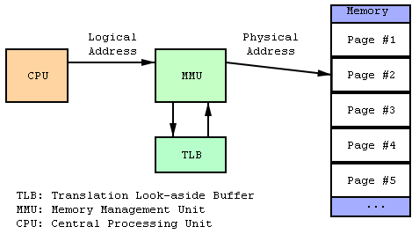
Virtual Memory Map
These are components that make up a virtual memory map system
  CPU/MMU/Memory
All logical address go through an MMU to be mapped to a physical address
This allows run time link and load of an application
Once the processor is running in a virtual mode, the memory map can no longer be considered contiguous
Want to re-iterate the point of not writing/reading physical addresses in the data sheet of the part, this will terminate the application with a segmentation fault.
Please Note this picture was taken from Wikipedia discussion on virtual memory
http://en.wikipedia.org/wiki/File:MMU_principle.png

Slide 27
Linux Virtual Memory (.....Review....)
Linux memory map
Total address range supported by the part is no longer relevant, MMU creates its own memory map
The actual memory on the board is hidden and managed by the OS virtual memory manager.
All apps are compiled to the same starting address
Linux sets up a process for an app so they all load to same address, this is possible with an MMU that sets up a virtual memory map
Every Application sees the same memory map
Once virtual, the memory can no longer be considered contiguous meaning a physical addressed DMA cannot be used.

Slide 28
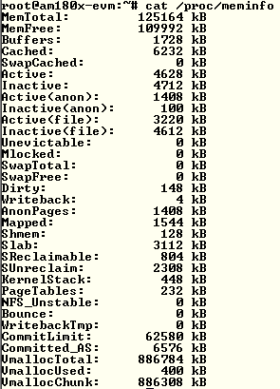
Linux Memory Info Table Dump
Mem Info Table Dump
Board has 128MB on it
Note that the mem total is less than 128M, this difference is where the kernel is stored.
Only usage described here and not location in the virtual memory map
Link that describes the components of meminfo
  http://www.linuxweblog.com/meminfo
Google “meminfo explained”

Slide 29
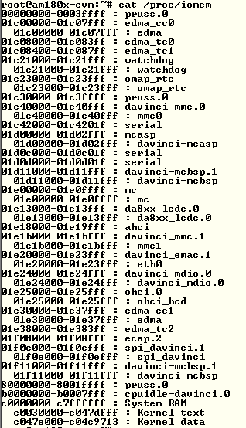
System Physical Memory Map
The physical memory map that has been registered on a platform.
Look at the data sheet for the part and see how these addresses match up.
  AM1808 Example
    Has a serial interface (UART 1) starting at 0x01d0c000
    Has DDR starting at 0xC0000000
    These are peripherals specific to this particular part.
Read this article about how to use this memory interface.
  http://lwn.net/Articles/102232/
Google “iomem linux explained”

Slide 30
Kernel Root File System
Kernel Must Have a Root File System defined in the kernel command line
Must be of a certain format in terms of directories contained
Can be sourced from various device interfaces, examples are:
  RAM Disk : /dev/ram0
  MMC : /dev/mmcblk0p2
  HDA : /dev/hda1
  NFS : /dev/nfs
Acronyms Explained
  HDA – The master device on the first ATA channel,
  NFS – Network File System
  MMC – This is the MMC/SD interface or Multi-Media Card/Secure Digital
Link to Overview of Linux Root File Systems
  http://www.linux-arm.org/LinuxFilesystem/WebHome

Slide 31
Linux Init Process
The last step of the Linux Kernel boot process is to call the user space initilization function “init”
  This is one call of several made by the kernel looking for the user space init function - run_init_process("/sbin/init"); (in init/main.c)
Is the first User Space application to run that setups the user environment and allows user interaction such as login. Below is a ps (process status) dump from a console, init typically has a PID of 1, first process started.
PID USER VSZ STAT COMMAND
1 root 1616 S init [5]
/etc/inittab is the script that contains instructions for the init process that sets up and calls other scripts as part of the user space initialization
  Sets the run level, this in turn sets which init scripts based on run level are run
  Identifier:RunLevel:Action:Command
  Based on sysv5init scheme

Slide 32
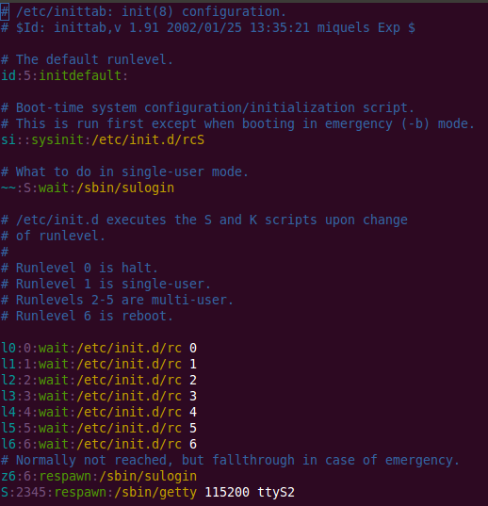
Init Process – inittab example
The inittab file is parsed by Init
The inittab file contains position dependent
  Identifier:RunLevel:Action:Command
  Colon is used as a delimiter and is used to comment the line if placed in the first character of the line entry.
id:5:initdefault:
  Indicates which run level that init is supposed to enter

Slide 33
Additional inittab resource links
http://publib.boulder.ibm.com/infocenter/aix/v6r1/index.jsp?topic=/com.ibm.aix.files/doc/aixfiles/inittab.htm

Slide 34
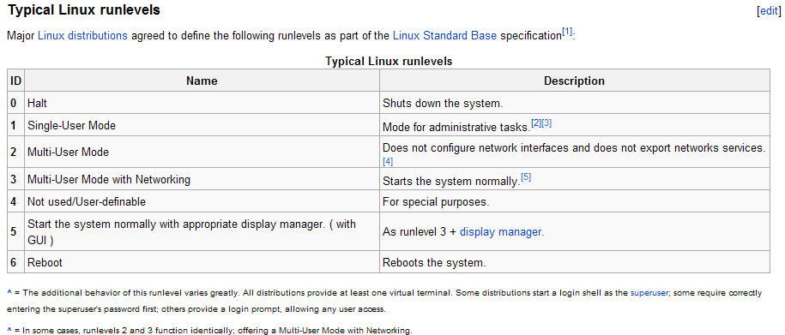
Linux Run-Levels
From Wikipedia
  http://en.wikipedia.org/wiki/Runlevel

Slide 35
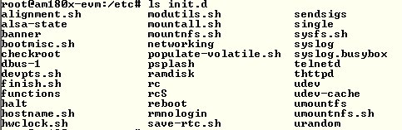

Initialization Directory (SysV)
Initialization Directory /etc/init.d in the root file system
All System initialization files are typically stored in this directory.
Initialization Directories for the different possible run levels in /etc/ in the root file system. Each run level has its own directory and contains scripts to be executed for that particular run-level.

Slide 36
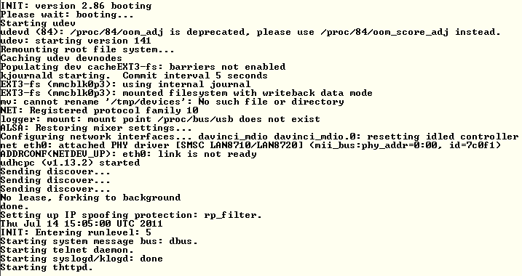
Init process console log
Init process console log
Running in Kernel context before this line
rcS.d
rc5.d – starts here

Slide 37
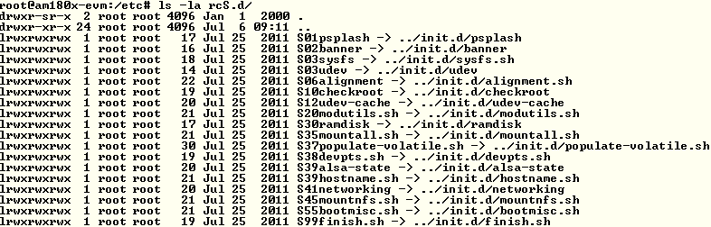
Init Process – rcS.d
rcS.d Base Initialization Directory contains several that all are sym linked to initialization directory /etc/init.d
These are all executed in the order displayed, if you want to change the order they are executed modify Sxx pre-fix number to the string

Slide 38

Run Level Init Directory Files
Run Level 5 Init Directory
Adding files to this directory are called by init process
Alphabetical is the order the scripts are executed in, S10 before S99
S prefix is intended to mean startup,
K prefix is intended to mean stoping a service or process, a script used to reset a possible running service. Typically called in Run Level 0 and 6 (halt and reboot)
An ls command will list K<script>s first and be executed first. So if the developer wants to make sure that a previous process is stopped before starting a new process using the same resources.

Slide 39
Linux Init Process Links
http://en.wikipedia.org/wiki/Init_process
http://publib.boulder.ibm.com/infocenter/aix/v6r1/index.jsp?topic=/com.ibm.aix.files/doc/aixfiles/inittab.htm
http://en.wikipedia.org/wiki/Runlevel
http://www.linux.com/news/enterprise/systems-management/8116-an-introduction-to-services-runlevels-and-rcd-scripts

Slide 40
Overview – Boot Process Background Links
http://processors.wiki.ti.com/index.php/Boot_Sequence
http://en.wikipedia.org/wiki/Linux_startup_process

Slide 41
Thank you!
01/09/12

