Slide 1
LET'S HAVE A POSSE!
Sebastian Dziallas, POSSE Workshop Coordinator

Slide 2







Academia
Industry
FOSS
.com
.edu
.com
.edu
.com
.com
.edu
Industry
Groups
edu
.org
FOSS
.org
Conference
Curriculum
Classes
Standards
GNOME
Kernel
KDE
etc.
LSB
OIE
etc.
RHEL
Virt.
etc.
Imagery on this slide was created and released by María Leandro under a CC-BY-SA 3.0 license.

Slide 3
(FOSS)
(academia)
6 months
ad-hoc – 1 year
6 – 12 months
Release Cycle
Planning Cycle
Execution Time
1 – 4 years
2 – 5 years
4 years
(including planning)

Slide 4
TEACHING OPEN SOURCE
Who
FOSS Contributors
Students
Professors
Industry Folks
What
Neutral Brand
Collaboration Space
Shared Vision*
(* includes a free dose of culture shock)

Slide 5

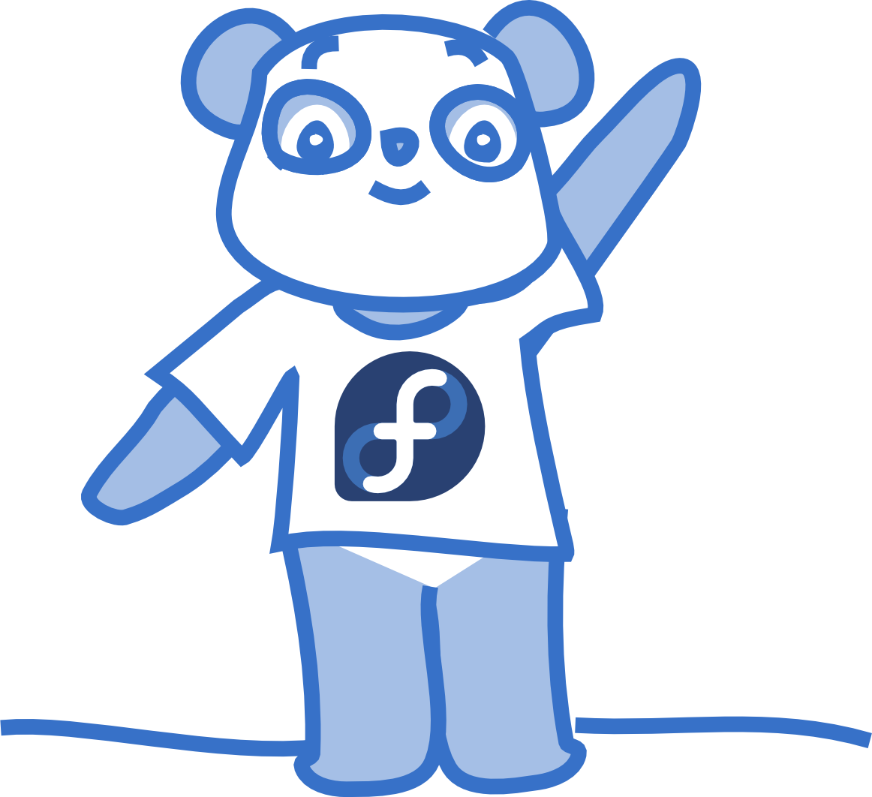

Imagery on this slide was created and released by Máirín Duffy under a CC-BY-SA 3.0 license.
Authentic Experiences!
Mentors!
Motivation!
Portfolio Material!
Workplace Readiness!
A better entrypathway
for new contributors
to my project!
Help! Extra hands!
What do I do?

Slide 6

Imagery on this slide was created and released by Máirín Duffy under a CC-BY-SA 3.0 license.
So chaotic!
How do I start?
Who do I trust?
Don't know the basics!
No infrastructure?
So slow & opaque!
How do we begin?
I can't teach the basics
over and over!
They can't use our infra?
Hm.

Slide 7
Imagery on this slide was created and released by Máirín Duffy under a CC-BY-SA 3.0 license.
So slow & opaque!
How do we begin?
I can't teach the basics
over and over!
They can't use our infra?
So chaotic!
How do I start?
Who do I trust?
Don't know the basics!
No infrastructure?
We'll mediate between
your release cycles!
Come to industry!
POSSE! Textbook!
Use ours!

Slide 8
TEACHING OPEN SOURCE
Who
FOSS Contributors
Students
Professors
Industry Folks
What
Neutral Brand
Collaboration Space
Shared Vision*
(* includes a free dose of culture shock)

Slide 9
SPEED OF CHANGE
For Academia
huge
and
fast
For FOSS
decent
and
not great

Slide 10
WHAT IS POSSE?
And what do we do? What do our attendees say?

Slide 11
INCENTIVES
In Exchange For
a week(end) of time
funding & expenses
Professors Get
grounding in FOSS
community contacts
connections to like-minded educators
means to learn more

Slide 12
PRODUCTIVELY LOST.
Dive into open source culture and experience immersion.

Slide 13
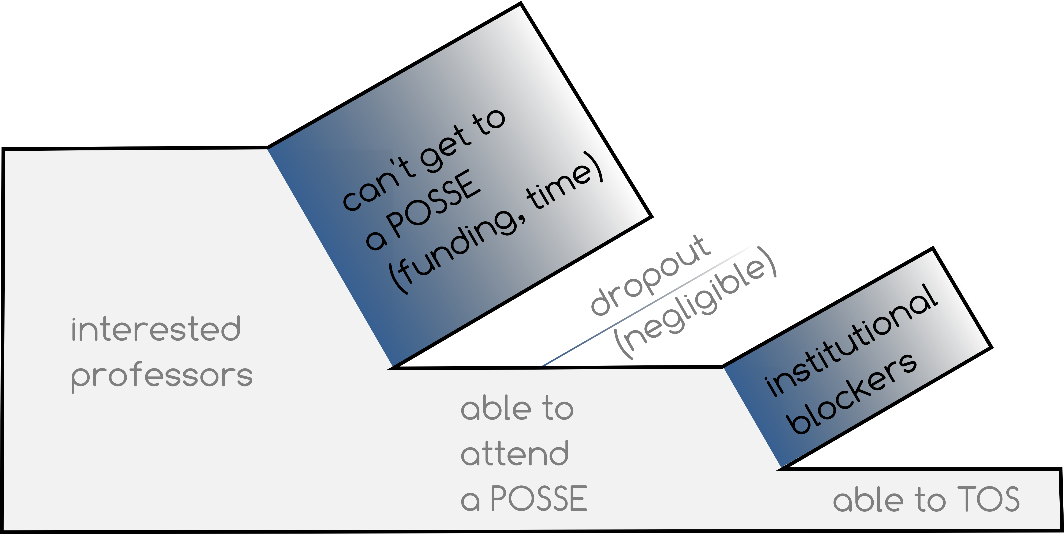
BUT IT WON'T BE EASY.
Imagery on this slide was created and released by Mel Chua under a CC-BY-SA 3.0 license.

Slide 14
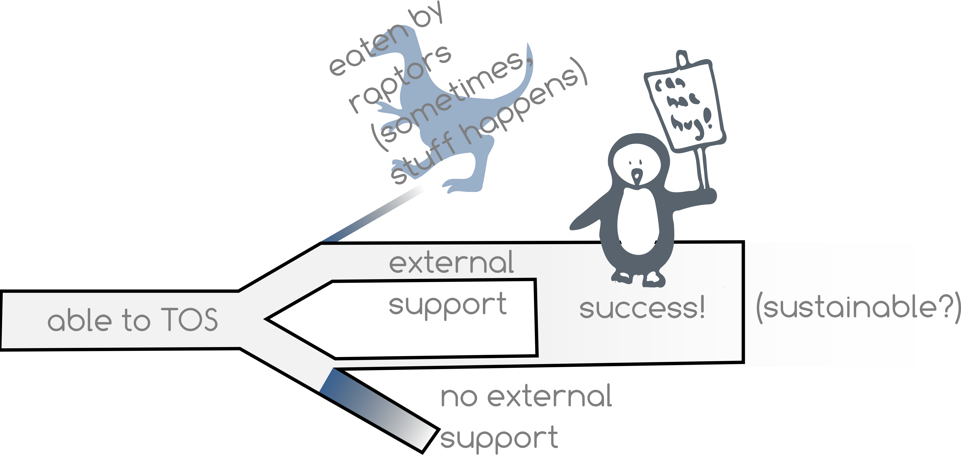
POSSE PIPELINE
Imagery on this slide was created and released by Mel Chua under a CC-BY-SA 3.0 license.

Slide 15
INTERESTED?
Join us for POSSE intensive. Tomorrow, starting 11:30am. Bel Air Room.

Slide 16
QUESTIONS?
E-Mail me. Anytime. sebastian@when.com

